Slide 1
DID YOU KNOW . . .
Engaged students are 2.5 times more likely to say that they get excellent grades and do well in school, and they are 4.5 times more likely to be hopeful about the future than their actively disengaged peers.
Gallup, Oct 2018
www.musicedconsultants.net/conference-materials.html

Slide 2
DID YOU KNOW . . .
96 percent of public school principals
believe that participating in music
education encourages and motivates
students to stay in school longer.
(Harris Poll)
www.musicedconsultants.net/conference-materials.html

Slide 3
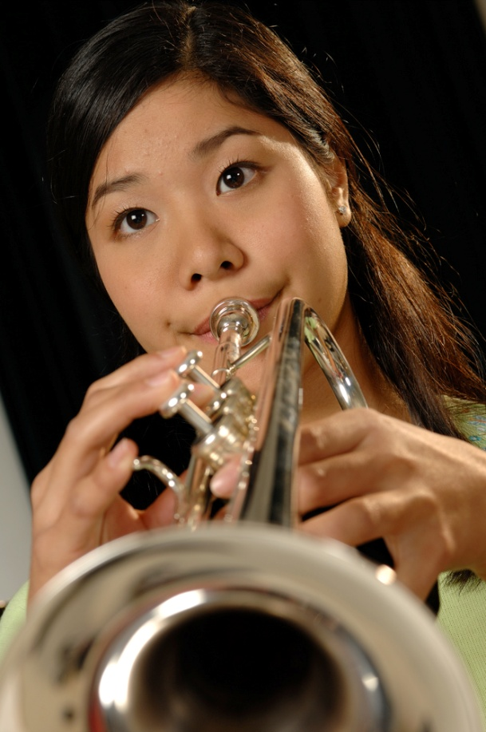
DID YOU KNOW . . .
An interactive poll confirms that music education at an early age greatly increases the likelihood that a child will grow up to seek higher education and ultimately even earn a higher salary. (2007 Harris Poll)
www.musicedconsultants.net/conference-materials.html

Slide 4
THE MESSAGE IS. . .
If you want to be a CEO, College President, or
even a Rock Star,
TAKE MUSIC!
www.musicedconsultants.net/conference-materials.html

Slide 5
THE MESSAGE IS. . .
If you want to be a CEO, College President, or
even a Rock Star,
TAKE MUSIC!
www.musicedconsultants.net/conference-materials.html

Slide 6
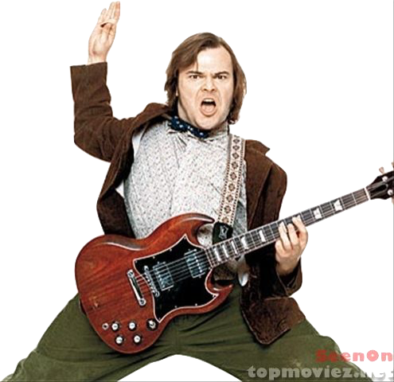
THE MESSAGE IS. . .
If you want to be a CEO, College President, or
even a Rock Star,
TAKE MUSIC!
www.musicedconsultants.net/conference-materials.html

Slide 7
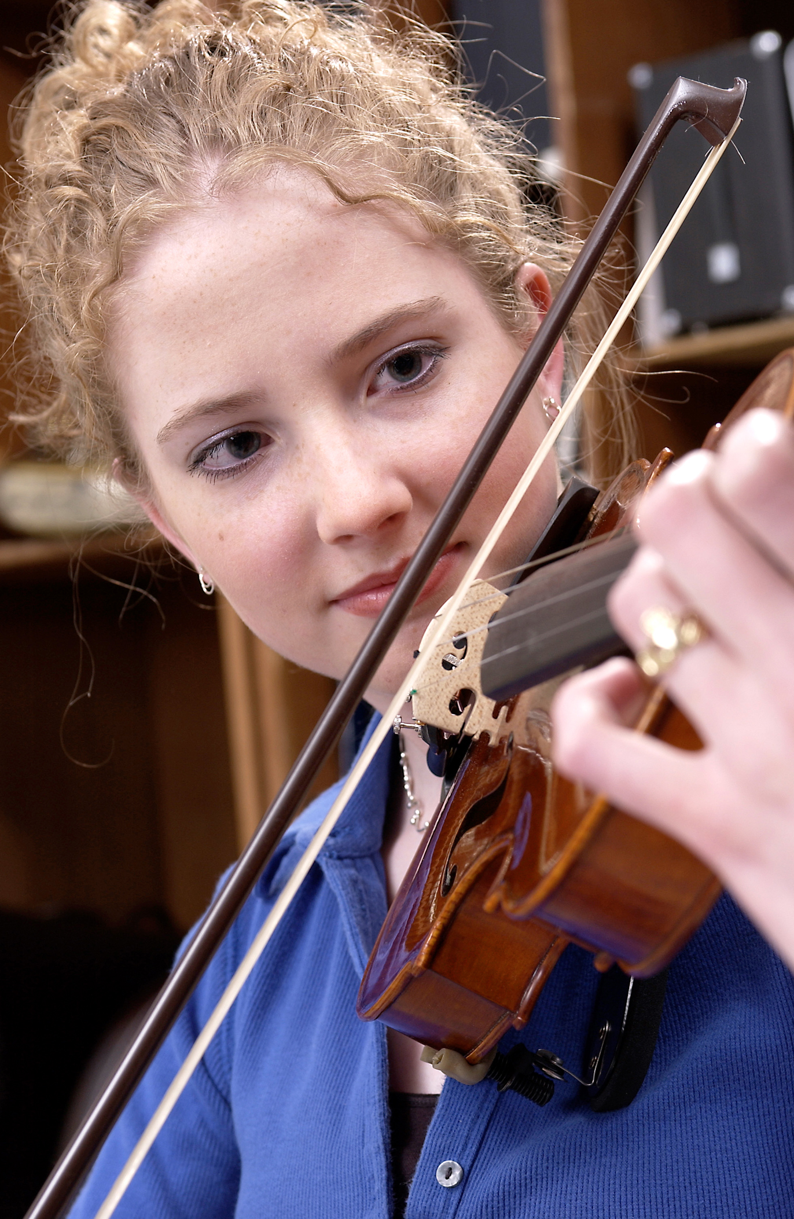
DID YOU KNOW . . .
82 percent of Americans who don’t currently play an instrument wish they had learned to play one. (Gallup Poll)
www.musicedconsultants.net/conference-materials.html

Slide 8
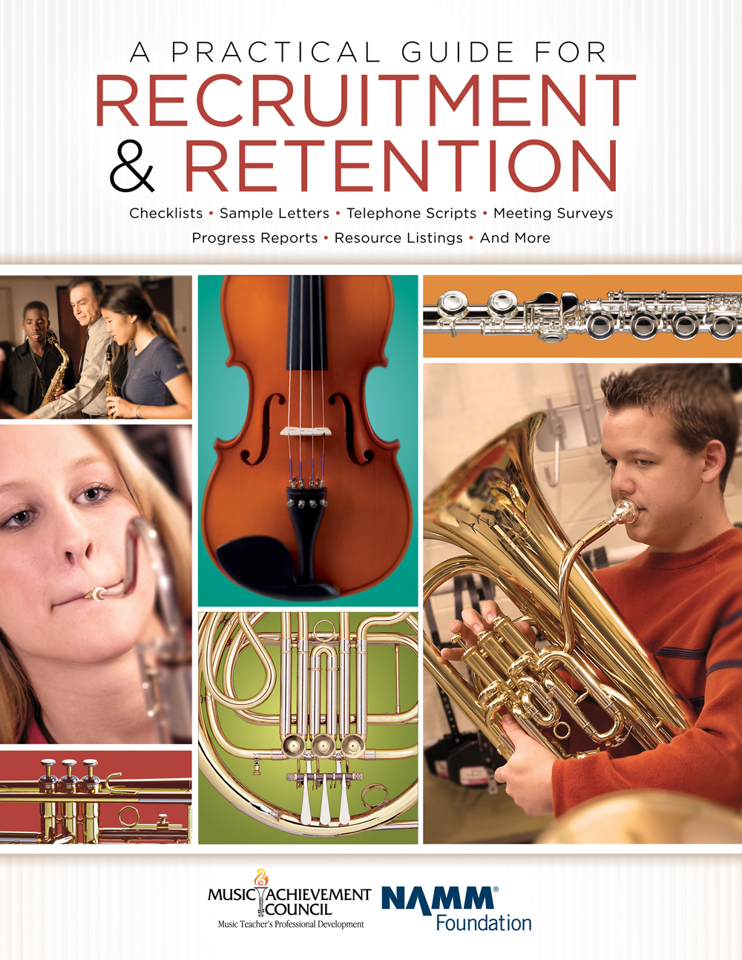
DID YOU KNOW . . .
All of today’s session attendees will receive FREE COPIES of:
A Practical Guide for Recruitment and Retention
www.musicachievementcouncil.org

Slide 9
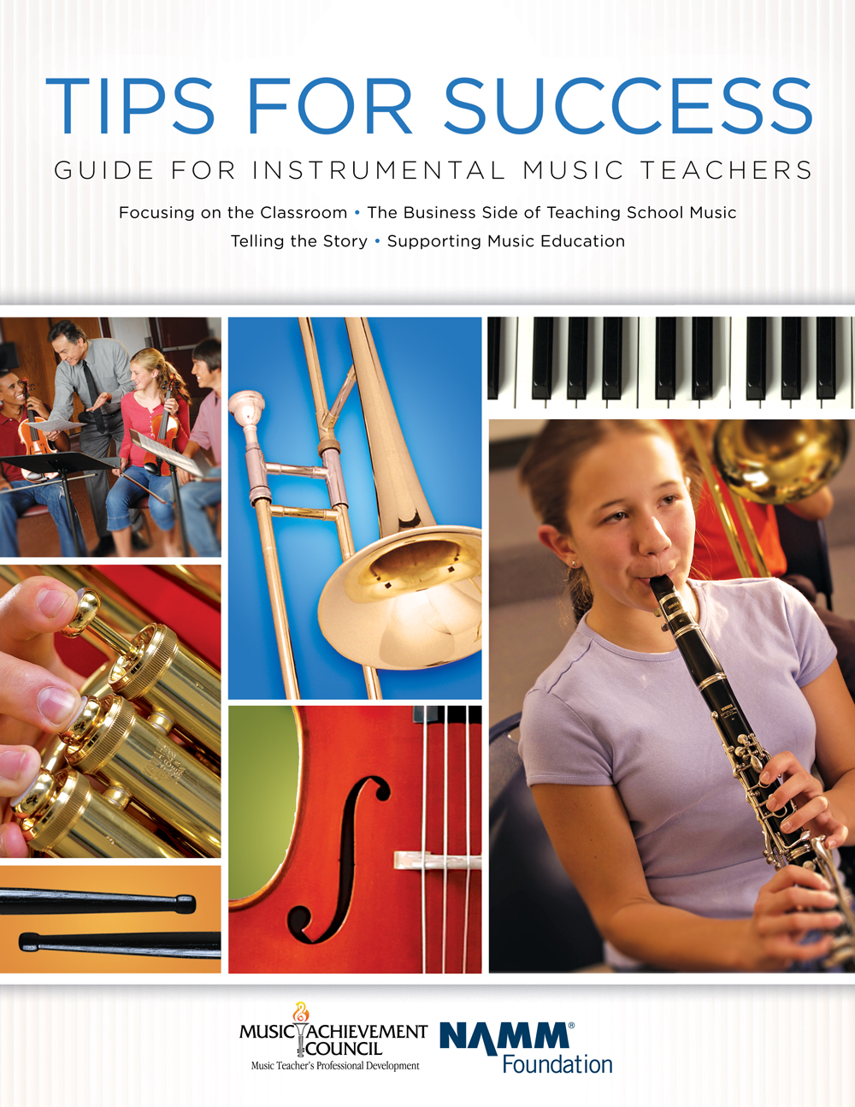
DID YOU KNOW . . .
All of today’s session attendees will receive FREE COPIES of:
Tips for Success:
A Guide for Instrumental Music Teachers
www.musicachievementcouncil.org

Slide 10
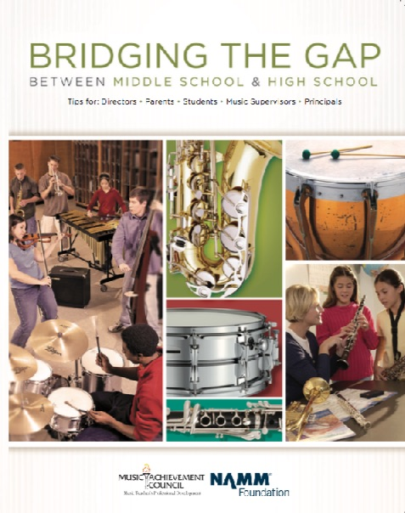
DID YOU KNOW . . .
All of today’s session attendees will receive FREE COPIES of:
Bridging the Gap between
Middle School and High School
www.musicachievementcouncil.org

Slide 11
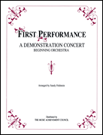
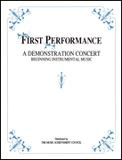
DID YOU KNOW . . .
The First Performance Demo Concert for Band and/or Orchestra features sheet music, parts, sample letters, programs and student certificates for beginning ensembles. Students can perform a composition in seven short weeks with the materials provided!
www.musicachievementcouncil.org

Slide 12
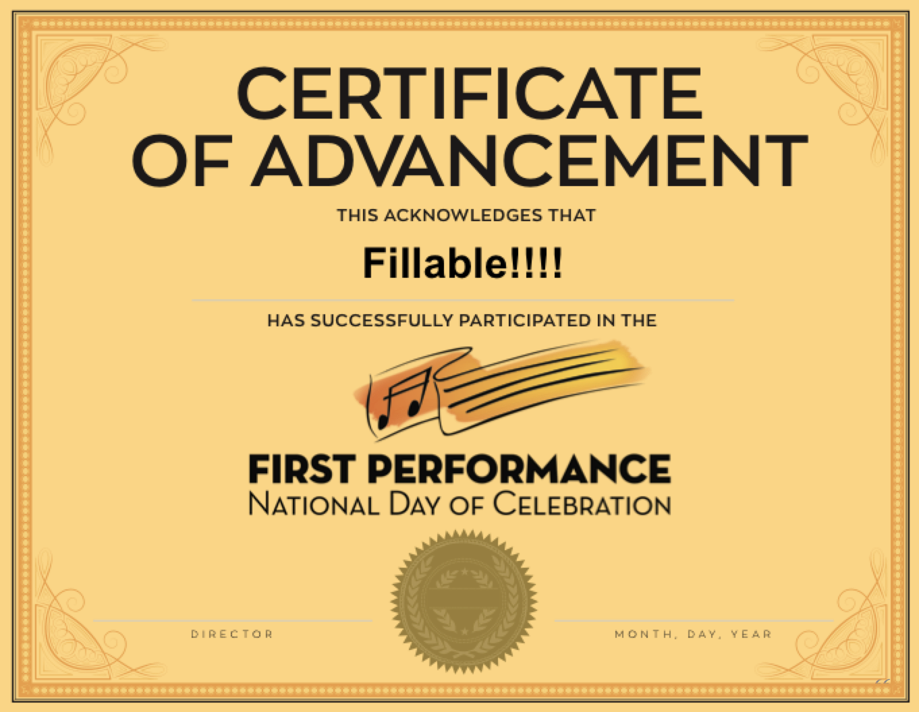
DID YOU KNOW . . .
The First Performance National Day of Celebration is held on the 3rd Thursday of November annually to recognize the achievements of your Beginning instrumental students?
www.musicachievementcouncil.org

Slide 13
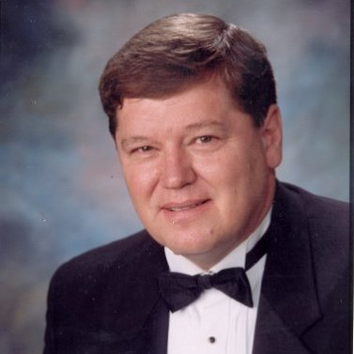
DID YOU KNOW . . .
Most of these publications are provided online at no charge by the Music Achievement Council.
Greg Bimm
They are based on real world strategies shared by the profession’s most successful music educators.

Slide 14
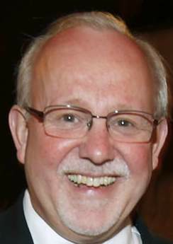
DID YOU KNOW . . .
Most of these publications are provided online at no charge by the Music Achievement Council.
Charlie Menghini
They are based on real world strategies shared by the profession’s most successful music educators.

Slide 15
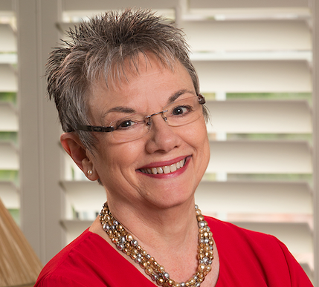
DID YOU KNOW . . .
Most of these publications are provided online at no charge by the Music Achievement Council.
Marcia Neel
They are based on real world strategies shared by the profession’s most successful music educators.

Slide 16
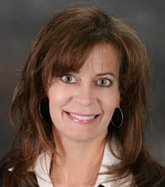
DID YOU KNOW . . .
Most of these publications are provided online at no charge by the Music Achievement Council.
Terry Shade
They are based on real world strategies shared by the profession’s most successful music educators.

Slide 17
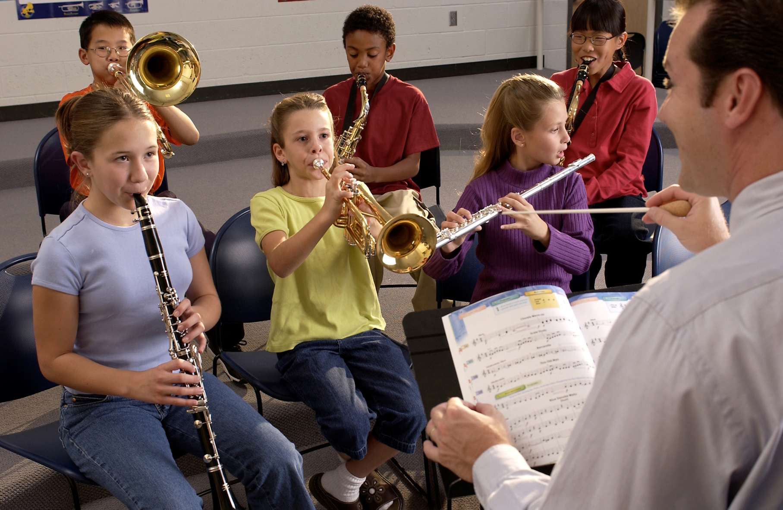
DID YOU KNOW . . .
www.musicedconsultants.net/conference-materials.html

Slide 18
DID YOU KNOW . . .
Music making has been scientifically proven to:
Exercise the brain
Inspire creativity
Increase productivity
Fight memory loss
Reduce stress
Lower blood pressure
Build confidence
Stave off depression

Slide 19
DID YOU KNOW . . .
Metropolitan Nashville Public Schools found that ATTENDANCE RATES ROSE with increased study in music.
No Music:
< 1 Year of Music:
> 1 Year of Music:
87% Attendance
91% Attendance
93% Attendance

Slide 20
DID YOU KNOW . . .
Metropolitan Nashville Public Schools found that DISCIPLINE REPORTS FELL with increased study in music.
No Music:
< 1 Year of Music:
> 1 Year of Music:
4.34 over 4 years
3.75 over 4 years
3.23 over 4 years

Slide 21
DID YOU KNOW . . .
Metropolitan Nashville Public Schools found that GPAs ROSE with increased study in music.
No Music:
< 1 Year of Music:
> 1 Year of Music:
2.51 Average
2.61 Average
2.89 Average

Slide 22
DID YOU KNOW . . .
Metropolitan Nashville Public Schools found that GRADUATION RATES ROSE with increased study in music.
No Music:
< 1 Year of Music:
> 1 Year of Music:
60% Average
81% Average
91% Average

Slide 23
DID YOU KNOW . . .
Metropolitan Nashville Public Schools found that ACT SCORES ROSE with increased study in music.
No Music:
< 1 Year of Music:
> 1 Year of Music:
16.95 Eng, 17.20 Math
17.64 Eng, 17.62 Math
19.58 Eng, 18.67 Math

Slide 24
WHAT WAS LEARNED?
The MORE a student participates in MUSIC,
the more POSITIVE these BENEFITS become.

Slide 25
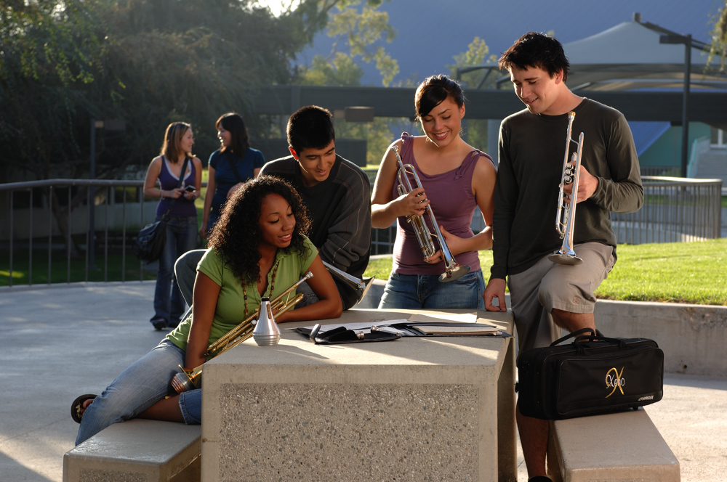
FAMOUS QUOTES. . .
Music has the power of producing a
certain effect on the moral character of
of the soul.
. . . Aristotle

Slide 26
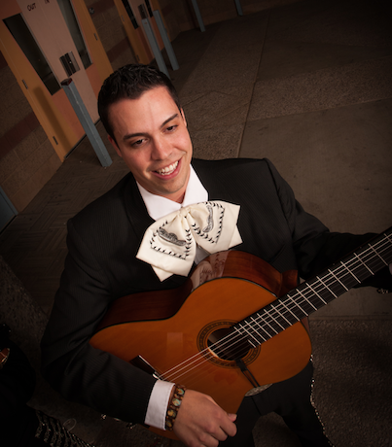
FAMOUS QUOTES. . .
Music furnishes a delightful recreation
for the hours of respite from the cares of the day, and lasts us through life.
. . . Thomas Jefferson

Slide 27
You CAN Successfully Recruit and Retain
Even MORE Students!
Marcia Neel
2019 Marching Band Workshop
Posted Online at:
MusicEdConsultants.net/conference-materials.html
marcia@musicedconsultants.net @MusicEdConsult on Twitter

Slide 28
Today’s Session
Tips for Recruiting Students
Tips for Retaining Students
First Performance National Day of Celebration

Slide 29
I. RECRUITING

Slide 30
The Four (4) Fundamental Beliefs of Effective Recruiters
It’s All About Equity
1. Every student will be interested and welcomed.
2. All students will have an equal opportunity to succeed.
3. Music is an integral part of every student’s total education.
4. All students want to play because it looks like fun!

Slide 31
Key Steps in Recruiting: Attracting Students. . .
Visibility fosters student interest
Informing parents of the benefits of music makes THEM smarter
Building and nurturing support among administration & classroom teachers contributes positively to overall school climate.

Slide 32
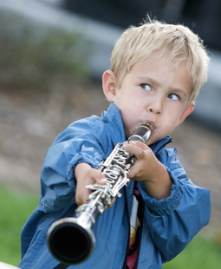
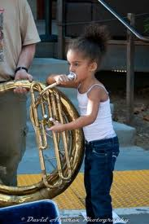
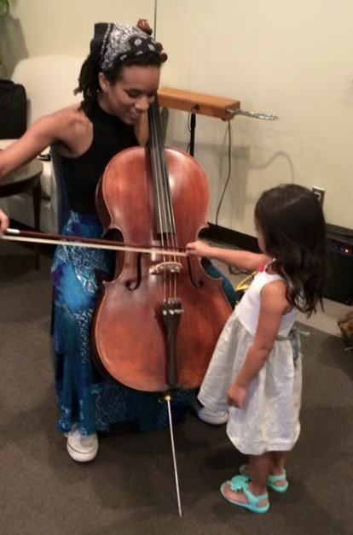
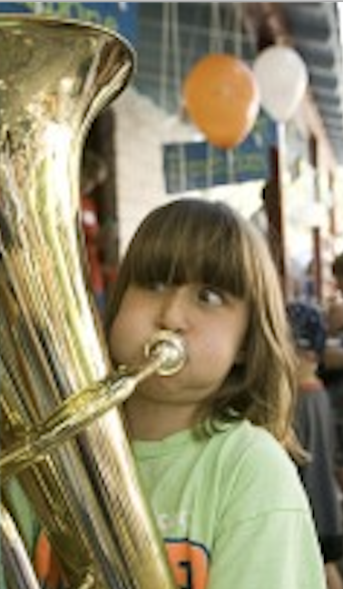
Key Steps in Recruiting Recruiting is a YEAR-ROUND process including:
Instrument demos/petting zoos with your current students
Regular visits with feeder programs/teachers (Exchange Days)
Mass Concerts with feeder programs including recorder classes
Follow-ups – Show Up for Everything!
www.musicachievementcouncil.org
Notes:
32

Slide 33
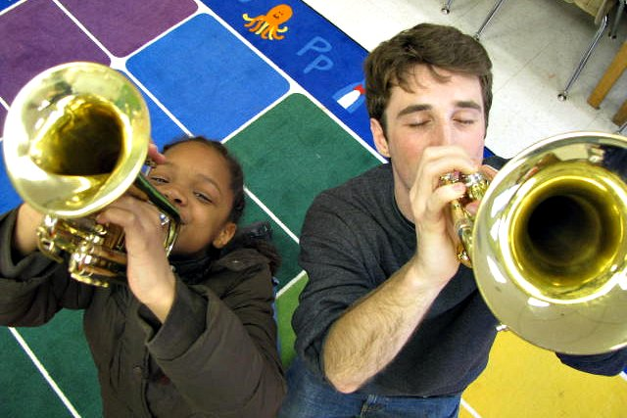
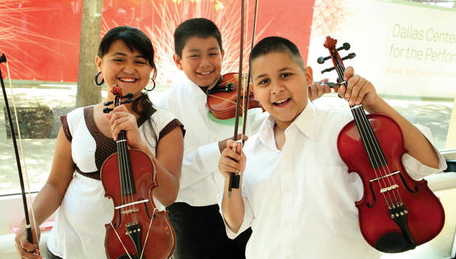
Follow-up idea #2 from: Chris Crone, PAMEA
Have each 4th grader touch, hold, and play three instruments of choice
Send a personal letter home letting parents know which instrument their child experienced successfully
“Watch numbers go through the roof!”
Notes:
33

Slide 34
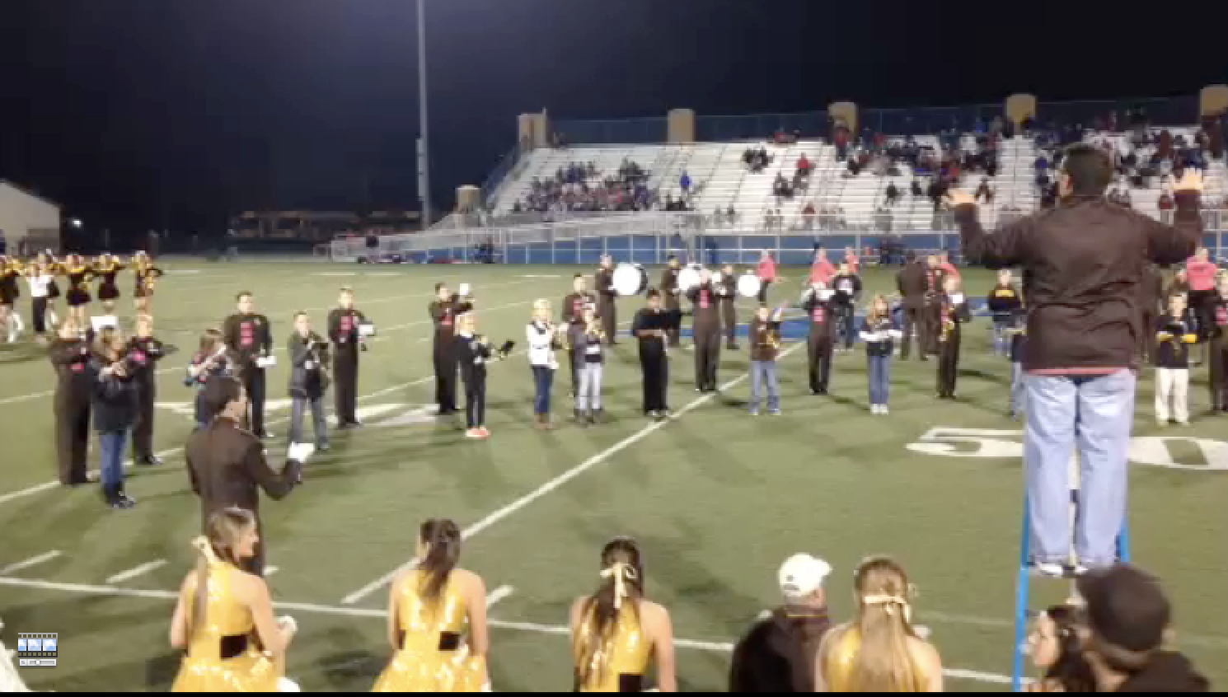
Key Steps in Recruiting: Engage Students Early. . .2-Note Show!
www.musicachievementcouncil.org
Notes:
34

Slide 35
Key Steps in Recruiting: Engage Students Early. . .2-Note Show!
www.musicachievementcouncil.org
Notes:
35

Slide 36
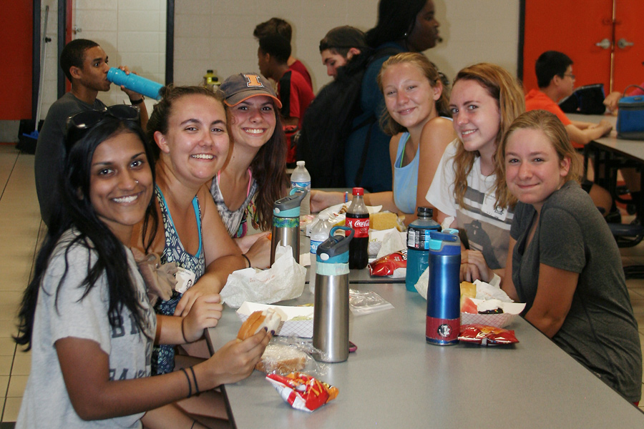
The Partnership Halftime Show:
Pre-game Activities
HS students invite beginners to join the high school students in a pre-game pizza party.

Slide 37
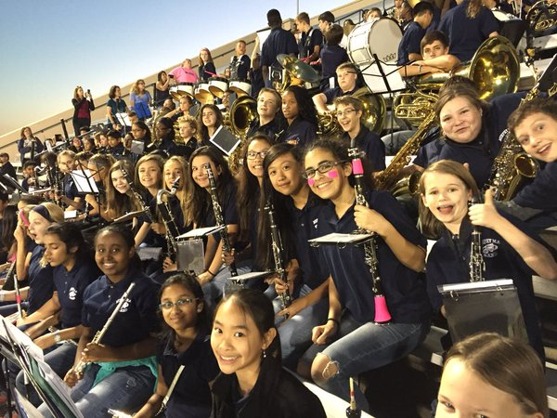
The Partnership Halftime Show:
Pre-game Activities
HS students invite beginners to join the high school students in a pre-game pizza party.
HS students invite beginners to sit/play with HS band at game.

Slide 38
The Partnership Halftime Show:
Pre-game Activities
HS students invite beginners to join the high school students in a pre-game pizza party.
HS students invite beginners to sit/play with HS band at game.
Encourage high school boosters to host a middle school parent reception and invite both principals to speak.

Slide 39
The Partnership Halftime Show:
Pre-game Activities
HS students invite beginners to join the high school students in a pre-game pizza party.
HS students invite beginners to sit/play with HS band at game.
Encourage high school boosters to host a middle school parent reception and invite both principals to speak.
4. Ensure VIP seating/treatment in the stands for parents.

Slide 40
Engage with Prospective Parents
Best Ambassador is an Excited Child
Recruitment Info
Emphasize rewards, benefits
Maintain accessibility to parents and don’t give up!
Initial Meeting: Involve
Current parents
Current student
Current administrator

Slide 41
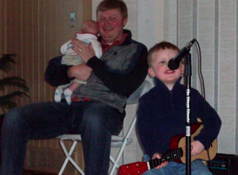
Teach the Parents Too. . . They don’t know what NORMAL is!
Teach PARENTS how to support their child’s practicing
Notes:
www.musiceducationconsultants.net/mmea2010
41

Slide 42
Teach the Parents Too. . . They don’t know what NORMAL is!
Teach PARENTS how to support their child’s practicing
Give PARENTS ideas of how to motivate their children
Notes:
www.musiceducationconsultants.net/mmea2010
42

Slide 43
Teach the Parents Too. . . They don’t know what NORMAL is!
Teach PARENTS how to support their child’s practicing
Give PARENTS ideas of how to motivate their children
Encourage PARENTS to play an active role in the learning process and to become involved
Notes:
www.musiceducationconsultants.net/mmea2010
43

Slide 44
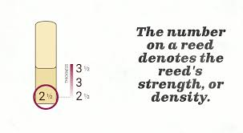
Teach the Parents Too. . . They don’t know what NORMAL is!
https://www.schoolmusiconline.com/central-music-highlights/2017/10/10/tips-for-beginning-band-parents-music-stands
Notes:
www.musiceducationconsultants.net/mmea2010
44

Slide 45
Teach the Parents Too. . . They don’t know what NORMAL is!
https://www.schoolmusiconline.com/central-music-highlights/2017/10/10/tips-for-beginning-band-parents-music-stands
Notes:
www.musiceducationconsultants.net/mmea2010
45

Slide 46
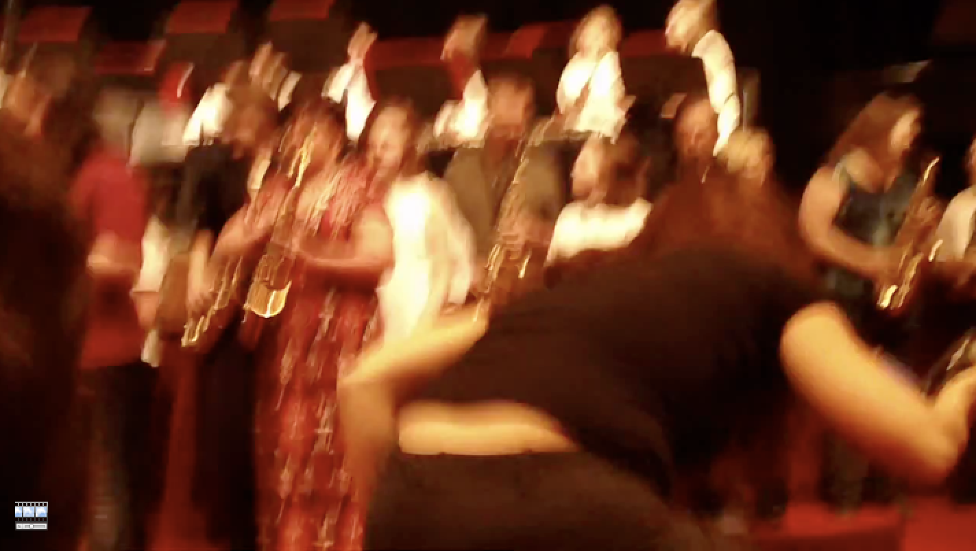
Engage Parent Support…Directly! The Parent Band – REALLY FUN!
Notes:
www.musiceducationconsultants.net/mmea2010
46

Slide 47
Engage Parent Support…Directly! The Parent Band – REALLY FUN!
Notes:
www.musiceducationconsultants.net/mmea2010
47

Slide 48
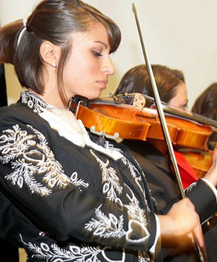
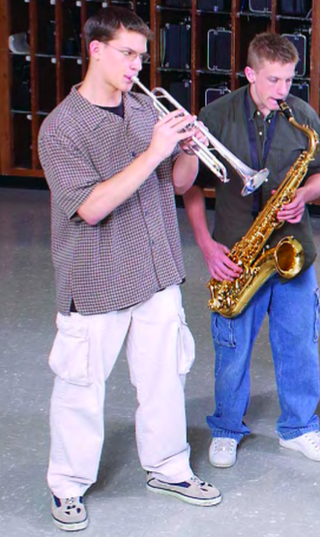
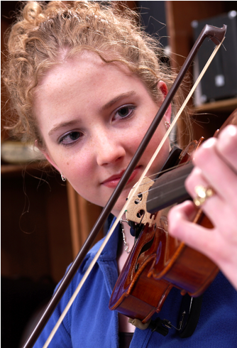
II. RETAINING

Slide 49
Keeping Your New Recruits Why Do Kids Stay? Let’s Ask THEM!

Slide 50
Keeping Your New Recruits Why Do Kids Stay? Let’s Ask THEM!

Slide 51
Consider More Effective Scheduling Models
Vertical Alignment
HS Band Director
also
teaches
Beginning ES/MS Band

Slide 52
Consider More Effective Scheduling Models
Vertical Alignment
HS Band
also
teaches
Beginning ES/MS Band
Director

Slide 53
Common Reasons for Drop-outs?
The first disappointment
Notes:
53

Slide 54
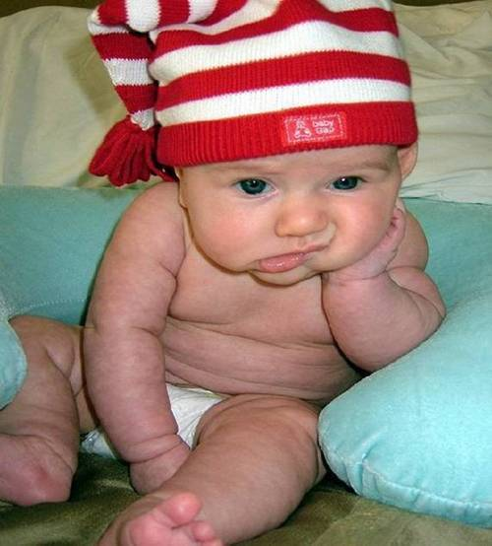
Common Reasons for Drop-outs?
The first disappointment
Lost interest
Notes:
54

Slide 55
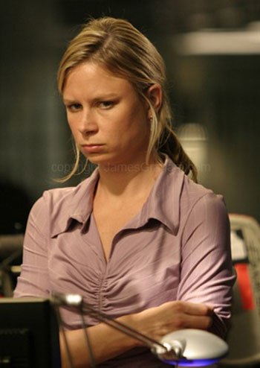
Common Reasons for Drop-outs?
The first disappointment
Lost interest
Didn’t like the teacher
Notes:
55

Slide 56
Common Reasons for Drop-outs?
The first disappointment
Lost interest
Didn’t like the teacher
Conflicts
Notes:
56

Slide 57
What Can You Do?
Talk to the student
Probe for real reason they want to quit
Check their instrument
Talk with the parents
Iowa Bandmasters Assn Exit Survey

Slide 59
III.

Slide 60
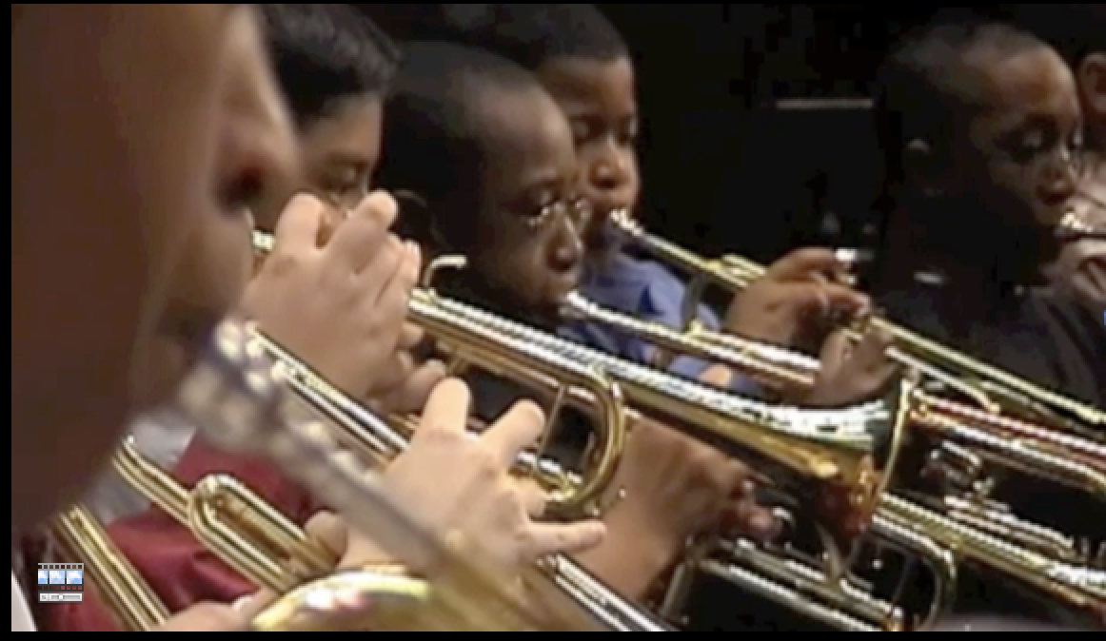
First Performance
National Day of Celebration
3rd Thursday of November Annually

Slide 61
First Performance
National Day of Celebration
3rd Thursday of November Annually

Slide 62
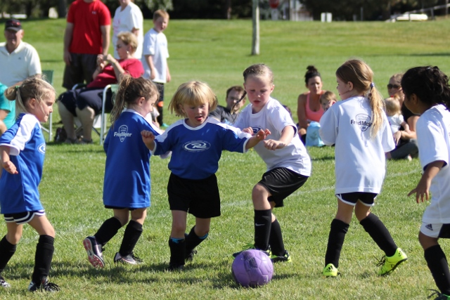

Slide 63
The Results:
Reduces Beginner Dropout
Provides Short-Range Achievement
Goals
Encourages Engagement with
Parents
Strengthens Administrative Support
Celebrates Musical Accomplishments
of Beginners

Slide 64
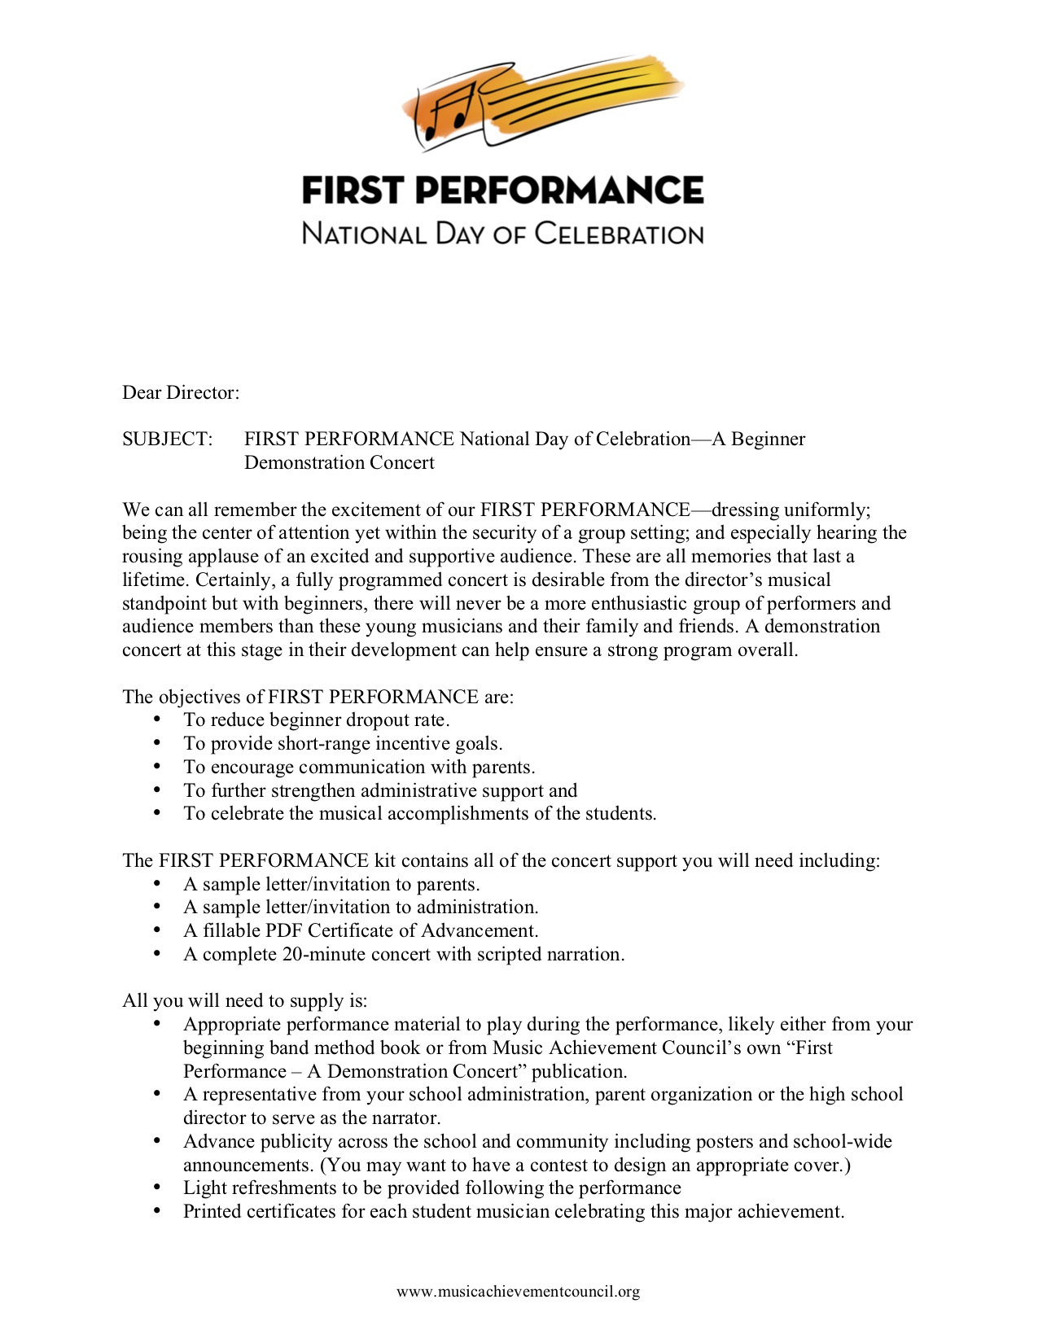
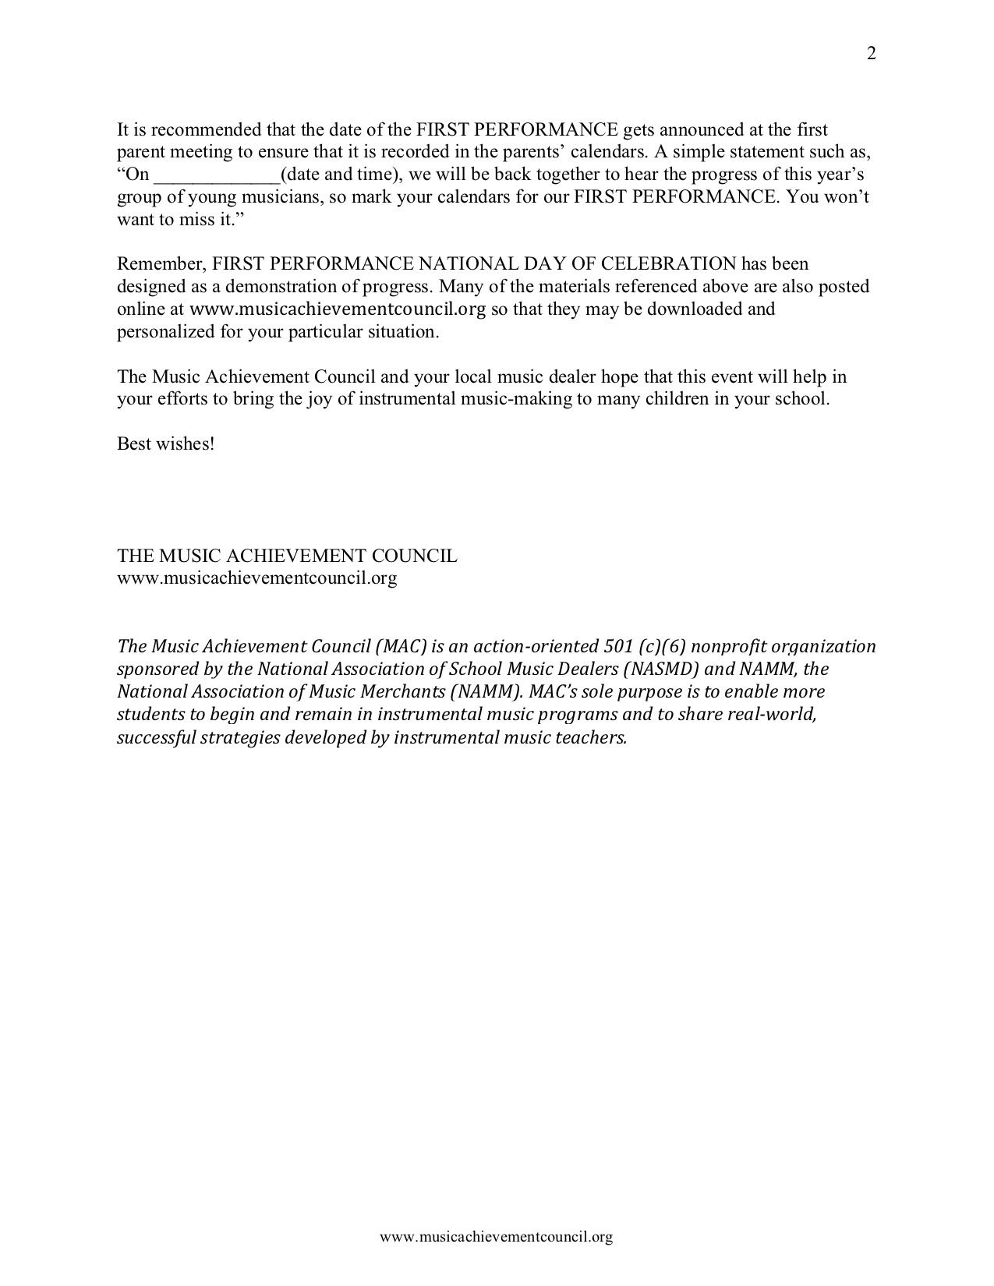
What’s Included?
a. Director Letter with Full Set of Instructions

Slide 65
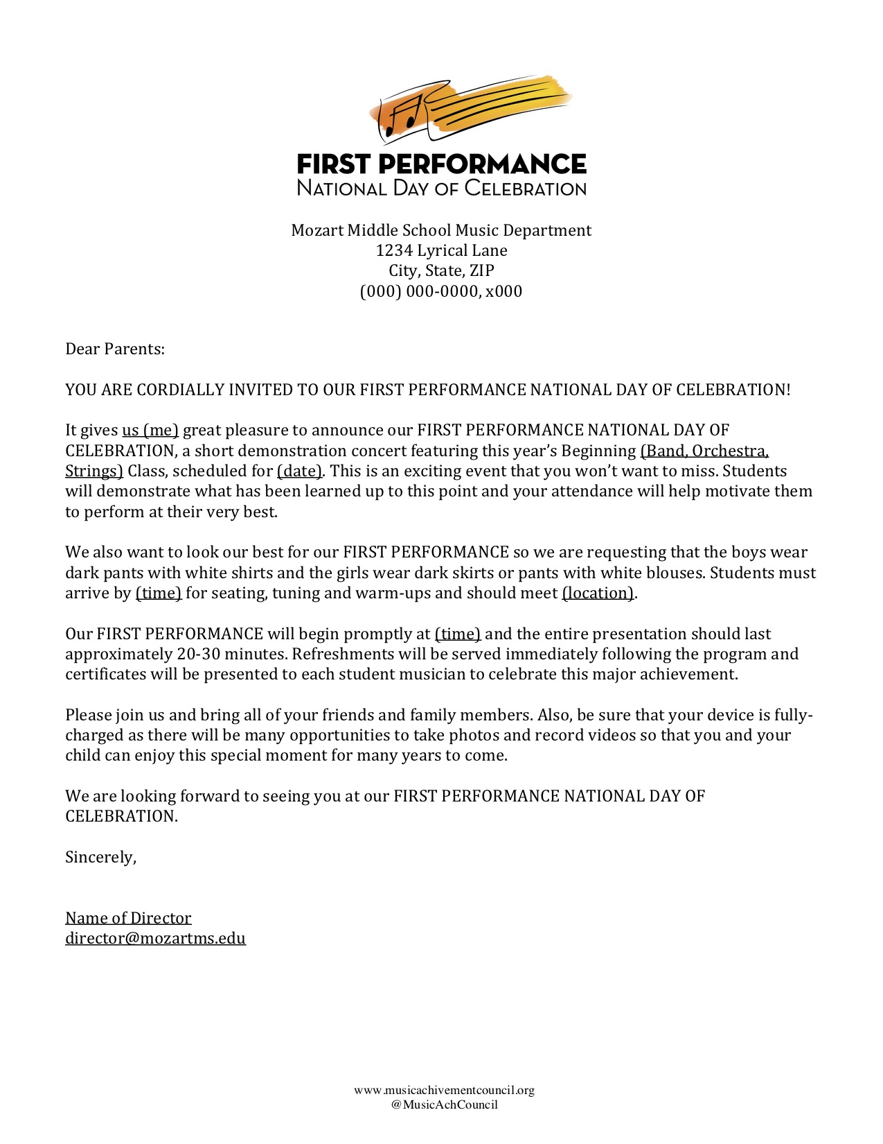
What’s Included?
b. Customizable Letter of Invitation to Parents

Slide 66
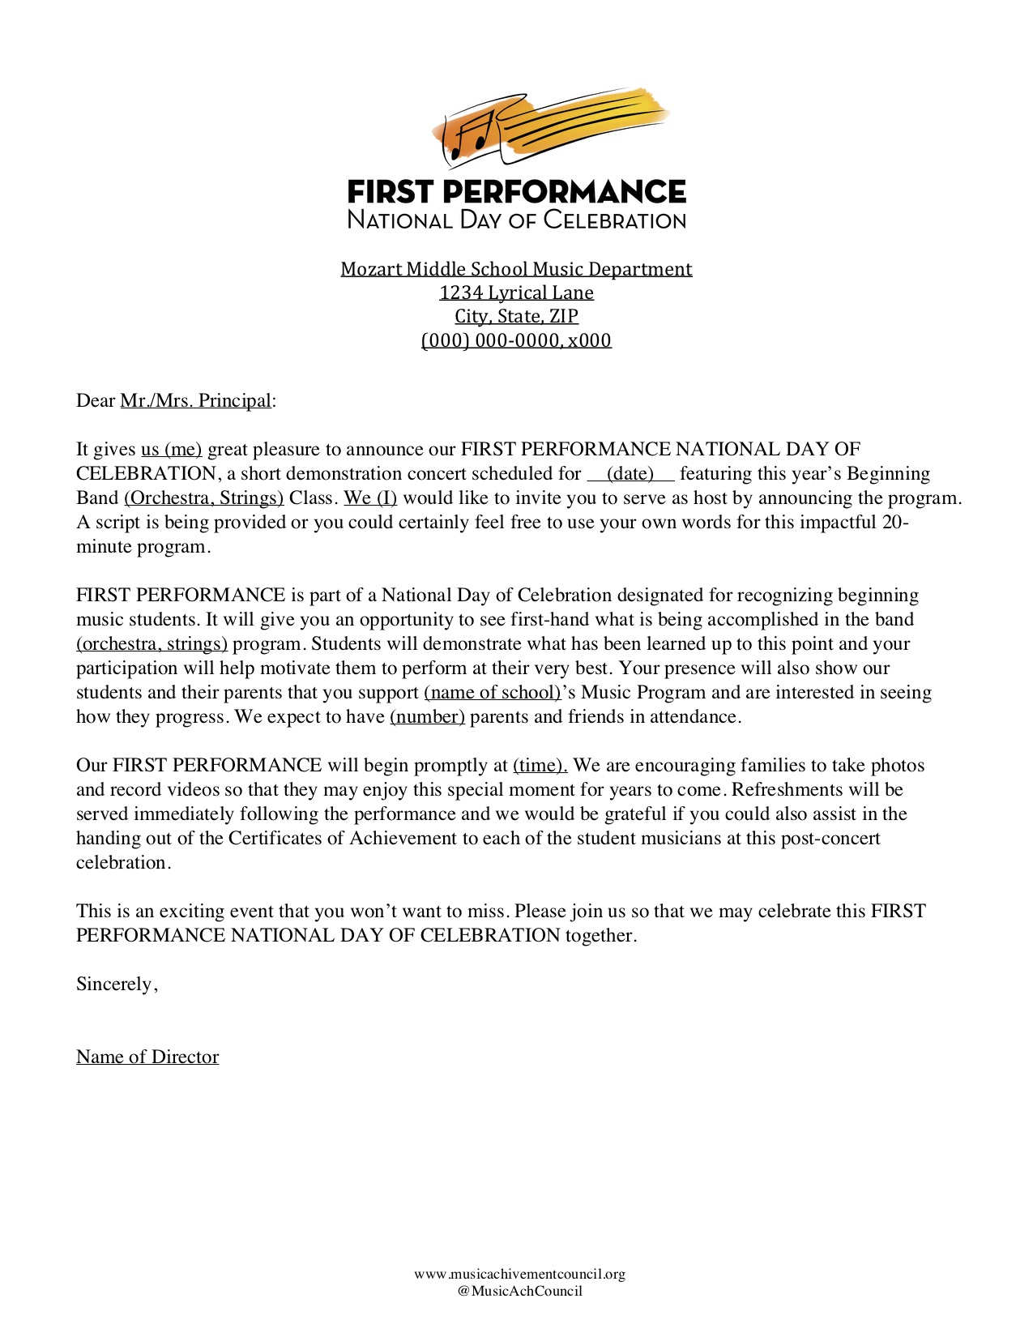
What’s Included?
c. Customizable Letter of Invitation to Principal

Slide 67
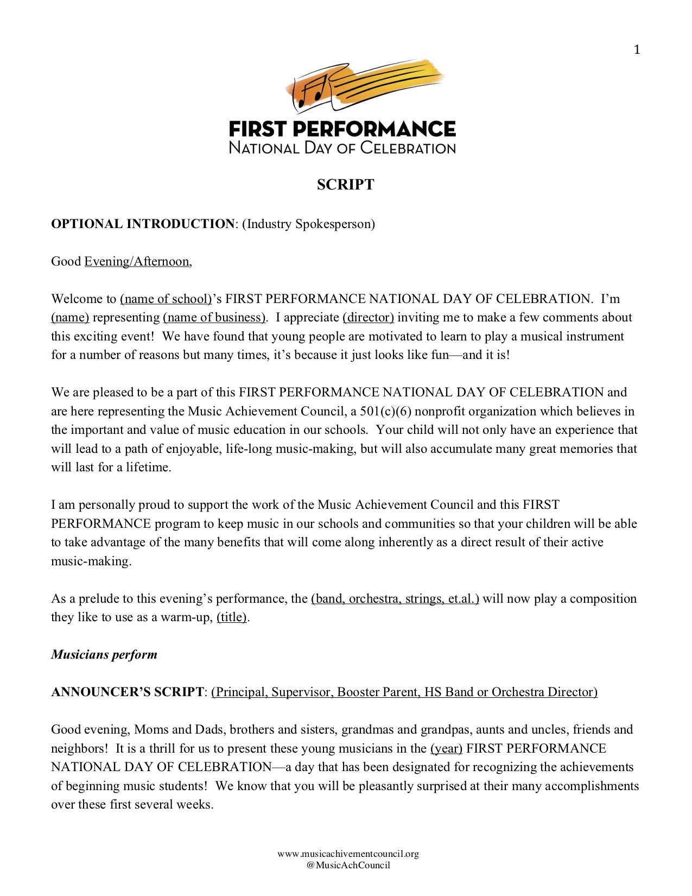
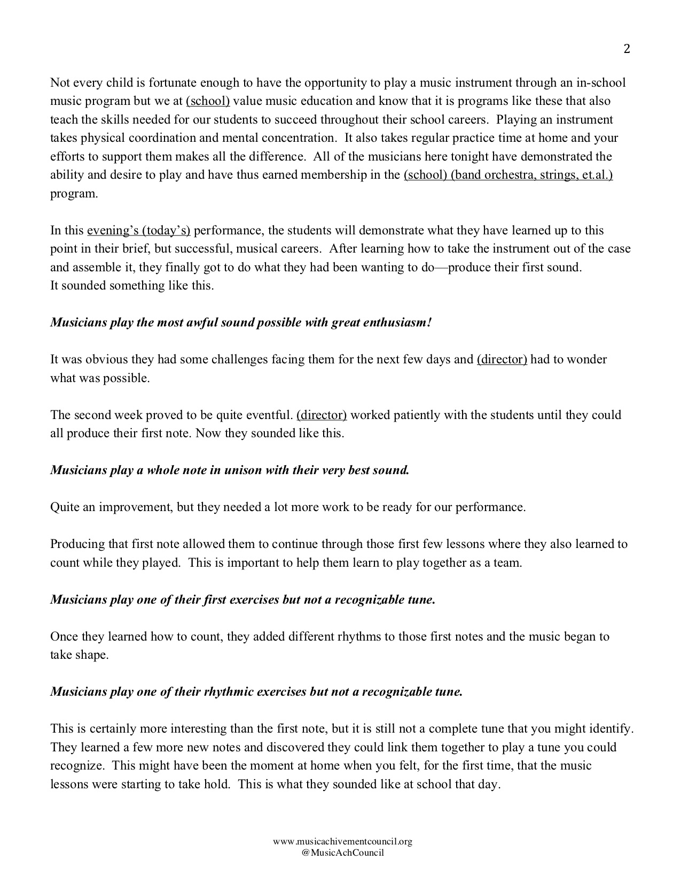
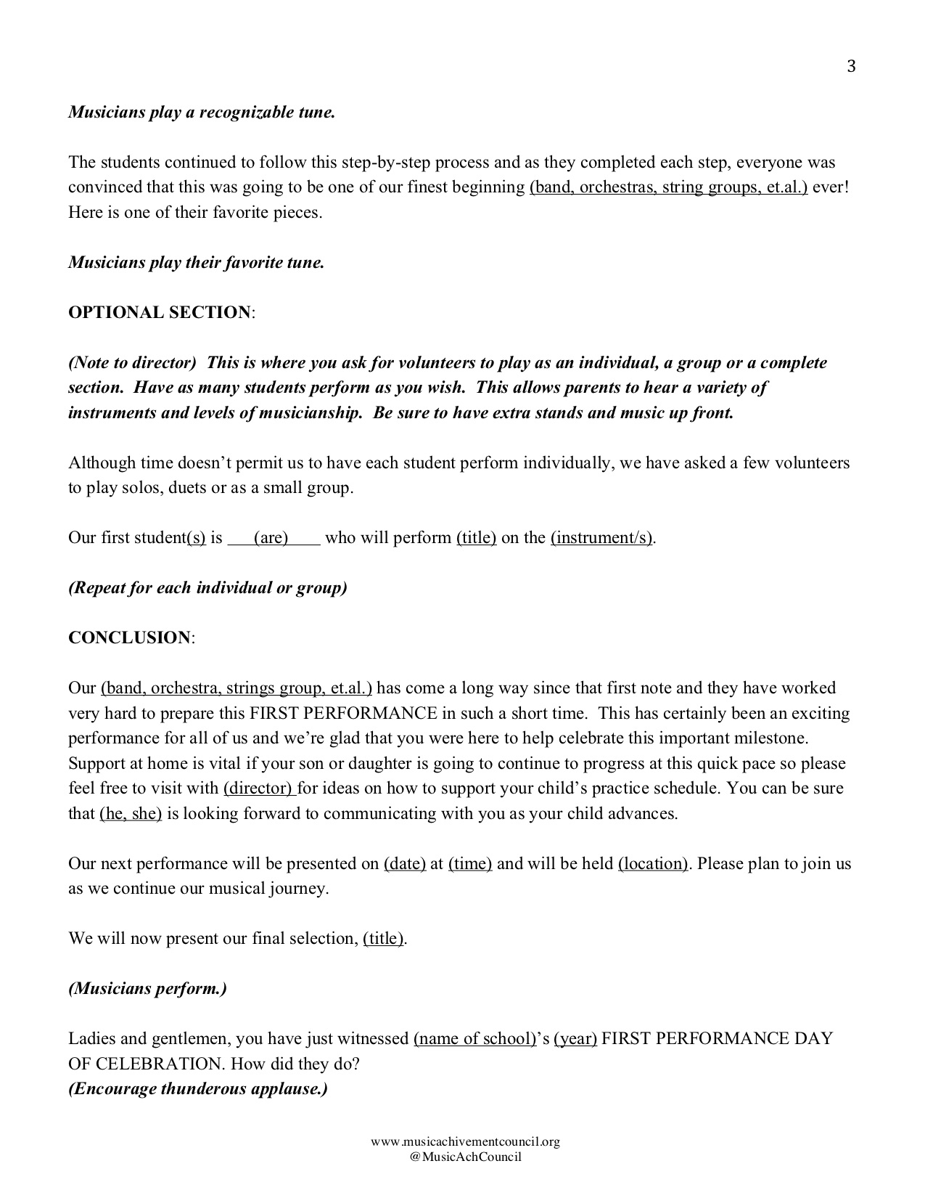
What’s Included?
d. Customizable Script to Make It Your Own!

Slide 68
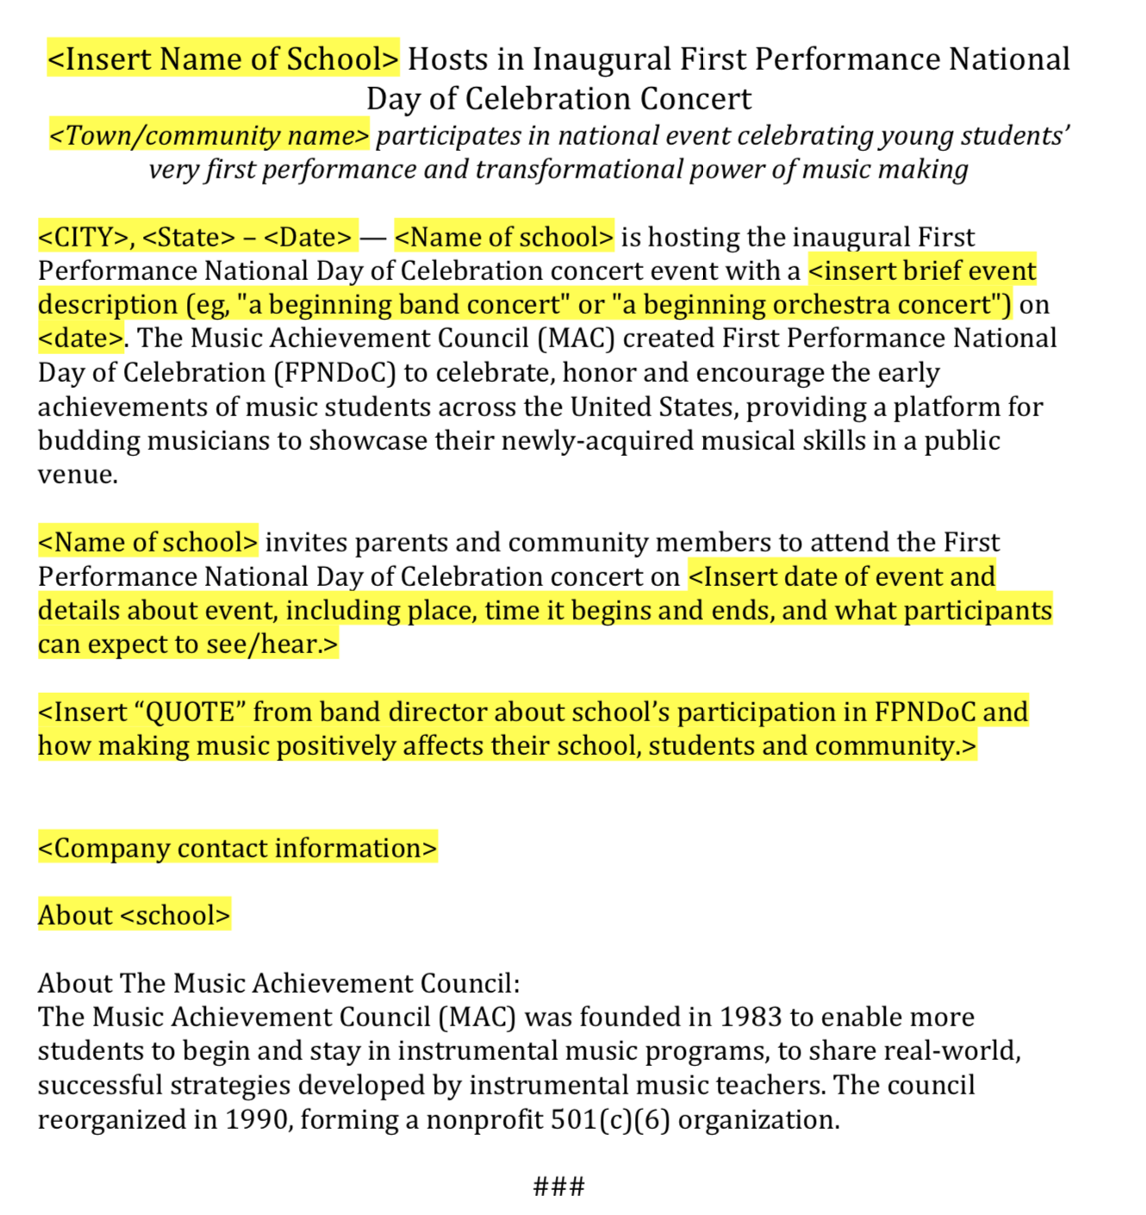
What’s Included?
e. Press Release Template

Slide 69
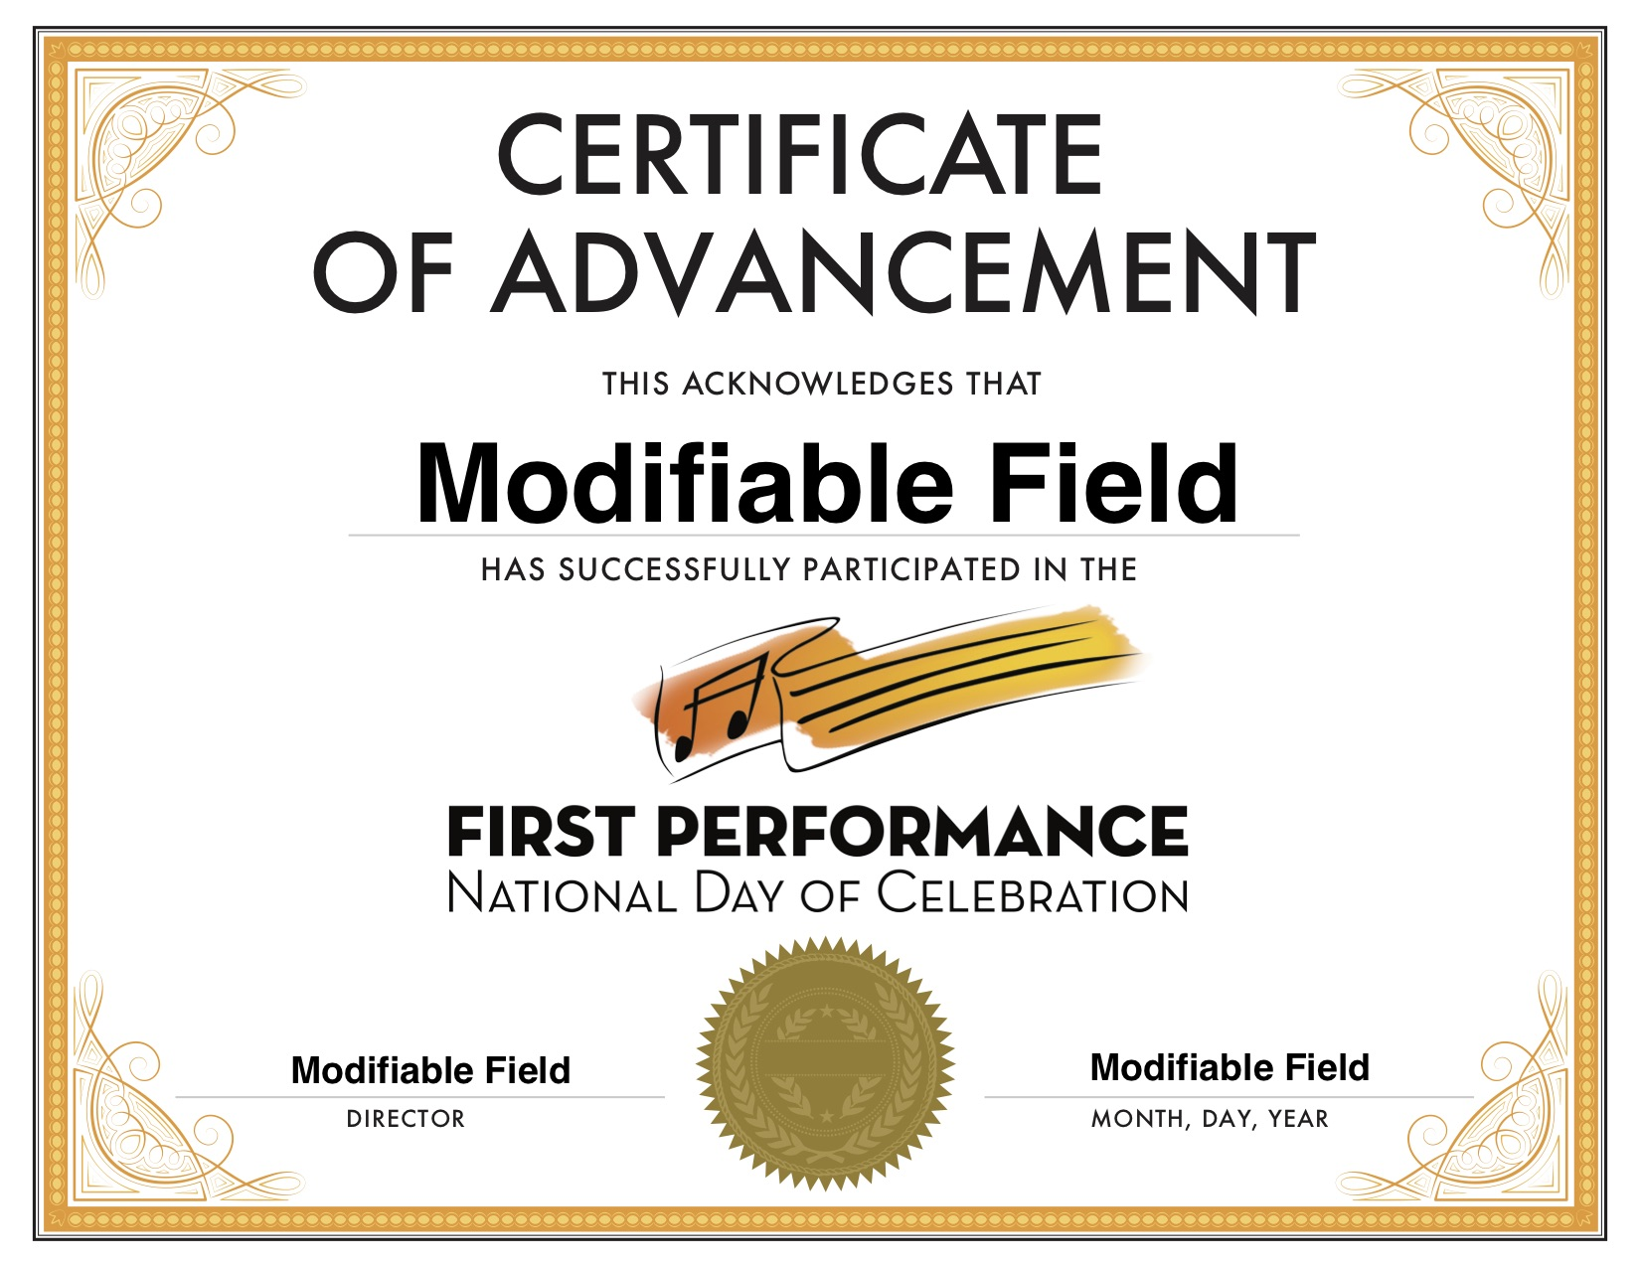
What’s Included?
f. Certificate of Advancement

Slide 70
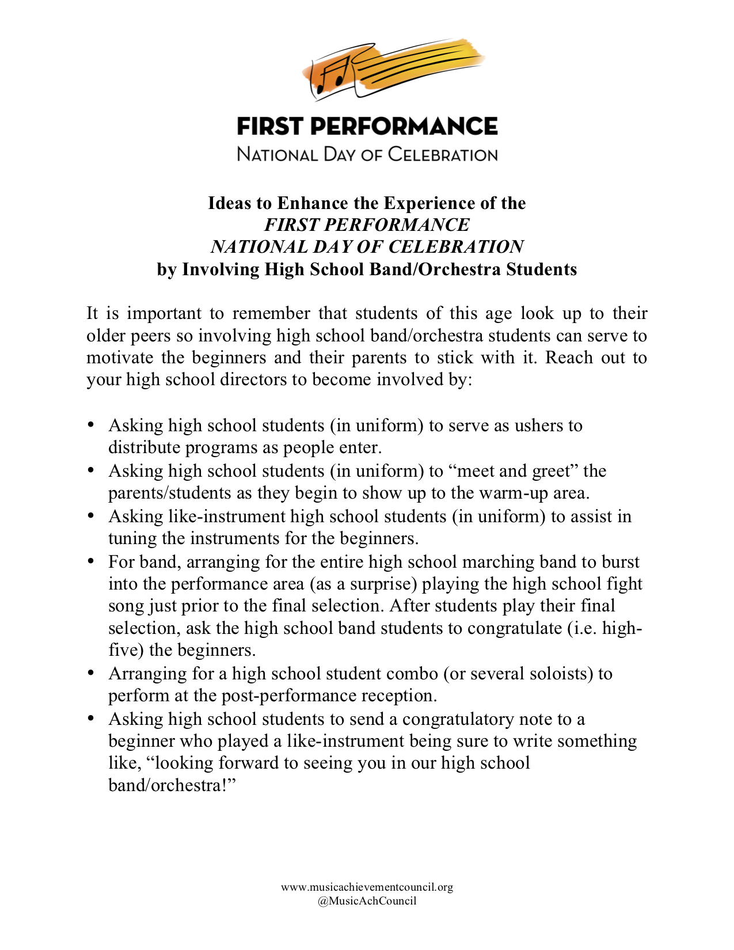
What’s Included?
g. Ideas to Enhance the Experience

Slide 71
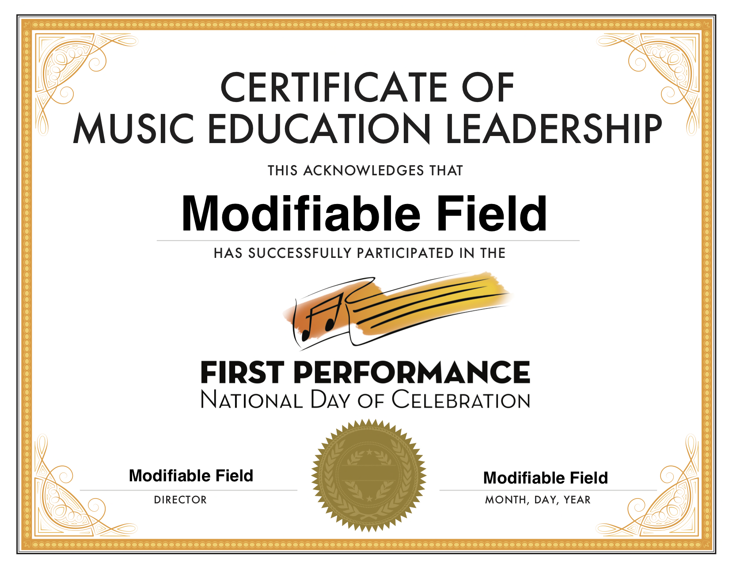
What’s Included?
h. Certificate of Music Ed Leadership for
High School Student Participants

Slide 72
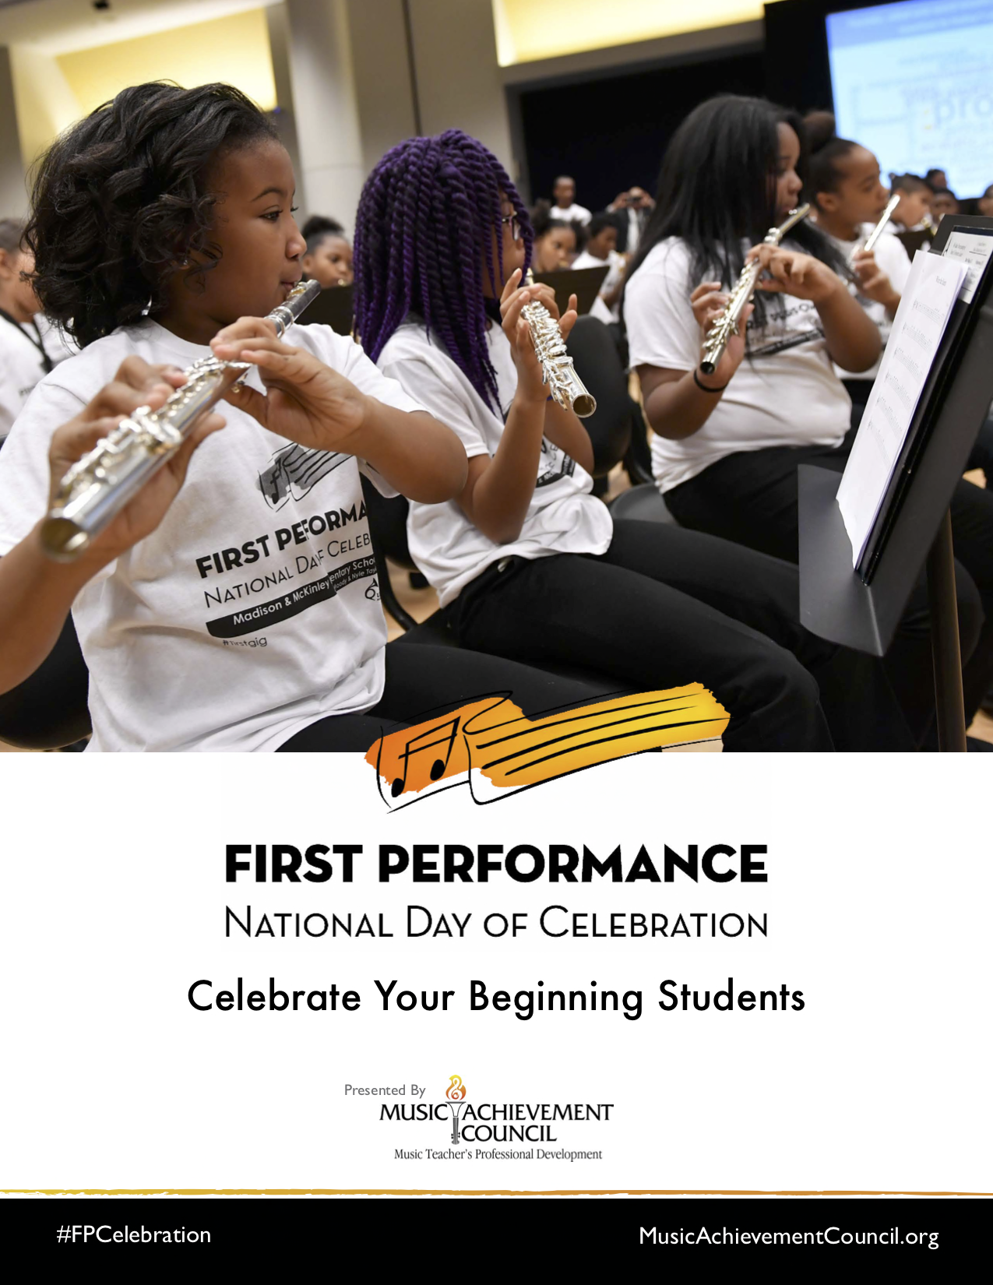
What’s Included?
i. #FPCelebration Toolkit

Slide 73
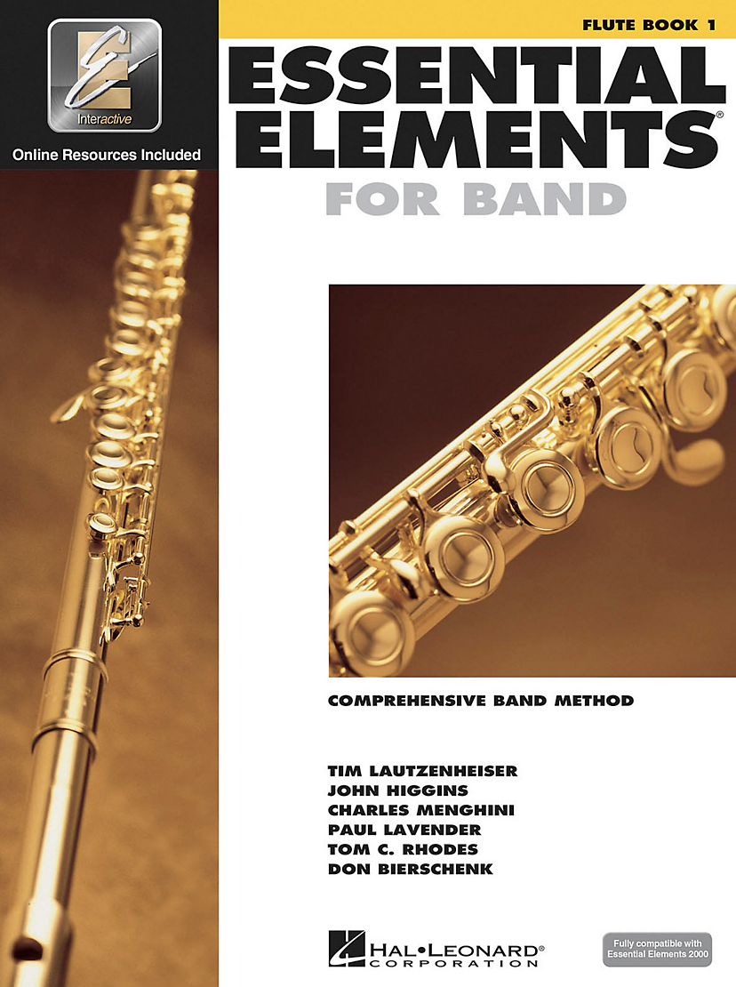
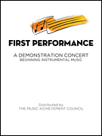
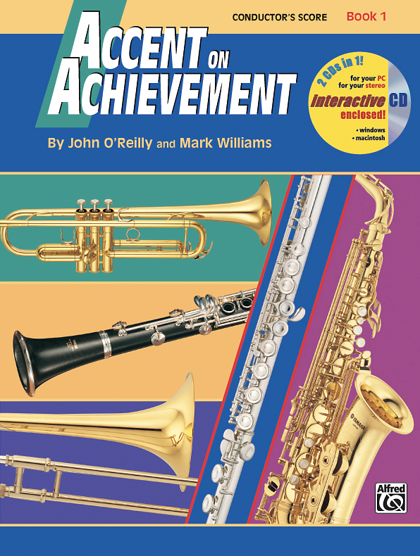
Music
Material
To Use:
Available for
Band or Orchestra at
Local Music Dealers
or online via
Hal Leonard

Slide 74
Why Does this Program Work?
The timing of the performance
Parents want to hear their kids
play
Student interest soars and they
learn to love performing
Students practice more prior to a performance
The audience will be large and enthusiastic!

Slide 75
Why Does this Program Work?
Administrators get involved! Many schools have the principal serve as the narrator -- GREAT PR!
The sound of
applause is
infectious

Slide 76
Response from F.P. LIVE at the 2017 Midwest Clinic

Slide 77
Response from F.P. LIVE at the 2017 Midwest Clinic

Slide 78
Response from F.P. LIVE at the 2017 Midwest Clinic

Slide 79
Response from F.P. LIVE at the 2017 Midwest Clinic

Slide 80
Response from Mario Moody, Director

Slide 81
Response from Mario Moody, Director
The experience of having our 1st year students
perform after only 8 weeks has had a profound
impact not only on their confidence and
expectations for themselves moving forward,
it has challenged me to continually grow by making
myself vulnerable and aware of how it feels to be
a “beginner." I can relate better to any feelings of
apprehension they may feel plus our rehearsals
are more effective because my students truly
understand that every practice counts.

Slide 82
It’s all FREE to Download!
www.nammfoundation.org/fpndoc
Share Your Student Success Stories on Video http://bit.ly/BegMus

Slide 84
Music offers a path to Success
Music provides meaningful, lifelong Memories
Music teaches Adaptability
Music teaches Respect
Music teaches Trust

Slide 85
There is a Place…
where kids are S.M.A.R.T.

Slide 86
There is a Place…where kids are S.M.A.R.T.

Slide 87
Your Enthusiasm is what Matters!

Slide 88
Additional M.A.C. Resources
www.MusicAchievementCouncil.org
Notes:
88

Slide 89
What is YOUR Most
Successful Recruiting Tool?

Slide 90
Complimentary Recruitment and Retention Materials MusicAchievementCouncil.org
This PPT and Videos will be Posted at:
MusicEdConsultants.net/conference-materials
Contact Information Marcia Neel marcia@musicedconsultants.net @MusicEdConsult on Twitter 702.361.3553

