Slide 1
One is Too Small a Number
to Achieve Something Great!
Engage, Excite and Enrich
Music Department Caucus
Marcia Neel
August 6, 2015
marcia@musicedconsultants.net
musiceducationconsultants.net

Slide 2
Today’s Sessions
A Memorable Vision
The WHAT
The WHY
The HOW

Slide 3
WHAT Other Teachers Think I Do!

Slide 4
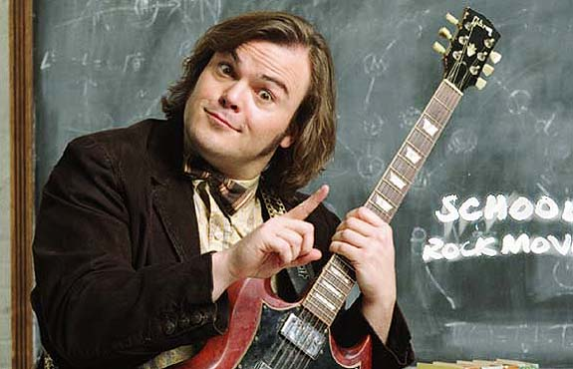
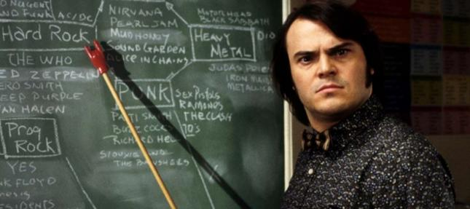
WHAT the Kids (I Don’t Teach) Think I Do!

Slide 5
WHAT Society Thinks I Do!

Slide 6
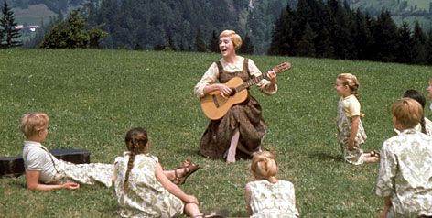
WHAT My Mom Thinks I Do!

Slide 7
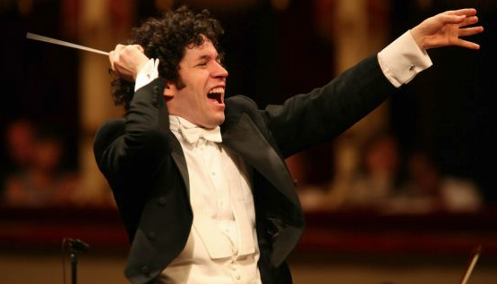
WHAT I Think I Do!

Slide 8
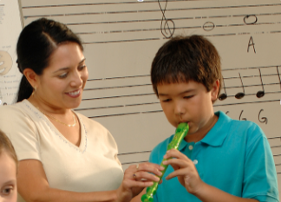
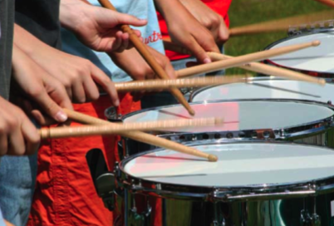
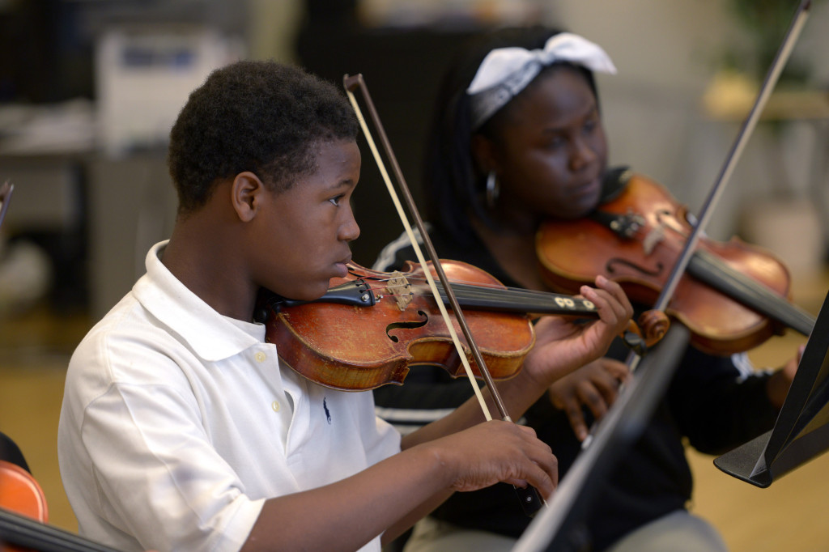
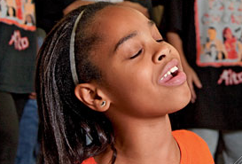
WHAT I Really Get to Do!
Facilitate Success and Fulfillment

Slide 9
The Why RECENT FINDINGS
Prelude:
Music Makes Us
Baseline Research Report
http://musicmakesus.org/resources/research

Slide 10
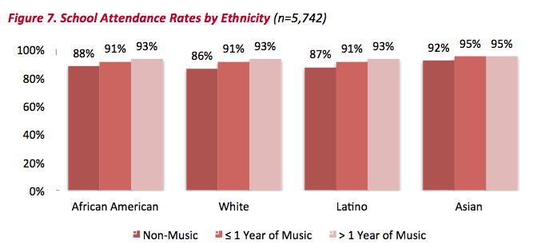
The WHY ATTENDANCE RATES
http://musicmakesus.org/resources/research

Slide 11
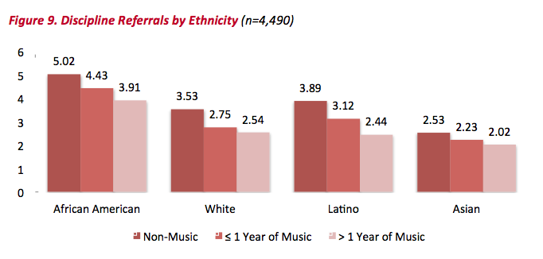
The WHY DISCIPLINE REFERRALS
http://musicmakesus.org/resources/research

Slide 12
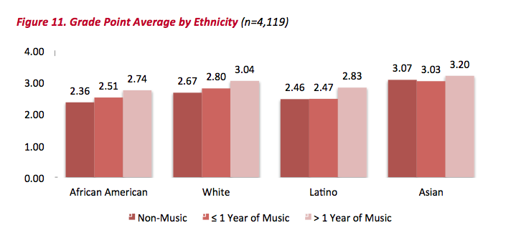
The WHY GPA
http://musicmakesus.org/resources/research

Slide 13
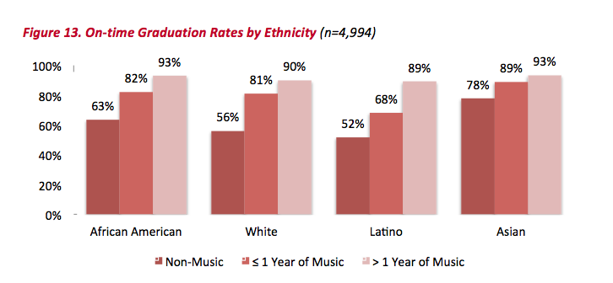
The WHY ON-TIME GRADUATION RATES
http://musicmakesus.org/resources/research

Slide 14
The WHY SUMMARY: What Was Learned?
“The more a student participates
in music, the more positive
these benefits become.”
http://musicmakesus.org/resources/research

Slide 15
The HOW Strategies to ENGAGE, EXCITE and ENRICH
What Music Educators Can Do
What Parents Can Do
What Students Can Do
What Principals Can Do
What Music Supervisors Can Do

Slide 16
Getting It Together as the Music Education Team
1. To Communicate a Unified Message
Why bother?
2. To generate the proper Attitudes toward Music Education

Slide 17
Getting It Together as the Music Education Team
Why bother?
3. To guarantee group Responsibility toward the agreed-upon Purpose
4. To ensure Excellence

Slide 18
Let’s Get Started!
@SDPC_E3 Music Caucus

Slide 19
The HOW
Strategies to
ENGAGE, EXCITE
and ENRICH begin with…
1. Creating & Communicating a
Unified Message

Slide 20
Ever had trouble getting someone to
understand what you’re trying to say?
https://youtu.be/H8xNj8mfcCU

Slide 21
And sometimes it seems as if
even though we are communicating
effectively, we STILL have to
keep REPEATING THE MESSAGE.
We can NEVER BE
COMPLETELY SATISFIED until
no matter HOW we deliver THE MESSAGE,
it FINALLY gets through!

Slide 22
So we keep trying and trying and trying!
https://youtu.be/siCVW5TKRUk

Slide 23
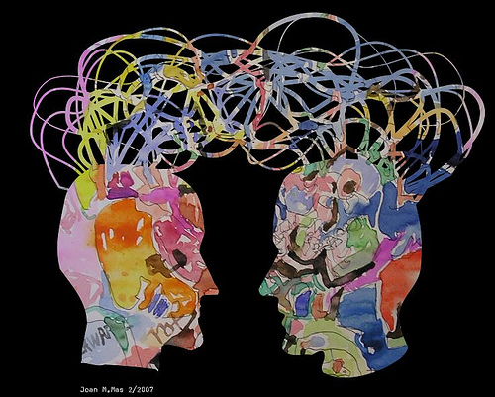
1. Communication. . .
Ability to listen
effectively
Ability to express
thoughts effectively
with others –
both verbally and non-verbally
Have you tried. . . .
Result-driven Communication?

Slide 24
Result-driven Communication: Precise communication at the right place and the right time is a guarantee for success.
https://www.youtube.com/watch?v=6nPXRAvY5Zo

Slide 25
A Unified Message Starts
With a Vision! What is the destination?
Can you see it from here?

Slide 26
Creating a Unified Message
Good Examples of Visions (Destinations)
A world where all children grow up feeling safe, loved, and joyful.
A. Life Is Good T-Shirts:
B. National Education Assoc. (NEA):
A great public school for all students.

Slide 27
Creating a Unified Message
Good Examples of Missions (Purposes):
A. Google:
Google’s mission is to organize the world’s information and make it universally accessible and useful.
To advance music education by
encouraging the studying and making of music by all.
B. NAfME:

Slide 28
Creating a Unified Message
1. Answer the question, “Who are ‘we’?”
2. Answer the question, “What is the
ultimate benefit (vision) for our
participating students?” (HELP: The
5 “which leads tos. . .”)
3.Answer the question, “What is our
overall purpose?” (HELP: The 5
“Whys”)

Slide 29
Creating a Unified Message
4. Answer the question, “What do we
believe in?”
5. Answer the question,“Why is it
important to have a written, district-wide Vision and Mission for our Music Department?”
BREAK-OUT

Slide 30
Creating a Unified Message
Work as a district-wide
Music Education TEAM with
one unified Message:
Who are “We”?
The district-wide, K-12 Music Department is the inclusive team of Music Educators which supports and promotes Music Education within the School District of Pickens County by providing quality, sequential instruction through fulfilling, life-changing opportunities for all of its children.

Slide 31
Creating a Unified Message
Work as a district-wide
Music Education TEAM with
one unified Message:
What is “Our” Vision?
The School District of Pickens County K-12 Music Department envisions a community where all are actively engaged in life-long, music-making activities.

Slide 32
Creating a Unified Message
Work as a district-wide
Music Education TEAM with
one unified Message:
What is “Our” Mission?
The Mission of the School District of Pickens County K-12 Music Department is to enhance the overall quality of life for all children by inspiring in them the desire to experience the joy of music-making throughout life.

Slide 33
Creating a Unified Message
Work as a district-wide
Music Education TEAM with
one unified Message:
What do we believe in?
Music is a core academic subject and should be taught within
the school day.
Music should be funded by the district sufficiently and equitably.
A Middle School Fine Arts requirement should be established.
A Fine and Performing Arts Coordinator position should be
established to advocate for the needs of the children.
Data should be gathered and used in determining the needs of the
SDPC Music Program and its students.
Band, Choir and Strings should be offered at every secondary school.

Slide 34
Creating a Unified Message
Work as a district-wide
Music Education TEAM with
one unified Message:
Why is it important to have written Vision
and Mission Statements?
To clarify and communicate our Purpose
To establish a singular, unified Message
To create Validity
To provide Direction

Slide 35
Communicating the Message
So what’s the problem?
Everyone communicates but. . .
Few Connect!

Slide 36
What is CONNECTING?
“Connecting is the ability to identify with people and relate to them in a way that increases your influence with them.”
Why is this IMPORTANT?
“Because the ability to communicate and connect with others is a major determining factor in reaching YOUR potential.”
John Maxwell

Slide 37
Five (5) Connecting Principles:
1. Connecting Increases Your Influence in
Every Situation. . .
Set people up to connect
with and receive your “message.”
How can we do this. . .
with Students?
with Parents?
with Administrators?
with the Community?

Slide 38
Five (5) Connecting Principles:
2. Connecting is All About Others. . .
It begins
when the other person feels valued.
STOP
LOOK
LISTEN!
Marcia’s
“Walking through the Halls”
Philosophy

Slide 39
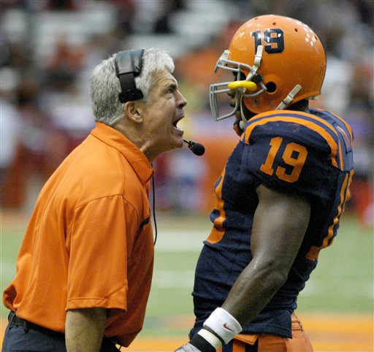
Five (5) Connecting Principles:
3. Connecting Goes Beyond Words. . .
“Your
actions are speaking so loudly, I can’t hear what you’re saying.”
Body
Language

Slide 40
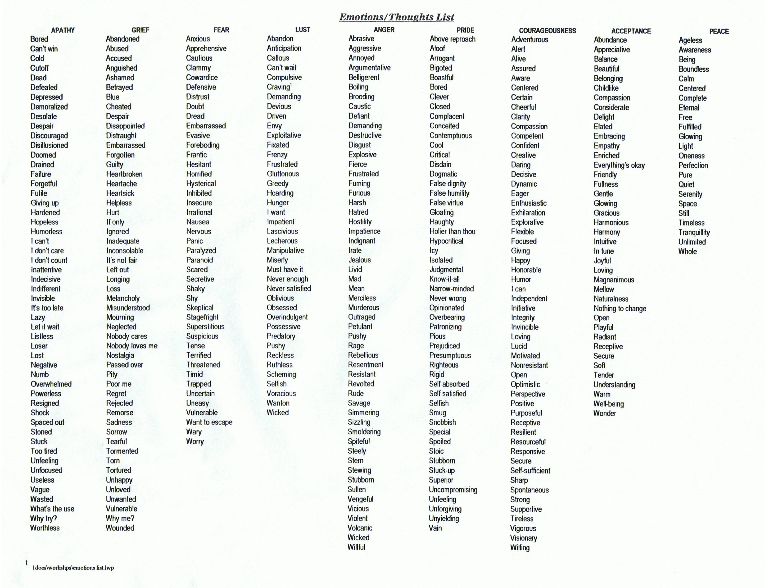

Slide 41
Five (5) Connecting Principles:
4. Connecting Always Requires Energy. . .
“They” get out of it what “you” put into it!
https://youtu.be/F_UWM2exxBY

Slide 42
Five (5) Connecting Principles:
5. Connecting is More Skill than Natural Talent. . .
It can be learned.
https://www.youtube.com/watch?v=0b4f5HxiYNI

Slide 43
The HOW
Strategies to
ENGAGE, EXCITE
and ENRICH involve…
2. Generating the Proper Attitudes toward
Music Education

Slide 44
2. Generating the Proper Attitudes toward Music Education Remember these?

Slide 45
2. Generating the Proper Attitudes toward Music Education Remember these?

Slide 46
2. Generating the Proper Attitudes toward Music Education Remember these?

Slide 48
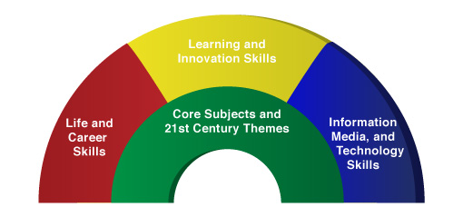
Promulgate the Correct Attitude!
We’re so much more than what it seems!
A focus on these 5 C’s is essential
to prepare students for the 21st Century.
Critical Thinking
Communication
Collaboration
Creativity
Confidence
Therefore. . .

Slide 49
The Music Skills Practice Room is. . .
The Life Skills Practice Room
1. Critical Thinking. . .
Ability to reason effectively and solve
problems creatively

Slide 50
The Music Skills Practice Room is. . .
The Life Skills Practice Room
Problem Solving:
Ability to solve problems.
EX: Having a problem getting
people to turn off their phones and
beepers at your concerts? See how one student found a creative solution!

Slide 51
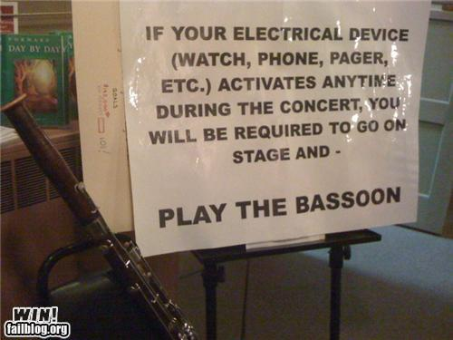
The Music Skills Practice Room is. . .
The Life Skills Practice Room

Slide 52
The Music Skills Practice Room is. . .
The Life Skills Practice Room
2. Communication
Refer back to slides 20 - 24
3. Collaboration (Teamwork). . .
Ability to work effectively and respectfully with ALL

Slide 53
The Music Skills Practice Room is. . .
The Life Skills Practice Room
Teamwork: Effective when EVERYONE
does their job.
https://youtu.be/FIya6xaWDWo

Slide 54
The Music Skills Practice Room is. . .
The Life Skills Practice Room
5. Confidence. . .
Ability to handle EVERY CIRCUMSTANCE and grow from it

Slide 55
The Music Skills Practice Room is. . .
The Life Skills Practice Room
Confidence: Ability to handle EVERY CIRCUMSTANCE
https://www.youtube.com/watch?v=rVvaX6n3ClM

Slide 56
Feature the Unique Individual Achievements/ Gifts of YOUR Students
So Speak Up!
Don’t be your school’s best kept secret
https://youtu.be/Qw1CZ6Biqdw

Slide 57
So Speak Up! Don’t be your school’s best kept secret
Feature the Unique Individual Achievements/
Gifts of YOUR Students
https://youtu.be/II_znS7pbRE

Slide 58
So Speak Up! Don’t be your school’s best kept secret
Feature the Unique Individual Achievements/
Gifts of YOUR Students
https://youtu.be/fr843OR1GZE

Slide 59
The HOW
Strategies to
ENGAGE, EXCITE
and ENRICH involve…
3. Group Responsibility for the Agreed-upon Purpose

Slide 60
The HOW: First Performance Instill the Vision EARLY – ELEMENTARY!
Order through music store or at www.musicachievementcouncil.org
https://www.youtube.com/watch?v=lk0xiAjwaGU

Slide 61
The HOW
Plan performances/activities together
Conduct each other’s ensembles
Attend each other’s performances
Chaperone each other’s trips
Hang out with each other!
Meet as a district-wide TEAM on a regular basis to establish goals and measure progress

Slide 62
A Photo is Worth 1000 Words! Build a “retention” section on all K-12 music websites. Content could include. . .
Lots of photos of elementary/middle students with the high school students at cool events (as well as at musical activities).
B. Lots of photos of elementary/middle parents with the high school parents/students at cool events (as well as at musical activities).
C. Lots of photos of elementary/middle/high school directors together at cool events (etc.).
D. Lots of photos of elementary/middle/high school principals together at cool events. (etc.)

Slide 63
A Video is Worth 10,000 Words! Feature the Elementary Band in HS Halftime Show
https://www.youtube.com/watch?v=I0JmBK-MF-A

Slide 64
The HOW Engage Parents EARLY—The Parent Band!
https://www.youtube.com/watch?v=zeo_VwHdsDE

Slide 65
The HOW Publicize Student “Testimonials”
https://www.youtube.com/watch?v=j_3KfZIctsI

Slide 66
The HOW
Write letters of invitation (Big Bro/Sis) and congratulations as appropriate
“Congratulations!
You have been chosen to
play (insert instrument)
in the (name of school) band!”
Giving a “Golden Invitation” to music makes
them feel special!”

Slide 67
The HOW
Strategies to
ENGAGE, EXCITE
and ENRICH involve…
4. Ensuring Excellence
for the right REASON—
the Joy of Music-making!

Slide 68
Excellence for the RIGHT REASON
The Simón Bolivár HS Youth Orch
https://youtu.be/bUJ0b_o8s-c

Slide 69
but. . .
“ONE IS TOO SMALL A
NUMBER TO ACHIEVE
SOMETHING GREAT”
SOOOOOO. . .
WHAT CAN BE DONE
TOGETHER TO ACHIEVE
GREATNESS IN
PICKENS COUNTY?

Slide 70
We must be
effective in
showing that
we truly C.A.R.E.

Slide 71
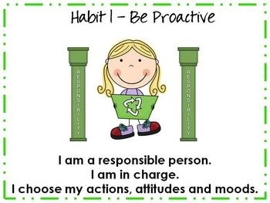

Slide 73
https://www.youtube.com/watch?v=tlUE5MK0Odw

Slide 74
3. Put First Things First
https://www.youtube.com/watch?v=IA8feapScso

Slide 76
4. Think Win-Win
https://youtu.be/SUe6Gf33WcQ

Slide 77
4a. Think Win-Win
Full OSU Video-Game Halftime Show
https://www.youtube.com/watch?v=rNzOVxHhjmQ

Slide 79
https://youtu.be/rYlyb2fFJSw

Slide 80
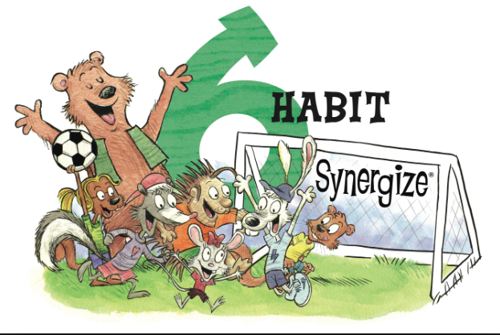

Slide 81
6. Synergize
https://youtu.be/jRsolX69BXc

Slide 83
7. Sharpen Your Saw
https://youtu.be/ZiXGFgK0Icw

Slide 84
What Will Make Our Programs Special?
Do We C.A.R.E.?
With GREAT THANKS to Dr. Tim!
1. Communicate a Unified Message
2. Generate the Proper Attitudes toward Music Education
3. Guarantee Group Responsibility Toward the Agreed-upon Purpose
4. Ensure Excellence

Slide 85
One final bit of inspiration. . .
The “Message” of the Foothill HS Band
https://youtu.be/MMdHJHX7Xa4

Slide 86
Next Step: Action Plans/Strategies to
Support Your Mission
1. Set dates for follow-up
meetings/brainstorming
for three (3) activities.
___
2. Choose two (2)
activities to implement.
___
3. Decide what data you
may want to collect.
___
4. Implement activities.
___
5. Assess each activity
using data and share out.
___

Slide 87
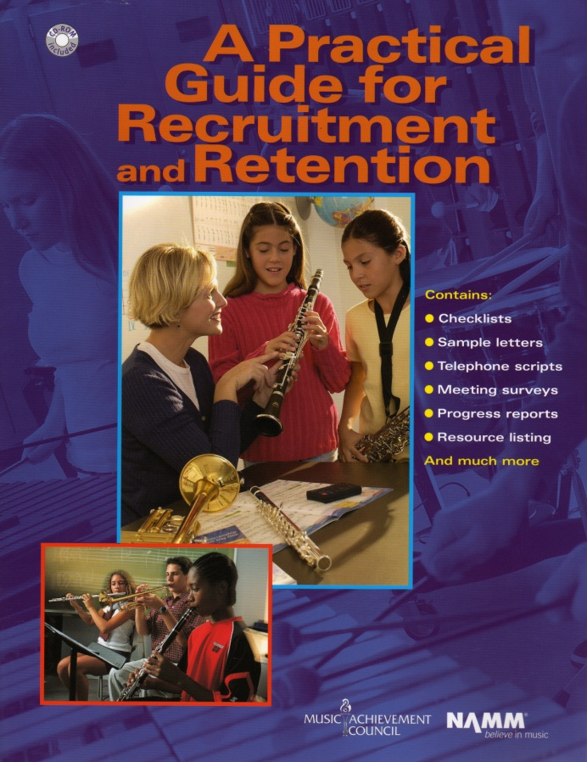
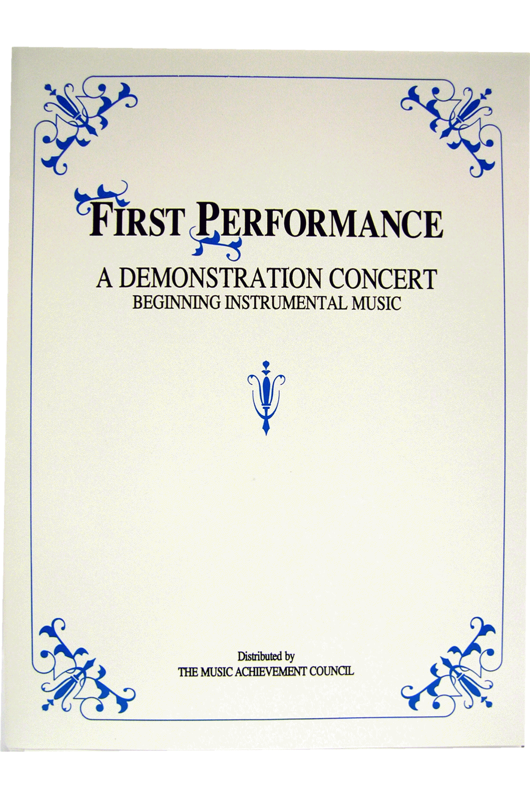
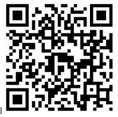
Got SMART Phone?
www.musicedconsultants.net/conference-materials
www.musicachievementcouncil.org

Slide 88
Got Smart Phone?
marcia@musicedconsultants.net
@MusicEdConsult
On Twitter
Thank You!
All materials are posted:
www.musicedconsultants.net/conference-materials

