Slide 1
“One is Too Small a Number to Achieve Something Great;
It’s Much More than the Music!”
February 16, 2017
marcia@musicedconsultants.net
www.musiceducationconsultants.net/conference-materials

Slide 2
School is. . .
Impressionistic
vs
Expressionistic
Music is. . .

Slide 3
Expressionistic

Slide 4
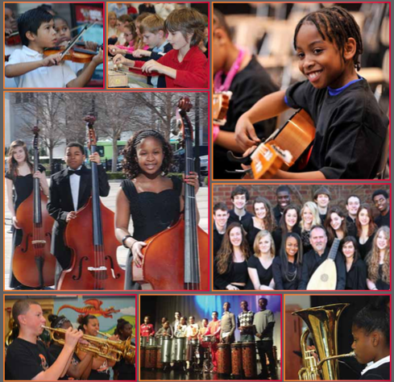
Today’s Session
1. What we are teaching
2. How we are teaching “that”

Slide 5
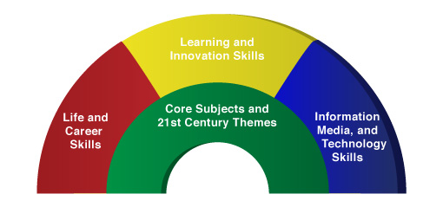
More Than One. . .
A focus on these 5 C’s is essential
to prepare students for their future.
Five!
Critical Thinking
Communication
Collaboration
Creativity
Confidence
Therefore. . .

Slide 6
The Music Skills Practice Room is. . .
The Life Skills Practice Room
1. Critical Thinking. . .
a) Ability to reason effectively and solve
problems
b) Ability to analyze how parts of a whole interact with each other to produce overall outcomes in complex systems.

Slide 7
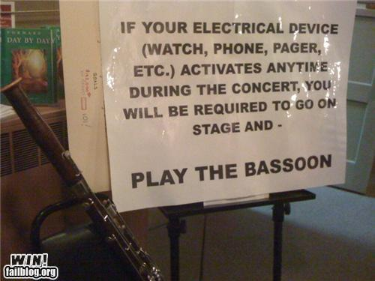
The Music Skills Practice Room is. . .
The Life Skills Practice Room
Problem Solving:
Are We Challenging Our Students?
EX: Having a problem getting
people to turn off their phones and
beepers at your concerts? A student came up with this clever solution. . .

Slide 8
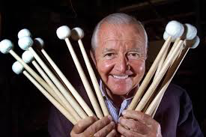
The Music Skills Practice Room is. . .
The Life Skills Practice Room
Problem Solvers:
Vic Firth

Slide 9
The Music Skills Practice Room is. . .
The Life Skills Practice Room
Problem Solvers:
Vic Firth was inspired to design a higher-quality mallet than the “warped utensils and implements not specifically designed
for percussionists” while
playing timpani with the
Boston Symphony Orchestra.

Slide 10
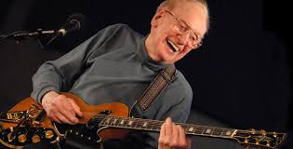
The Music Skills Practice Room is. . .
The Life Skills Practice Room
Problem Solvers:
Les Paul

Slide 11
The Music Skills Practice Room is. . .
The Life Skills Practice Room
Problem Solvers:
Les Paul invented the solid body guitar because his audience at a BBQ joint couldn’t hear him play.

Slide 12
The Music Skills Practice Room is. . .
The Life Skills Practice Room
Producing Creative Outcomes:
Are We Challenging Our Students?
EX: Ability to analyze how parts of a whole interact with each other to produce overall outcomes in complex systems.

Slide 13
The Music Skills Practice Room is. . .
The Life Skills Practice Room
Meet Jason Collier!

Slide 14
The Music Skills Practice Room is. . .
The Life Skills Practice Room
2. Communication. . .
Ability to express
thoughts effectively
Ability to listen
effectively
Have you tried Result-driven Communication?

Slide 15
The Music Skills Practice Room is. . .
The Life Skills Practice Room
Result-driven Communication:
Expressing (and listening) effectively

Slide 16
The Music Skills Practice Room is. . .
The Life Skills Practice Room
3. Collaboration (Teamwork). . .
Ability to work effectively and respectfully with ALL

Slide 17
The Music Skills Practice Room is. . .
The Life Skills Practice Room
Collaboration:
EFFECTIVE when EVERYONE performs at their best!
Gustavo Dudamel and Simón Bolívar National Youth Orchestra El Sistema

Slide 18
The Music Skills Practice Room is. . .
The Life Skills Practice Room
Creativity (Innovation). . .
Ability to create new and more worthwhile ideas and to work creatively with others.

Slide 19
The Music Skills Practice Room is. . .
The Life Skills Practice Room
Create new and more worthwhile ideas and work creatively with others
Meet Eric Whitacre

Slide 20
The Music Skills Practice Room is. . .
The Life Skills Practice Room
5. Confidence. . .
Ability to handle EVERY CIRCUMSTANCE and grow from it!

Slide 21
The Music Skills Practice Room is. . .
The Life Skills Practice Room
Confidence:
Ability to handle EVERY CIRCUMSTANCE

Slide 22
but. . .
“ONE IS TOO SMALL A
NUMBER TO DO IT ALL”
SOOOOOO. . .
HOW CAN WE ALL WORK
TOGETHER TO CREATE
SOMETHING GREAT!
Parents
Teachers
Principals
Custodians
Support Staff
Community

Slide 23
“We either hang together, or
we hang separately” . . . Ben Franklin
When ALL of the people involved in a music program decide to unselfishly GIVE, it’s THEN that we realize the true value of the program—
a gathering of wonderful people who genuinely C.A.R.E. for one another.
. . . “Dr Tim” Lautzenheizer

Slide 24
Get EVERYONE on the Same Page
One Goal:
To ensure continued,
active music-making
for all.

Slide 25
We C.A.R.E.!
C: Communication
We all encourage one another to reach out to each other.
We all apply harmony and balance to more than great music-making.

Slide 26
We C.A.R.E.!
A: Attitude
We all generate the right attitude.
Our attitude plays a crucial role in the outcome of our students’ experiences.

Slide 27
We C.A.R.E.
R: Responsibility
We all come together ready to invest energy for ongoing growth to advance the entire program to the next level.

Slide 28
We C.A.R.E.!
E: Excellence
We all reflect a sense of excellence to go beyond the basic requirements—to put forth extra effort.

Slide 29
We C.A.R.E.!
...Because “she” deserves the very best
from ALL of us!

Slide 30
Thank You!
Posted at
www.musiceducationconsultants.net/
conference-materials
marcia@musicedconsultants.net

