Slide 1
“One is Too Small a Number to Achieve Something Great”
February 10, 2017
marcia@musicedconsultants.net
www.musiceducationconsultants.net/conference-materials

Slide 2
School is. . .
Impressionistic
vs
Expressionistic
Music is. . .

Slide 3
Expressionistic

Slide 4
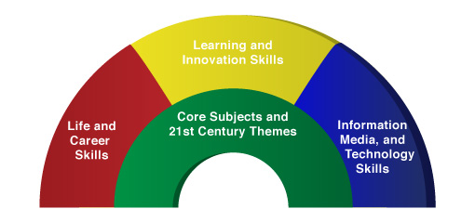
A focus on these 5 C’s is essential
to prepare students for their future.
Critical Thinking
Communication
Collaboration
Creativity
Confidence
Therefore. . .

Slide 5
The Music Skills Practice Room is. . .
The Life Skills Practice Room
1. Critical Thinking. . .
Ability to reason effectively and solve
problems and analyze how parts
of a whole interact with each other to produce overall outcomes in complex systems.

Slide 6
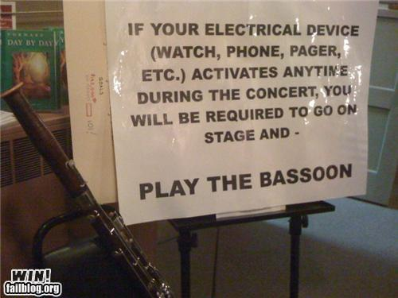
The Music Skills Practice Room is. . .
The Life Skills Practice Room
Solve Problems
EX: Having a problem getting
people to turn off their phones and
beepers at your concerts? One teacher
challenged his students to come up
with the solution. Here it is. . .

Slide 7
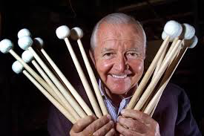
The Music Skills Practice Room is. . .
The Life Skills Practice Room
Problem Solvers:
Vic Firth

Slide 8
The Music Skills Practice Room is. . .
The Life Skills Practice Room
Problem Solvers:
Vic Firth was inspired to design a higher-quality mallet than the “warped utensils and implements not specifically designed
for percussionists” while
playing timpani with the
Boston Symphony Orchestra.

Slide 9
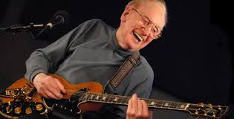
The Music Skills Practice Room is. . .
The Life Skills Practice Room
Problem Solvers:
Les Paul

Slide 10
The Music Skills Practice Room is. . .
The Life Skills Practice Room
Problem Solvers:
Les Paul invented the solid body guitar because his audience at a BBQ joint couldn’t hear him play.

Slide 11
The Music Skills Practice Room is. . .
The Life Skills Practice Room
EXAMPLE: Ability to analyze how parts
of a whole interact with each other to produce overall outcomes in complex systems.
See how this creative young man used this concept to produce a remarkable outcome!

Slide 12
The Music Skills Practice Room is. . .
The Life Skills Practice Room
JEFFREY DING - Produce overall outcomes

Slide 13
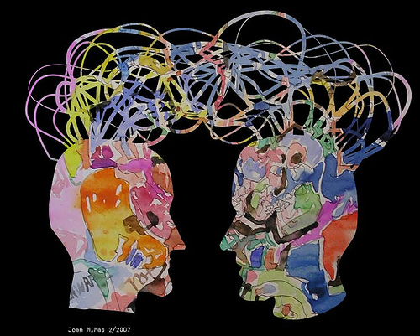
The Music Skills Practice Room is. . .
The Life Skills Practice Room
2. Communication. . .
Ability to listen
effectively
Ability to express
thoughts effectively
Have you tried Result-driven Communication?

Slide 14
The Music Skills Practice Room is. . .
The Life Skills Practice Room
Result-driven Communication: Listening and
communicating effectively will guarantee success!

Slide 15
The Music Skills Practice Room is. . .
The Life Skills Practice Room
3. Collaboration (Teamwork). . .
Ability to work effectively and respectfully
with ALL

Slide 16
The Music Skills Practice Room is. . .
The Life Skills Practice Room
Teamwork:
MOST EFFECTIVE when EVERYONE does their best!
Gustavo Dudamel and Simón Bolívar National Youth Orchestra El Sistema

Slide 17
The Music Skills Practice Room is. . .
The Life Skills Practice Room
Creativity (Innovation). . .
Ability to create new and more worthwhile ideas and to work creatively with others.

Slide 18
The Music Skills Practice Room is. . .
The Life Skills Practice Room
(Innovation): Ability to think and work creatively with others
OSU Video

Slide 19
The Music Skills Practice Room is. . .
The Life Skills Practice Room
5. Confidence. . .
Ability to handle EVERY CIRCUMSTANCE
and grow from it!

Slide 20
The Music Skills Practice Room is. . .
The Life Skills Practice Room
Confidence: Ability to handle EVERY CIRCUMSTANCE

Slide 21
but. . .
“ONE IS TOO SMALL A
NUMBER TO DO IT ALL”
SOOOOOO. . .
HOW CAN WE ALL WORK
TOGETHER TO CREATE
SOMETHING GREAT!
Parents
Teachers
Principals
Custodians
Support Staff
Community

Slide 22
“We either hang together, or
we hang separately” . . . Ben Franklin
When ALL of the people involved in a music program decide to unselfishly GIVE, it’s THEN that we realize the true value of the program—
a gathering of wonderful people who genuinely C.A.R.E. for one another.
. . . “Dr Tim” Lautzenheizer

Slide 23
Get EVERYONE on the Same Page
One Goal:
To ensure continued,
active music-making
for all.

Slide 24
We C.A.R.E.!
C: Communication
We all encourage one another to reach out to each other.
We all apply harmony and balance to more than great music-making.

Slide 25
We C.A.R.E.!
A: Attitude
We all generate the right attitude.
Our attitude plays a crucial role in the outcome of our students’ experiences.

Slide 26
We C.A.R.E.
R: Responsibility
We all come together ready to invest energy for ongoing growth to advance the entire program to the next level.

Slide 27
We C.A.R.E.!
E: Excellence
We all reflect a sense of excellence to go beyond the basic requirements—to put forth extra effort.

Slide 28
We C.A.R.E.!
...Because “she” deserves the very best
from ALL of us!

Slide 29
Thank You!
www.musiceducationconsultants.net/conference-materials
marcia@musicedconsultants.net

