Slide 1
One is Too Small a Number
to Achieve Something Great
NAfME Western Division
Leadership Conference
Marcia Neel
June 17, 2015
www.musiceducationconsultants.net

Slide 2
Ever had trouble getting someone to
understand what you’re trying to say?

Slide 3
You keep trying and trying and trying?

Slide 4
So what’s the problem?
Everyone communicates but. . .
few connect!

Slide 5
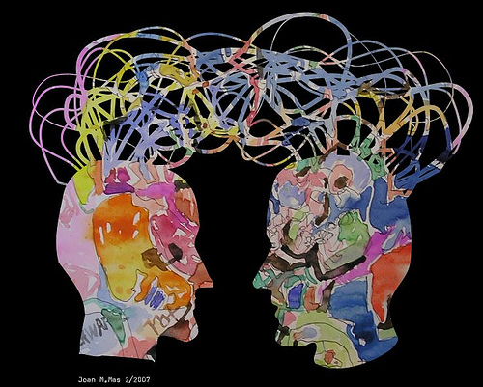
1. Communication. . .
Ability to listen
effectively
Ability to express
thoughts effectively
with others –
both verbally and non-verbally
Have you tried. . . .
Result-driven Communication?

Slide 6
Result-driven Communication: Precise communication at the right place and the right time is a guarantee for success.

Slide 7
So what is CONNECTING?
“Connecting is the ability to identify with people
and relate to them in a way that increases your
influence with them.”
Why is that IMPORTANT?
“Because the ability to communicate and connect
with others is a major determining factor in
reaching your potential.”

Slide 8
Five Connecting Principles:
1. Connecting Increases Your Influence in
Every Situation. . .
set people up to connect
with and receive your “message.”

Slide 9
Five Connecting Principles:
2. Connecting is All About Others. . .
It begins
when the other person feels valued.
STOP
LOOK
LISTEN!

Slide 10
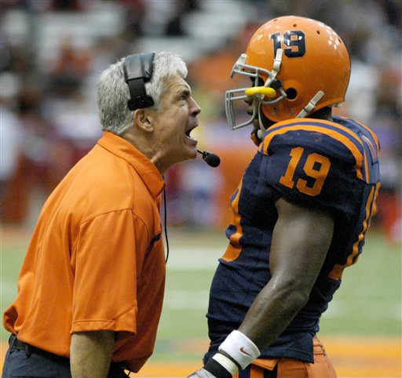
Five Connecting Principles:
your
actions speak so loudly, I can’t hear your words.
3. Connecting Goes Beyond Words. . .

Slide 11
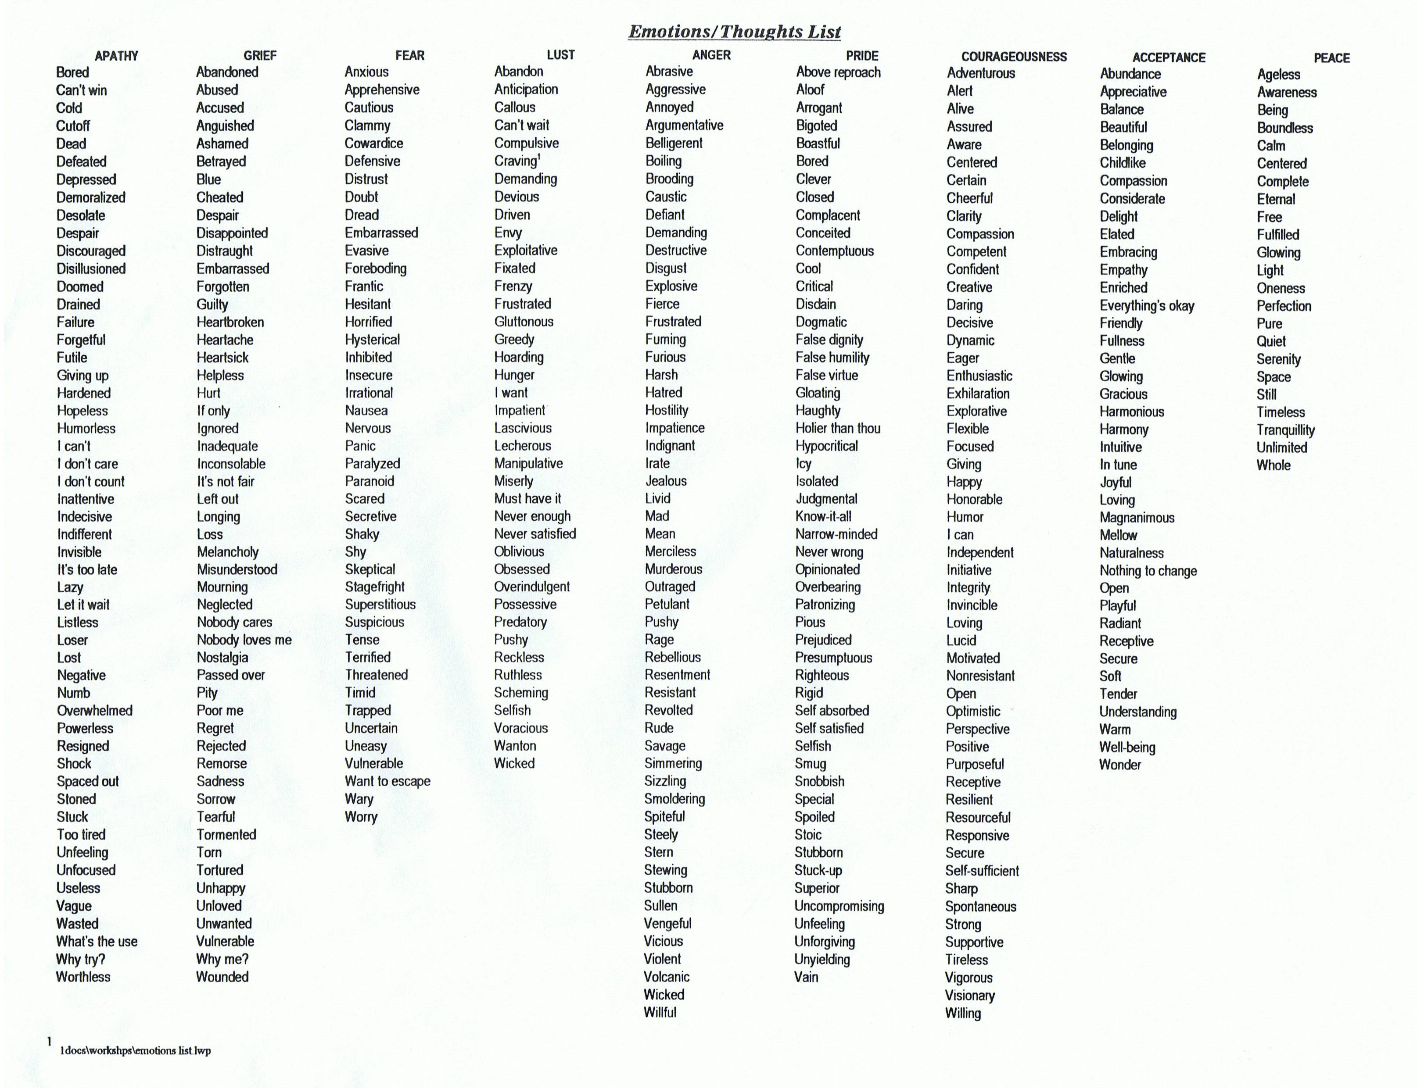

Slide 12
Five Connecting Principles:
“they” get out of it what “you” put into it!
4. Connecting Always Requires Energy. . .
5. Connecting is More Skill than Natural Talent. . .
it can be learned.

Slide 13
but. . .
“ONE IS TOO SMALL A
NUMBER TO ACHIEVE
SOMETHING GREAT”
SOOOOOO. . .
WHAT CAN BE DONE
TOGETHER TO ACHIEVE
GREATNESS?

Slide 14
YOU’VE GOT TO BE VISIONARY!

Slide 15
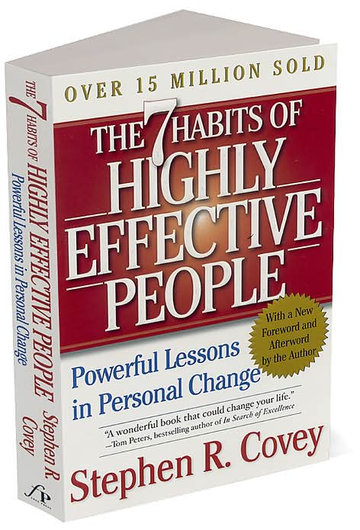

Slide 16
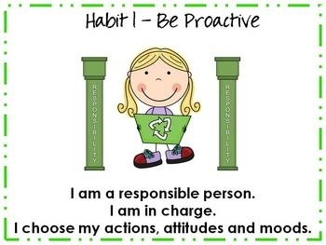

Slide 19
3. Put First Things First

Slide 20
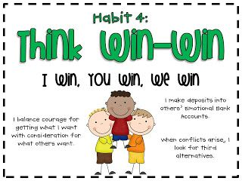
4. Think Win-Win

Slide 21
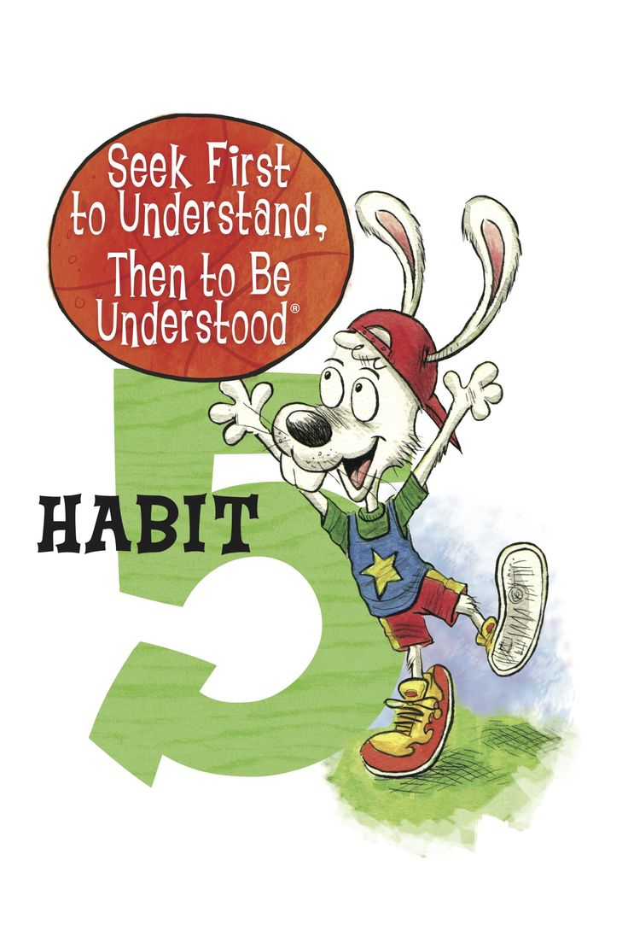

Slide 22
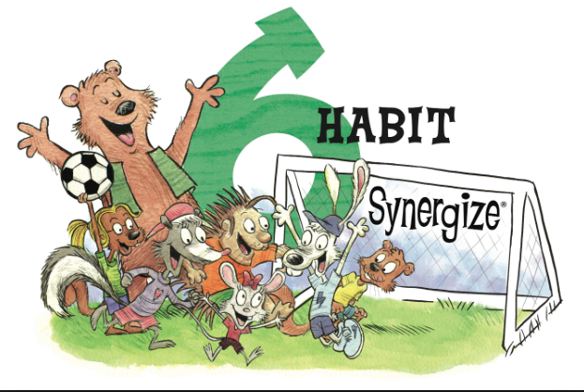

Slide 23
6. Synergize

Slide 24
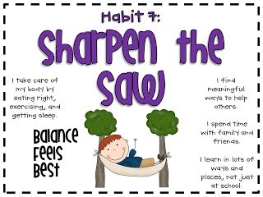

Slide 25
Getting It Together
What about Strategic Planning?
1. Why bother?
2. How do I get started?

Slide 26
How do I get started? The First 5 Steps
1. Answer the question, “Who are we?”
This forms the Preamble.
2. Answer the question, “What is our
overall purpose?” This forms the
Mission Statement.
3. Answer the question, “What do we
believe in?” This forms your
Advocacy Statement.

Slide 27
How do I get started? The First Five Steps
4. Answer the question,“Why a Strategic
Plan?” This forms the Commitment.
5. When ready, determine what the
objectives of the organization are
based upon. . .
Who you are
Your Mission Statement
c. What you advocate for

Slide 28
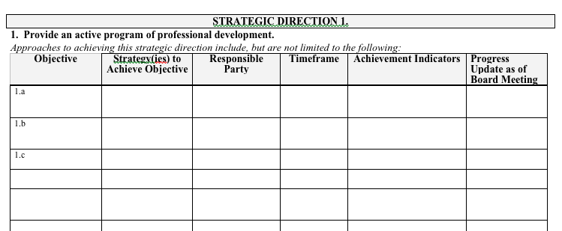
Writing Objectives

Slide 30
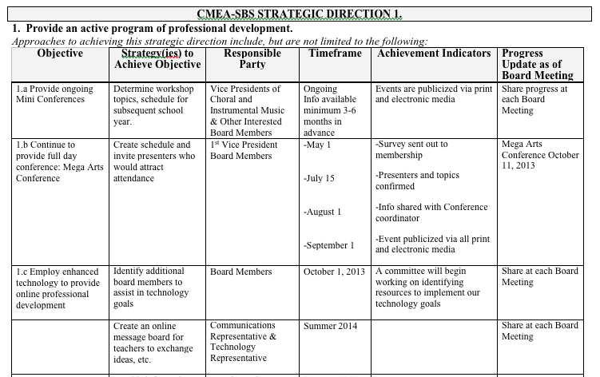

Slide 31
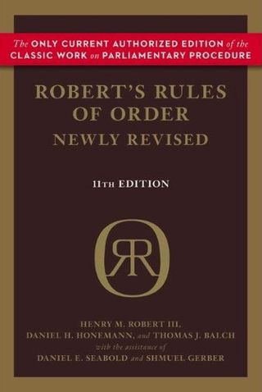
Provides common rules
and procedures for
deliberation and debate
in order to place the
whole membership on
the same footing and
speaking the same
language.

Slide 32
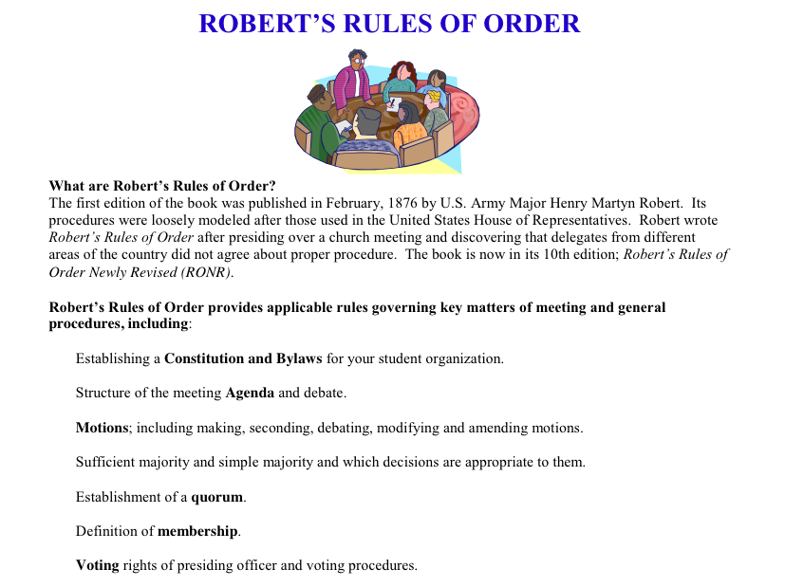

Slide 33
What Makes Our Programs Special?
Do We C.A.R.E.?
With GREAT THANKS to Dr. Tim!
C: REAL Communication
Do we encourage one another to reach out to each other?
Do harmony and balance apply to more than great music-making?

Slide 34
What Makes Our Programs Special?
Do We C.A.R.E.?
A: Attitude
Do we generate the proper attitude?
Does our attitude play a crucial role in the outcome of our organization’s success?

Slide 35
What Makes Our Programs Special?
Do We C.A.R.E.?
R: Responsibility
Do we come together ready to invest energy for ongoing growth and development of our goals?
Do we respond to each other in a fashion that will advance the entire organization to the next level?

Slide 36
What Makes Our Programs Special?
Do We C.A.R.E.?
E: Excellence
Do we reflect a sense of excellence to go beyond the basic requirements -- to put forth extra effort?

Slide 37
Got Smart Phone?
marcia@musicedconsultants.net
@MusicEdConsult
On Twitter
Thank You!
www.musicedconsultants.net/
conference-materials

