Slide 1
Making an Advocate Out of Your Principal:
10 Easy Strategies
Marcia Neel
January 15, 2015

Slide 2
The Two Querries…
What Do Principals Really Think?
2. What Have You Done to Make an Advocate out of Your Principal?

Slide 3
1. What I love best about my music teacher is
that he/she is. . .(here we go!)
Caring
Dedicated
Passionate
Committed
Success-oriented
Organized
Dynamic
Positive
A Team Player/Builder with Students, Staff and Parents

Slide 4
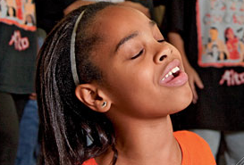
1. What I love best about my music teacher is
that he/she is. . . (cont.)
Communicative
Encouraging
Flexible
Professional
Creative
Talented (Performer)
Intense (In a Good Way)
Effective with Pedagogy

Slide 5
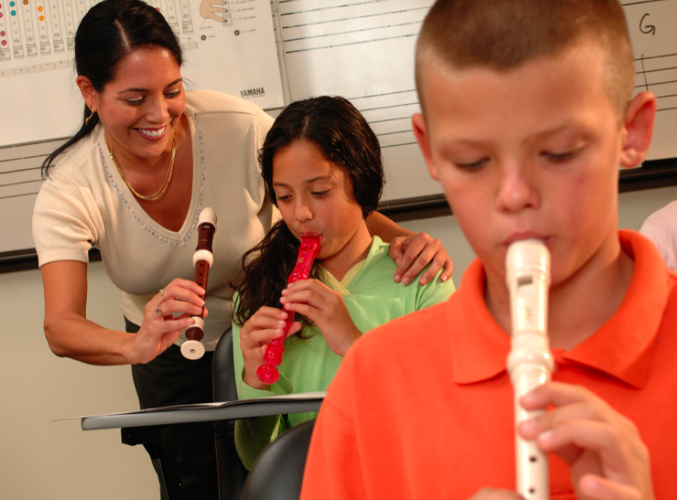
1. What I love best about my music teacher is
that he/she is. . . (cont.)
Responsible
Collegial
Motivational
Inspirational
Helpful
Content-oriented
A Music Advocate (Recruiter)
Demanding (Self and Students)

Slide 6
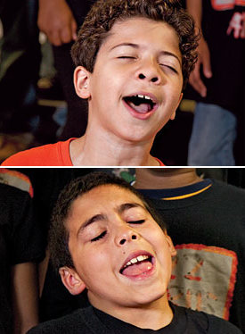
2. To improve the music program, I would ask my music teachers to. . .
Communicate ! Communicate! Communicate!
Coordinate/Collaborate with Colleagues
Articulate with Feeder Schools More
Recruit/Retain More
Focus on Building Group Identity
Promote More
Perform More

Slide 7
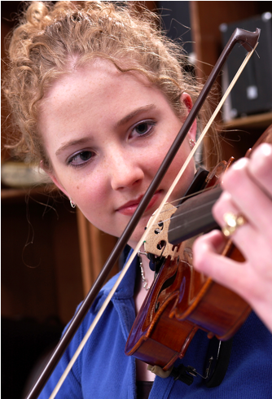
2. To improve the music program, I would ask my music teachers to. . .(cont.)
Help Administrators to Help Them
(esp. on Class Sizes)
Extend Learning Into the Community
Develop More Partnerships
Incorporate School-wide Objectives
Assess Their Own Programs More
Often

Slide 8
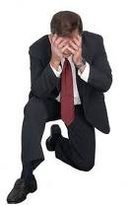
3. What troubles me most is that he/she is not. . .
Passionate
Considerate of the “Big Picture”
Communicative
Demanding Enough
Managing the Classroom Well
Lesson-planning Effectively
Even-tempered
A Team Player
Organized

Slide 9
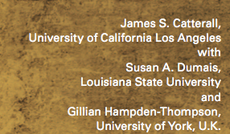
What Have You Done to Make an Advocate Out of Your Principal?
“I communicate and keep my principal informed.”

Slide 10
“I communicate and keep my principal informed.”

Slide 11
Always Have Small Ensembles READY to Perform
Invite Her (and Faculty) to PERFORM in the Holiday Concert
Copy Him on All Correspondence
Communicate Music Advocacy Information
Took him Golfing
. . .He Won!!!!

Slide 12
Sometimes Though -- It Seems As If Principals TRY To Trip Us UP!
http://www.youtube.com/watch?v=dzuVvlAuZmY

Slide 13
It’s a Team Effort!

Slide 14
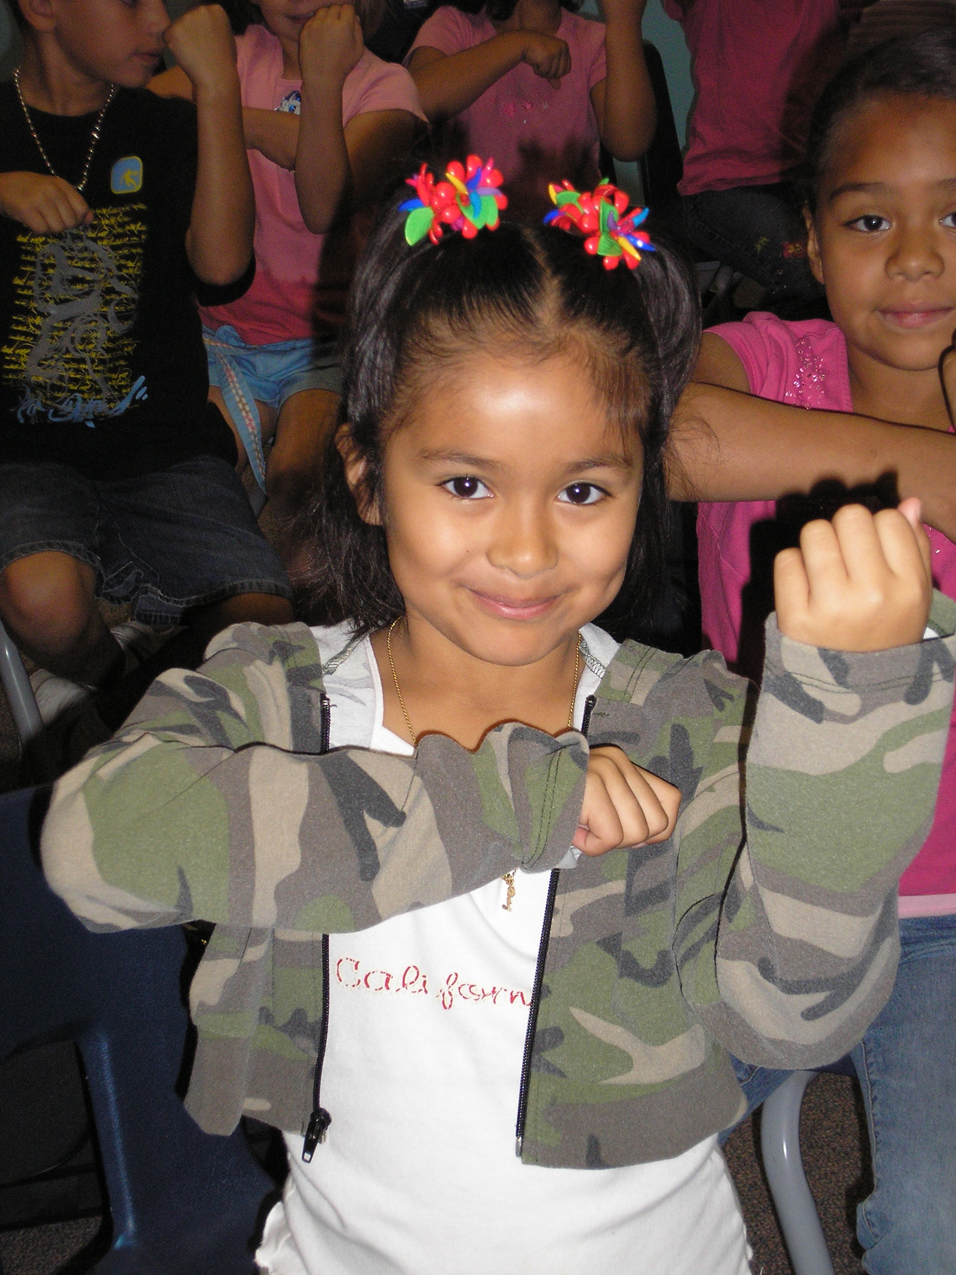
1. Engage Your Principal
Come on down. . .
“Help me give out
instruments to the kids!”

Slide 15
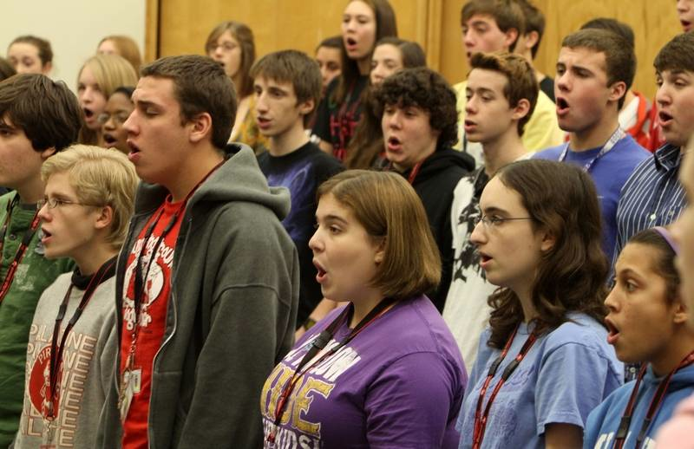
1. Engage Your Principal
Come on down. . .
“I need an audience to help the students prepare for…”

Slide 16
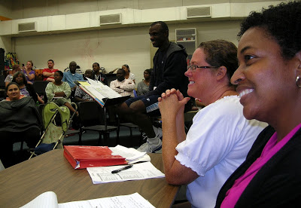
1. Engage Your Principal
Come on down. . .
“Could you give a presentation to the Booster Parents?”

Slide 17
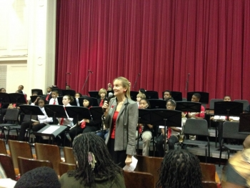
1. Engage Your Principal
Come on down. . .
“Could you provide Opening Remarks at our upcoming concert?”
Praise your administrator in front of the
parents for their support.
Have students present a signed, framed print.

Slide 18
2. Ask your students to complete the sentence, “Music makes the difference because. . .” then use their responses.
“…when you’re sad and then you hear music, it will cheer you up. And when you’re down, it will make you get up from where you are and start dancing. Music will always be there for you.”

Slide 19
Music Makes the Difference Because…
“…it makes me feel free and like nobody is judging me.”
“…it helps me express my feelings into something other than words. Music makes you want to dance, and sing out loud; it can cheer you up, even on the gloomiest days.”

Slide 20
Music Makes the Difference Because…
“…it’s a perfect way to tell and show how you feel.”
“…hearing music helps me work and helps me be the person I want to be.”
“…it gives you a feeling; a feeling that makes you think you can do anything whether it’s doing chores, finishing your homework, or even reaching your goals in life.”

Slide 21
2. Ask your students to complete the sentence,
“Music makes the difference because. . .”
Use their responses. . .
a. In your upcoming concert programs
b. In your school newspaper’s “music corner” (Don’t have a “music corner?” You know what to do!)
c. As copy for making banners/posters to display around the school
d. As copy for recruitment fliers and posters at feeder schools
e. As copy for IMEA publications
f. As copy for a publication about your school’s FANTASTIC music program

Slide 22
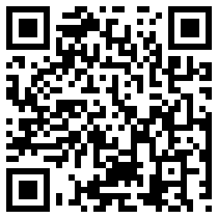
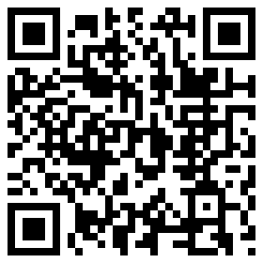
3. Retrieve information about the value of studying music - quote it in any of the above outlets but especially on recruitment information! Share with your supervisor.
HINT: Start by visiting:
musiced.nafme.org/resources
supportmusic.com

Slide 23
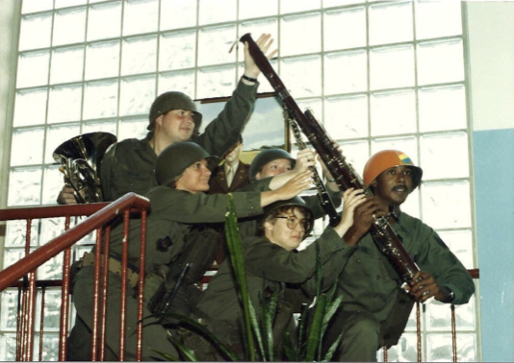
4. Recruit 24/7

Slide 24
5. Recruit 24/7 – Keep Music Education Strong
GREAT FOR PARENT NIGHTS!!!!!
Recently Revised to include the Very Latest Research and Statistics on the Benefits of Music Education.
FREE COPIES of assorted brochures available from
SupportMusic.com

Slide 25
6. In your next concert program, include an insert designating each attendee as a member of the newly-formed Mozart Middle School Coalition for Music Education/Music Boosters Club/Committee to Promote Music Education
a. To help make the program better for those they love
b. To help establish the program as a school-wide entity using a positive approach
d. To feel invested -- i.e. “buy-in”
continued. . .

Slide 26
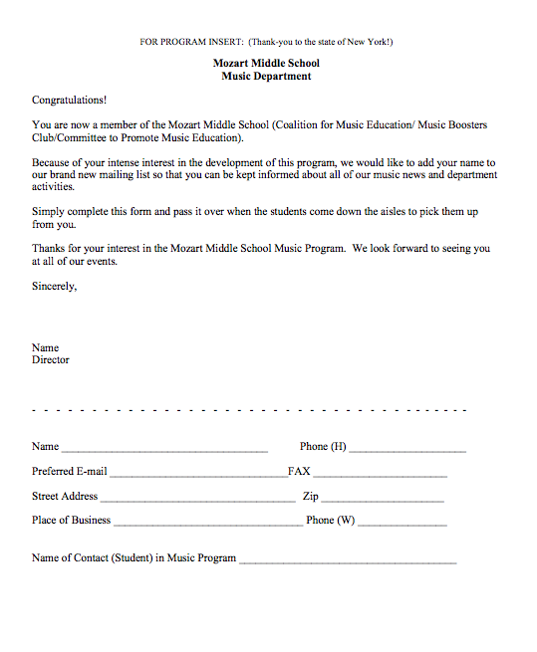
Parents are the ones who have the most important interest at hand. It is THEIR child’s music education.
They can become your voice if needed.

Slide 27
7. Let the Information Come Directly to YOU!!!
Get on Twitter and start following!!!
@NAfME
@MaryLNAMM
@MusicEdConsult
@MusicAchCouncil
@EricWhitacre

Slide 28
8. Arrange for a performance for the principal’s meeting, school board, city council, state legislature, etc. They will appreciate the “good news” for a change.
BE READY!!!!!!!!
PERFORM WELL!!!!

Slide 29
9. Create a website, Twitter Account, etc. and communicate, communicate, communicate. Share the GOOD NEWS!!!!

Slide 31
10. Come up with a clever version of a “Happy Birthday” song to serenade your school staff on their special day. THEY WILL LOVE YOU FOR IT! Give away FREEBIES!
Insert Serenade Photo

Slide 32
Remember. . .Your principal needs YOU!
Be an active, involved member of the faculty.
Take part in as many school activities as you can.
Volunteer to help when needed.
Organize faculty functions, school food drives, etc. (at least one each semester)
Ask how you/your program can help build school spirit.

Slide 33
11 Leadership Truths from “Dr. Tim”
(From: Leadership, Vision, Commitment, Action)
1. If you let other people do it for you, they will do it to you.
2. The harder I work, the luckier I get.
3. 99% responsibility doesn’t work.
4. Yesterday was the deadline for all complaints.
5. Good leaders are scarce so I’m following myself.
6. The things that come to those who wait,
may be the things left by those who get there first.

Slide 34
11 Leadership Truths from “Dr. Tim”
(From: Leadership, Vision, Commitment, Action)
7. There is no growth without discontent.
8. We move toward what we picture in our minds.
9. People who believe things can’t be done will go
out and prove they are right!
10. Real leaders are the cause, NOT the effect.
11. Learn to create, NOT to compete.

Slide 35
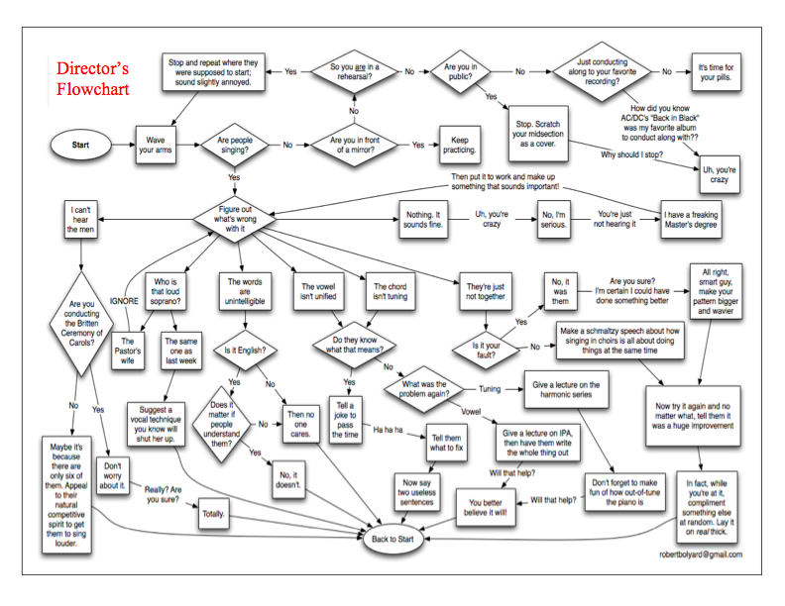
How Can I Do It All?

Slide 36
How Can I Do It All?
Stay Focused
on the “Why!”
We are ALL in this
for the Kids!

Slide 37
ALWAYS SAY, “Thank You!”
Contact Information:
marcia@musicedconsultants.net
@MusicEdConsult on Twitter
Posted: www.musicedconsultants.net/conference-materials.html

