Slide 1
Making an Advocate Out of Your Principal:
Saied Music
10 Things You Can Do Monday!
Marcia Neel
June 1, 2015

Slide 2
The Two Questions…
What Do Principals Really Think?
2. What Have You Done to Make an Advocate out of Your Principal?

Slide 3
1. What Do Principals Really Think?
What I love best about my music teacher is
that he/she is. . .(here we go!)
Caring
Dedicated
Passionate
Committed
Success-oriented
Organized
Dynamic
Positive
A Team Player/Builder with Students, Staff and Parents

Slide 4
1. What Do Principals Really Think?
What I love best about my music teacher is
that he/she is. . .
Communicative
Encouraging
Flexible
Professional
Creative
Talented (Performer)
Intense (In a Good Way)
Effective with Pedagogy

Slide 5
1. What Do Principals Really Think?
What I love best about my music teacher is
that he/she is. . .
Responsible
Collegial
Motivational
Inspirational
Helpful
Content-oriented
A Music Advocate (Recruiter)
Demanding (Self and Students)

Slide 6
1. What Do Principals Really Think?
To improve the music program, I would ask my
music teachers to. . .
Communicate ! Communicate! Communicate!
Coordinate/Collaborate with Colleagues
Articulate with Feeder Schools More
Focus on Building Group Identity
Recruit/Retain More
Promote More
Perform More

Slide 7
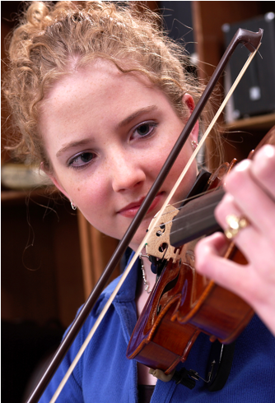
1. What Do Principals Really Think?
To improve the music program, I would ask my
music teachers to. . .(cont.)
Help Administrators to Help Them
(esp. on Class Sizes)
Extend Learning Into the Community
Develop More Partnerships
Incorporate School-wide Objectives
Assess Their Own Programs More
Often

Slide 8
1. What Do Principals Really Think?
What troubles me most is that he/she is not. . .
Passionate
Considerate of the “Big Picture”
Communicative
Demanding Enough
Managing the Classroom Well
Lesson-planning Effectively
Even-tempered
A Team Player
Organized

Slide 9
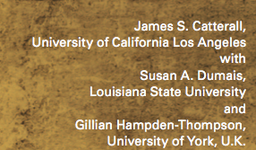
What Have You Done to Make an Advocate Out of Your Principal?
“I communicate and keep my principal informed.”

Slide 10
What Have You Done to Make an Advocate Out of Your Principal?
“I communicate and keep my principal informed.”

Slide 11
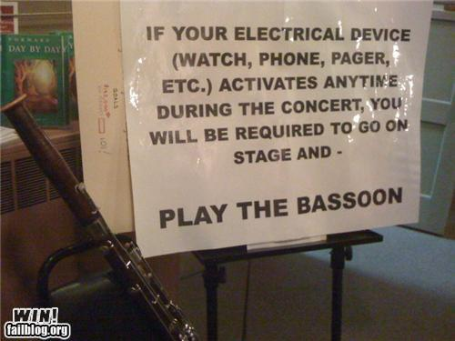
COMMUNICATION DOESN’T ALWAYS HAVE TO BE SO SERIOUS!

Slide 12
What Have You Done to Make an Advocate Out of Your Principal?
“I always have small ensembles READY to perform.”
“I invite her (and faculty) to PERFORM in the Holiday Concert.”
“I copy him on all correspondence.”
“I communicate music advocacy information.”
“I took him golfing
. . .He won!!!!”

Slide 13
Sometimes Though -- It Seems As If Principals TRY To Trip Us UP!
http://www.youtube.com/watch?v=dzuVvlAuZmY

Slide 14
It’s a Team Effort!

Slide 15
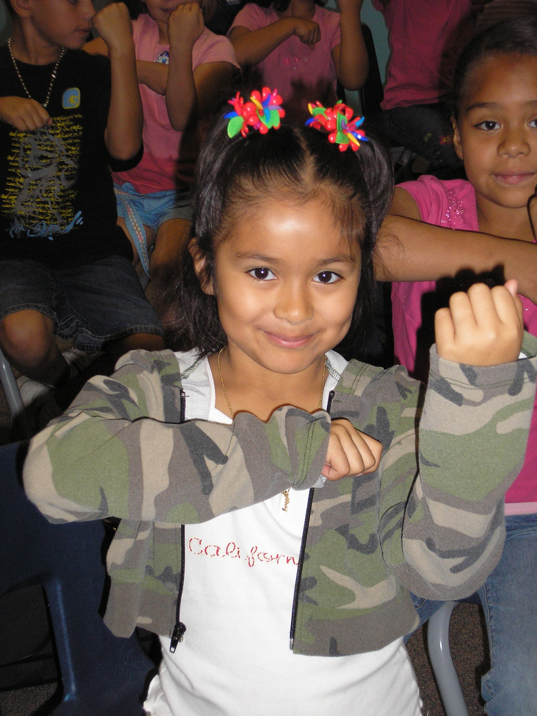
1. Engage Your Principal
Come on down. . .
“Help me give out
instruments to the kids!”

Slide 16
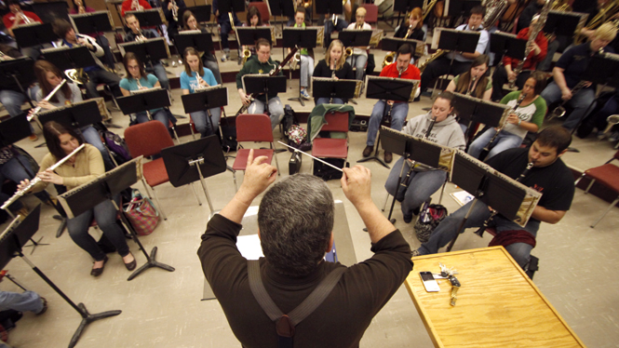
1. Engage Your Principal
Come on down. . .
“I need an audience to help the students prepare for…”

Slide 17
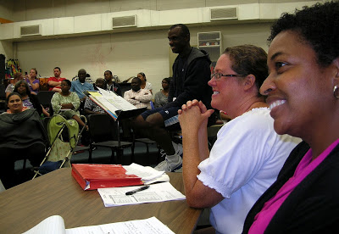
1. Engage Your Principal
Come on down. . .
“Could you give a presentation to the Booster Parents?”

Slide 18
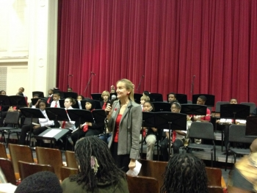
1. Engage Your Principal
Come on down. . .
“Could you provide Opening Remarks at our upcoming concert?”
Then. . .
Praise your administrator in front of the parents for their support.
Have students present a signed, framed print.

Slide 19
1. Engage Your Principal
Help them show their “human” side. . .

Slide 20
2. Give to Your School Community
Faculty Appreciation
Week Luncheon
Holiday Faculty
Party
Valentine’s Day
Faculty Luncheon

Slide 21
3. Ask students to complete the sentence:
“Music makes the difference because. . .”
Use their responses. . .
a. In your upcoming concert programs
b. As copy for making banners/posters to display around the school
c. As copy for recruitment fliers and posters at feeder schools
d. As copy for AMEA publications
e. As copy for a publication about your school’s FANTASTIC music program

Slide 22
Music Makes the Difference Because…
…when you’re sad and then you hear music, it will cheer you up. Music will always be there for you.

Slide 23
Music Makes the Difference Because…
…it makes me feel free and like nobody is judging me.
…it helps me express my feelings into something other than words.

Slide 24
Music Makes the Difference Because…
…it’s a perfect way to tell and show how you feel.
…hearing music helps me work and helps me be the person I want to be.

Slide 25
Music Makes the Difference Because…
…it gives you a feeling; a feeling that makes you think you can do anything whether it’s doing chores, finishing your homework, or even reaching your goals in life.

Slide 26
4. Honor Fellow Faculty and Staff

Slide 27
5. Always Wear Your “Happy Face”

Slide 28
5. Always Wear Your “Happy Face”
Get out of “the box.”
Be approachable.
Always speak in positive terms.
Don’t get emotional – just solve the problem.
Choose your battles wisely.
Be aware of body language.

Slide 29
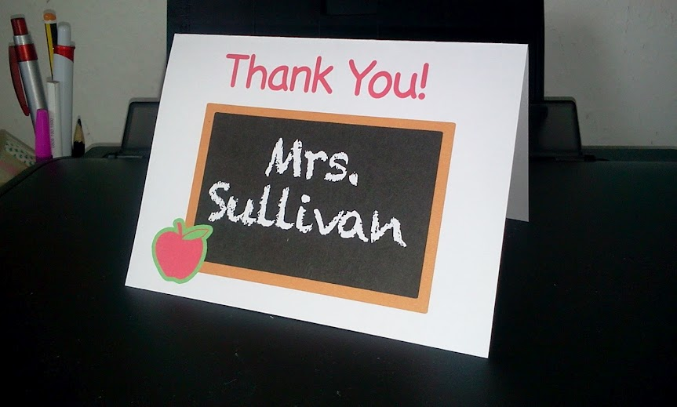
6. Say “Thank You” Even MORE Often!

Slide 30
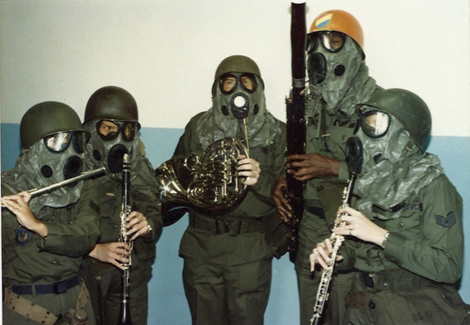
7. Recruit and Advocate 24/7

Slide 31
7. Recruit and Advocate 24/7
The Music Corner. . .

Slide 32
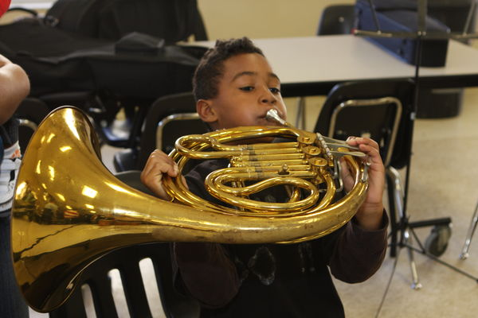
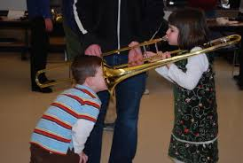
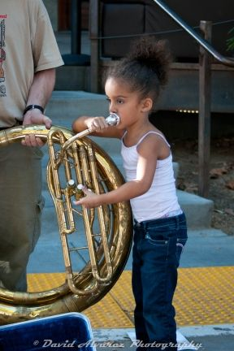
7. Recruit and Advocate 24/7
Instrument demos/petting zoos

Slide 33
7. Recruit and Advocate 24/7
Keep Informed!
Get on Twitter and start following!!!
@NAfME
@MaryLNAMM
@MusicEdConsult
@MusicAchCouncil
@EricWhitacre

Slide 34
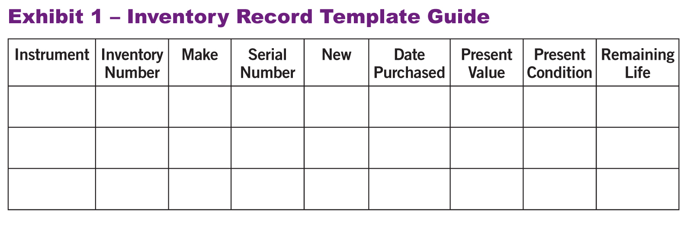
8. ALWAYS be within a 5-Year Instrument Replacement Plan
a. Evaluate the instruments/equipment. Create an Inventory Record Guide
HINT: Know your school’s Fiscal Policies!

Slide 35
5-Year Instrument Replacement Plan
b. Prioritize a list that should be replaced within 5 years. Estimate probable growth of program
c. Write up a complete 5-YEAR PLAN that begins
with a clear explanation. Provide the plan to
your supervising administrator.
Keep Your Rationale STUDENT-CENTERED
Notes:
Produced by the Music Achievement Council
35

Slide 36
5-Year Instrument Replacement Plan
Sample Forms to Use to Develop Your Plan. . .

Slide 37
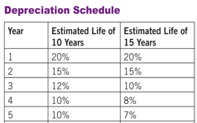
5-Year Instrument Replacement Plan
d. Maintain a Depreciation Chart.

Slide 38
9. Arrange for a performance for the principal’s meeting, school board, city council, state legislature, etc. They will appreciate the “good news” for a change.
BE READY AND PERFORM WELL!!!!
10. Create a website and communicate, communicate, communicate. Share the GOOD NEWS!!!!

Slide 39
11. Come up with a clever version of a “Happy Birthday” song to serenade your school staff on their special day. THEY WILL LOVE YOU FOR IT! Give away FREEBIES!
Insert Serenade Photo

Slide 40
12. Remember. . .Your principal needs YOU!
Be an active, involved member of the faculty.
Take part in as many school activities as you can.
Volunteer to help out when needed.
Organize faculty functions, school food drives, etc. (at least one each semester)
Ask how you/your program can help build school spirit.
Students, parents, faculty, and your administrators will see YOU as a LEADER – something that comes naturally to you.

Slide 41
10 Leadership Truths from “Dr. Tim”
(From: Leadership, Vision, Commitment, Action)
1. If you let other people do it for you, they will do it to you.
2. The harder I work, the luckier I get.
3. 99% responsibility doesn’t work.
4. Yesterday was the deadline for all complaints.
5. Good leaders are scarce so I’m following myself.
6. The things that come to those who wait,
may be the things left by those who get there first.

Slide 42
11 Leadership Truths from “Dr. Tim”
(From: Leadership, Vision, Commitment, Action)
7. There is no growth without discontent.
8. We move toward what we picture in our minds.
9. People who believe things can’t be done will go
out and prove they are right!
10. Real leaders are the cause, NOT the effect.

Slide 43
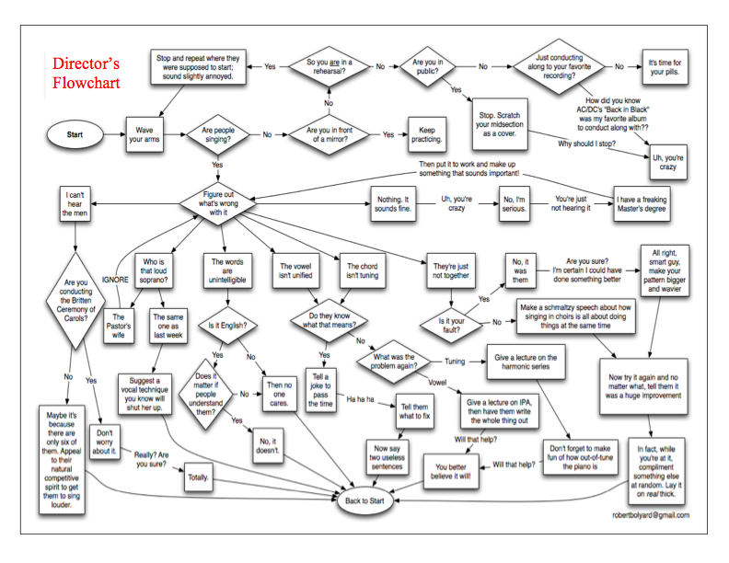
How Can I Do It All?

Slide 44
Stay Focused
on the “Why!”
We are ALL in this
for the Kids!

Slide 45
Music and Arts Education
Even though it’s
Even though it’s
Even though it’s a
IMPORTANT!
THE LAW!
CORE SUBJECT!
It’s STILL. . .
Notes:
45

Slide 46
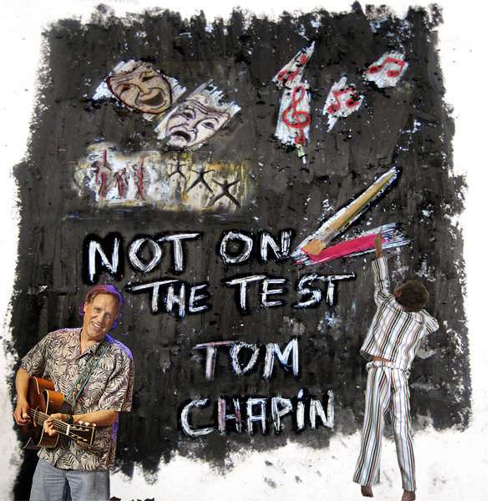

Slide 48
Thank You!
Contact Information:
marcia@musicedconsultants.net
@MusicEdConsult on Twitter
www.musiceducationconsultants.net
www.musicedconsultants.net/conference-materials

Slide 49
Thank You!
Contact Information:
marcia@musicedconsultants.net
@MusicEdConsult on Twitter
www.musiceducationconsultants.net
www.musicedconsultants.net/conference-materials

Slide 50
Thank You!
Contact Information:
marcia@musicedconsultants.net
@MusicEdConsult on Twitter
www.musiceducationconsultants.net
www.musicedconsultants.net/conference-materials

Slide 51
5. Be a Faculty Leader

