Slide 1
2015 IMEA
January 16, 2015
Bridging the Gap Between
Middle School and High School

Slide 2
Today’s Session:
WE WANT (TO KEEP) YOU!
The WHAT
The WHY
The HOW

Slide 3
WHAT Other Teachers Think I Do!

Slide 4
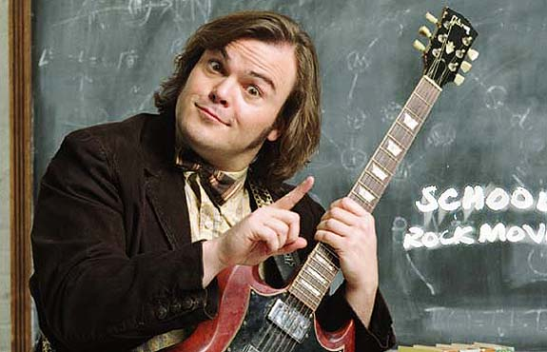
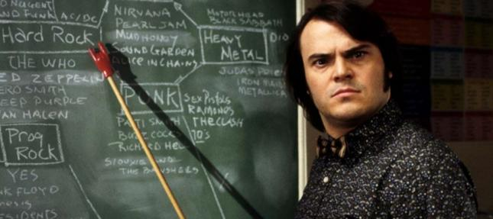
WHAT the Kids Think I Do!

Slide 5
WHAT Society Thinks I Do!

Slide 6
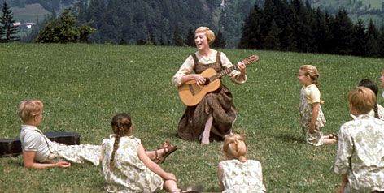
WHAT My Mom Thinks I Do!

Slide 7
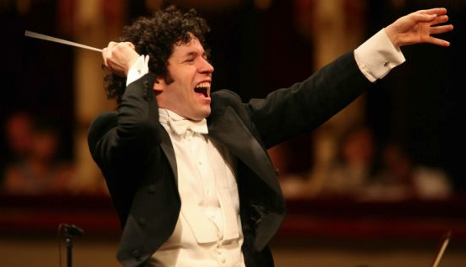
WHAT I Think I Do!

Slide 8
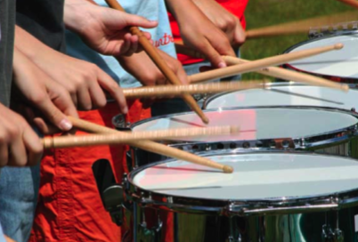
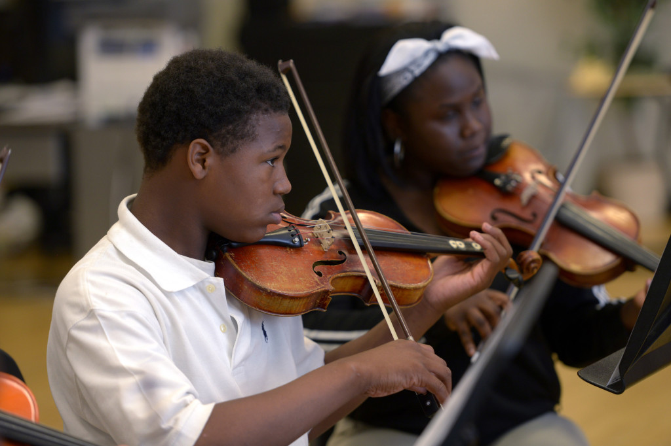
WHAT I Really Get to Do!
Give Kids Opportunities to Succeed

Slide 9
The WHY RECENT FINDINGS
Prelude:
Music Makes Us Baseline Research Report
http://musicmakesus.org/resources/research

Slide 10
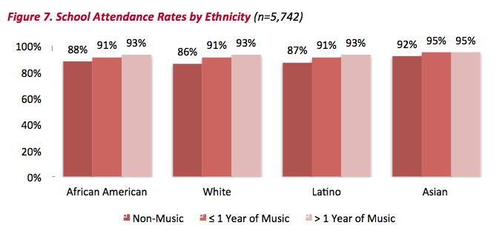
The WHY THE VERY LATEST FINDINGS
http://musicmakesus.org/resources/research

Slide 11
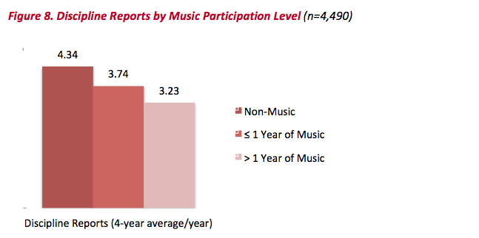
The WHY THE VERY LATEST FINDINGS
http://musicmakesus.org/resources/research

Slide 12
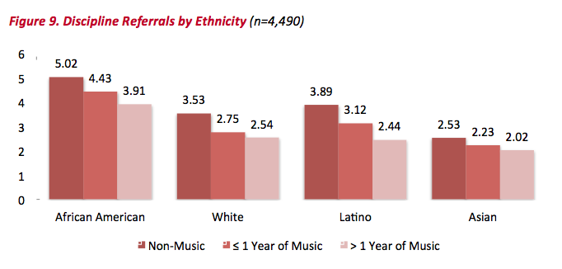
The WHY THE VERY LATEST FINDINGS
http://musicmakesus.org/resources/research

Slide 13
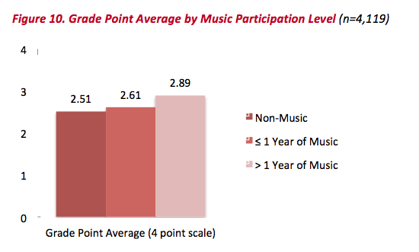
The WHY THE VERY LATEST FINDINGS
http://musicmakesus.org/resources/research

Slide 14
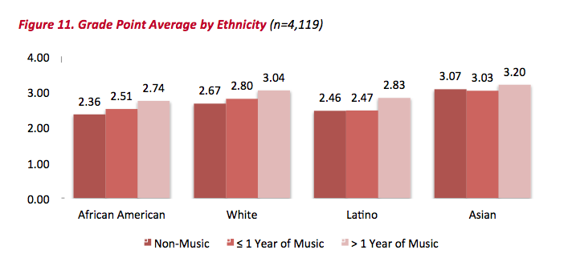
The WHY THE VERY LATEST FINDINGS
http://musicmakesus.org/resources/research

Slide 15
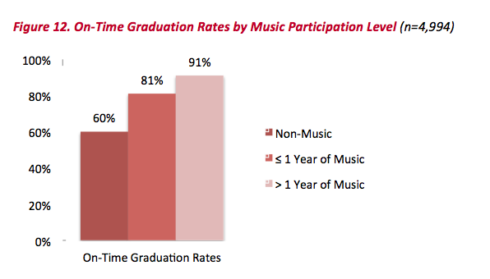
The WHY THE VERY LATEST FINDINGS
http://musicmakesus.org/resources/research

Slide 16
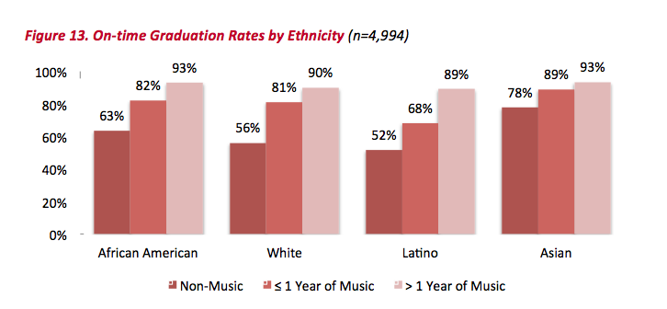
The WHY THE VERY LATEST FINDINGS
http://musicmakesus.org/resources/research

Slide 17
The WHY SUMMARY: What Was Learned?
“The more a student participates
in music, the more positive
these benefits become.”
http://musicmakesus.org/resources/research

Slide 18
The HOW STRATEGIES TO BRIDGE THE GAP

Slide 19
The HOW STRATEGIES TO BRIDGE THE GAP
What HS/MS Directors Can Do
What HS/MS Parents Can Do
What HS/MS Students Can Do
What HS/MS Principals Can Do
What Music Supervisors Can Do

Slide 20
The HOW STRATEGIES TO BRIDGE THE GAP
What HS/MS Directors Can Do:
Work as a team with all elementary/middle
school directors with one goal. . .
To ensure continued,
active music-making.
Build the vision EARLY – ELEMENTARY!

Slide 21
The HOW Build the vision EARLY – ELEMENTARY!

Slide 22
The HOW Build the vision EARLY—ELEMENTARY!
1. Show up – Be visible – For everything!
2. Invite Elementary Band to Halftime

Slide 23
The HOW Build the vision EARLY—ELEMENTARY!
1. Show up – Be visible – For everything!
2. Invite Elementary Band to Halftime

Slide 24
The HOW Build the vision EARLY—ELEMENTARY!
1. Show up – Be visible – For everything!
2. Invite Elementary Band to Halftime
3. Schedule a “Switch Day”

Slide 25
The HOW Build the vision EARLY—ELEMENTARY!
1. Show up – Be visible – For everything!
2. Invite Elementary Band to Halftime
3. Schedule a “Switch Day”
4. Engage parents EARLY!

Slide 26
The HOW Engage Parents EARLY—The Parent Band!

Slide 27
The HOW
What HS/MS Parents Can Do:
1. Schedule a VIP Parent Night at a joint concert/halftime show performance
2. Facilitate events and activities
3. Host MS parent meetings at the high school
4. Mentor parent leaders of feeder programs

Slide 28
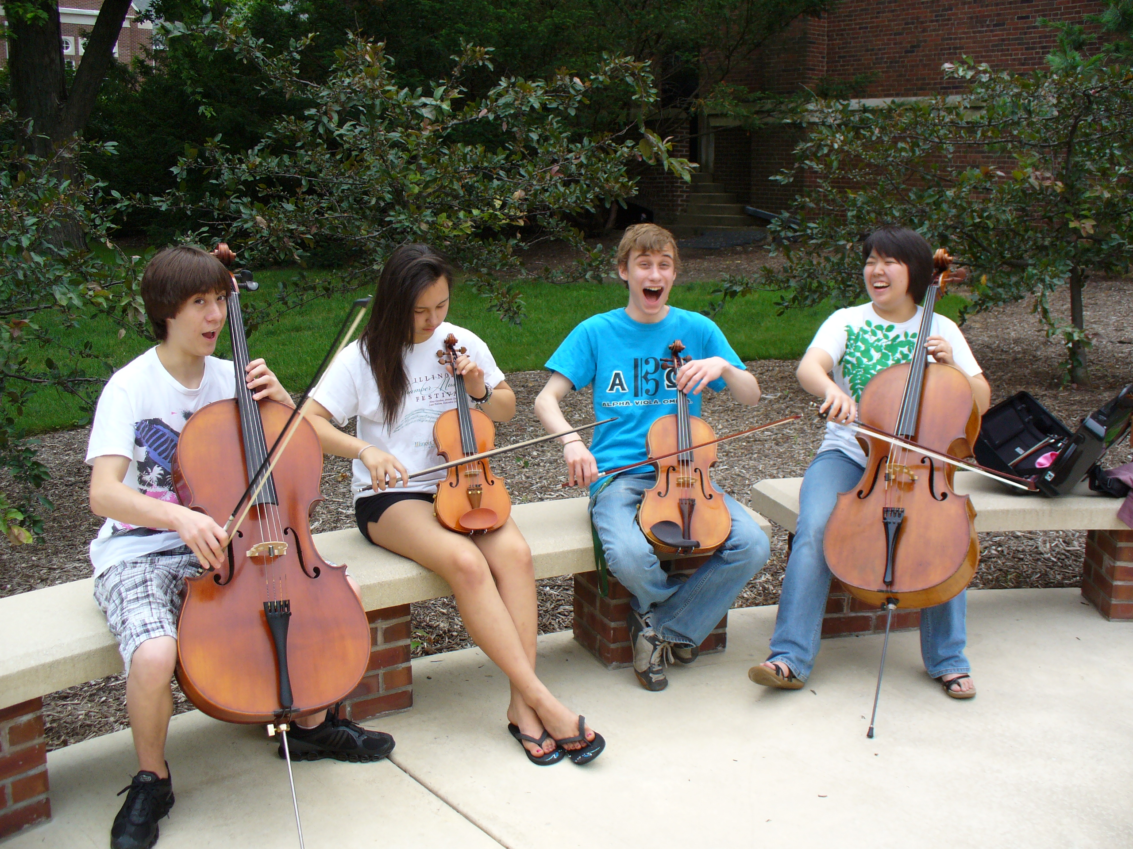
The HOW
What HS/MS Students Can Do:
1. Serve as “Intern Instructors” for Summer
Lesson Program for beginning students

Slide 29
The HOW What HS/MS Students Can Do:
2. Participate ACTIVELY in ALL recruitment efforts – give “testimonials”
1. Serve as “Intern Instructors” for Summer
Lesson Program for beginning students

Slide 30
The HOW Give “testimonials”

Slide 31
The HOW What HS/MS Students Can Do:
1. Serve as “Intern Instructors” for Summer
Lesson Program for beginning students
2. Participate ACTIVELY in ALL recruitment efforts – give “testimonials”
3. Remain engaged with former programs

Slide 32
The HOW What HS/MS Students Can Do:
1. Serve as “Intern Instructors” for Summer
Lesson Program for beginning students
2. Participate ACTIVELY in ALL recruitment efforts – give “testimonials”
3. Remain engaged with former programs
4. Write letters of invitation (Big Bro/Sis)

Slide 33
The HOW What HS/MS Principals Can Do:
1. Help facilitate recruitment assemblies/ events/activities at feeder schools
2. Work with feeder principals on scheduling
3. Create joint presentation for feeder parents
4. Provide opening remarks at each other’s concerts

Slide 34
The HOW What Music Supervisors Can Do:
1. Ensure that faculty sees itself as part of
one, K – 12 Music Program
2. Track articulation data
3. Provide sample high school schedules
4. Provide students with quality learning experiences

Slide 35
Check Out MAC
Online Resources
www.musicachievementcouncil.org

Slide 36
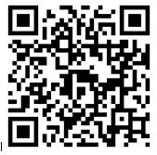
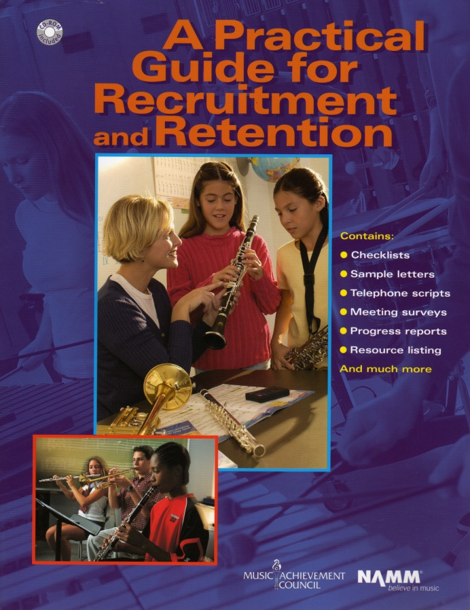
Got SMART Phone?
www.musicachievementcouncil.org

Slide 37
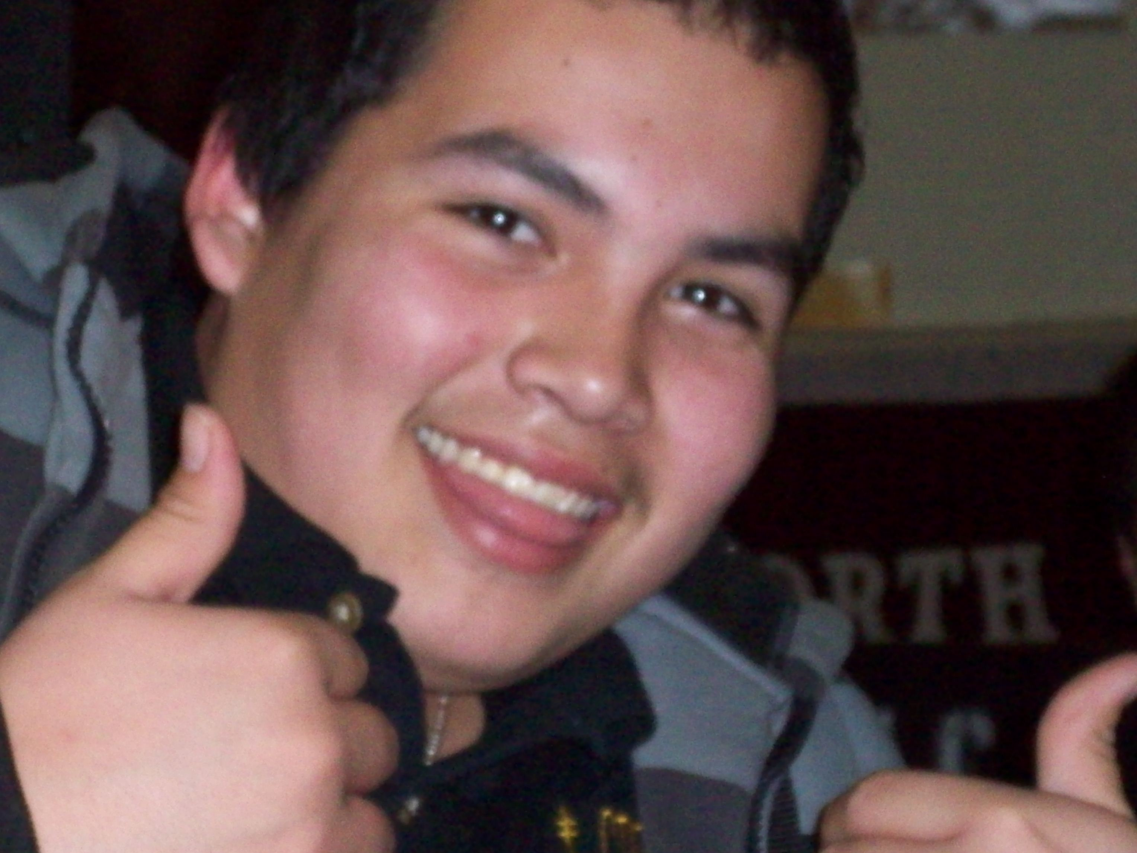
It’s True. . .
If You Build It. . .They Will Come!
A
N
D
S
T
A
Y

Slide 38
Thanks to the Music Achievement Council and These Quality Companies!

Slide 39
Thanks to the Music Achievement Council and These Quality Companies!

