Slide 1
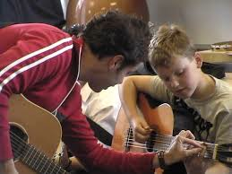
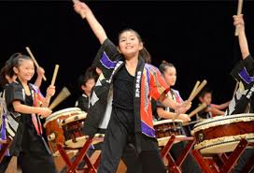
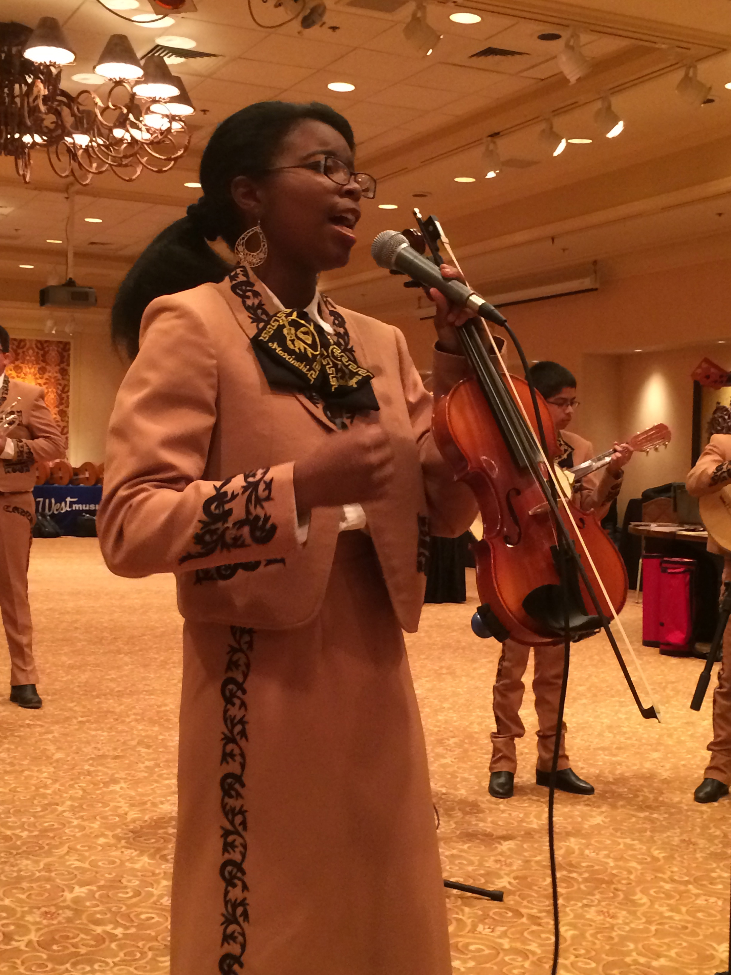
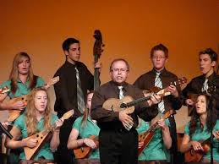
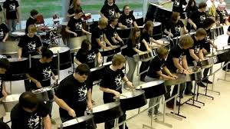
The New National Music Standards
Emerging Ensembles
Marcia Neel
Eastern Division Conference
April 10, 2015

Slide 2
The WHY. . .
Meet Dorothy Custer

Slide 3
Jay McTighe and Grant Wiggins
Understanding by Design (UbD)
Backwards Design: Identify outcomes then design goals.
Backwards Assessment Model (BAM)
Defining Arts Literacy
Using Artistic Processes (4)
and Anchor Standards (11)
Identifying Creative Practices
Specifying Enduring Understandings and Essential Questions
Embedding Assessments

Slide 4
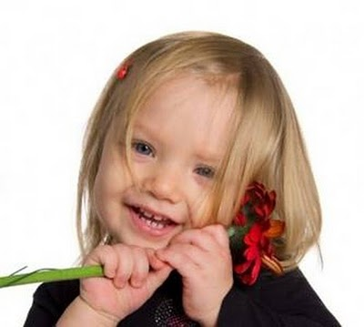
Defining Arts Literacy
Artistic literacy is the knowledge and understanding required to participate authentically in the arts.
Fluency in the language(s) of the arts is the ability to create, perform/produce/present, respond, and connect through symbolic and metaphoric forms that are unique to the arts.
An artistically literate person can transfer arts knowledge, skills, and capacities to other subjects, settings, and contexts.
BUT. . .
Artistic literacy is not limited to arts history and appreciation
courses, but should include art-making experiences that can
lead to a satisfying lifetime of active and creative practices.

Slide 5
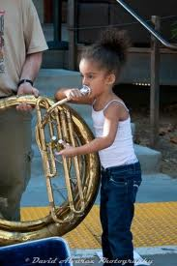
Arts Success and Achievement
through Creative Practices
Success and achievement in the arts demands engagement in the four fundamental creative practices of imagination, investigation, construction, and reflection in multiple contexts.
These meta-cognitive activities nurture the effective work habits of curiosity, creativity and innovation, critical thinking and problem solving, communication, and collaboration, each of which transfer to all aspects of learning and life in the 21st century.
--------------------- Oops! I mean, 22nd century!!!

Slide 6
Specifying Enduring Understandings and Essential Questions
Enduring understandings and essential questions focus on what are often called “big ideas.” E.U. statements summarize important ideas that are central to a discipline and have lasting value beyond the classroom.
Essential questions are those that encourage, hint at, even demand transfer beyond the particular topic in which students first encounter them, and therefore, should recur over the years to promote conceptual connections and curriculum coherence.

Slide 7
Cornerstone (Embedded) Assessments
• are curriculum embedded (as opposed to externally imposed); • recur over the grades, becoming increasingly sophisticated
over time;
• establish authentic contexts for performance; • assess understanding and transfer via genuine performance; • integrate 21st century skills (e.g., critical thinking,
technology use, teamwork) with subject area content; • evaluate performance with established rubrics;
• engage students in meaningful learning while encouraging
the best teaching; • provide content for a student’s portfolio (so that they
graduate with a resume of demonstrated accomplishments rather
than simply a transcript of courses taken).

Slide 8
Artistic Processes and Anchor Standards
1. Creating: Conceiving and
Developing New Artistic
Ideas and Work

Slide 9
Artistic Processes and Anchor Standards
1. Creating: Anchor Standards
Lifelong Goals
The student will. . .
Anchor Standard 1:
Generate and conceptualize artistic ideas and work.
Anchor Standard 2:
Organize and develop artistic ideas and work.
Anchor Standard 3:
Refine and complete artistic work.

Slide 10
Artistic Processes and Anchor Standards
1. Creating: Conceiving and Developing New Artistic Ideas and Work
2. Performing: Realizing Artistic Ideas and Work through Interpretation and Presentation

Slide 11
Artistic Processes and Anchor Standards
2. Performing: Anchor Standard
Lifelong Goals
The student will. . .
Anchor Standard 4:
Select, analyze, and interpret artistic work for presentation.
Anchor Standard 5:
Develop and refine artistic techniques and work
for presentation.
Anchor Standard 6:
Convey meaning through the presentation of
artistic work.

Slide 12
Artistic Processes and Anchor Standards
1. Creating: Conceiving and Developing New Artistic Ideas and Work
2. Performing: Realizing Artistic Ideas and Work Through
Interpretation and Presentation
3. Responding: Understanding and Evaluating how “The Arts” Convey Meaning

Slide 13
Artistic Processes and Anchor Standards
3. Responding: Anchor Standards
Lifelong Goals
The student will. . .
Anchor Standard 7:
Perceive and analyze artistic work.
Anchor Standard 8:
Interpret intent and meaning in artistic work.
Anchor Standard 9:
Apply criteria to evaluate artistic work.

Slide 14
Artistic Processes and Anchor Standards
1. Creating: Conceiving and Developing New Artistic Ideas and Work
2. Performing: Realizing Artistic Ideas and Work Through
Interpretation and Presentation
3. Responding: Understanding and Evaluating how the Arts
Convey Meaning
4. Connecting: Relating Artistic Ideas and Work with Personal Meaning and External Context

Slide 15
Artistic Processes and Anchor Standards
4. Connecting: Anchor Standards
Lifelong Goals
The student will. . .
Anchor Standard 10:
Synthesize and relate knowledge and personal
experiences to make art.
Anchor Standard 11:
Relate artistic ideas and works with societal, cultural,
and historical context to deepen understanding.

Slide 16
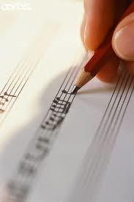
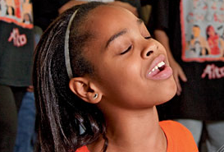
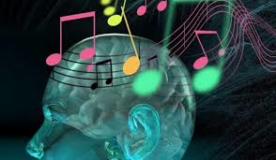
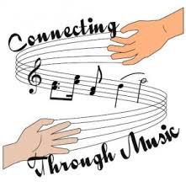
The Four (4) Artistic Processes
1. Creating: Conceiving and Developing New Artistic Ideas and Work
2. Performing: Realizing Artistic Ideas and Work Through Interpretation and Presentation
3. Responding: Understanding and Evaluating how the Arts Convey Meaning
4. Connecting: Relating Artistic Ideas
and Work with Personal Meaning
and External Context

Slide 17
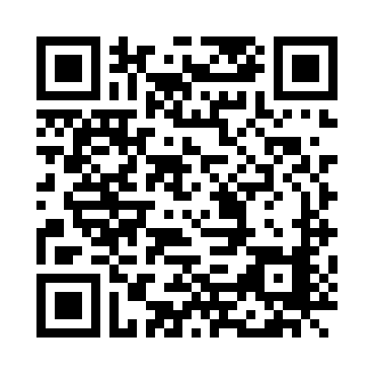
Got Smart Phone?
http://www.musicedconsultants.net/conference-materials

Slide 18
Curriculum
SAMPLE INSTRUCTIONAL GOALS: (IGs)
MARIACHI: ARMONIA (Guitar, Vihuela, and Guitarrón)
Instructional Goals (IGs): Some sample goals are :
1. To develop correct vocal production technique.
10. To recognize form in simple Mariachi styles through
listening to recordings and live performances.
13. To incorporate the traditional mánicos used in simple
Mariachi styles into live performances.
19. To demonstrate an awareness of the regional and
historical significance and variations of Mariachi music.
http://www.musicedconsultants.net/conference-materials

Slide 19
Curriculum
SAMPLE GOAL: VOCAL PRODUCTION
Instructional Goal (IG): The goal is:
1. To develop correct vocal production technique
http://www.musicedconsultants.net/conference-materials

Slide 20
Curriculum
SAMPLE GOAL: VOCAL PRODUCTION
1. To develop correct vocal production technique
1.1 The student will demonstrate proper breathing
techniques necessary for supporting tone. (IG1)_____
Artistic Process?
(Pr)
BUT. . .
How do we assess this skill?
http://www.musicedconsultants.net/conference-materials

Slide 21
Curriculum
SAMPLE GOAL: VOCAL PRODUCTION
1. To develop correct vocal production technique
1.1 The student will demonstrate proper breathing
techniques necessary for supporting tone. (IG1)_____
(Pr)
1.1. A Have students take an “air sip” using “oo” vowel
embouchure over slow 4 count, exhaling over slow 8
count demonstrating proper upper body posture
throughout (Assessment)
Now YOU try writing an assessment for this IG.
http://www.musicedconsultants.net/conference-materials

Slide 22
Curriculum
SAMPLE GOAL: VOCAL PRODUCTION
1. To develop correct vocal production technique
1.1 The student will demonstrate proper breathing
techniques necessary for supporting tone. (IG1)_____
(Pr)
1.1. A Have students take an “air sip” using “oo” vowel
embouchure over slow 4 count, exhaling over slow 8
count demonstrating proper upper body posture
throughout (Assessment)
1.1. B Have students take an “air sip” then blow out short
puffs demonstrating awareness of abdominal muscles
involved in breathing. (Assessment)
http://www.musicedconsultants.net/conference-materials

Slide 23
Curriculum
SAMPLE GOALS: SIMPLE MARIACHI STYLES (FORM)
Instructional Goals (IGs): The sample goals are:
10. To recognize simple Mariachi styles by
listening to recordings and live performances.
13. To incorporate the traditional mánicos used in simple
Mariachi styles into live performances.
19. To demonstrate an awareness of the regional and
historical significance and variations of Mariachi music.
X.1 The student will identify Ranchera Lenta (a.k.a. Romantica) style
(IGs 10, 13, 19)
http://www.musicedconsultants.net/conference-materials

Slide 24
Ranchera Lenta Style
4/4 Time Signature Mánico: Down Strums
Mostly Major Keys Golpe Strum
HINT: Have students speak text in rhythm before playing.

Slide 25
Bailey Middle School, Year 2 of Program
“El Rey” Ranchera Lenta (a.k.a. Romantica) Style
4/4 Time Signature Mánico: Down Strums
Mostly Major Keys Golpe Strum

Slide 26
Curriculum
SAMPLE GOALS: SIMPLE MARIACHI STYLES (FORM)
10.1 X.1 The student will identify Ranchera Lenta (a.k.a. Romantica) style (IGs 10, 13, 19) ________________ Artistic Processes?
(Cr) (Pr) (Re) (Cn)
10. To recognize simple Mariachi styles by
listening to recordings and live performances.
13. To incorporate the traditional mánicos used in simple
Mariachi styles into live performances.
19. To demonstrate an awareness of the regional and historical
significance and variations of Mariachi music.
http://www.musicedconsultants.net/conference-materials

Slide 27
Curriculum
SAMPLE GOALS: SIMPLE MARIACHI STYLES (FORM)
X.1 The student will identify Ranchera Lenta (a.k.a. Romantica) style
(IGs 10, 13, 19)
(Cr) (Pr) (Re) (Cn)
X.1.A Ask students to compose a simple song in the style of
a Ranchera Lenta using the I, IV and V7 chords
of Re Major. (Create)
X.1.B Have students perform selections in the Ranchera
Lenta style. (Perform)
http://www.musicedconsultants.net/conference-materials

Slide 28
Curriculum
SAMPLE GOALS: SIMPLE MARIACHI STYLES (FORM)
X.1 The student will identify Ranchera Lenta (Romantica)
style. (IGs 10, 13, 19)
(Cr) (Pr) (Re) (Cn)
X.1.C Have students listen to or view recorded
performances of like Ranchera Lentas then
describe the various differences in the recordings using correct terminology. (Respond)
X.1.D Have students explain the derivation of the Ranchera
Lenta style and its significance (Connecting)
(from the ranch—cowboy songs, love songs)

Slide 29
Next Stop: Performance Standards in Music
Performance
Standards
11
Anchor
Standards
4
Artistic
Processes

Slide 30
Performance Standards: Creating
Google: (Traditional and) Emerging Ensembles Strand

Slide 31
Performance Standards: Performing
Google: (Traditional and) Emerging Ensembles Strand

Slide 32
Performance Standards: Responding
Google: (Traditional and) Emerging Ensembles Strand

Slide 33
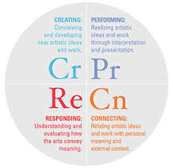
Performance Standards: Connecting
Google: (Traditional and) Emerging Ensembles Strand

Slide 34
EXAMPLE: Performance Standards
Artistic Process: Creating (Cr)
Anchor Standard 1:
Generate and conceptualize artistic ideas and work.
Enduring Understanding:
The creative ideas, concepts, and
feelings that influence musicians’ work
emerge from a variety of sources.
Essential Question:
How do musicians generate creative ideas?

Slide 35
EXAMPLE: Performance Standards
Artistic Process: Creating (Cr)
Performance
Standard #
Anchor Standard 1:
Generate and conceptualize
artistic ideas and work.
Anchor
Standard #
Ensemble
Strand
Novice: MU:CR.1.1.E.5
Compose and improvise melodic and rhythmic ideas or motives that
reflect characteristics(s) of music or text(s) studied in rehearsal.
Grade
Enduring Understanding:
The creative ideas, concepts,
and feelings that influence musicians’ work emerge
from a variety of sources.
Vocabulary
(in Glossary)
What changed
Intermediate: MU:CR.1.1.E.8
Compose and improvise ideas for melodies and rhythmic passages based on characteristic(s) of music or text(s) studied in rehearsal.
Essential Question:
How do musicians generate creative ideas?

Slide 36
EXAMPLE: Performance Standards
Artistic Process: Creating (Cr)
HS Proficient: MU:CR1.1.E.I
Compose and improvise ideas for melodies, rhythmic passages, and arrangements for specific purposes that reflect characteristic(s) of music from a variety of historical periods studied in rehearsal.
Anchor Standard 1:
Generate and conceptualize
artistic ideas and work.
Enduring Understanding:
The creative ideas, concepts,
and feelings that influence musicians’ work emerge
from a variety of sources.
HS Accomplished: MU:CR1.1.E.II
Compose and improvise ideas for arrangements, sections, and short compositions for specific purposes that reflect characteristic(s) of music from a variety of cultures studied in rehearsal.
Essential Question:
How do musicians generate creative ideas?
HS Advanced: MU:CR1.1.E.III
Compose and improvise musical ideas for a variety of purposes and contexts.

Slide 37
Model Cornerstone Assessments
McTighe “Evaluate performance with established rubrics”

Slide 38
Model Cornerstone Assessments
McTighe “Evaluate performance with established rubrics”

Slide 39
Model Cornerstone Assessments
McTighe “Evaluate performance with established rubrics”

Slide 40
Google

Slide 41
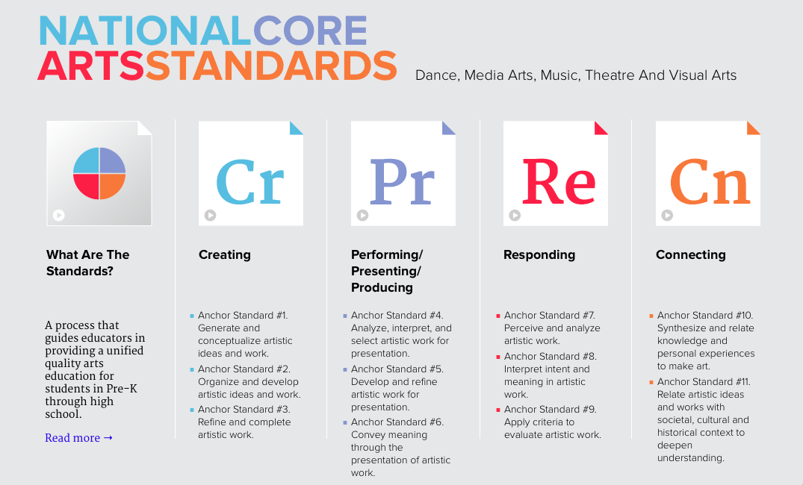
www.nationalartsstandards.org
http://www.musicedconsultants.net/conference-materials

Slide 42
Back to Dorothy Custer…
http://www.musicedconsultants.net/conference-materials

Slide 43
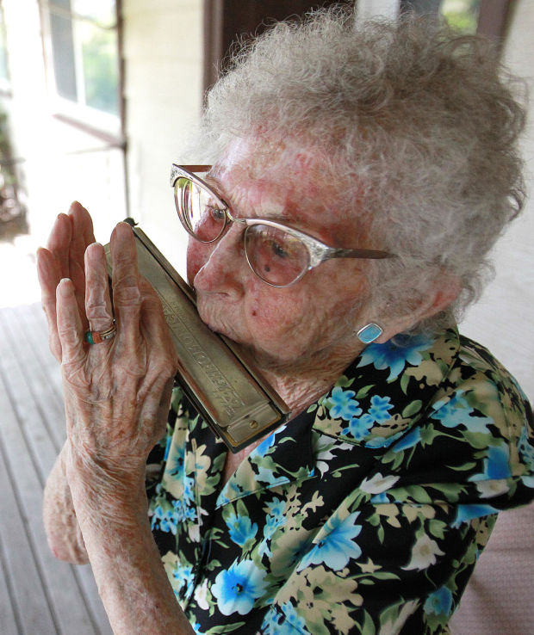
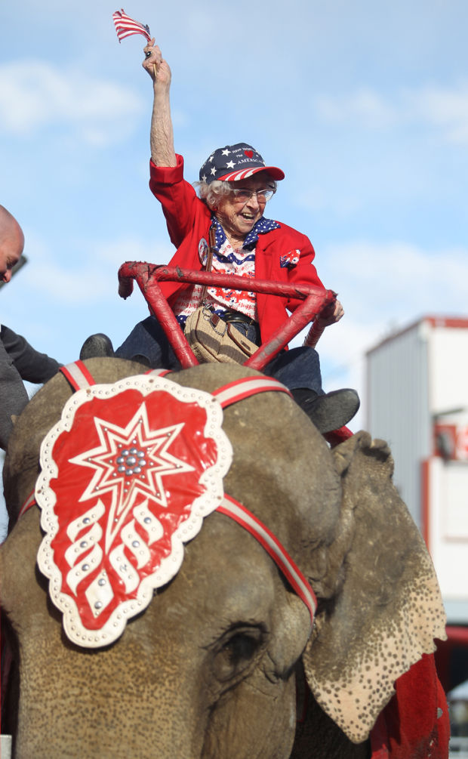
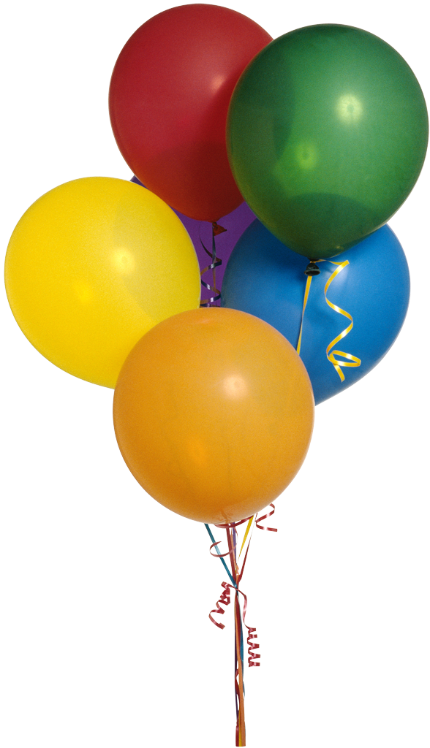
Happy 103rd Birthday, Dorothy!

Slide 44
Resource Info
http://nafme.org/standards
This Presentation:
http://www.musicedconsultants.net/conference-materials
Marcia Neel
marcia@musicedconsultants.net
Twitter: @musicedconsult
Join us in Las Vegas for Mariachi!
www.musicedconsults.net/2015-mariachi-workshops

