Slide 1
2016 #TBDW
“One is Too Small a Number to Achieve Something Great”
July 28, 2016
marcia@musicedconsultants.net
www.musiceducationconsultants.net/conference-materials

Slide 2
School is. . .
Impressionistic
vs
Expressionistic
Music is. . .

Slide 3
Expressionistic

Slide 4
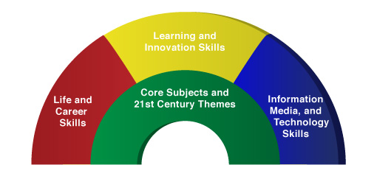
A focus on these 5 C’s is essential
to prepare students for their future.
Critical Thinking
Communication
Collaboration
Creativity
Confidence
Therefore. . .

Slide 5
The Music Skills Practice Room is. . .
The Life Skills Practice Room
How does music create MORE than music and how does it all comes together to create something GREAT?

Slide 6
The Music Skills Practice Room is. . .
The Life Skills Practice Room
1. Critical Thinking. . .
Ability to reason effectively and solve
problems and analyze how parts
of a whole interact with each other to produce overall outcomes in complex systems.

Slide 7
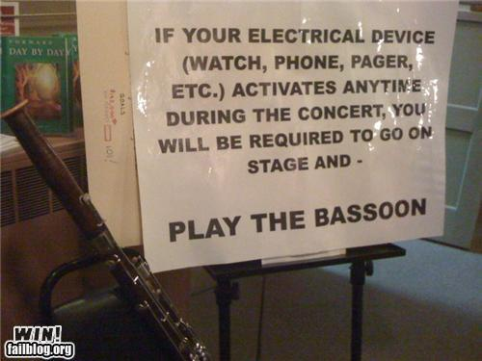
The Music Skills Practice Room is. . .
The Life Skills Practice Room
Solve Problems
EX: Having a problem getting
people to turn off their phones and
beepers at your concerts? One teacher
challenged his students to come up
with the solution. Here it is. . .

Slide 8
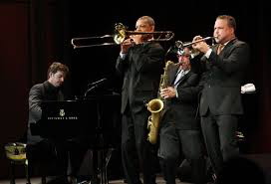
The Music Skills Practice Room is. . .
The Life Skills Practice Room
Problem Solvers:
Harry Connick, Jr.

Slide 9
The Music Skills Practice Room is. . .
The Life Skills Practice Room
Problem Solvers:
Harry Connick, Jr. holds a
patent for a digital sheet
music, touch-screen system
that coordinates musical
displays for musicians in
an orchestra. No need to
print revised parts!

Slide 10
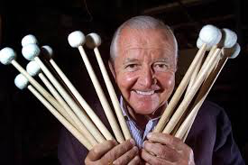
The Music Skills Practice Room is. . .
The Life Skills Practice Room
Problem Solvers:
Vic Firth

Slide 11
The Music Skills Practice Room is. . .
The Life Skills Practice Room
Problem Solvers:
Vic Firth was inspired to design a higher-quality mallet than the “warped utensils and implements not specifically designed
for percussionists” while
playing timpani with the
Boston Symphony Orchestra.

Slide 12
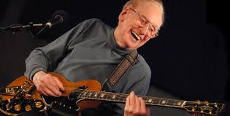
The Music Skills Practice Room is. . .
The Life Skills Practice Room
Problem Solvers:
Les Paul

Slide 13
The Music Skills Practice Room is. . .
The Life Skills Practice Room
Problem Solvers:
Les Paul invented the solid body guitar because his audience at a BBQ joint couldn’t hear him play.

Slide 14
The Music Skills Practice Room is. . .
The Life Skills Practice Room
EXAMPLE: Ability to analyze how parts
of a whole interact with each other to produce overall outcomes in complex systems.
See how this creative young man used this concept to produce a remarkable outcome!

Slide 15
The Music Skills Practice Room is. . .
The Life Skills Practice Room
JEFFREY DING - Produce overall outcomes

Slide 16
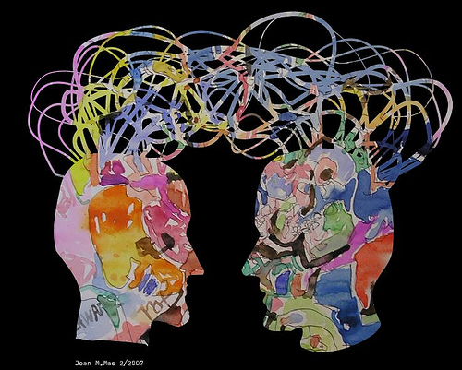
The Music Skills Practice Room is. . .
The Life Skills Practice Room
2. Communication. . .
Ability to listen
effectively
Ability to express
thoughts effectively
with others –
both verbally and non-verbally
Have you tried Result-driven Communication?

Slide 17
The Music Skills Practice Room is. . .
The Life Skills Practice Room
Result-driven Communication: Listening and
communicating effectively will guarantee success!

Slide 18
The Music Skills Practice Room is. . .
The Life Skills Practice Room
3. Collaboration (Teamwork). . .
Ability to work effectively and respectfully
with ALL

Slide 19
The Music Skills Practice Room is. . .
The Life Skills Practice Room
Teamwork: EFFECTIVE when EVERYONE does their job.

Slide 20
The Music Skills Practice Room is. . .
The Life Skills Practice Room
Creativity (Innovation). . .
Ability to create new and more worthwhile ideas and to work creatively with others.

Slide 21
The Music Skills Practice Room is. . .
The Life Skills Practice Room
(Innovation): Ability to think and work creatively with others
OSU Video

Slide 22
The Music Skills Practice Room is. . .
The Life Skills Practice Room
5. Confidence. . .
Ability to handle EVERY CIRCUMSTANCE
and grow from it!

Slide 23
The Music Skills Practice Room is. . .
The Life Skills Practice Room
Confidence: Ability to handle EVERY CIRCUMSTANCE

Slide 24
but. . .
“ONE IS TOO SMALL A
NUMBER TO ACHIEVE IT ALL”
SOOOOOO. . .
HOW CAN WE ALL WORK
TOGETHER?
Parents
Teachers
Principals
Custodians
Support Staff
Community

Slide 25
Get EVERYONE on the Same Page
One Goal:
To ensure continued,
active music-making
for all.

Slide 26
Active music-making for all.
Bailey Middle School

Slide 27
What Makes Our Programs Special?
Do We C.A.R.E.?
With GREAT THANKS to Dr. Tim!
C: REAL Communication
Do we encourage one another to reach out to each other?
Do harmony and balance apply to more than great music-making?

Slide 28
What Makes Our Programs Special?
Do We C.A.R.E.?
A: Attitude
Do we generate the proper attitude?
Does our attitude play a crucial role in the outcome of the program’s success?

Slide 29
What Makes Our Programs Special?
Do We C.A.R.E.?
R: Responsibility
Do we come together ready to invest energy for ongoing growth and development of our goals?
Do we respond to each other in a fashion that will advance the entire program to the next level?

Slide 30
What Makes Our Programs Special?
Do We C.A.R.E.?
E: Excellence
Do we reflect a sense of excellence to go beyond the basic requirements -- to put forth extra effort?

Slide 31
“We either hang together, or
we hang separately” . . . Ben Franklin
When ALL of the people involved in a music program decide to unselfishly GIVE, it’s THEN that we realize the true value of the program --
a gathering of wonderful people who genuinely C.A.R.E. for one another.
. . . Tim Lautzenheiser

Slide 32
After all, doesn’t he deserve our very best?
Joey Alexander

Slide 33
Thank You!

