Slide 1
DID YOU KNOW . . .
The Music Achievement Council (MAC) is an action-oriented, non-profit organization whose sole
purpose is to enable more students to begin and continue in instrumental music programs.
www.musicachievementcouncil.org

Slide 2
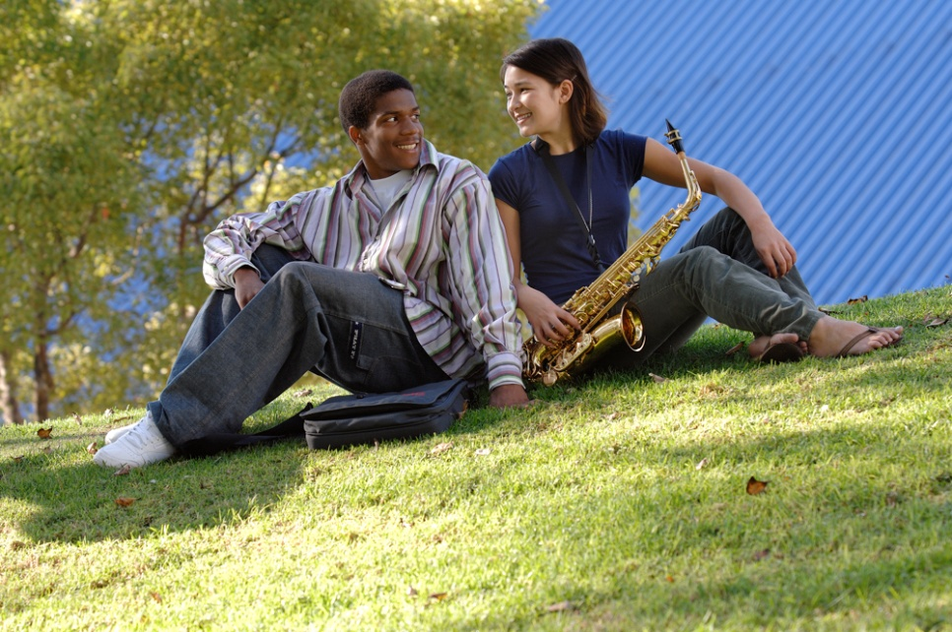
DID YOU KNOW . . .
96 percent of public school principals
believe that participating in music
education encourages and motivates
students to stay in school longer.
(Harris Poll)
www.musicachievementcouncil.org

Slide 3
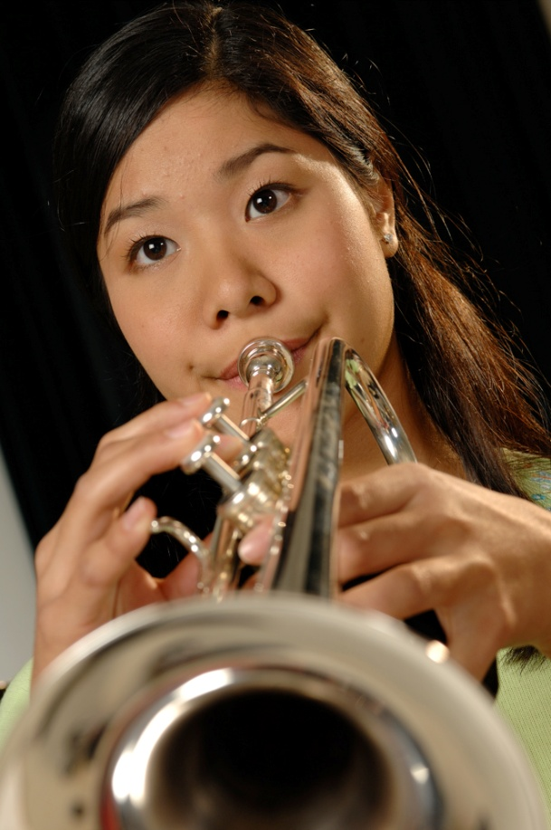
DID YOU KNOW . . .
An interactive poll confirms that music education at an early age greatly increases the likelihood that a child will grow up to seek higher education and ultimately even earn a higher salary. (2007 Harris Poll)
www.musicachievementcouncil.org

Slide 4
THE MESSAGE IS. . .
If you want to be a CEO, College President, or
even a Rock Star,
TAKE MUSIC!
www.musicachievementcouncil.org

Slide 5
THE MESSAGE IS. . .
If you want to be a CEO, College President, or
even a Rock Star,
TAKE MUSIC!
www.musicachievementcouncil.org

Slide 6
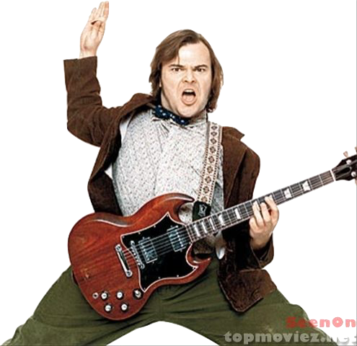
THE MESSAGE IS. . .
If you want to be a CEO, College President, or
even a Rock Star,
TAKE MUSIC!
www.musicachievementcouncil.org

Slide 7
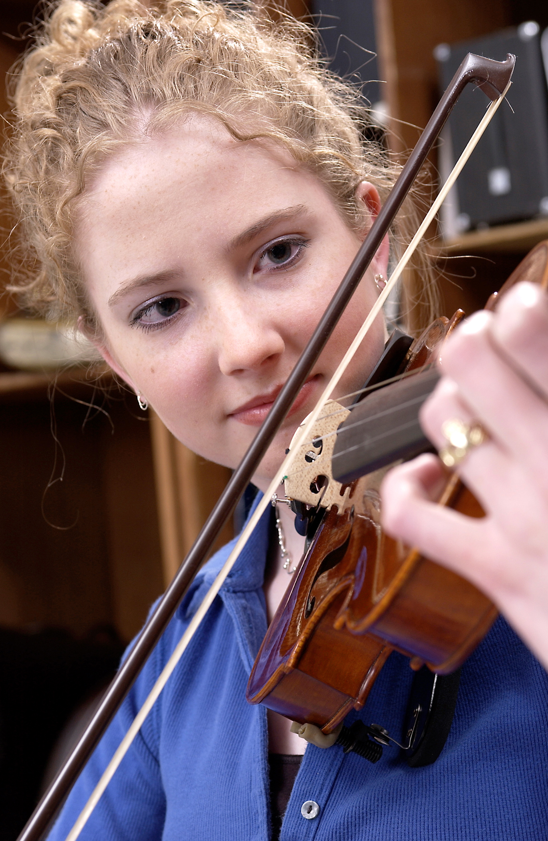
DID YOU KNOW . . .
82 percent of Americans who don’t currently play an instrument wish they had learned to play one. (Gallup Poll)
www.musicachievementcouncil.org

Slide 8
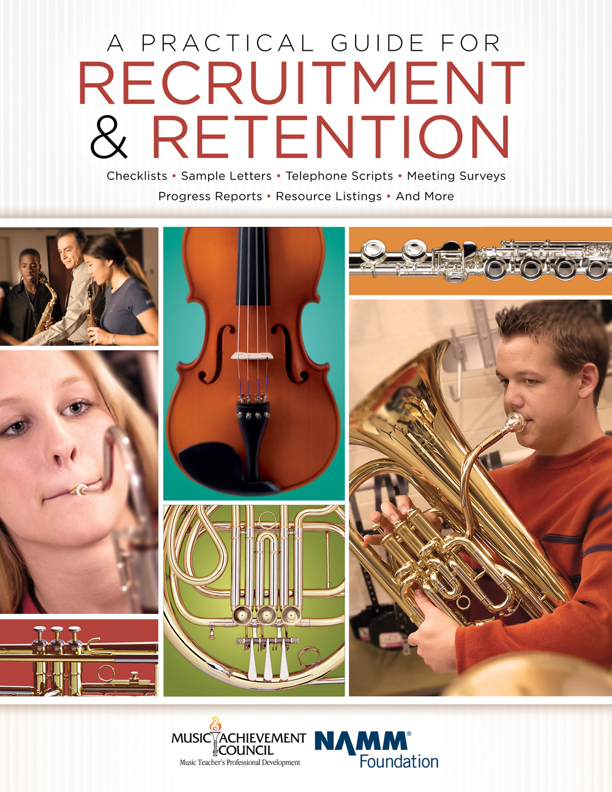
DID YOU KNOW . . .
All of today’s session attendees will receive FREE COPIES of:
A Practical Guide for Recruitment and Retention
www.musicachievementcouncil.org

Slide 9
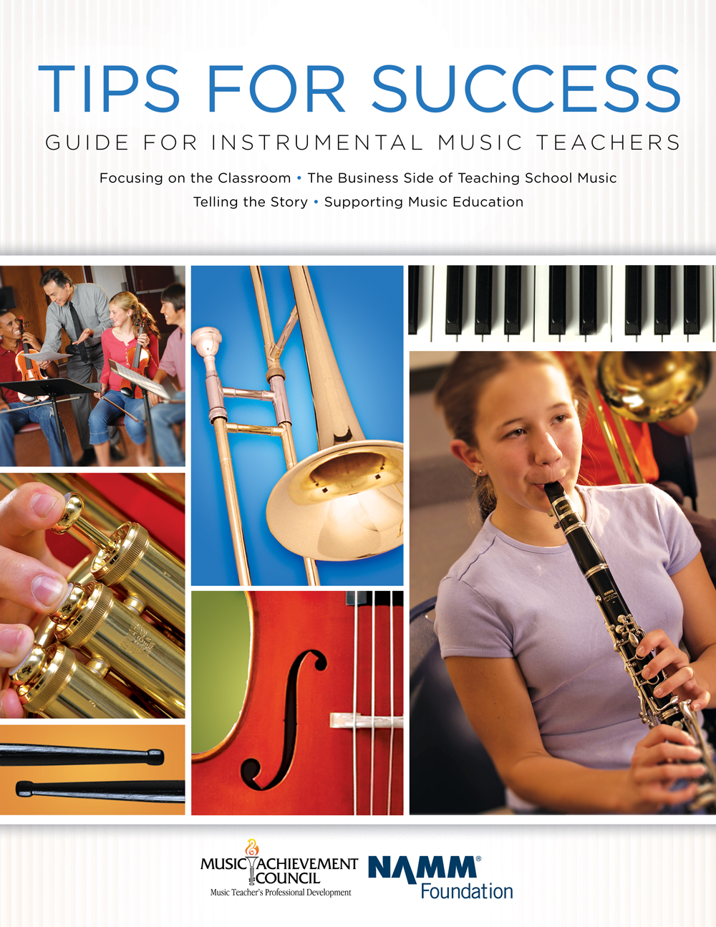
DID YOU KNOW . . .
All of today’s session attendees will receive FREE COPIES of:
Tips for Success:
A Guide for Instrumental Music Teachers
www.musicachievementcouncil.org

Slide 10
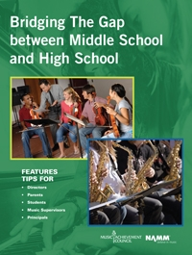
DID YOU KNOW . . .
All of today’s session attendees will receive FREE COPIES of:
Bridging the Gap between
Middle School and High School
www.musicachievementcouncil.org

Slide 11
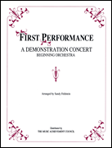
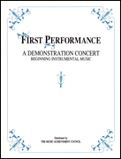
DID YOU KNOW . . .
First Performance Demo Concert for Band and/or Orchestra features sheet music, parts, sample letters, programs and student certificates for beginning ensembles. Students can perform a composition in seven short weeks with the materials provided!
www.musicachievementcouncil.org

Slide 12
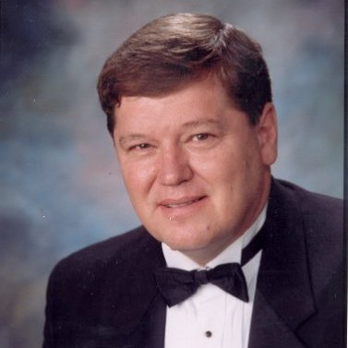
DID YOU KNOW . . .
Three of these publications are provided online at no charge by the Music Achievement Council.
They are based on real world strategies shared by the profession’s most successful music educators.
Greg Bimm

Slide 13
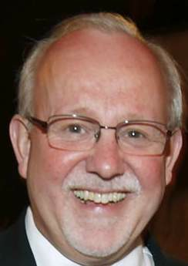
DID YOU KNOW . . .
Three of these publications are provided online at no charge by the Music Achievement Council.
They are based on real world strategies shared by the profession’s most successful music educators.
Charlie Menghini

Slide 14
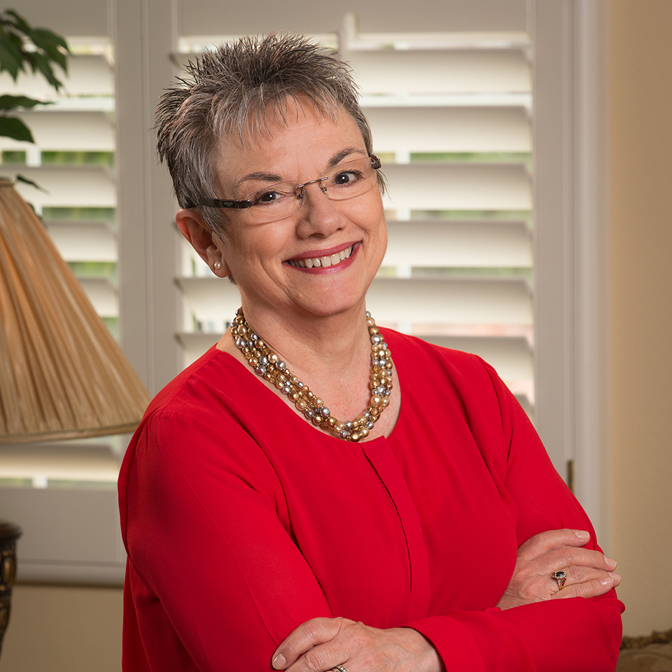
DID YOU KNOW . . .
Three of these publications are provided online at no charge by the Music Achievement Council.
They are based on real world strategies shared by the profession’s most successful music educators.
Marcia Neel

Slide 15
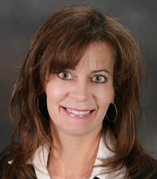
DID YOU KNOW . . .
Three of these publications are provided online at no charge by the Music Achievement Council.
They are based on real world strategies shared by the profession’s most successful music educators.
Terry Shade

Slide 16
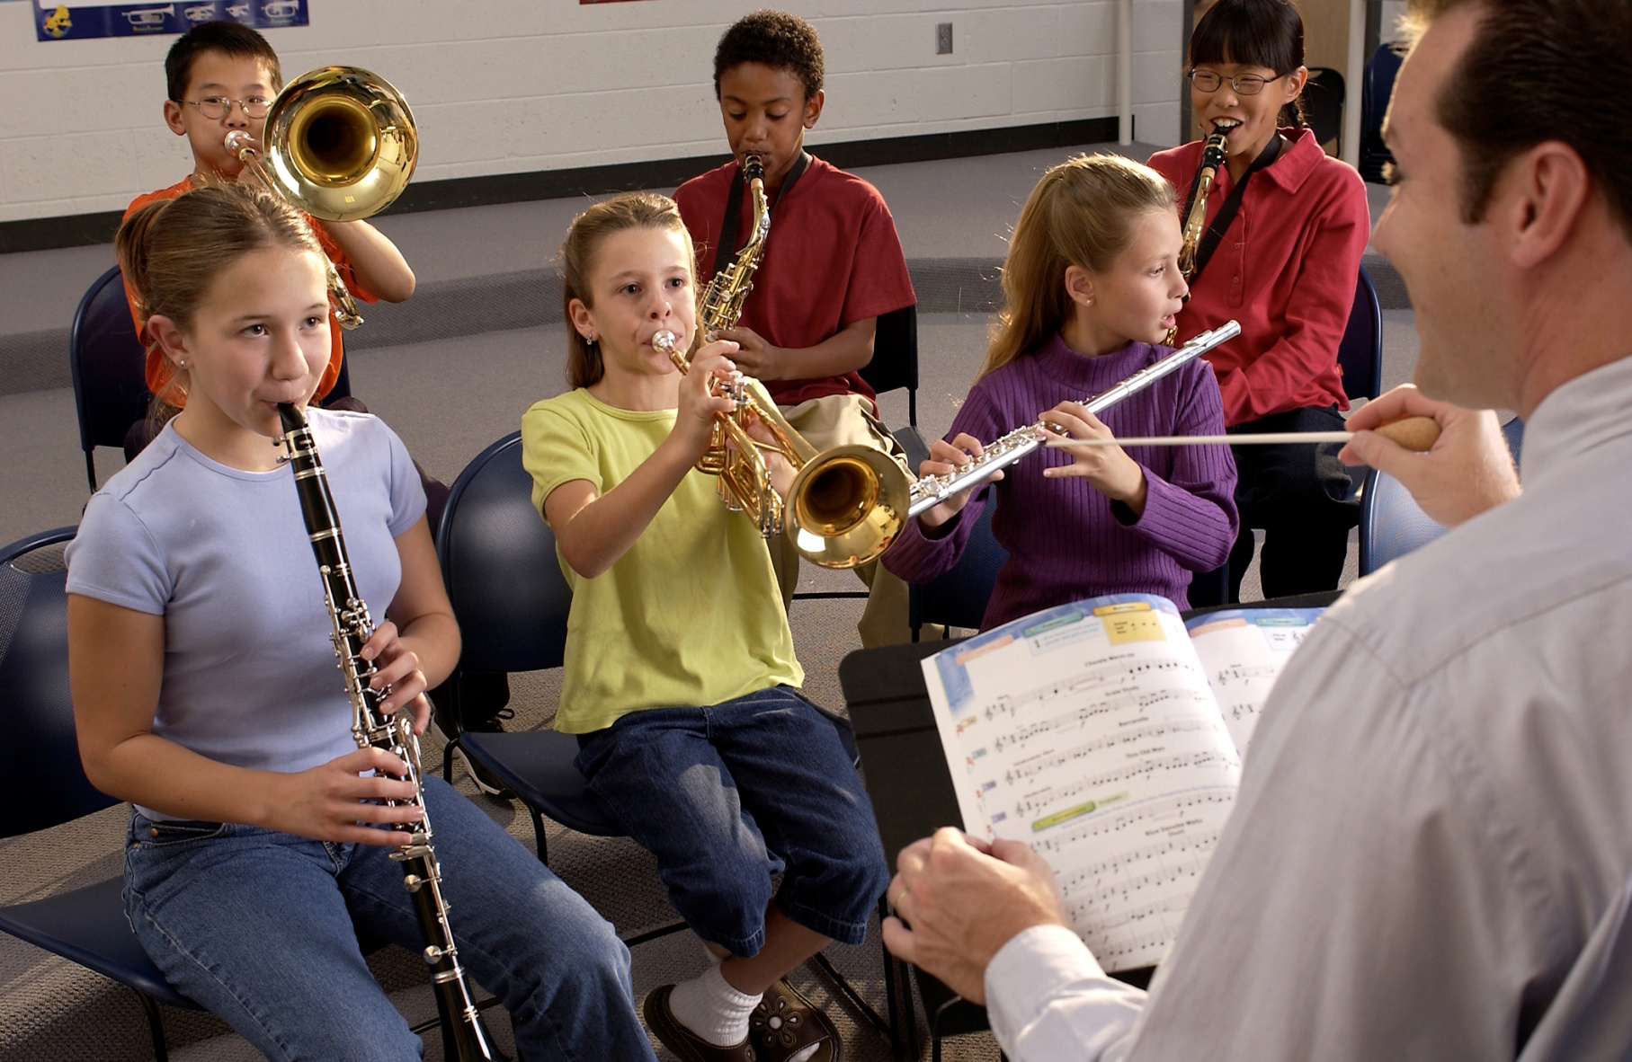
DID YOU KNOW . . .
www.musicachievementcouncil.org

Slide 17
DID YOU KNOW . . .
Music making has been scientifically proven to:
Exercise the brain
Inspire creativity
Increase productivity
Fight memory loss
Reduce stress
Lower blood pressure
Build confidence
Stave off depression

Slide 18
DID YOU KNOW . . .
Metropolitan Nashville Public Schools found that ATTENDANCE RATES ROSE with increased study in music.
No Music:
< 1 Year of Music:
> 1 Year of Music:
87% Attendance
91% Attendance
93% Attendance

Slide 19
DID YOU KNOW . . .
Metropolitan Nashville Public Schools found that DISCIPLINE REPORTS FELL with increased study in music.
No Music:
< 1 Year of Music:
> 1 Year of Music:
4.34 over 4 years
3.75 over 4 years
3.23 over 4 years

Slide 20
DID YOU KNOW . . .
Metropolitan Nashville Public Schools found that GPAs ROSE with increased study in music.
No Music:
< 1 Year of Music:
> 1 Year of Music:
2.51 Average
2.61 Average
2.89 Average

Slide 21
DID YOU KNOW . . .
Metropolitan Nashville Public Schools found that GRADUATION RATES ROSE with increased study in music.
No Music:
< 1 Year of Music:
> 1 Year of Music:
60% Average
81% Average
91% Average

Slide 22
DID YOU KNOW . . .
Metropolitan Nashville Public Schools found that ACT SCORES ROSE with increased study in music.
No Music:
< 1 Year of Music:
> 1 Year of Music:
16.95 Eng, 17.20 Math
17.64 Eng, 17.62 Math
19.58 Eng, 18.67 Math

Slide 23
WHAT WAS LEARNED?
The MORE a student
participates in MUSIC,
the more POSITIVE these BENEFITS become.

Slide 24
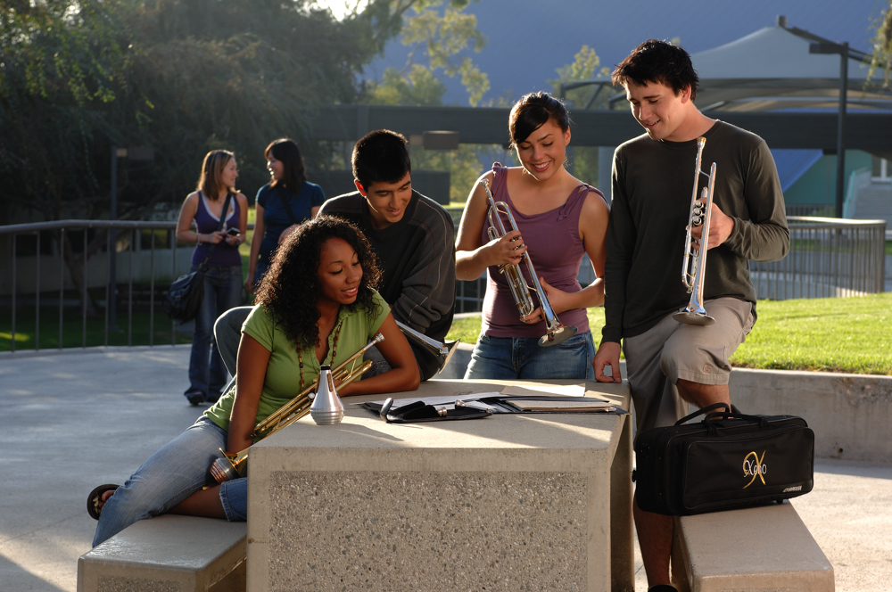
FAMOUS QUOTES. . .
Music has the power of producing a
certain effect on the moral character of
of the soul.
. . . Aristotle

Slide 25
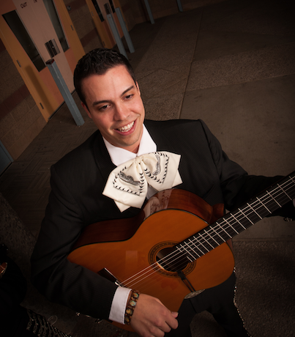
FAMOUS QUOTES. . .
Music furnishes a delightful recreation
for the hours of respite from the cares of the day, and lasts us through life.
. . . Thomas Jefferson

Slide 26
Middle School High School
2018 Winter Conference

Slide 27
Today’s Session: Bridging the Gap Between Middle and High School
WE WANT (TO KEEP) YOU!
The WHAT
The WHY
The HOW

Slide 28
WHAT Other Teachers Think I Do!

Slide 29
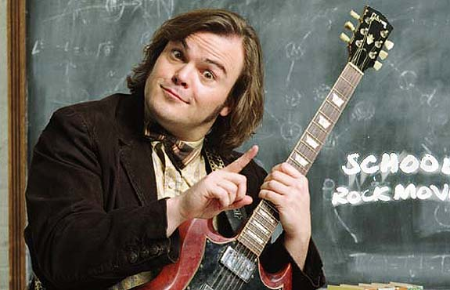
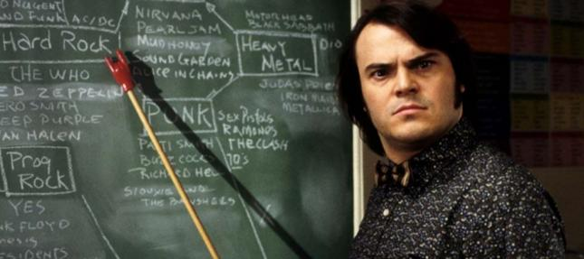
WHAT the (Other) Kids Think I Do!

Slide 30
WHAT Society Thinks I Do!

Slide 31
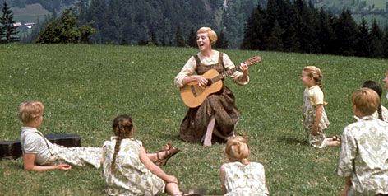
WHAT My Mom Thinks I Do!

Slide 32
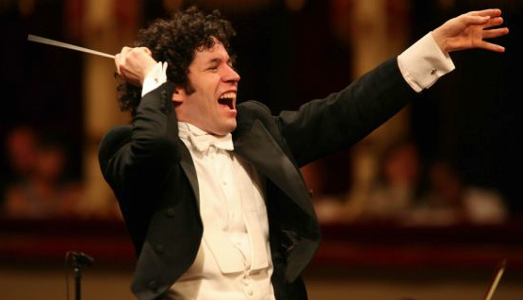
WHAT I Think I Do!

Slide 33
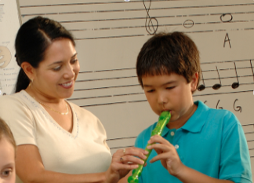
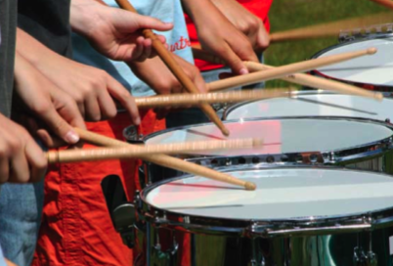
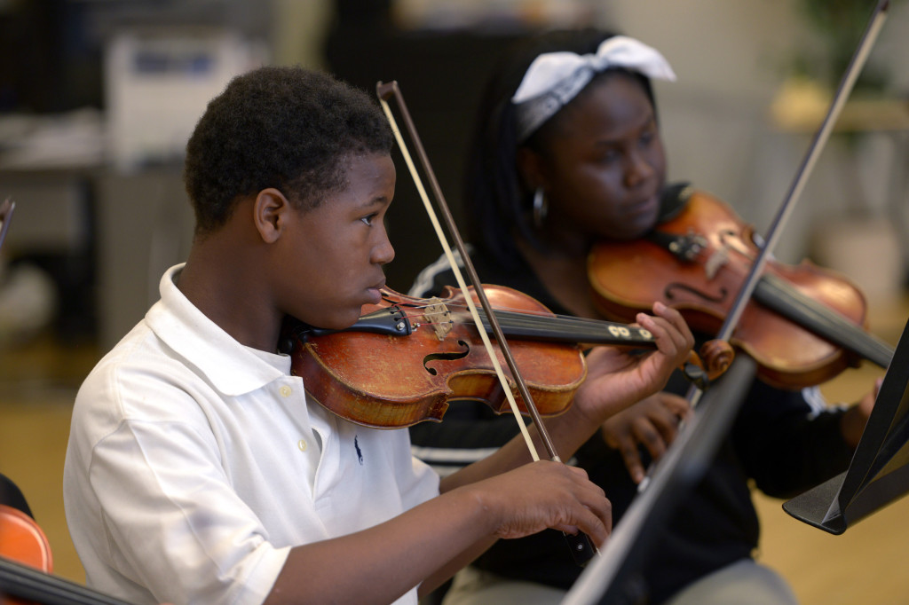
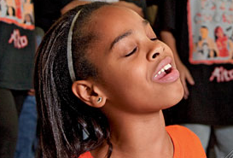
WHAT I Really Get to Do!
Facilitate Success and Fulfillment
www.musicachievementcouncil.org

Slide 34
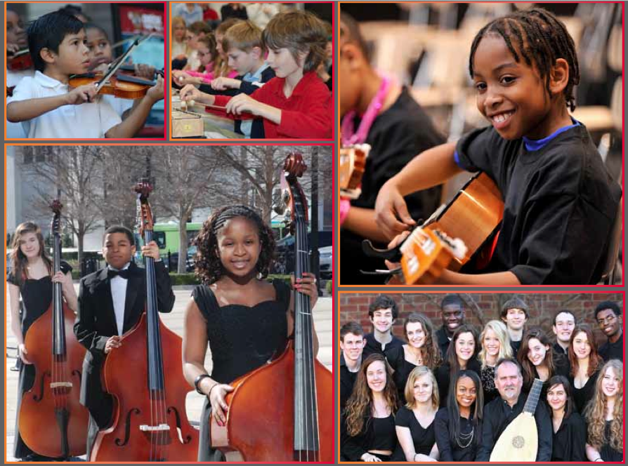
The WHY
Music Makes Us
Baseline Research Report
http://musicmakesus.org/resources/research

Slide 35
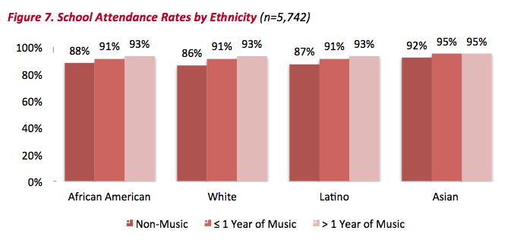
The WHY ATTENDANCE RATES
http://musicmakesus.org/resources/research

Slide 36
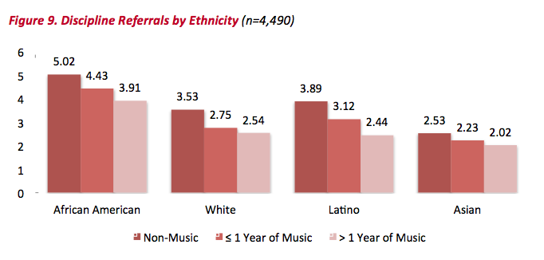
The WHY DISCIPLINE REFERRALS
http://musicmakesus.org/resources/research

Slide 37
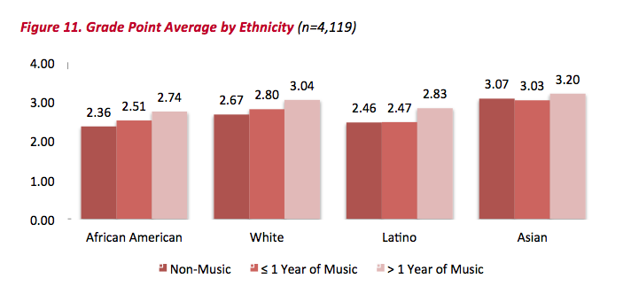
The WHY GPAS
http://musicmakesus.org/resources/research

Slide 38
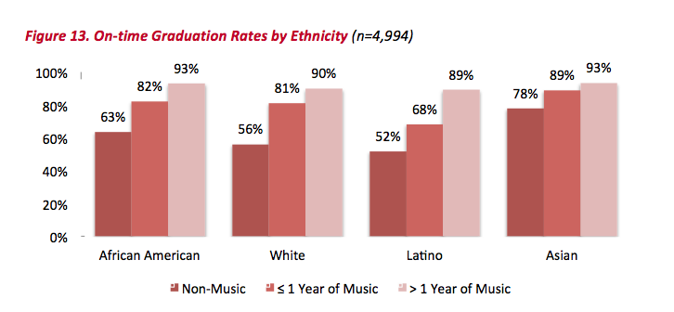
The WHY ON-TIME GRADUATION RATES
http://musicmakesus.org/resources/research

Slide 39
The WHY SUMMARY: What Was Learned?
“The More a Student Participates in Music,
the More Positive
these (Life-Changing)
Benefits Become.”
http://musicmakesus.org/resources/research

Slide 40
The HOW Strategies to Bridge the Gap
What Music Educators Can Do
What HS/MS Parents Can Do
What HS/MS Students Can Do
What HS/MS Principals Can Do
What Music Supervisors Can Do

Slide 41
The HOW: What Music Educators Can Do
Partner with Colleagues
1. Work more as one District-wide Faculty
with one Goal:
To ensure continued,
active music-making.

Slide 42
The HOW: What Music Educators Can Do
Partner with Colleagues
2. Establish a District-wide Vision (Destination) Good Examples: (“We envision. . .”)
A. Life is Good T-Shirts
. . .a world where all
children grow up feeling safe, loved, and joyful.
. . .great
public schools for all students.
B. National Education Association (NEA)

Slide 43
The HOW: What Music Educators Can Do
Partner with Colleagues
3. Establish a District-wide Mission (Purpose) Good Examples: (“We exist to. . .”)
A. Google
. . .organize the world’s information
and make it universally accessible and useful.
B. NAfME
. . .advance music education by
encouraging the studying and making of music
by all.

Slide 44
The HOW: What Music Educators Can Do
Partner with Colleagues
4. Vision/Mission Ideas for your district’s
Music Education Program:
A. Vision:
We envision a community where all
children grow up experiencing the joy of
active music-making
B. Mission:
We exist to prepare all students for
fulfilling, life-long music-making experiences.

Slide 45
The HOW: What Music Educators Can Do
Partner with Colleagues
5. Extra Idea: How about a Tag Line?
Good example:
What happens in Vegas. . .

Slide 46
The HOW: What Music Educators Can Do
Partner with Colleagues

Slide 47
The HOW: What Music Educators Can Do
Partner with Colleagues
6. Extra Idea: How about a Tag Line?
Good example:
What happens in Music. . .
Lasts for a Lifetime!

Slide 48
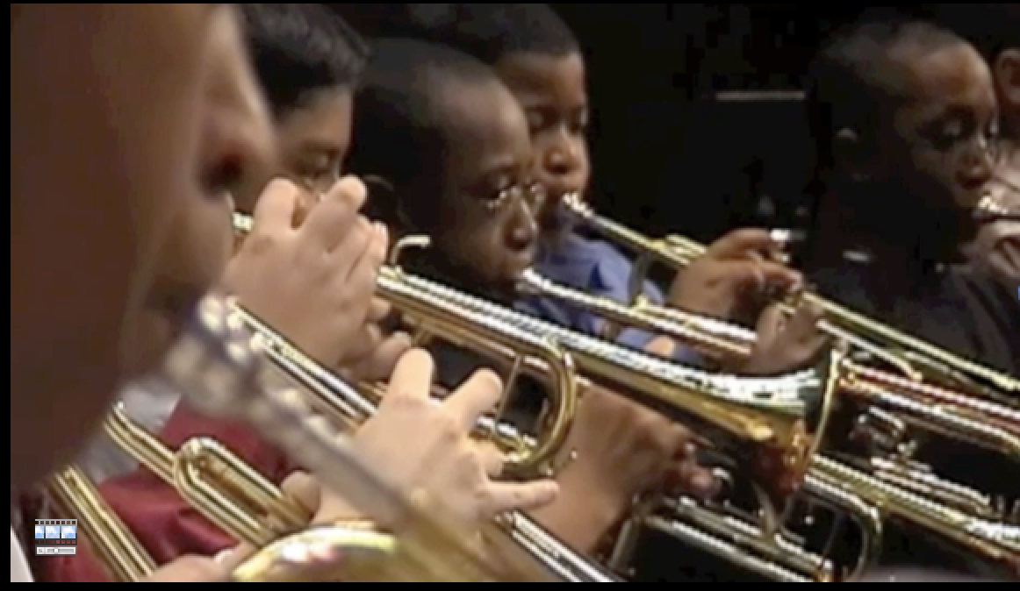
Build the Vision EARLY 7. First Performance National Day of Celebration (Third Thursday of November Annually)
The HOW: What Music Educators Can Do

Slide 49
7. First Performance National Day of Celebration (Third Thursday of November Annually)
The HOW: What Music Educators Can Do

Slide 50
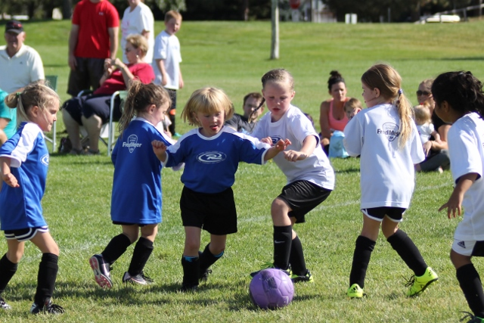

Slide 51
The Results
Reduces Beginner Dropout
Provides Short-Range Achievement
Goals
Encourages Engagement with
Parents
Strengthens Administrative Support
Celebrates Musical Accomplishments
of Beginners

Slide 52
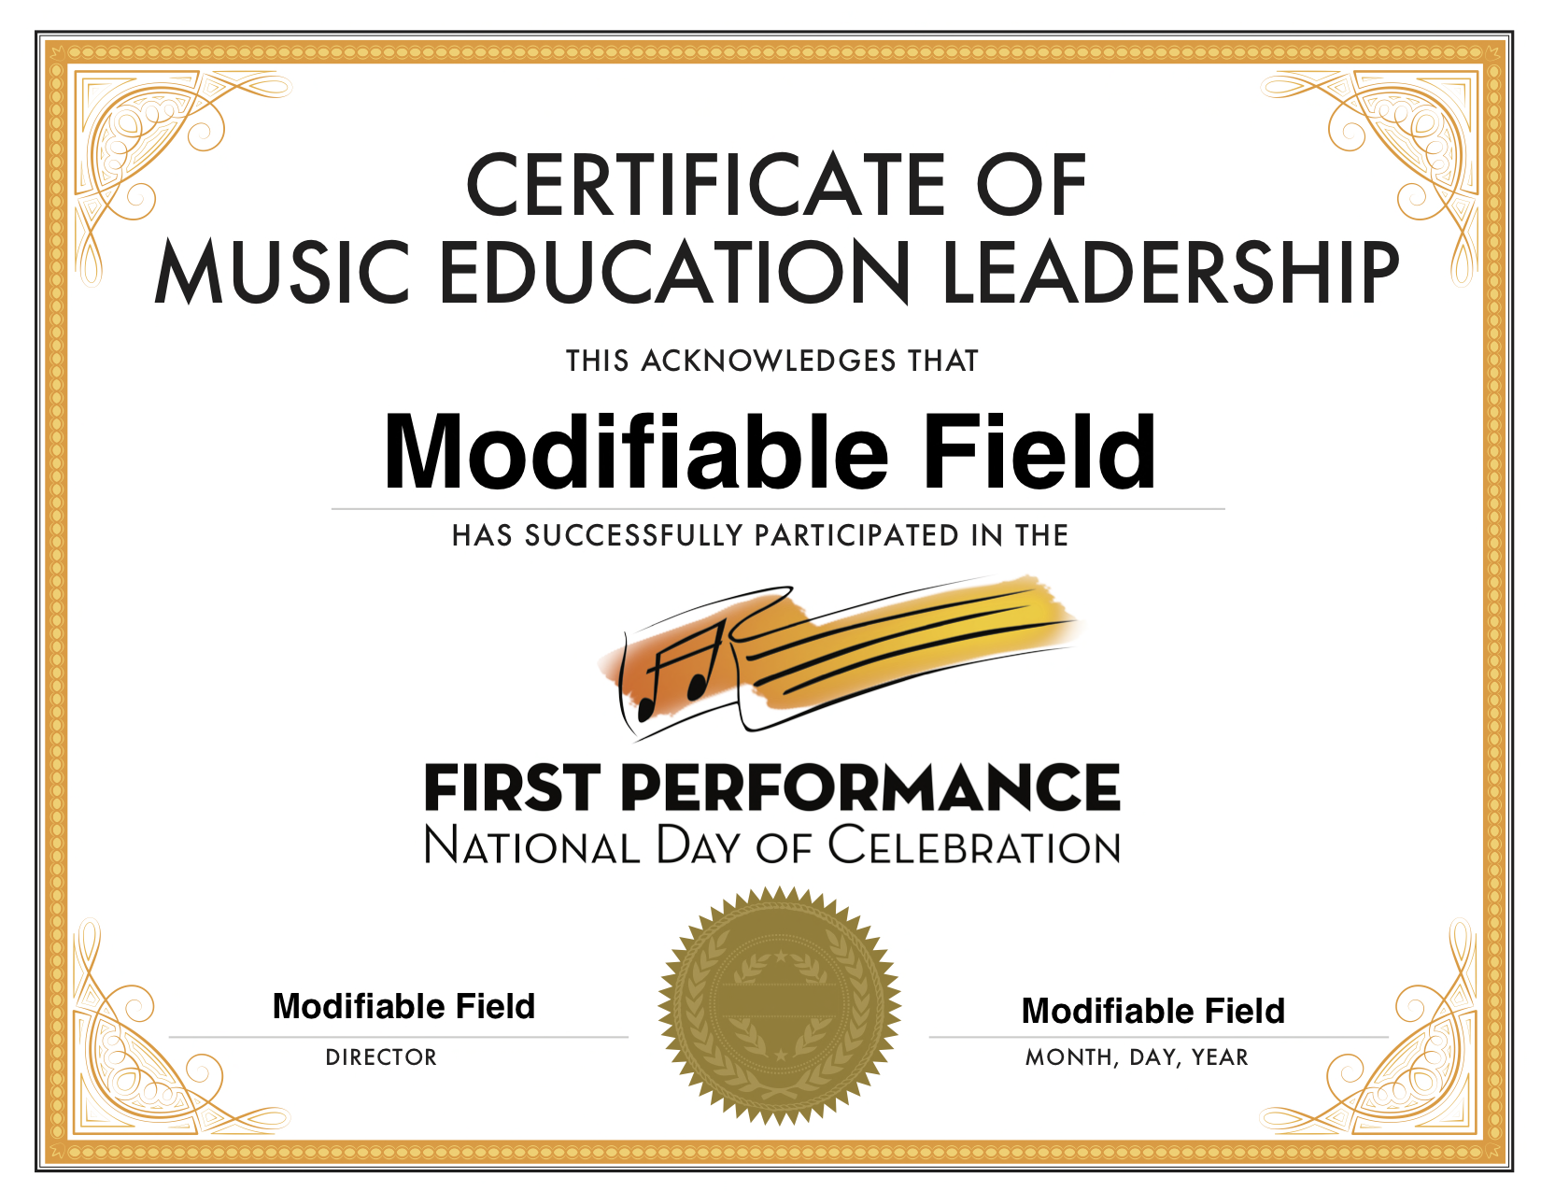
8. Certificate of Music Ed Leadership for
High School Student Participants

Slide 53
7. First Performance National Day of Celebration
The HOW: What Music Educators Can Do
Ask HS students (in uniform) to serve as ushers to distribute programs as people enter.
Ask HS students (in uniform) to “meet and greet” the parents/students as they report.
Ask like-instrument HS students (in uniform) to assist in tuning the instruments.
Arrange for a HS student combo (or soloists) to perform at the post-performance reception.
Ask HS students to send a congrats note to a like-instrument beginner.

Slide 54
Response from LIVE at the 2017 Midwest Clinic

Slide 55
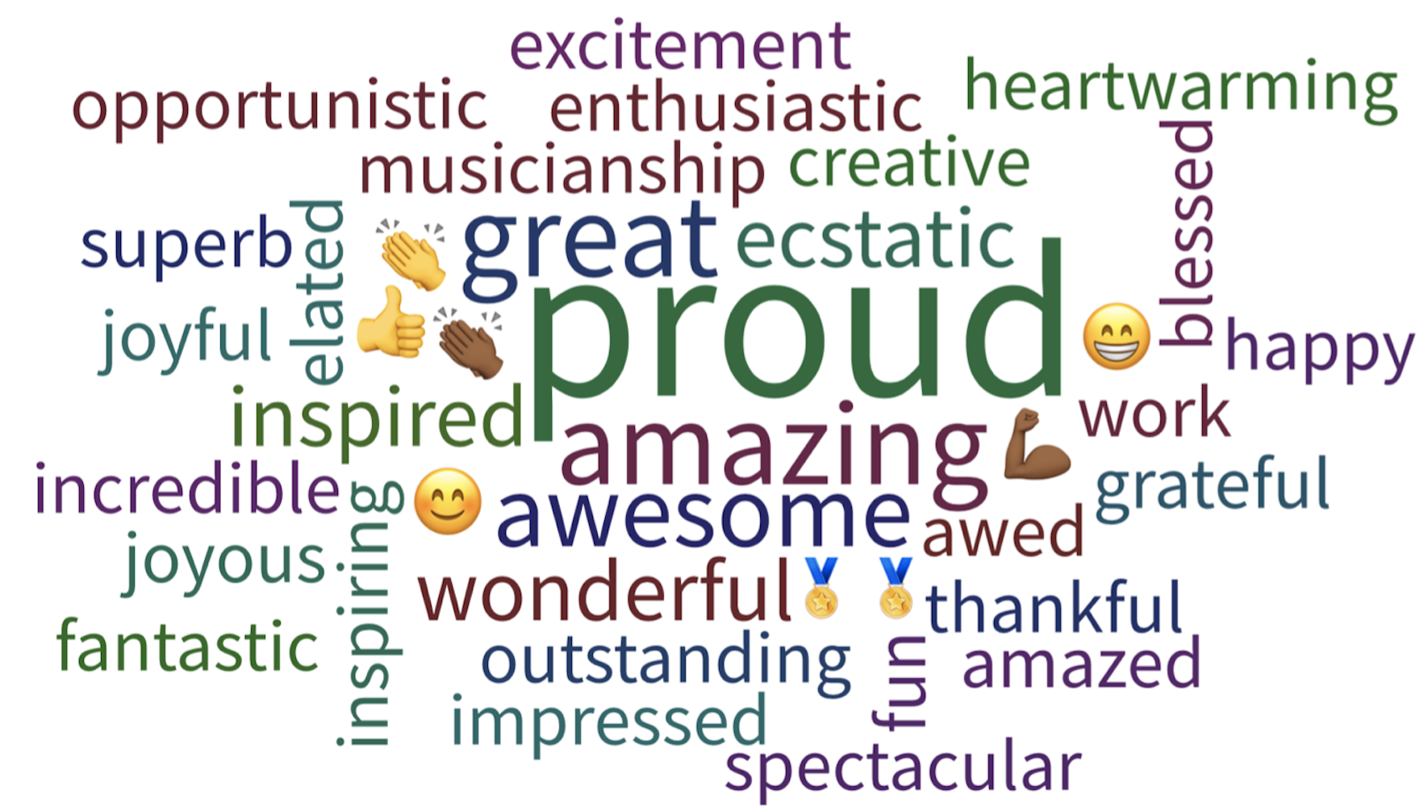
Response from LIVE at the 2017 Midwest Clinic

Slide 56
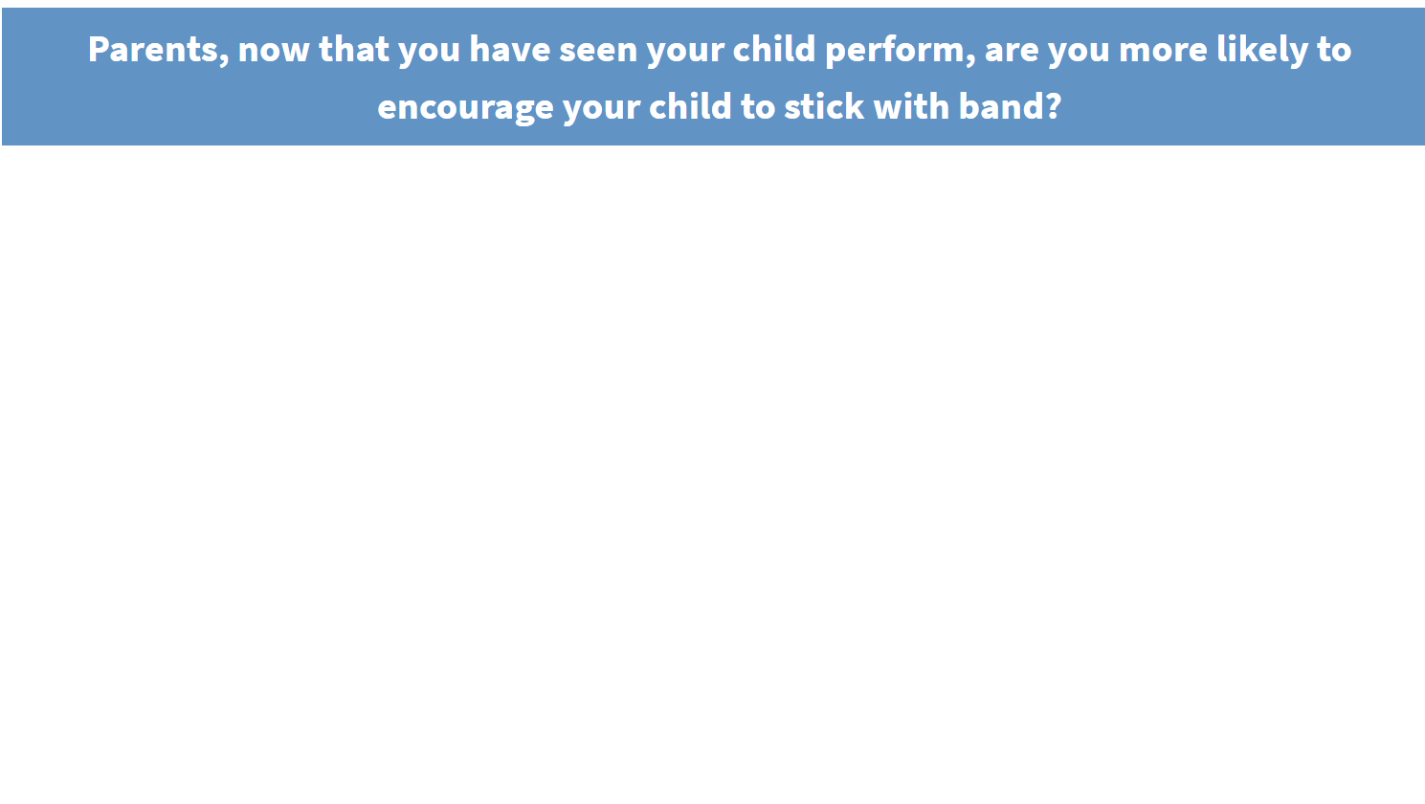
Response from LIVE at the 2017 Midwest Clinic

Slide 57
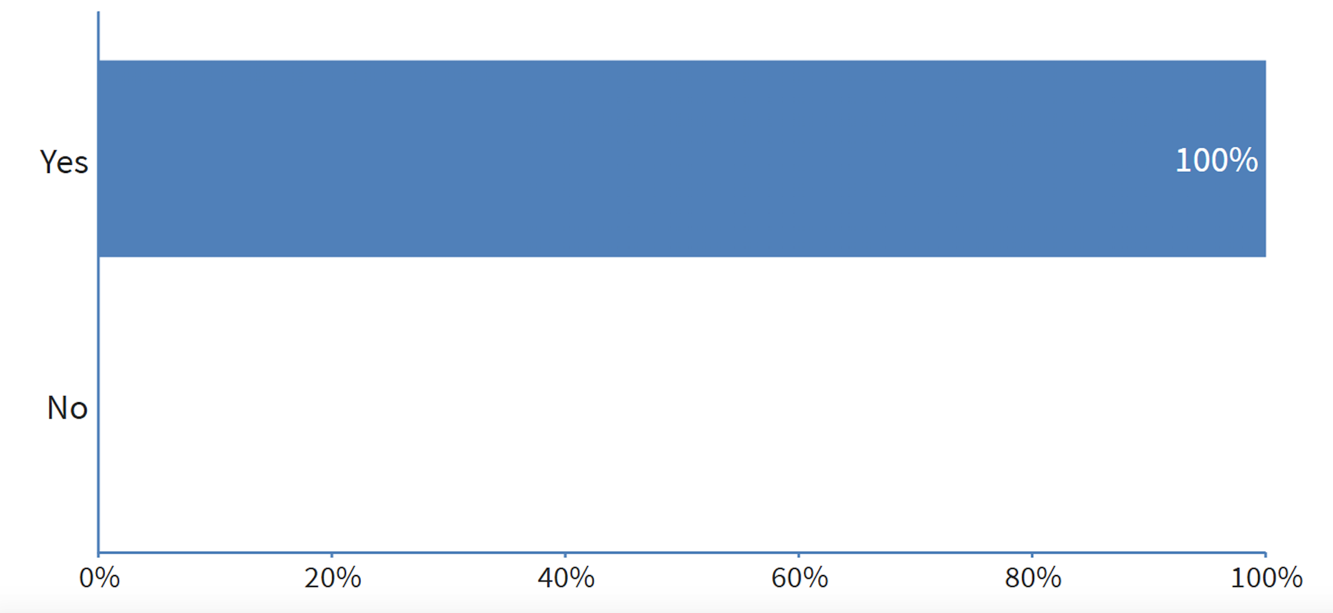
Response from LIVE at the 2017 Midwest Clinic

Slide 58
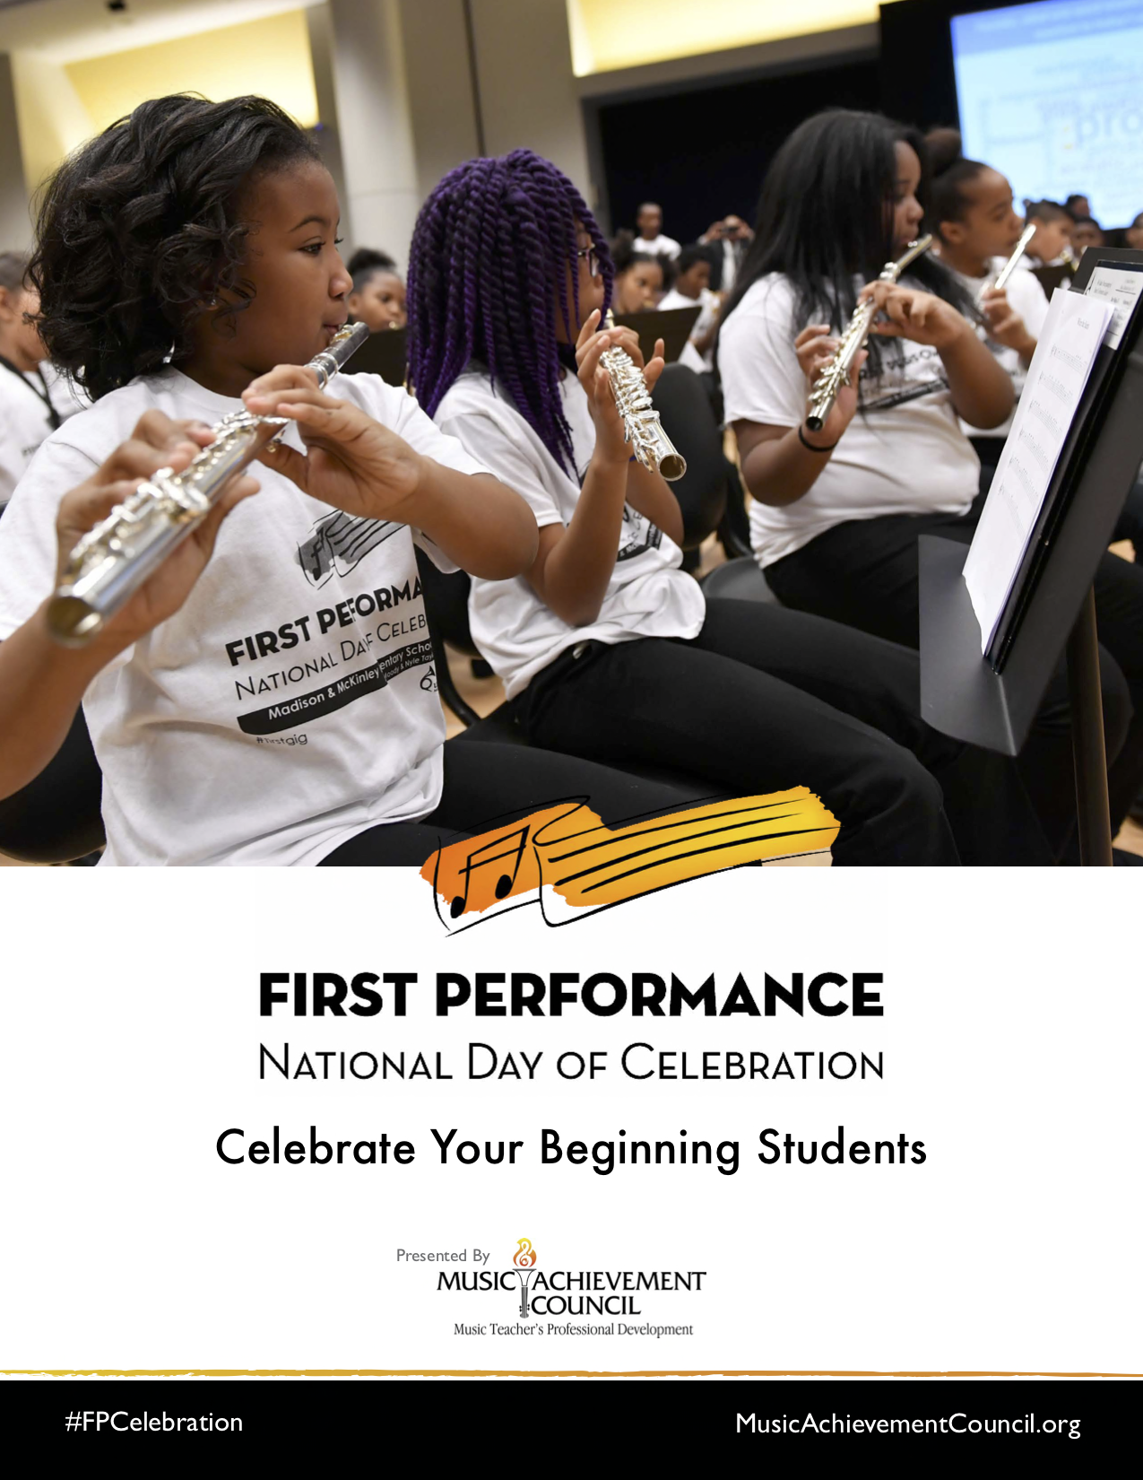
#FPCelebration Toolkit

Slide 59
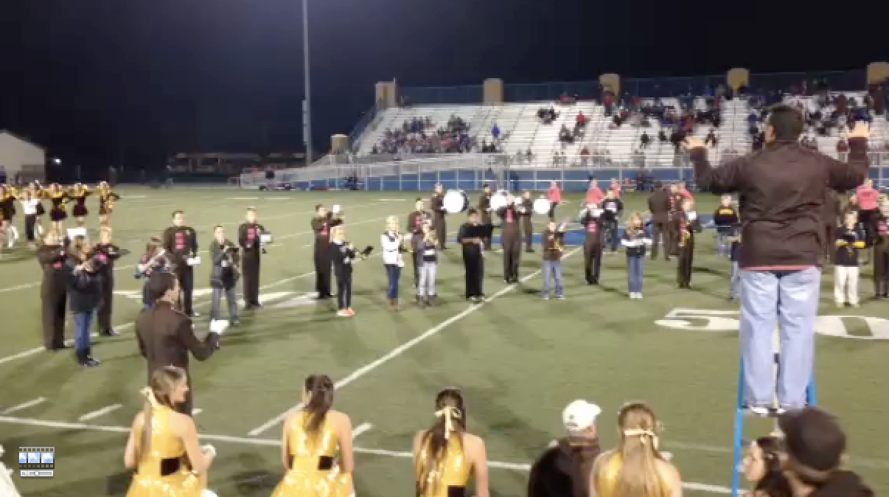
8. The Two-Note Halftime Show
The HOW: What Music Educators Can Do

Slide 60
8. The Two-Note Halftime Show
The HOW: What Music Educators Can Do

Slide 61
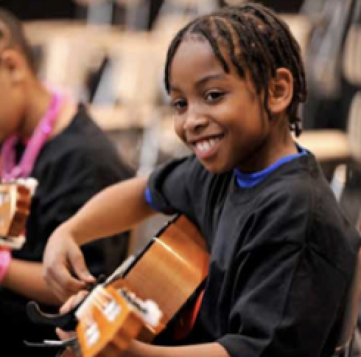
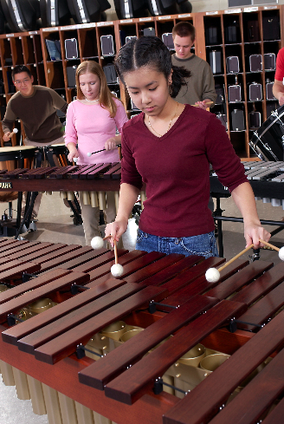
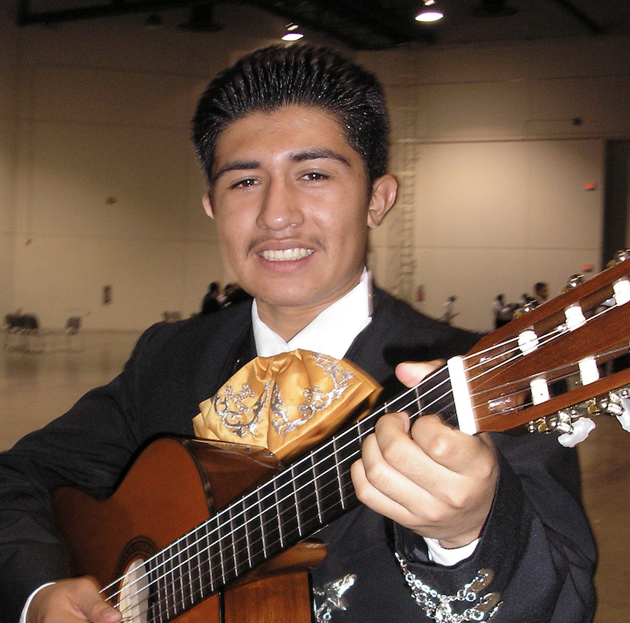
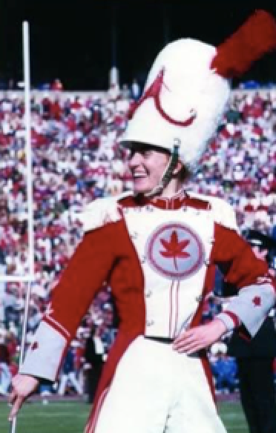
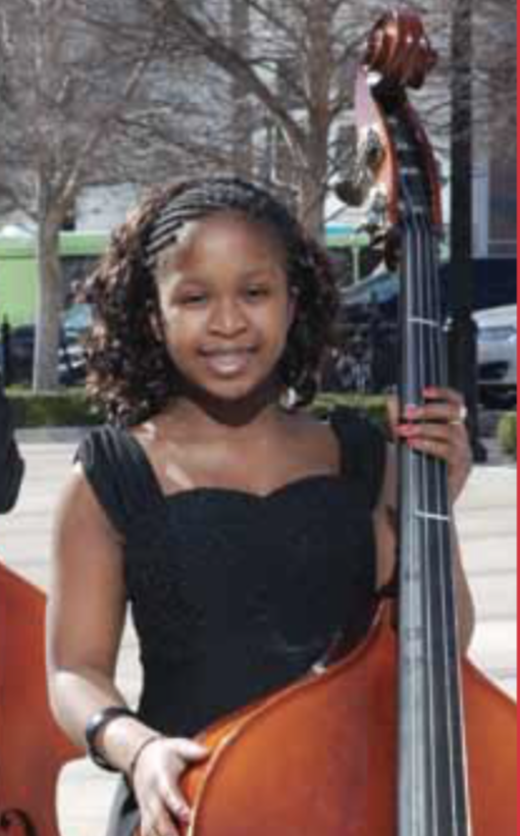
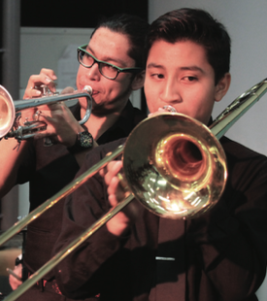
The HOW: What Music Educators Can Do
9. Help Them See Their Futures

Slide 62
9. A Vision Board Photo is Worth 1000 Words!
The HOW: What Music Educators Can Do
Include lots of photos of:
Elementary/middle students with the high school
students at fun events/musical activities.
Elementary/middle parents with the high school
parents at fun events/musical activities
Elementary/middle/high school directors together at fun events/musical activities.
Elementary/middle/high school principals together
at fun events/musical activities.

Slide 63
The HOW: What Music Educators Can Do
Partner with Colleagues
10. More Ideas
Meet regularly as a district-wide Faculty to establish goals and assess progress.
Plan performances/activities together
Conduct each other’s ensembles
Attend each other’s performances
Chaperone each other’s trips
Hang out with each other
Schedule “Switch Days” with each other

Slide 64
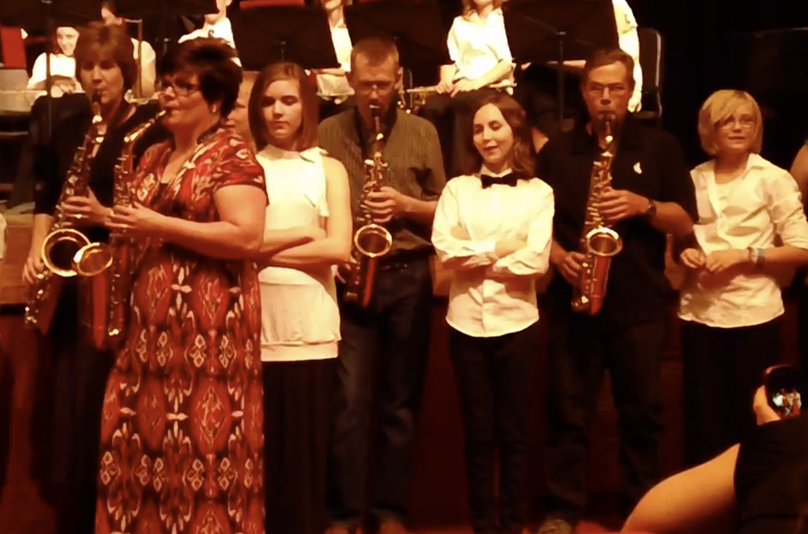
1. Get them engaged: The Parent Band!
The HOW: What Parents Can Do

Slide 65
1. Get them engaged: The Parent Band!
The HOW: What Parents Can Do

Slide 66
The HOW: What Parents Can Do
2. Get them engaged: Promote Leadership!
a. Schedule a VIP Parent Night at a joint
concert/halftime show performance
b. Host MS/ES parent meetings at the high
school
c. Mentor parent leaders of feeder
programs

Slide 67
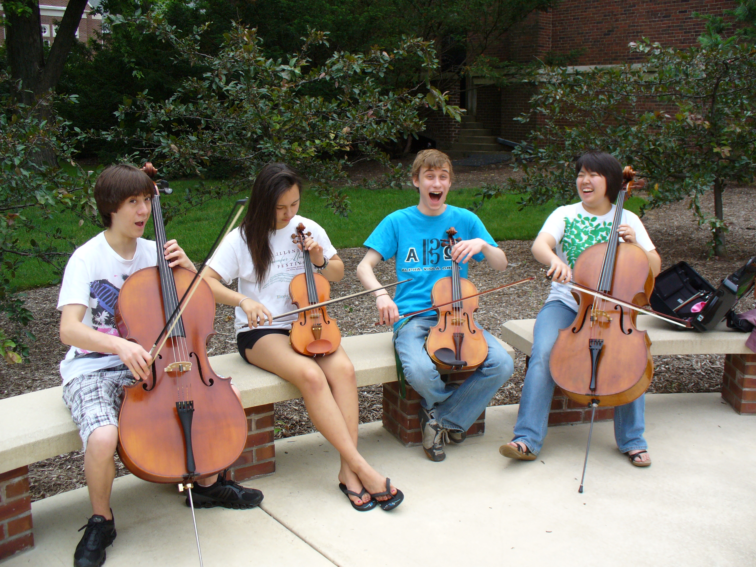
The HOW: What Students Can Do
1. Serve as “Intern Instructors” for FREE Summer Lesson Program for beginners.

Slide 68
The HOW: What Students Can Do
2. Participate ACTIVELY in ALL retention
efforts – give “testimonials”

Slide 69
The HOW: What Students Can Do
2. Participate ACTIVELY in ALL retention
efforts – give “testimonials”

Slide 70
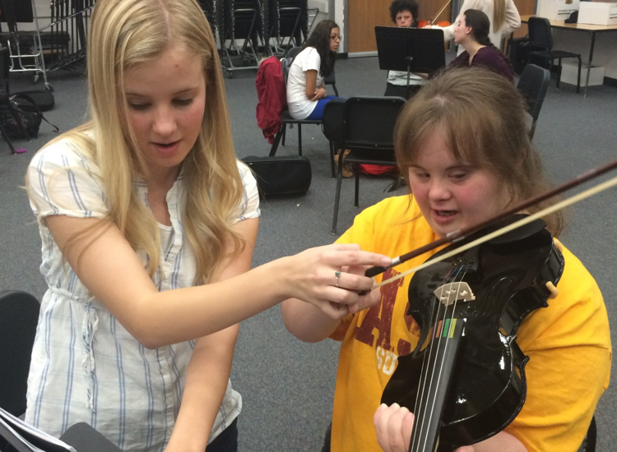
The HOW: What Students Can Do
Remain engaged with former programs

Slide 71
The HOW: What Students Can Do
Write letters of invitation (Big Bro/Sis)
and congratulations as appropriate
“Congratulations!
You have been chosen to
play (insert instrument)
in the (name of school) band!”
Giving a “Golden Invitation” to
band/orchestra makes them feel special!”

Slide 72
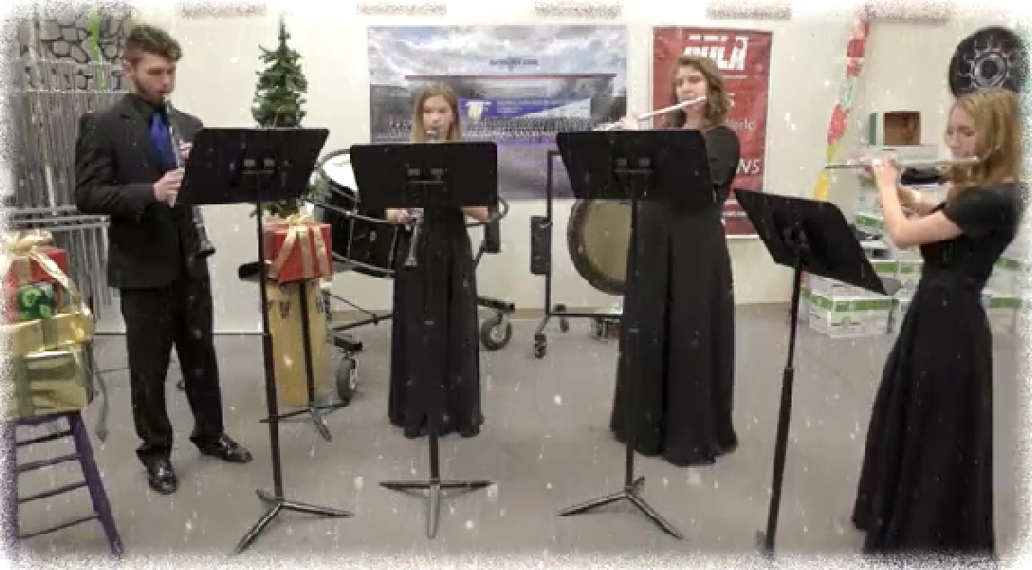
The HOW: What Students Can Do
5. Send Musical Greeting Cards!

Slide 73
The HOW: What Students Can Do
5. Send Musical Greeting Cards!

Slide 74
The HOW: What Principals Can Do
1. Help facilitate recruitment assemblies/
events/activities at feeder schools
2. Work with feeder principals on
scheduling
3. Create joint presentation for (feeder)
parents
4. Provide opening remarks at each other’s
concerts

Slide 75
The HOW: What Music Supervisors Can Do
1. Ensure that faculty sees itself as part of
one, K–12 Music Program – build purpose and unity

Slide 76
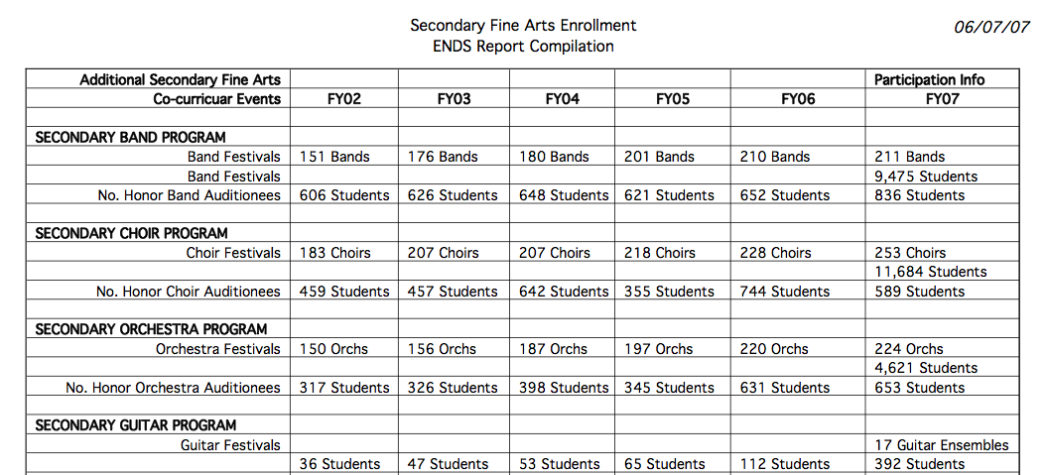
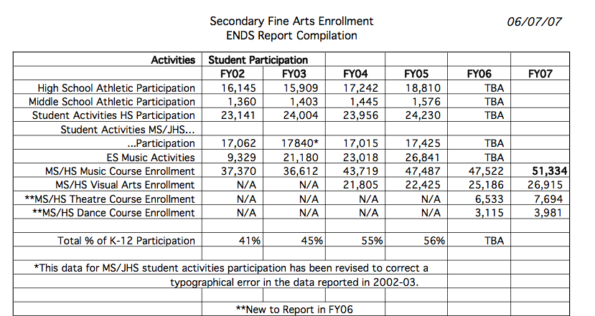
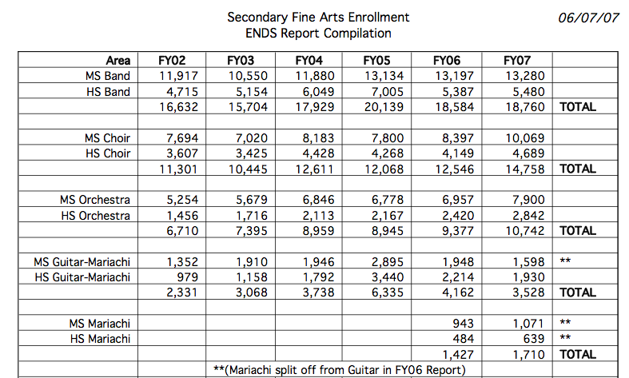
2. Track articulation/achievement data

Slide 77
The HOW: What Music Supervisors Can Do
3. Provide sample student schedules
Wind Symphony
Algebra I
Biology
AP English
Music Theory
Orchestra
Jazz Band
Geometry
Chemistry
Chamber Ensemble
Algebra II
Algebra XV
Calculus

Slide 78
The HOW: What Music Supervisors Can Do
4. Ensure that students receive quality
learning opportunities and experiences

Slide 79
A GREAT EXAMPLE: Foothill HS
“There is a place. . .”

Slide 80
A GREAT EXAMPLE: Foothill HS
“There is a place. . .”

Slide 81
M.A.C. Resources
www.MusicAchievementCouncil.org
Notes:
81

Slide 82
Thanks to these
Quality Companies!
Notes:
www.musiceducationconsultants.net/mmea2010
82

Slide 83
Contact Information Marcia Neel marcia@musicedconsultants.net @MusicEdConsult on Twitter 702.361.3553 Complimentary Recruitment and Retention Materials www.musicachievementcouncil.org

