Slide 1
DID YOU KNOW . . .
Engaged students are 2.5 times more likely to get excellent grades and do well in school, and they are 4.5 times more likely to be hopeful about their futures than their disengaged peers.
Gallup, Oct 2018
musicedconsultants.net/conference-materials

Slide 2
DID YOU KNOW . . .
96 percent of public school principals
believe that participating in music
education encourages and motivates
students to stay in school longer.
(Harris Poll)
musicedconsultants.net/conference-materials

Slide 3
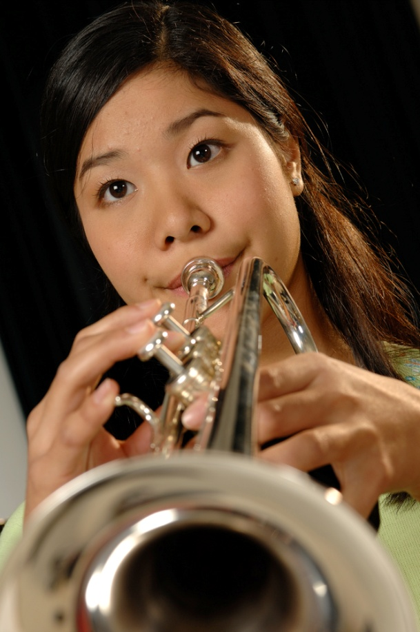
DID YOU KNOW . . .
An interactive poll confirms that music education at an early age greatly increases the likelihood that a child will grow up to seek higher education and ultimately even earn a higher salary. (2007 Harris Poll)
musicedconsultants.net/conference-materials

Slide 4
THE MESSAGE IS. . .
If you want to be a CEO, College President, or
even a Rock Star,
TAKE MUSIC!
musicedconsultants.net/conference-materials

Slide 5
THE MESSAGE IS. . .
If you want to be a CEO, College President, or
even a Rock Star,
TAKE MUSIC!
musicedconsultants.net/conference-materials

Slide 6
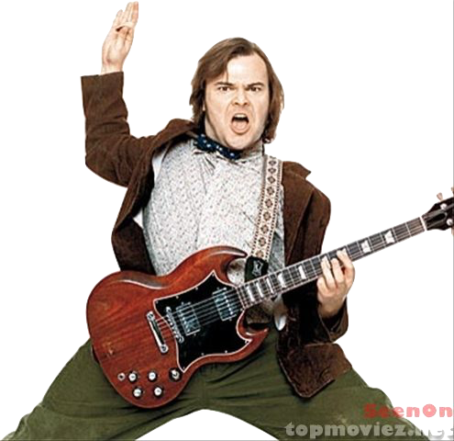
THE MESSAGE IS. . .
If you want to be a CEO, College President, or
even a Rock Star,
TAKE MUSIC!
musicedconsultants.net/conference-materials

Slide 7
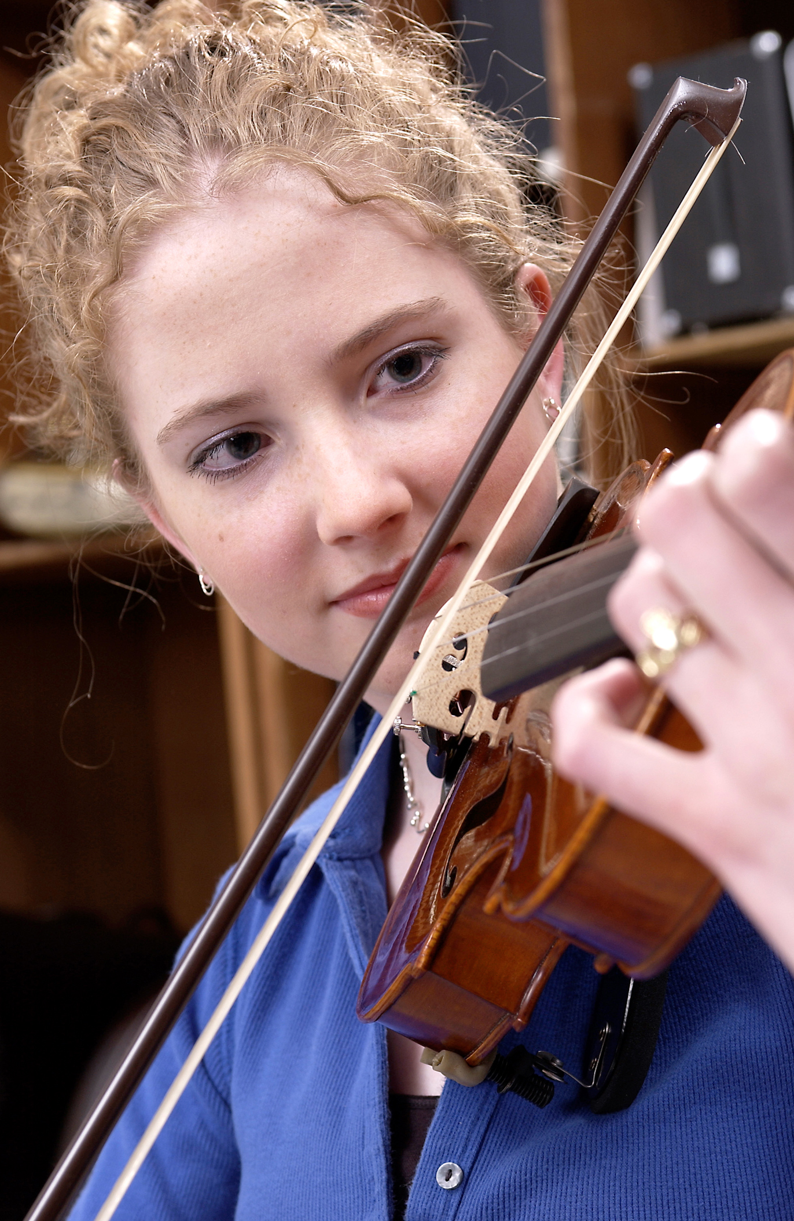
DID YOU KNOW . . .
82 percent of Americans who don’t currently play an instrument wish they had learned to play one. (Gallup Poll)
musicedconsultants.net/conference-materials

Slide 8
DID YOU KNOW . . .
You can download FREE COPIES of:
Bridging the Gap Between
Middle School and High School
musicachievementcouncil.org

Slide 9
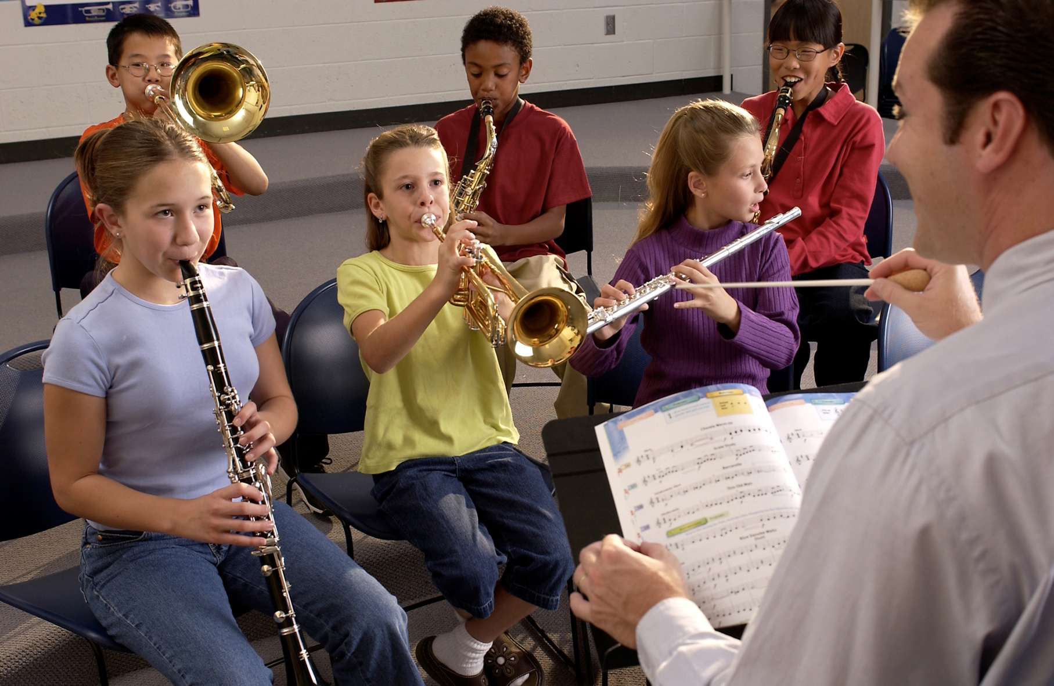
DID YOU KNOW . . .
musicedconsultants.net/conference-materials

Slide 10
DID YOU KNOW . . .
Music making has been scientifically proven to:
Exercise the brain
Inspire creativity
Increase productivity
Fight memory loss
Reduce stress
Lower blood pressure
Build confidence
Stave off depression

Slide 11
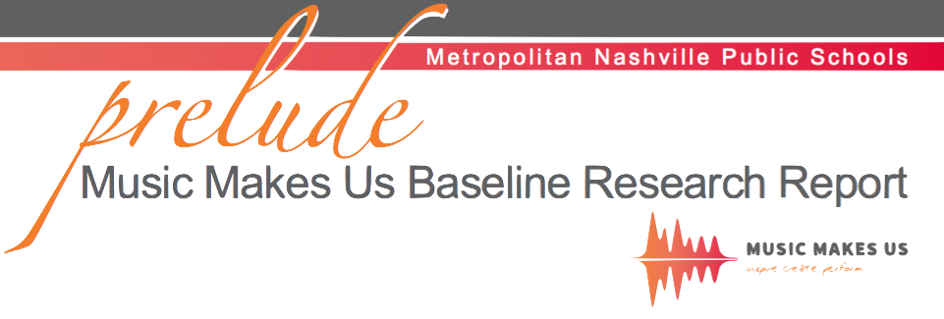
DID YOU KNOW . . .
Metropolitan Nashville Public Schools found that ATTENDANCE RATES ROSE with increased study in music.
No Music:
< 1 Year of Music:
> 1 Year of Music:
87% Attendance
91% Attendance
93% Attendance

Slide 12
DID YOU KNOW . . .
Metropolitan Nashville Public Schools found that DISCIPLINE REPORTS FELL with increased study in music.
No Music:
< 1 Year of Music:
> 1 Year of Music:
4.34 over 4 years
3.75 over 4 years
3.23 over 4 years

Slide 13
DID YOU KNOW . . .
Metropolitan Nashville Public Schools found that GPAs ROSE with increased study in music.
No Music:
< 1 Year of Music:
> 1 Year of Music:
2.51 Average
2.61 Average
2.89 Average

Slide 14
DID YOU KNOW . . .
Metropolitan Nashville Public Schools found that GRADUATION RATES ROSE with increased study in music.
No Music:
< 1 Year of Music:
> 1 Year of Music:
60% Average
81% Average
91% Average

Slide 15
DID YOU KNOW . . .
Metropolitan Nashville Public Schools found that ACT SCORES ROSE with increased study in music.
No Music:
< 1 Year of Music:
> 1 Year of Music:
16.95 Eng, 17.20 Math
17.64 Eng, 17.62 Math
19.58 Eng, 18.67 Math

Slide 16
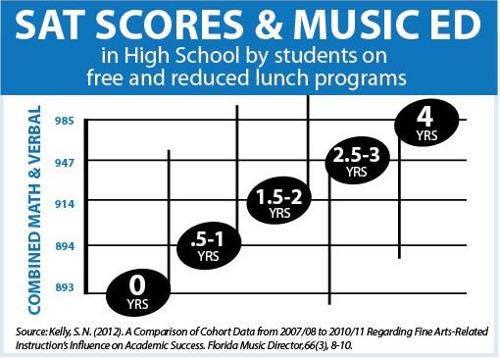

Slide 17
WHAT WAS LEARNED?
The MORE a student participates in MUSIC,
the more POSITIVE these BENEFITS become.

Slide 18
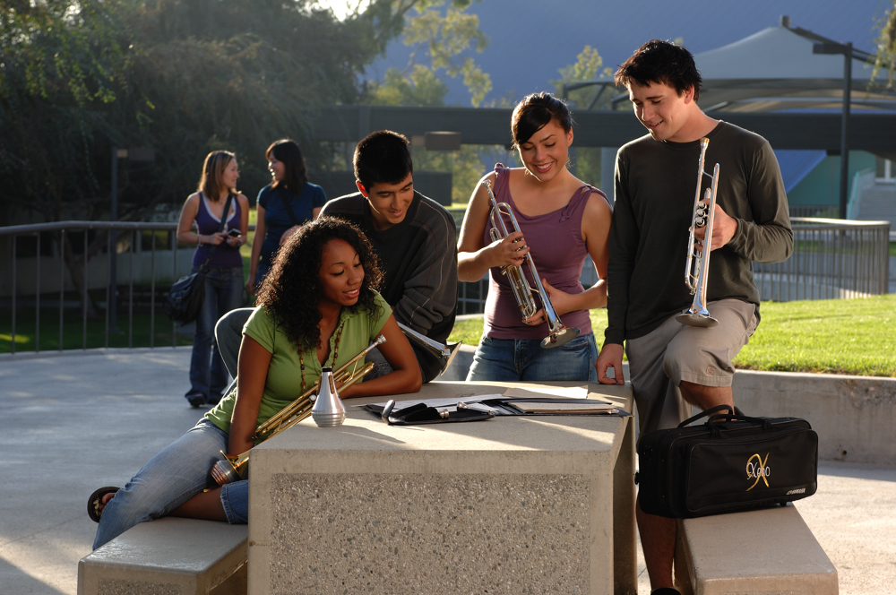
FAMOUS QUOTES. . .
Music has the power of producing a
certain effect on the moral character of
of the soul.
. . . Aristotle

Slide 19
FAMOUS QUOTES. . .
Music furnishes a delightful recreation
for the hours of respite from the cares of the day, and lasts us through life.
. . . Thomas Jefferson

