Slide 1
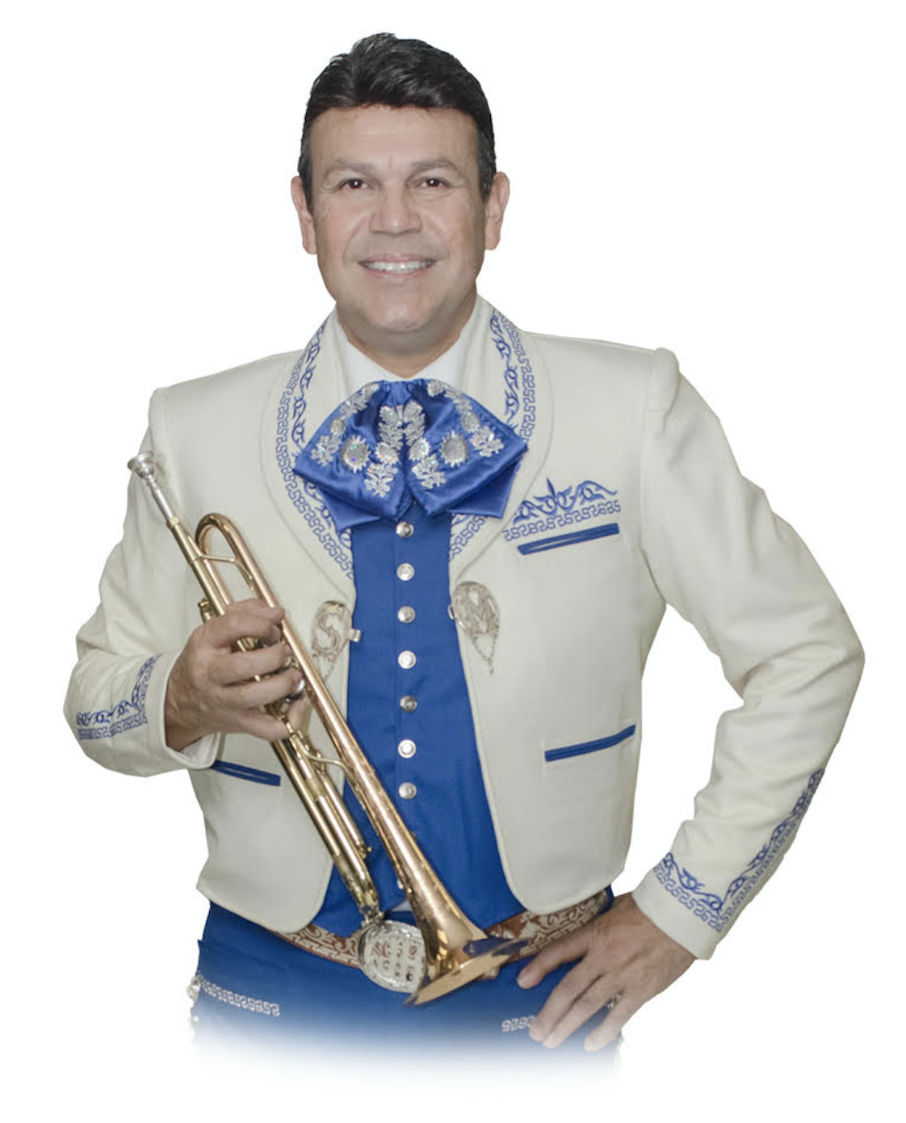
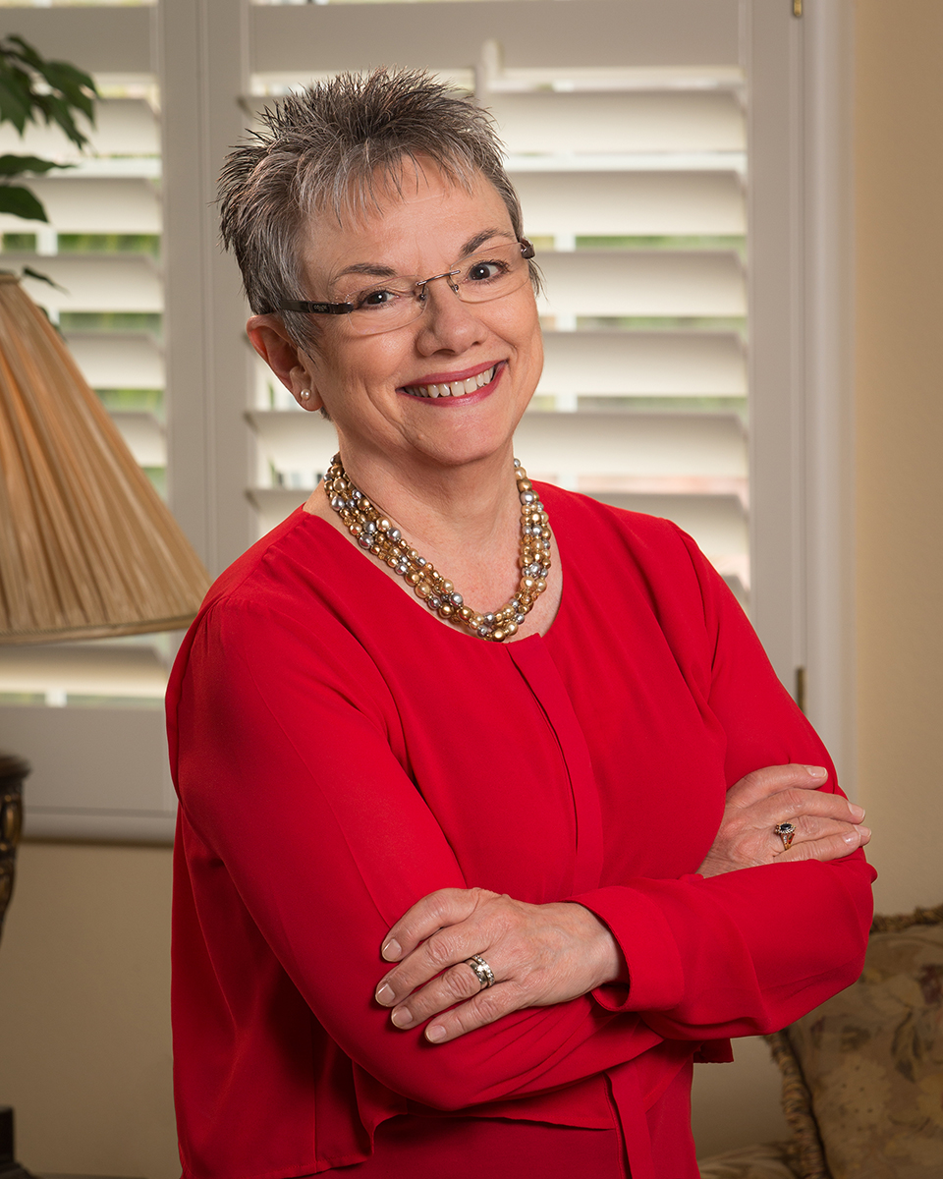
Introduction to Mariachi!
Jose Hernandez
Marcia Neel
¡MARIACHI IOWA!
April 21, 2018

Slide 2
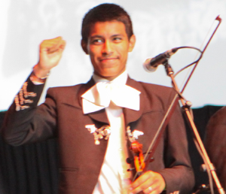
Benefits of a School Mariachi Program
Involves More Students in Music
Provides an entry-level music
experience at anytime
Helps keep students in school
Increases student self-esteem and
self-confidence
Provides an effective bridge to parental involvement
Celebrates/Recognizes this specific culture and heritage

Slide 4
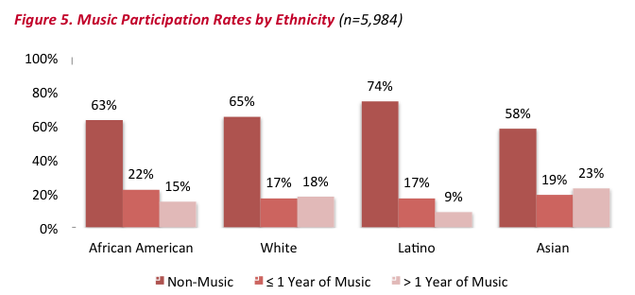
Music Participation Rates by Ethnicity
Music Makes Us Baseline Research Report

Slide 5
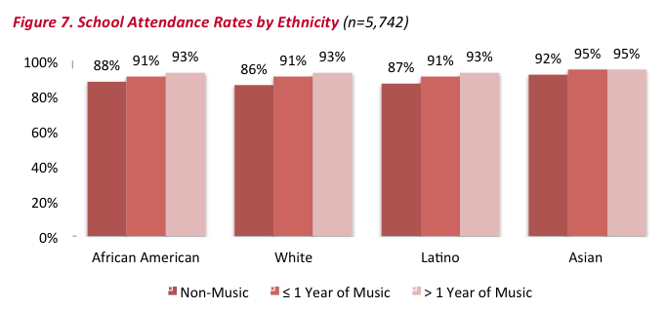
School Attendance Rates by Ethnicity
Music Makes Us Baseline Research Report

Slide 6
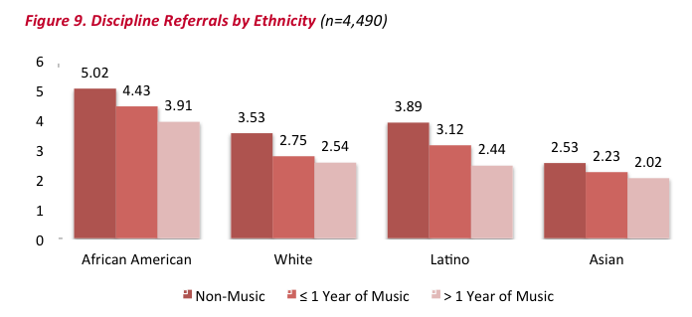
Discipline Referrals by Ethnicity
Music Makes Us Baseline Research Report

Slide 7
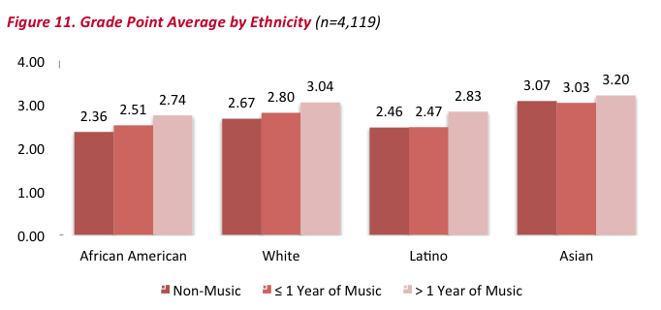
GPA by Ethnicity
Music Makes Us Baseline Research Report

Slide 8
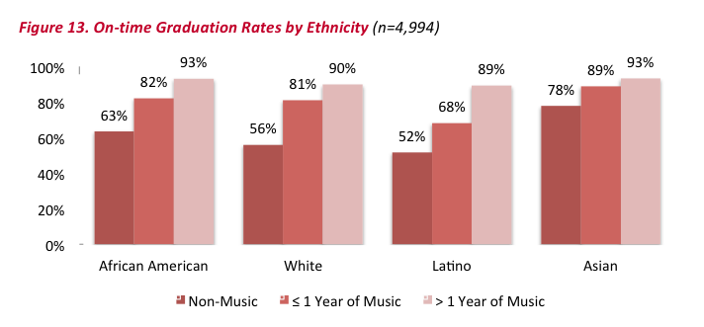
On-time Graduation Rates by Ethnicity
Music Makes Us Baseline Research Report

Slide 9
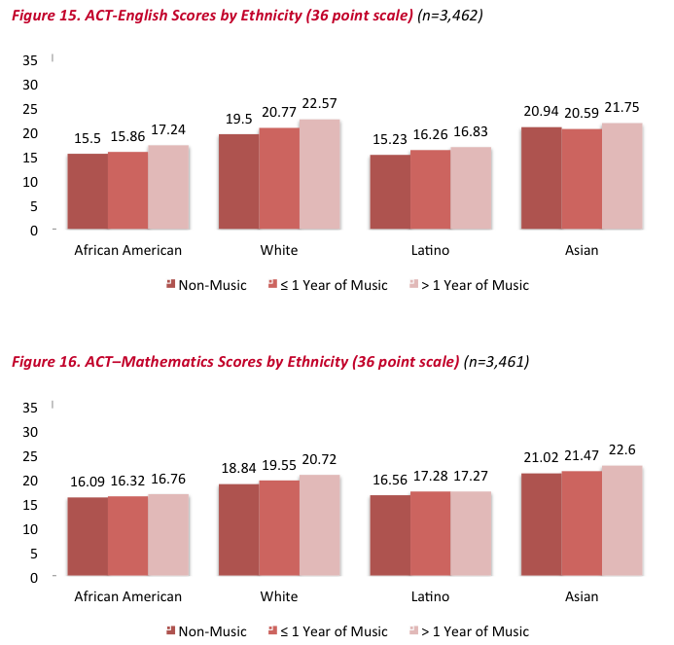
ACT Scores (English) by Ethnicity
ACT Scores (Math) by Ethnicity

Slide 10
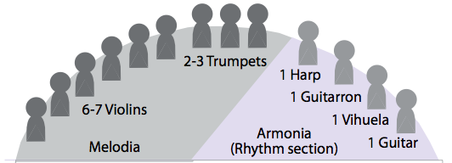
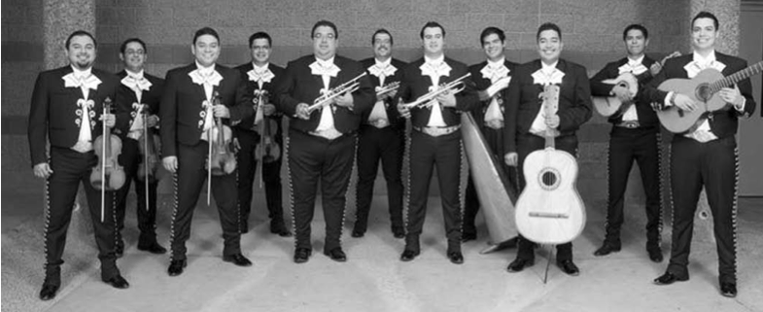
The Mariachi Ensemble
Use Photo of Sol de Mexico

Slide 11
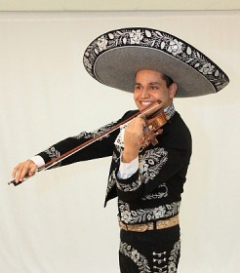
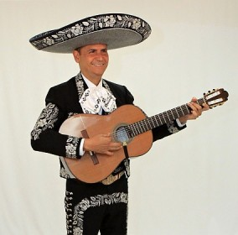
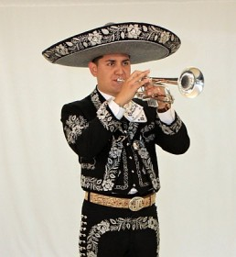
Instrumentation Traditional Instruments
Erick Hernandez
Violin
Jesus (Chuy) Hernandez
Guitarra
Jorge Contreras
Trompeta
Notes:
11

Slide 12
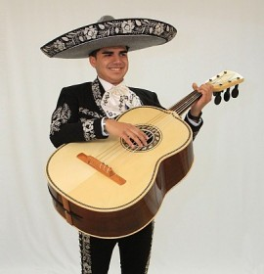
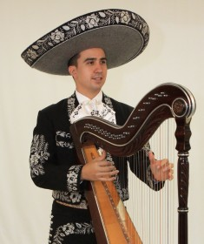
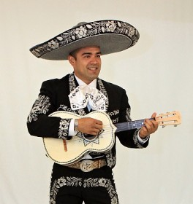
Instrumentation Characteristic Instruments
Jorge Flores
Guitarron
Guillermo Acuna
Arpa
Antonio Zúñiga
Vihuela
Notes:
12

Slide 13
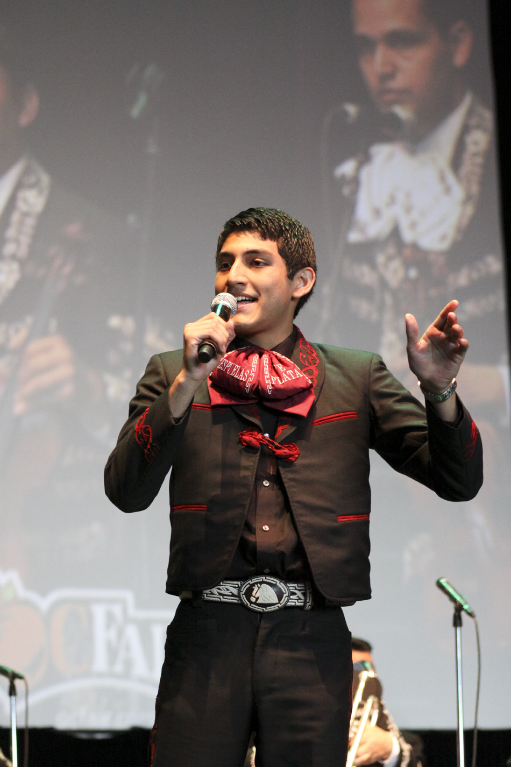
Some New Terms
1. Melodia
Violin, Trumpet
Voice
2. Armonia:
The Rhythm Section
Guitar, Vihuela
Guitarron, Arpa
3. Mánico
Strumming Pattern
Notes:
13

Slide 14
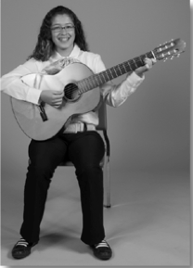
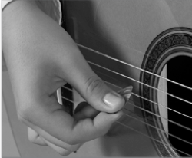
Getting to Know the Guitarra (p. 3)
Notes:
14

Slide 15
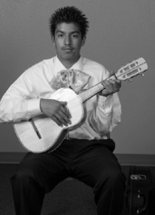
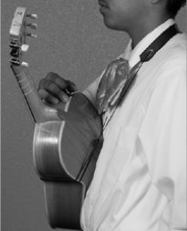
Getting to Know the Vihuela (p. 4)
Notes:
15

Slide 16
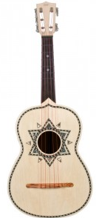
Characteristic Instruments: The Vihuela
A
D
G
B
E
5
4
3
2
1

Slide 17
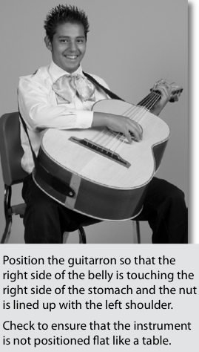
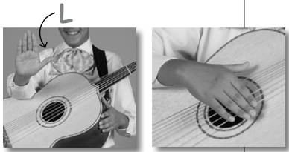
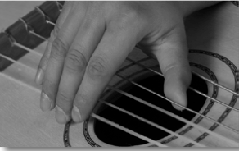
Getting to Know the Guitarron (pp. 7-8)
Backwards L
Jalón
Notes:
17

Slide 18
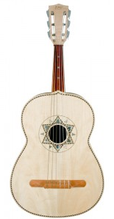
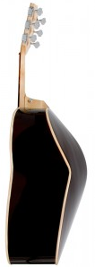
Characteristic Instruments: The Guitarron
(pp. 7-8)
A
D
G
C
E
A
T
Tape: One Whole Step
From the Nut
6
5
4
3
2
1
Written Range: Sounds One Octave Lower

Slide 19
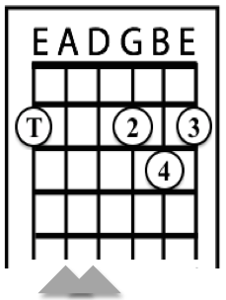
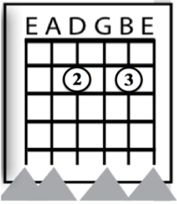
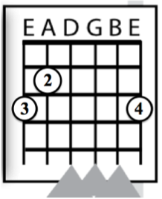
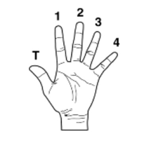
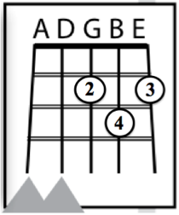
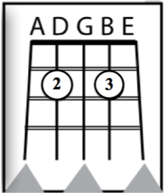
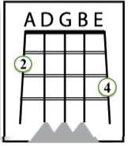
Today’s Chords: D Major, A7, G Major
Key of “Re” (p. 5)
Primera
Segunda
Tercera
D Major
A7
G Major
*Use thumb if hand is
large enough. If not, do
not play E String.
*
Guitarra
Vihuela

Slide 20
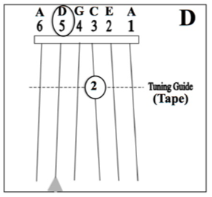
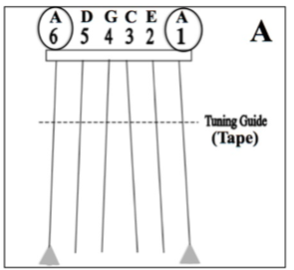
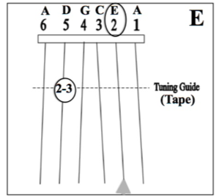
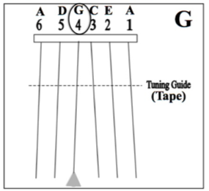
Guitarron Notes: D, A, G, F# E,
Key of “Re” (p. 10)
Tape: One Whole
Step from Nut

Slide 21
Ranchera Valseada Style (p 11)
3/4 Time Signature Mánico: Down Strums
Mostly Major Keys Golpe Strum
Cielito
Lindo
HINT: Have students speak text in rhythm before playing.

Slide 22
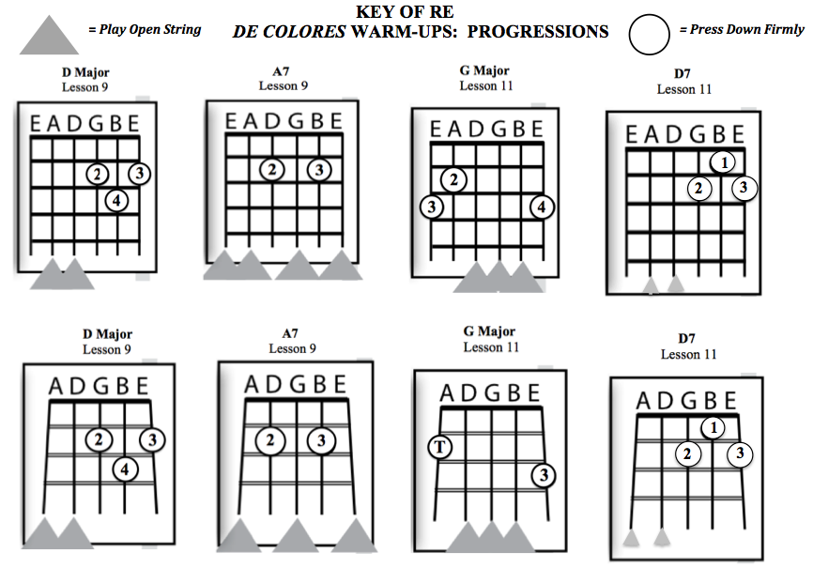
(p 6)
New Chord
New Chord

Slide 23
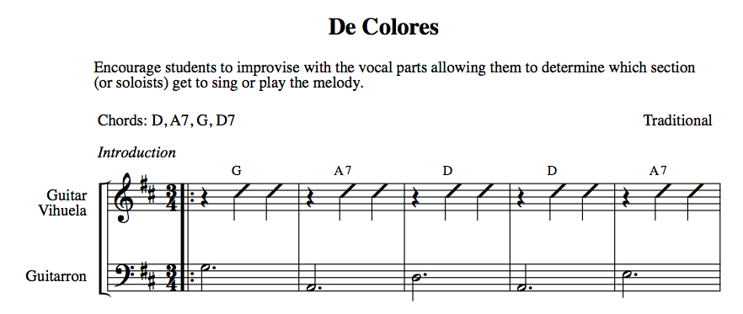
(pp 12-13)
Rehearsing Chord Progressions

Slide 24
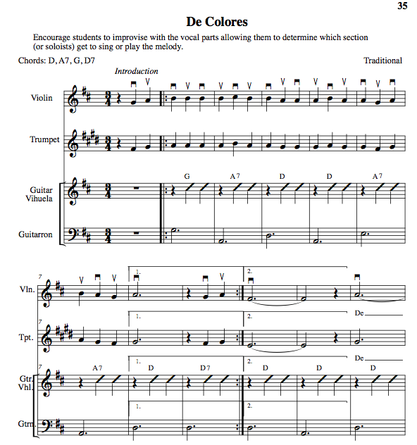
De Colores
p 14
Speak text first.

Slide 25
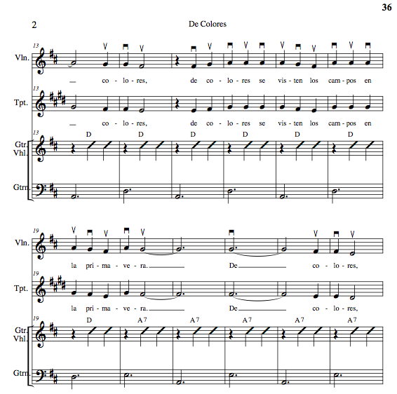
p 15

Slide 26
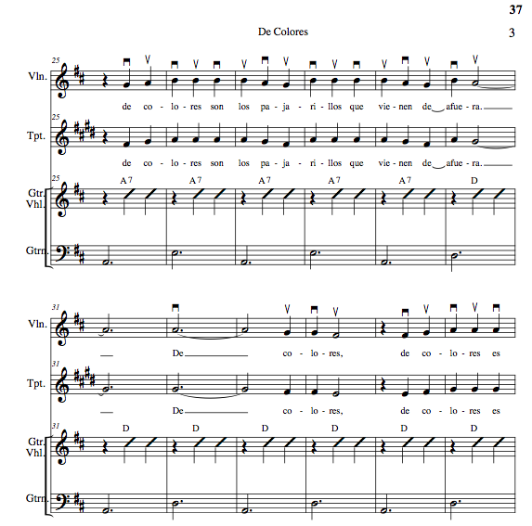
p 16

Slide 27
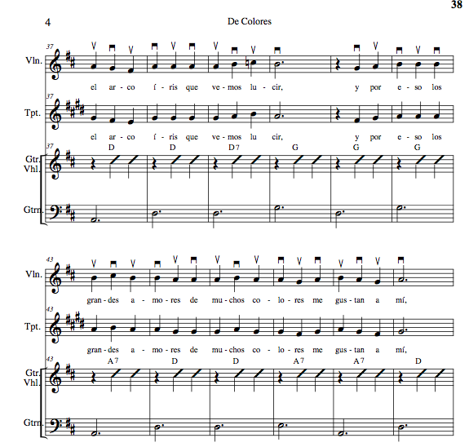
p 17

Slide 28
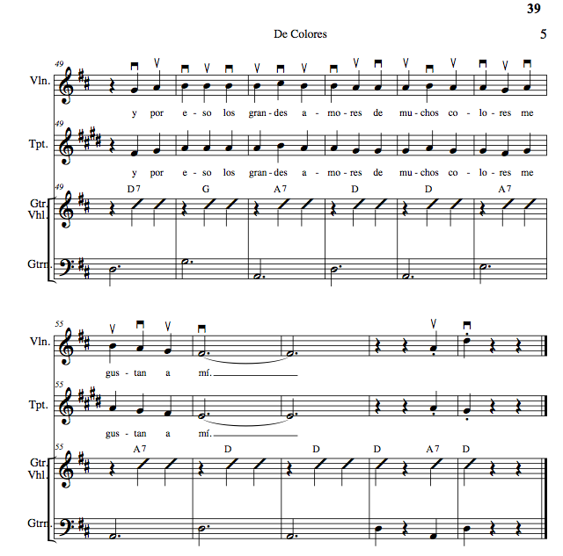
p 18

Slide 29
Bolero Style (p 19)
Mánico: Note Down Strums Common Time
Note Guitarron Rhythm Mostly Major Keys
Gema
Notes:
29

Slide 30
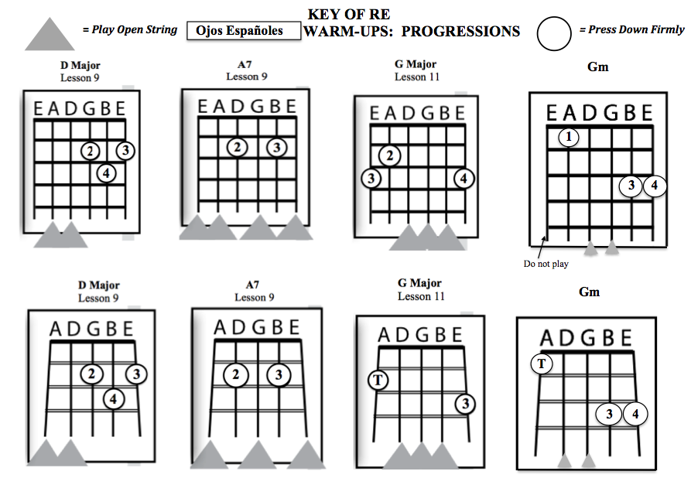
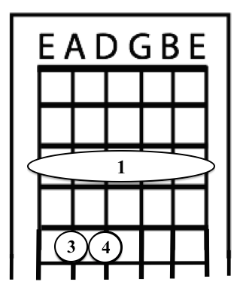
Ojos Españoles (p 20)
(Spanish Eyes)
Gm
New Chord
New Chord
Notes:
30

Slide 31
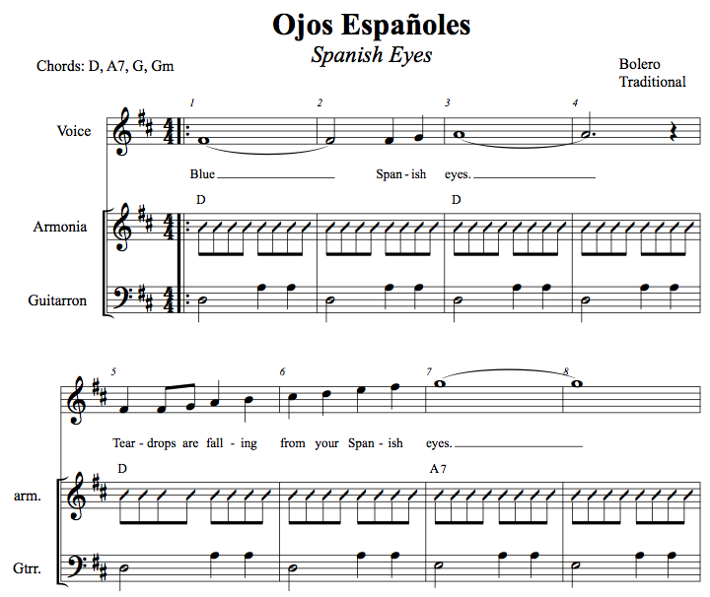
p. 21
31
Notes:
31

Slide 32
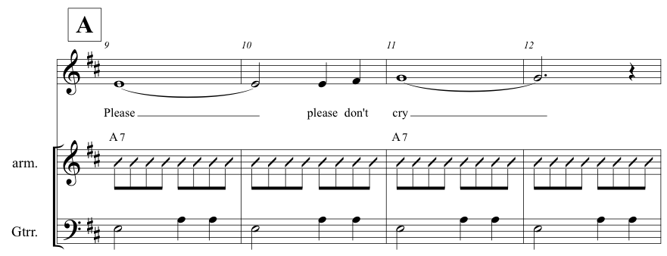
Notes:
32

Slide 33
Gm Coming Up
33
Notes:
33

Slide 34
Skip Repeats
34
Notes:
34

Slide 36
p 24

Slide 37
Mariachi Education

Slide 39
Scope and Goals – Course Syllabi
BEGINNING MARIACHI
Course Scope:
This one-year course is designed for the student who is interested in learning to play a mariachi instrument including violin, trumpet, guitar, vihuela and guitarron. It includes the development of skills necessary to become independent as a musician. This course concentrates on the development of note-reading skills, aural skills, singing skills, rhythmic patterns, intonation, and tonality inherent to the mariachi genre. A progression of fundamental and technical proficiency is expected.
Course Goals:
To develop age-appropriate individual singing and playing skills leading to independence as a mariachi musician.
To develop the singing and playing skills necessary to create an ensemble sound in the basic mariachi styles.
To identify and respond appropriately to music notation.
To develop the ability to play with correct intonation.
To demonstrate an understanding of the form and structure of the basic mariachi styles.
To demonstrate nuances inherent to the basic mariachi styles.
To demonstrate reasonable progression in fundamental and technical proficiency.

Slide 40
Rubrics

Slide 41
Must-have Standards-based Materials for Beginning Level Programs Method Series Song Book Series

Slide 42
¡Simplemente Mariachi!
EX: Lesson 1 Plan
Notes:
42

Slide 43
More References for Beginning Level Programs Must-have Materials

Slide 44
Just Released from
Hal Leonard!
Arranged by
Jose Hernandez

Slide 48
The Fabulous Golden Nugget
Hotel and Casino Las Vegas
www.musicedconsultants.net/2018-mariachi-workshops
National Mariachi Workshops
for Educators®
3 Grad Credits Available
July 9-13(14), 2018

Slide 50
Instrument Options KNOW YOUR VENDOR!!! You Get What You Pay For!
ALWAYS Buy from a Reputable Dealer!

Slide 51
Uniform Options
White Shirt and Black Pant with Basic Moño
Traje de Gala
(Full Mariachi Suit)
Decorative Jacket
with pant/skirt
and coordinating Moño.
Vaquero Uniform
(Ranch/Cowboy)
Decorative pant/skirt
and shirt with
Coordinating Moño

Slide 52
Bailey MS Mariachi Year 2 of Program

Slide 53
MUCHAS GRACIAS!
West Music & U of Iowa!
@MusicEdConsult @JoseSoldeMexico
Posted Online at:
www.musicedconsultants.net/conference-materials
marcia@musicedconsultants.net

