Slide 1
I Can’t Hear You –
You’re SCREAMING!
Marcia Neel
October 8, 2015
marcia@musicedconsultants.net
www.musiceducationconsultants.net

Slide 2
Ever had trouble getting someone to
understand what you’re trying to say?

Slide 3
You keep trying and trying and trying?

Slide 4
So what’s the problem?
Everyone communicates but. . .
few connect!

Slide 5
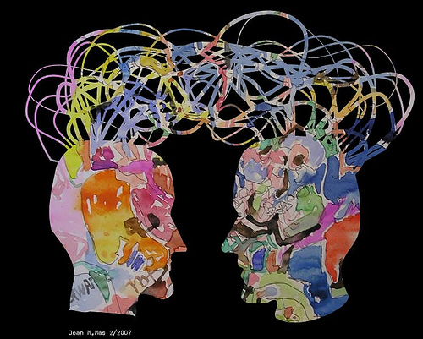
1. Communication. . .
Ability to listen
effectively
Ability to express
thoughts effectively
with others –
both verbally and non-verbally
Have you tried. . . .
Result-driven Communication?

Slide 6
Result-driven Communication: Precise communication at the right place and the right time is a guarantee for success.

Slide 7
So what is CONNECTING?
“Connecting is the ability to identify with people
and relate to them in a way that increases your
influence with them.”
Why is that IMPORTANT?
“Because the ability to communicate and connect
with others is a major determining factor in
reaching YOUR potential.”

Slide 8
Prime Goal: YOU’VE GOT TO
HAVE A VISION!

Slide 9
Five Connecting Principles
1. Connecting Increases Your Influence in
Every Situation. . .
set people up to connect
with and receive your “message” or “vision.”
a. With Students
b. With Parents
c. With Administrators
d. With EVERYONE!

Slide 10
Five Connecting Principles
2. Connecting is All About Others. . .
It begins
when the other person feels valued.
STOP
LOOK
LISTEN!

Slide 11
Five Connecting Principles
2. Connecting is All About Others. . .It begins when the other person feels valued.
a. Transfer the Vision
b. Walk Slowly Through the Halls
c. Develop Each “Team Member” as a Person
d. Place People in their Strength Zones

Slide 12
Five Connecting Principles
2. Connecting is All About Others. . .It begins when the other person feels valued.
e. Model the Behavior You Desire
f. Reward for Results
g. See Everyone as a “10!”

Slide 13
Five Connecting Principles
3. Connecting Goes Beyond Words. . .
Body
Language

Slide 14
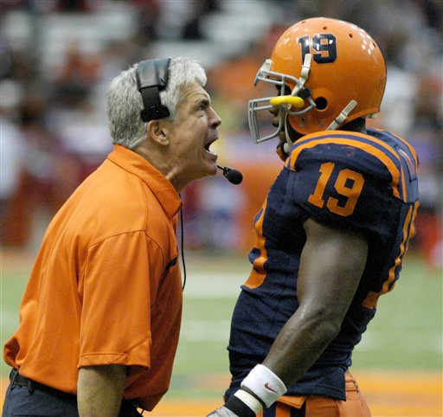
Five Connecting Principles
3. Connecting Goes Beyond Words. . .
…Your actions speak so loudly, I can’t hear what you’re saying!

Slide 15
Expressive Body Language Begins Early Check out this Toddler

Slide 17
Five Connecting Principles
“they” get out of it what “you” put into it!
4. Connecting Always Requires Leadership. . .
a. A Leadership Team is More Effective
than Just One Leader…
build your team
everything rises and falls on leadership
b. Leaders are Needed at Every Level…
c. Leading Successfully at One Level is a
Qualifier for Leading at the Next Level…
focus on leading well where you are

Slide 18
Five Connecting Principles
“they” get out of it what “you” put into it!
4. Connecting Always Requires Leadership. . .
d. Good leaders create good leaders…
strength brings out strength

Slide 19
Five Connecting Principles
“they” get out of it what “you” put into it!
4. Connecting Always Requires Leadership. . .
e. Good leaders possess needed qualities…
Adaptability—Quickly Adjusts to Change
Discernment—Understands the Real Issues
Perspective—Sees Beyond Their Own
Vantage Point
Communication—Links to everyone
effectively
Security—Finds Identify in Self, Not Position

Slide 20
Five Connecting Principles
5. Connecting is More Skill than Natural Talent. . .
GOOD NEWS--it can be learned!
a. Resourcefulness—Finding Creative Ways to Make Things Happen by Reaching Out
b. Maturity—Putting Team before Self
c. Endurance—Remaining Consistent in
Character and Competence over the
Long Haul
d. Countability—Can be Counted on when it
Counts

Slide 22
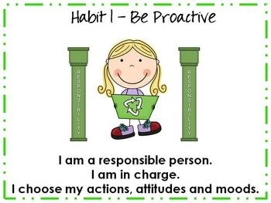

Slide 25
3. Put First Things First

Slide 26
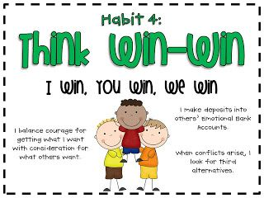
4. Think Win-Win

Slide 27
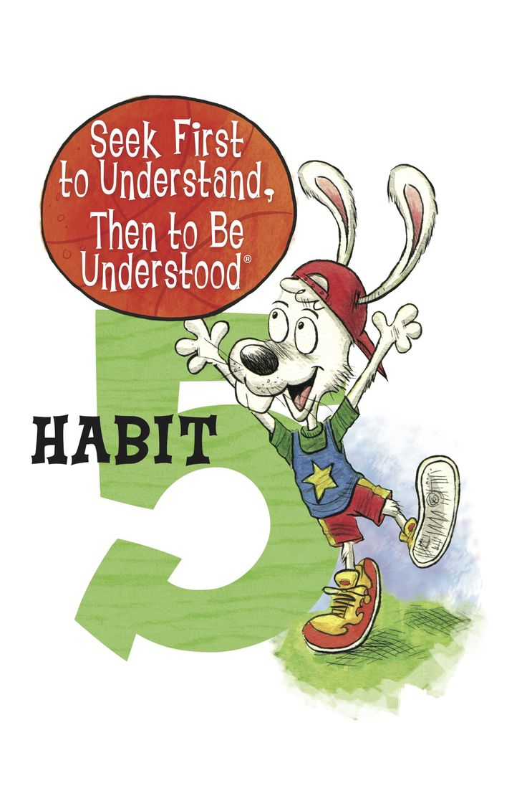

Slide 28
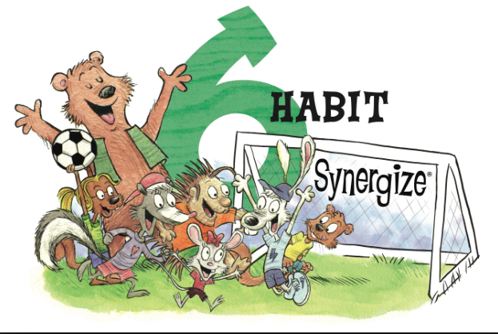

Slide 29
6. Synergize

Slide 30
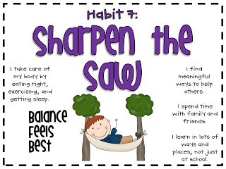

Slide 31
Dorothy Custer

Slide 32
Got Smart Phone?
marcia@musicedconsultants.net
@MusicEdConsult
On Twitter
Thank You!
www.musicedconsultants.net/
conference-materials

