Slide 1
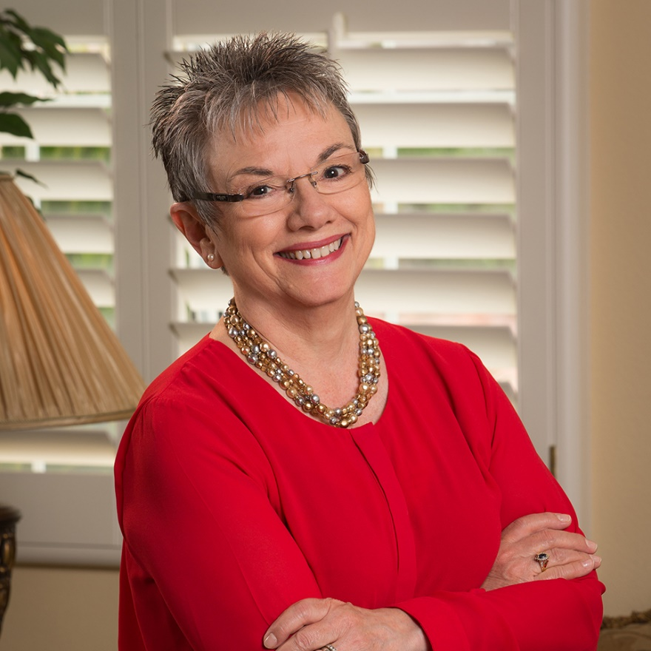
Marcia Neel Master Educator

Slide 3
From: Paradise Lost
Exstasis: All I Want to do is Fly

Slide 5
Why?

Slide 6
School is. . .
Impressionistic
vs
Expressionistic
Music is. . .

Slide 7
A focus on these 5 C’s is essential
to prepare students for their future.
Creativity
Critical Thinking
Collaboration
Confidence
Communication
Therefore. . .

Slide 8
The Music Skills Practice Room is. . .
The Life Skills Practice Room

Slide 9
The Life Skills Practice Room
1. Creativity (Innovation). . .
Ability to create new and more
worthwhile ideas and to work
creatively with others.
Create something that we don’t even know that we need!

Slide 10
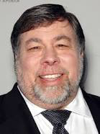
The Life Skills Practice Room
Creative Thinkers

Slide 11
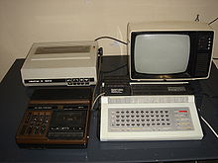
The Life Skills Practice Room
Creative Thinkers
Steve Wozniak

Slide 12
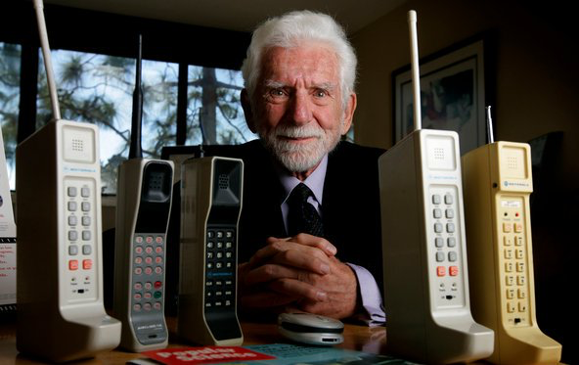
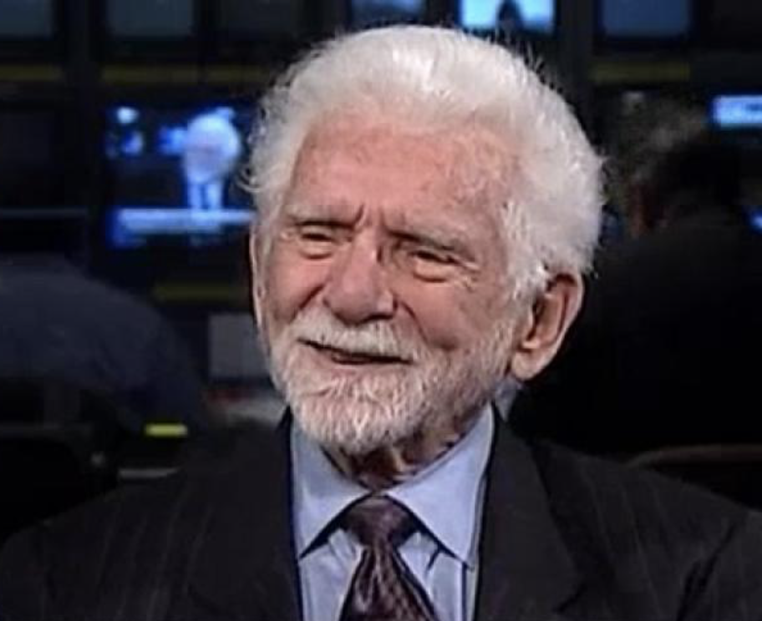
The Life Skills Practice Room
Creative Thinkers

Slide 13
The Life Skills Practice Room
Creative Thinkers
Martin Cooper

Slide 14
The Life Skills Practice Room
Creative Thinker

Slide 15
The Life Skills Practice Room
2. Critical Thinking. . .
Ability to reason effectively and
solve problems.

Slide 16
The Life Skills Practice Room
Problem-Solving
EX: A student’s solution to getting
people to turn off their phones during a performance:

Slide 17
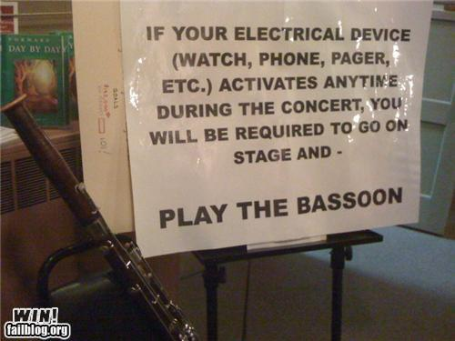

Slide 18
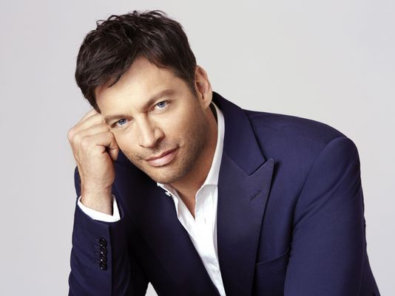
The Life Skills Practice Room
Problem Solvers:

Slide 19
The Life Skills Practice Room
Harry Connick, Jr. holds a
patent for a digital sheet
music, touch-screen system
that coordinates musical
displays for musicians in
an orchestra. No need to
print revised parts!

Slide 20
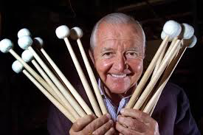
The Life Skills Practice Room
Problem Solvers:

Slide 21
The Life Skills Practice Room
Vic Firth was inspired to design a
higher-quality mallet than the
“warped utensils and implements
not specifically designed for
percussionists” while
playing timpani with the
Boston Symphony Orchestra.

Slide 22
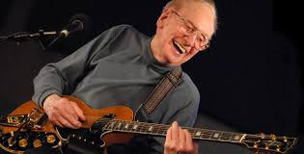
The Life Skills Practice Room
Problem Solvers:

Slide 23
The Life Skills Practice Room
Les Paul invented the
solid body guitar because his audience at the BBQ joint
where he performed
couldn’t hear him play.

Slide 24
The Life Skills Practice Room
3. Collaboration (Teamwork). . .
Ability to work effectively and respectfully with ALL

Slide 25
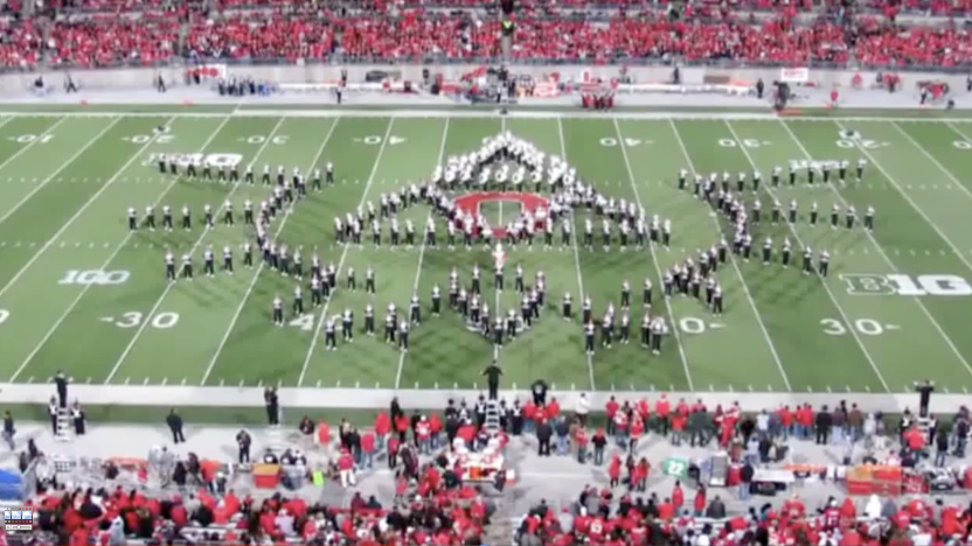
The Life Skills Practice Room
Ohio State University Marching Band

Slide 26
The Life Skills Practice Room
Ohio State University Marching Band

Slide 27
The Life Skills Practice Room
4. Confidence. . .
Ability to handle EVERY
CIRCUMSTANCE and grow from it.

Slide 28
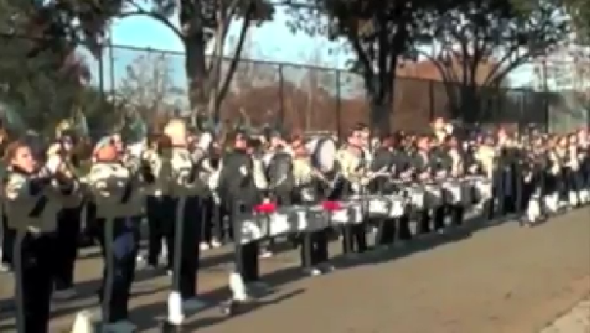
The Life Skills Practice Room

Slide 29
The Life Skills Practice Room

Slide 30
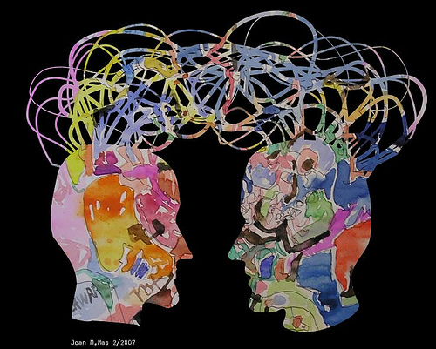
The Life Skills Practice Room
5. Communication. . .
Ability to listen
and express thoughts
effectively

Slide 31
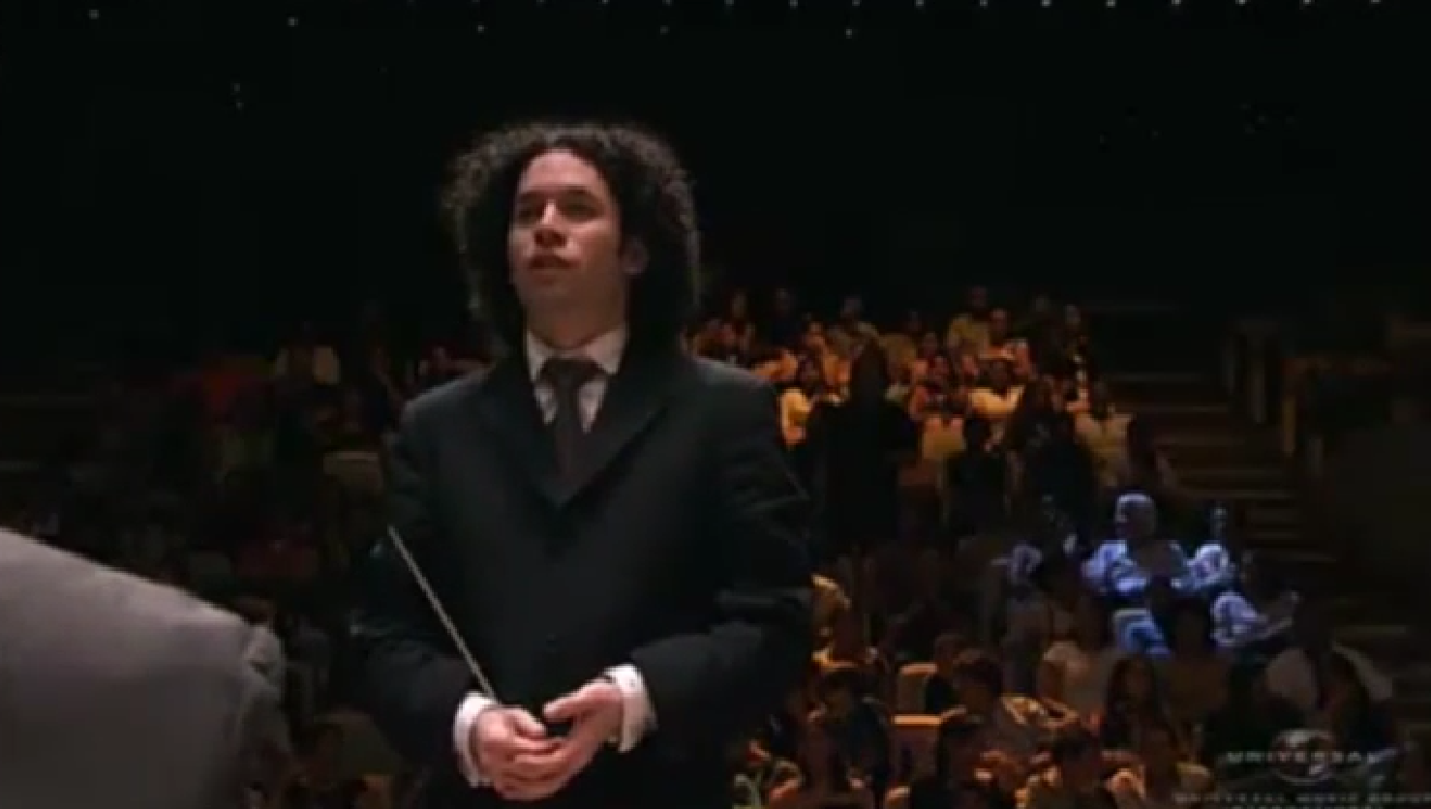
Communication
Maestro Gustavo Dudamel

Slide 32
Communication
Simón Bolivar School Orchestra, Venezuela

Slide 33
Parents
Teachers
“ONE IS TOO SMALL A
NUMBER TO ACHIEVE
SOMETHING GREAT”
Principals
Custodians
How can we ALL come together?
Support Staff
Dealers
Community

Slide 34
Focus on One Goal

Slide 35
Focus on One Goal
Ensure continued,
active music-making.

Slide 37
We offer a path to Success
We provide meaningful, lifelong Memories
We provide authentic learning through Action
We teach mutual Respect
We teach students to Think

Slide 38
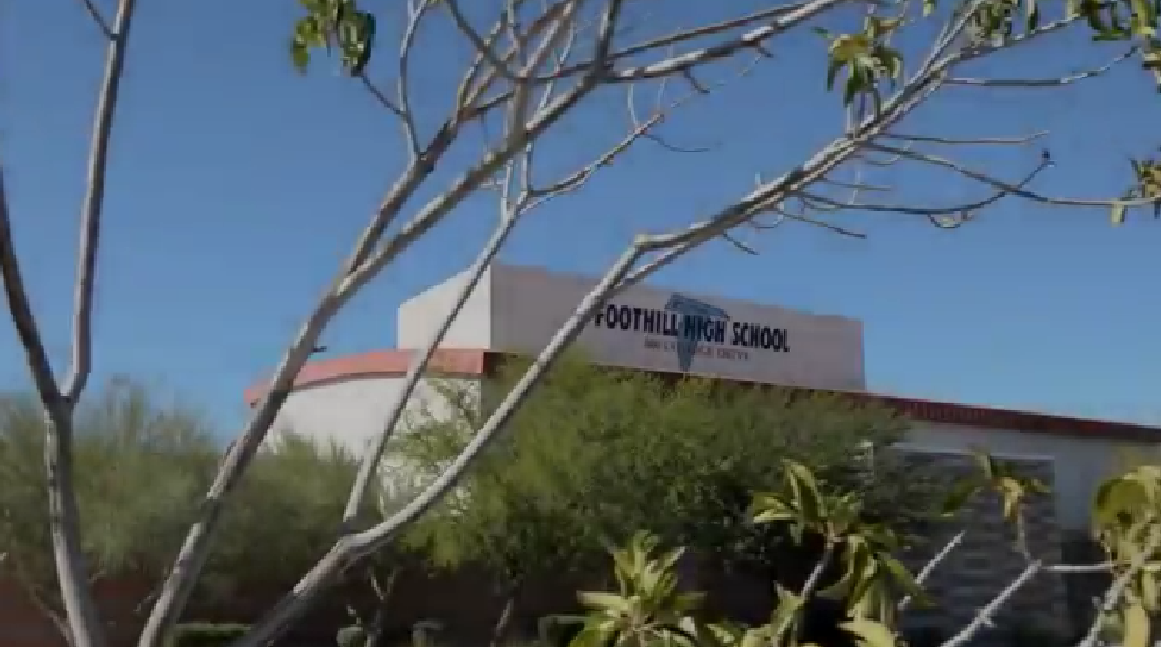
There is a Place…where kids are S.M.A.R.T.

Slide 39
There is a Place…where kids are S.M.A.R.T.

Slide 40
Master Educator Program
Our mission is to provide inspiring professional development opportunities and artistic music collaborations for music educators at the local, state and national levels.

