Slide 1
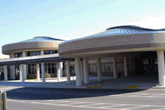
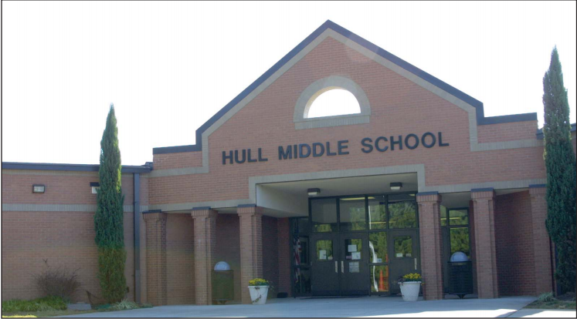
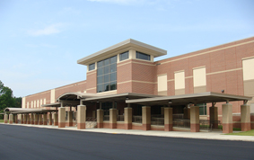
Peachtree Ridge High School
Hull Middle School Northbrook Middle School
March 9, 2018 11:00 AM
www.musicachievementcouncil.org

Slide 2
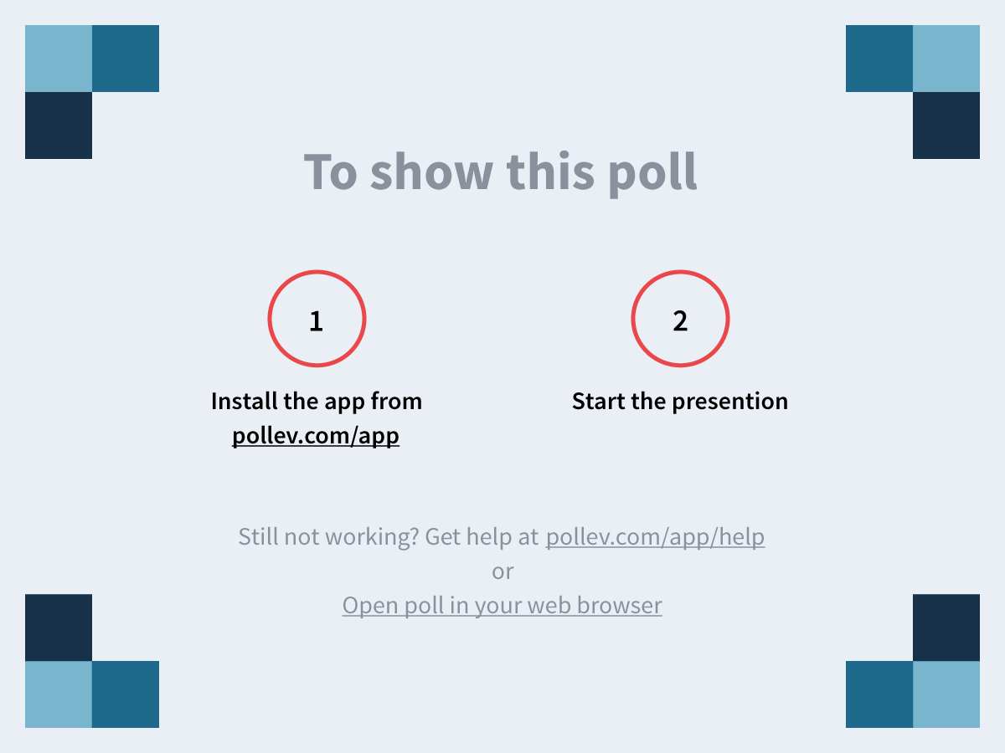
Notes:
Parents, what one word would you use to describe your reaction to today's performance? https://www.polleverywhere.com/free_text_polls/6R1FuKsPv4YxtMe

Slide 3
Who: Beginning Instrumental Programs
What: Director Letter
Parent Letter
Principal Letter
Script
Ideas to Enhance the Experience
Fillable Certificate of “Advancement”

Slide 4
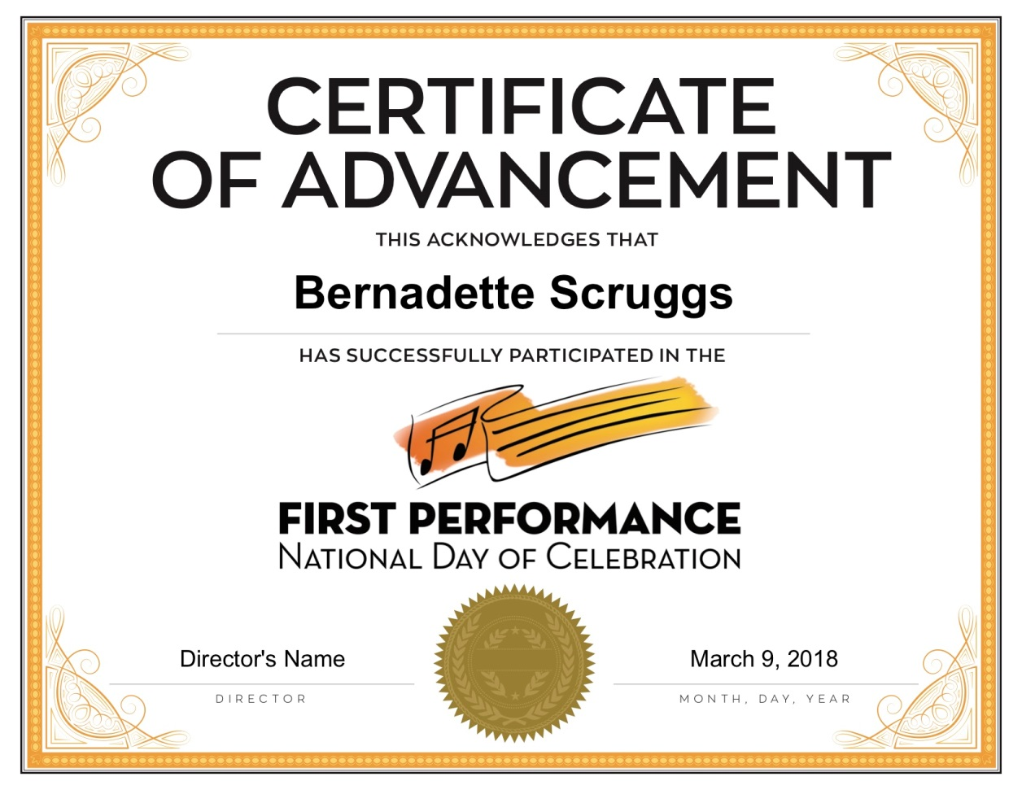
www.musicachievementcouncil.org

Slide 5
When: 3rd Thursday of November Annually
Why: To Increase Retention
How: www.musicachievementcouncil.org
Panel: Questions, Ideas
www.musicachievementcouncil.org

Slide 6
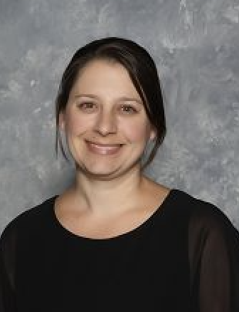
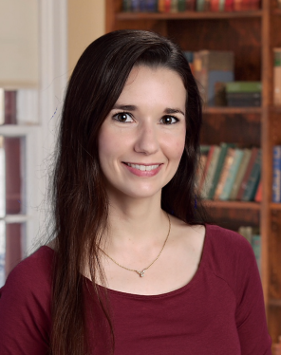
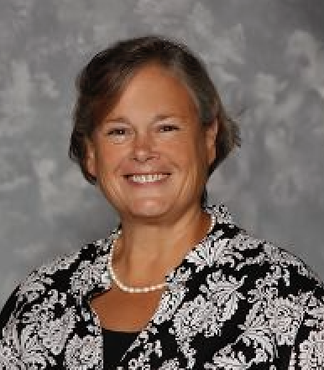
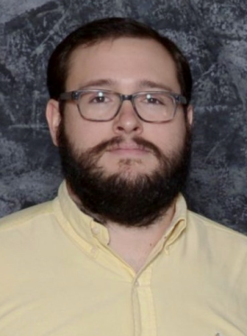
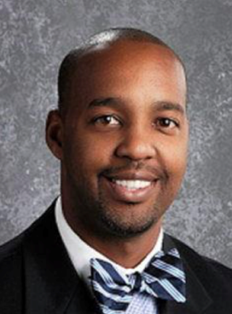
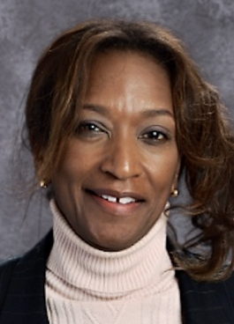
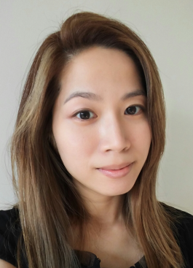
Victoria Enloe Amanda McClellan Bernadette Scruggs
Director Director Director
Peachtree Ridge HS Hull MS Peachtree Ridge HS
Bill Scruggs Keith Thompson Denise Showell Janice Yoon
Director Principal Principal Director
Northbrook MS Northbrook MS Hull MS Northbrook MS
www.musicachievementcouncil.org

Slide 7
Notes:
Parents, now that you have seen your child perform, are you more likely to encourage your child to stick with music? https://www.polleverywhere.com/multiple_choice_polls/gLxFirjIo5vaOCe

Slide 8
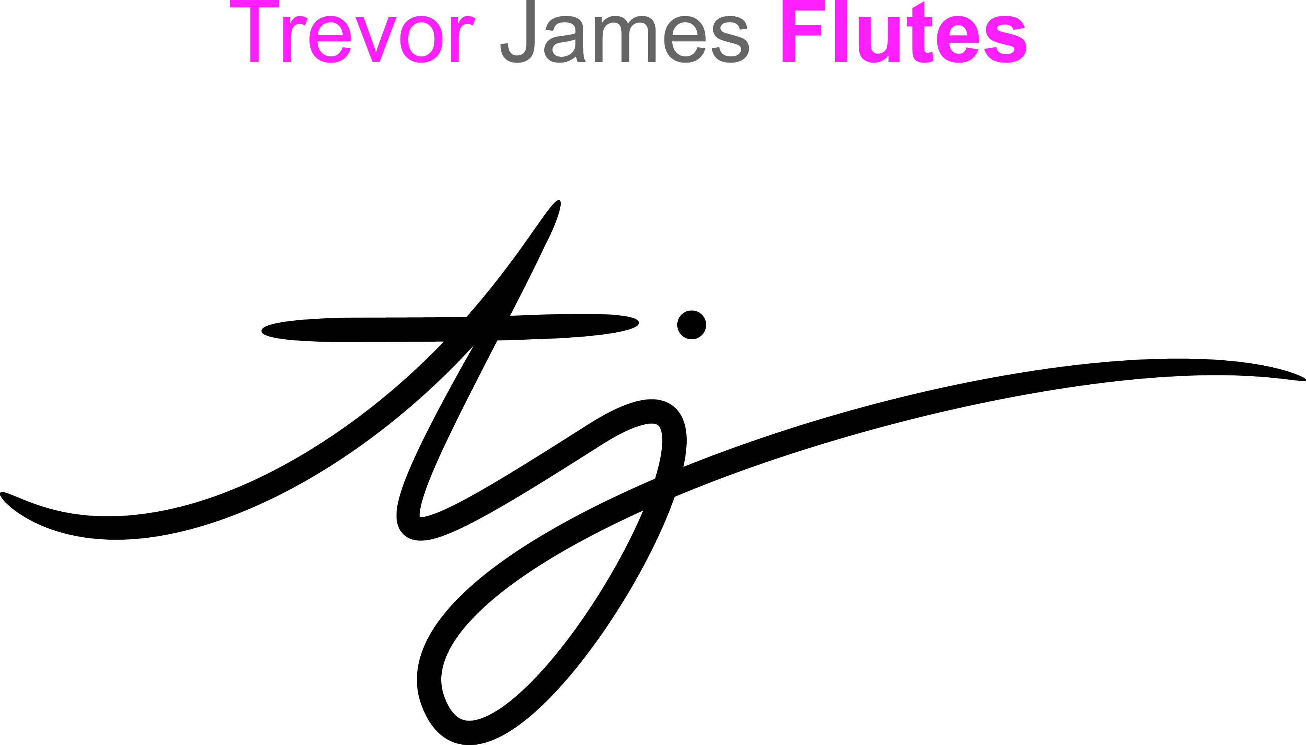
@FirstGigMAC @MusicEdConsult
Thanks to these Quality Companies!
www.musicachievementcouncil.org
Notes:
www.musiceducationconsultants.net/mmea2010
8

Slide 9
@FirstGigMAC @MusicEdConsult
Thanks to these Quality Companies!
www.musicachievementcouncil.org
Notes:
www.musiceducationconsultants.net/mmea2010
9

