Slide 1
DID YOU KNOW . . .
The Music Achievement Council (MAC) is an action-oriented, non-profit organization whose sole
purpose is to enable more students to begin and continue in instrumental music programs.
www.musicachievementcouncil.org

Slide 2
DID YOU KNOW . . .
96 percent of public school principals
believe that participating in music
education encourages and motivates
students to stay in school longer.
(Harris Poll)
www.musicachievementcouncil.org

Slide 3
DID YOU KNOW . . .
An interactive poll confirms that music education at an early age greatly increases the likelihood that a child will grow up to seek higher education and ultimately even earn a higher salary. (2007 Harris Poll)
www.musicachievementcouncil.org

Slide 4
THE MESSAGE IS. . .
If you want to be a CEO, College President, or
even a Rock Star,
TAKE MUSIC!
www.musicachievementcouncil.org

Slide 5
THE MESSAGE IS. . .
If you want to be a CEO, College President, or
even a Rock Star,
TAKE MUSIC!
www.musicachievementcouncil.org

Slide 6
THE MESSAGE IS. . .
If you want to be a CEO, College President, or
even a Rock Star,
TAKE MUSIC!
www.musicachievementcouncil.org

Slide 7
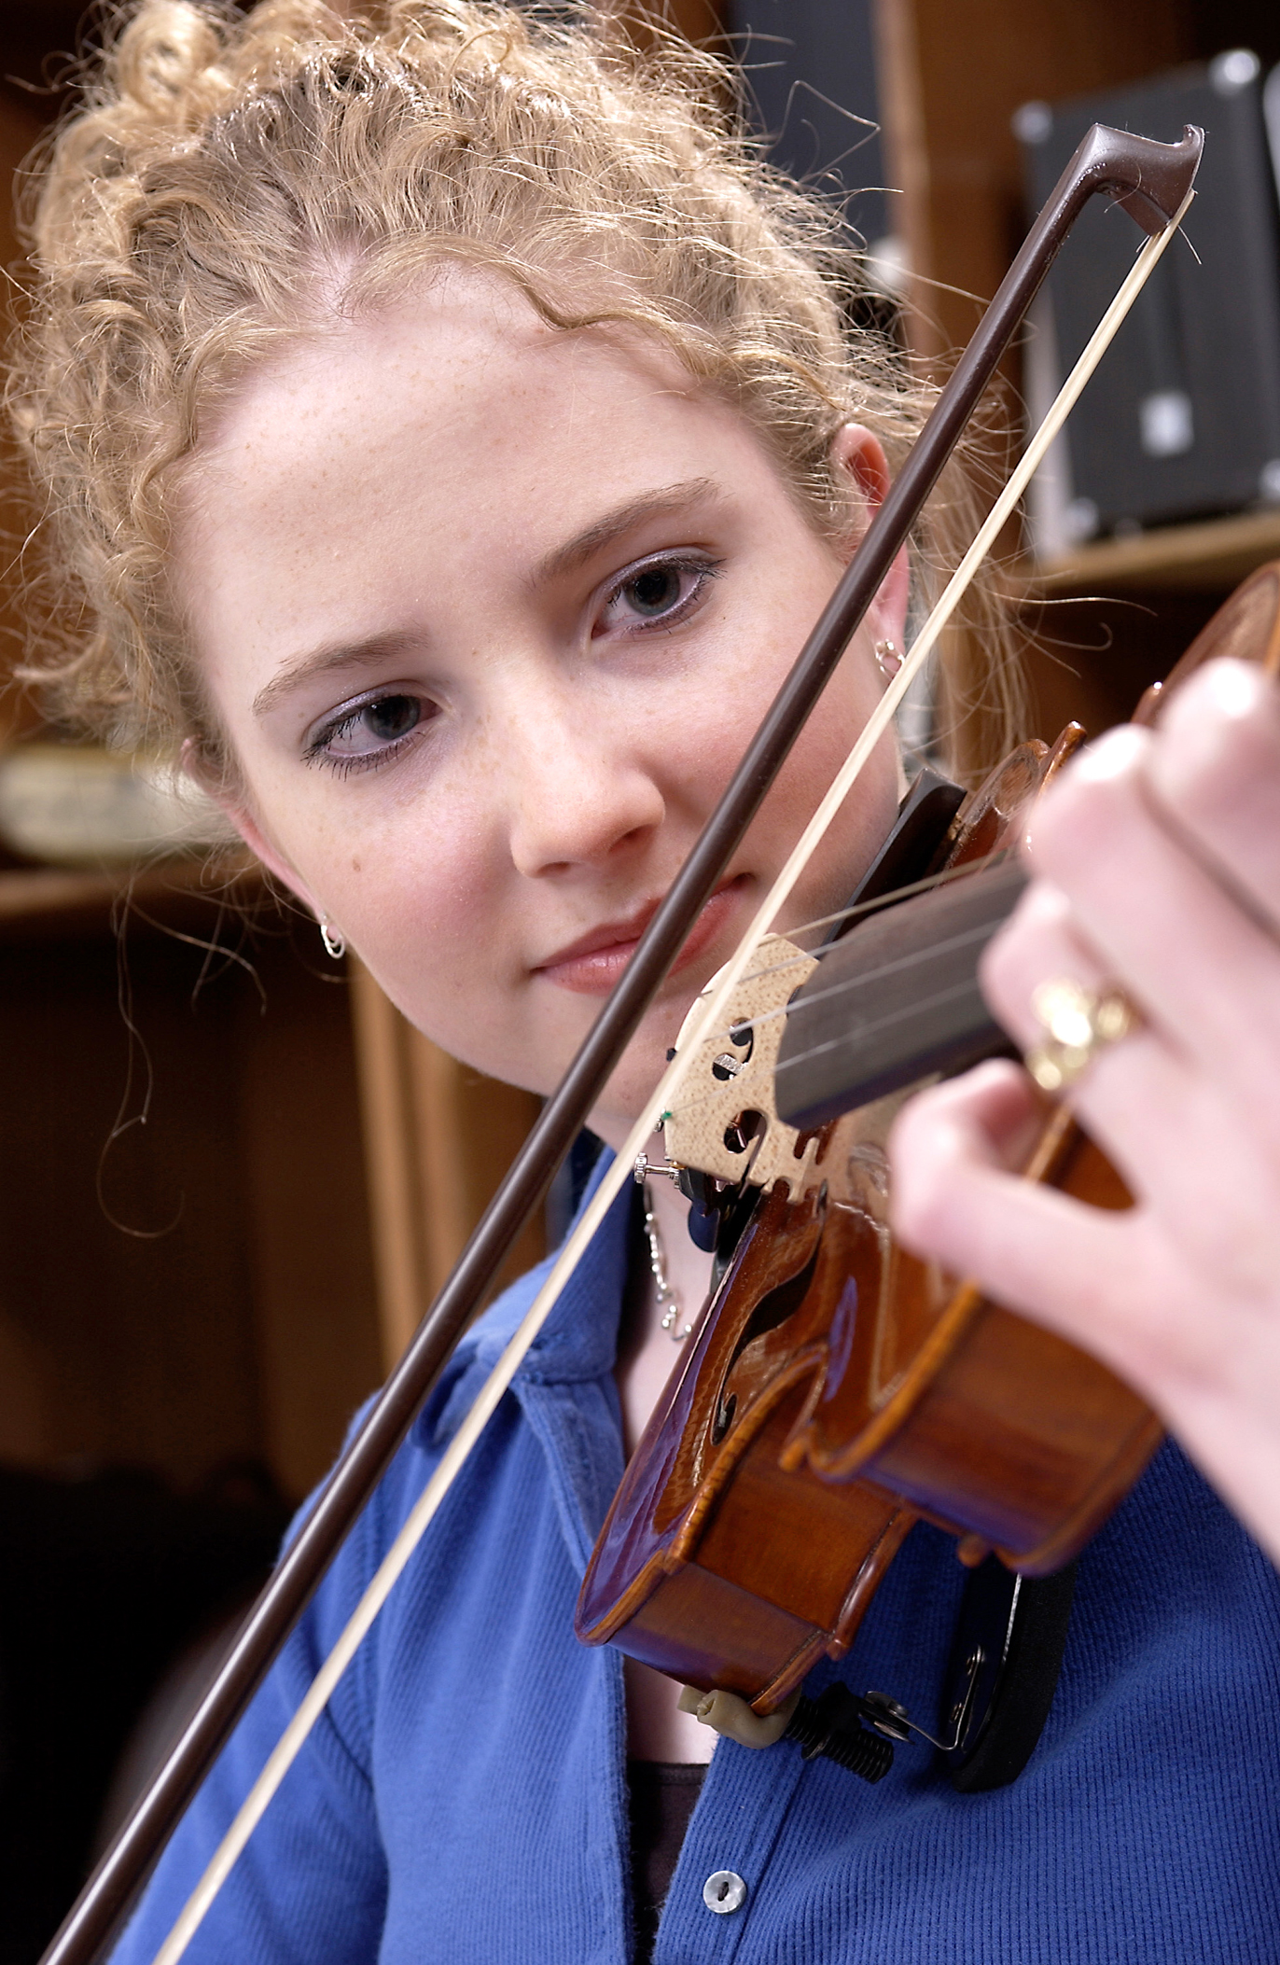
DID YOU KNOW . . .
82 percent of Americans who don’t currently play an instrument wish they had learned to play one. (Gallup Poll)
www.musicachievementcouncil.org

Slide 8
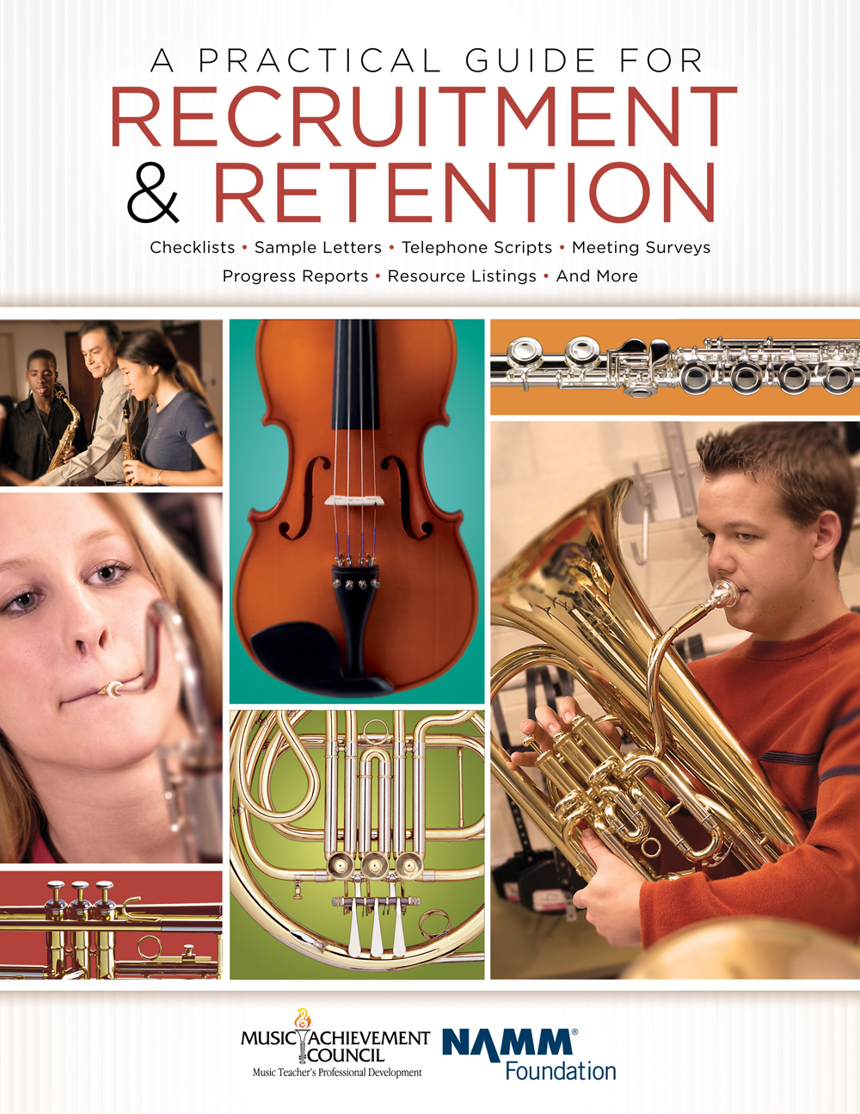
DID YOU KNOW . . .
All of today’s session attendees will receive FREE COPIES of:
A Practical Guide for Recruitment and Retention
www.musicachievementcouncil.org

Slide 9
DID YOU KNOW . . .
All of today’s session attendees will receive FREE COPIES of:
Tips for Success:
A Guide for Instrumental Music Teachers
www.musicachievementcouncil.org

Slide 10
DID YOU KNOW . . .
All of today’s session attendees will receive FREE COPIES of:
Bridging the Gap between
Middle School and High School
www.musicachievementcouncil.org

Slide 11
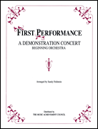
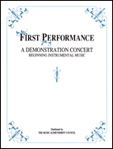
DID YOU KNOW . . .
The First Performance Demo Concert for Band and/or Orchestra features sheet music, parts, sample letters, programs and student certificates for beginning ensembles. Students can perform a composition in seven short weeks with the materials provided!

Slide 12
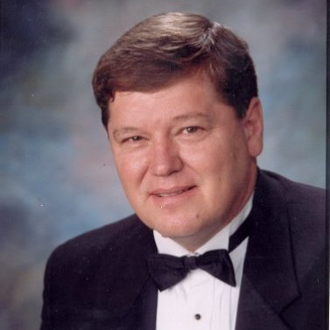
DID YOU KNOW . . .
Three of these publications are provided online at no charge by the Music Achievement Council.
Greg Bimm
They are based on real world strategies shared
by the profession’s most successful music educators.
www.musicachievementcouncil.org

Slide 13
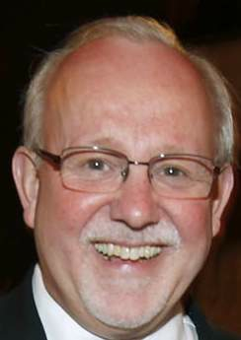
DID YOU KNOW . . .
Three of these publications are provided online at no charge by the Music Achievement Council.
Charlie Menghini
They are based on real world strategies shared
by the profession’s most successful music educators.
www.musicachievementcouncil.org

Slide 14
DID YOU KNOW . . .
Three of these publications are provided online at no charge by the Music Achievement Council.
Marcia Neel
They are based on real world strategies shared
by the profession’s most successful music educators.
www.musicachievementcouncil.org

Slide 15
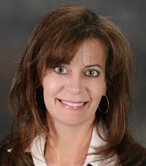
DID YOU KNOW . . .
Three of these publications are provided online at no charge by the Music Achievement Council.
Terry Shade
They are based on real world strategies shared
by the profession’s most successful music educators.
www.musicachievementcouncil.org

Slide 16
DID YOU KNOW . . .
www.musicachievementcouncil.org

Slide 17
DID YOU KNOW . . .
Music making has been scientifically proven to:
Exercise the brain
Inspire creativity
Increase productivity
Fight memory loss
Reduce stress
Lower blood pressure
Build confidence
Stave off depression

Slide 18
DID YOU KNOW . . .
Metropolitan Nashville Public Schools found that ATTENDANCE RATES ROSE with increased study in music.
No Music:
< 1 Year of Music:
> 1 Year of Music:
87% Attendance
91% Attendance
93% Attendance

Slide 19
DID YOU KNOW . . .
Metropolitan Nashville Public Schools found that DISCIPLINE REPORTS FELL with increased study in music.
No Music:
< 1 Year of Music:
> 1 Year of Music:
4.34 over 4 years
3.75 over 4 years
3.23 over 4 years

Slide 20
DID YOU KNOW . . .
Metropolitan Nashville Public Schools found that GPAs ROSE with increased study in music.
No Music:
< 1 Year of Music:
> 1 Year of Music:
2.51 Average
2.61 Average
2.89 Average

Slide 21
DID YOU KNOW . . .
Metropolitan Nashville Public Schools found that GRADUATION RATES ROSE with increased study in music.
No Music:
< 1 Year of Music:
> 1 Year of Music:
60% Average
81% Average
91% Average

Slide 22
DID YOU KNOW . . .
Metropolitan Nashville Public Schools found that ACT SCORES ROSE with increased study in music.
No Music:
< 1 Year of Music:
> 1 Year of Music:
16.95 Eng, 17.20 Math
17.64 Eng, 17.62 Math
19.58 Eng, 18.67 Math

Slide 23
WHAT WAS LEARNED?
The LONGER a student participates in MUSIC,
the more POSITIVE these BENEFITS become.

Slide 24
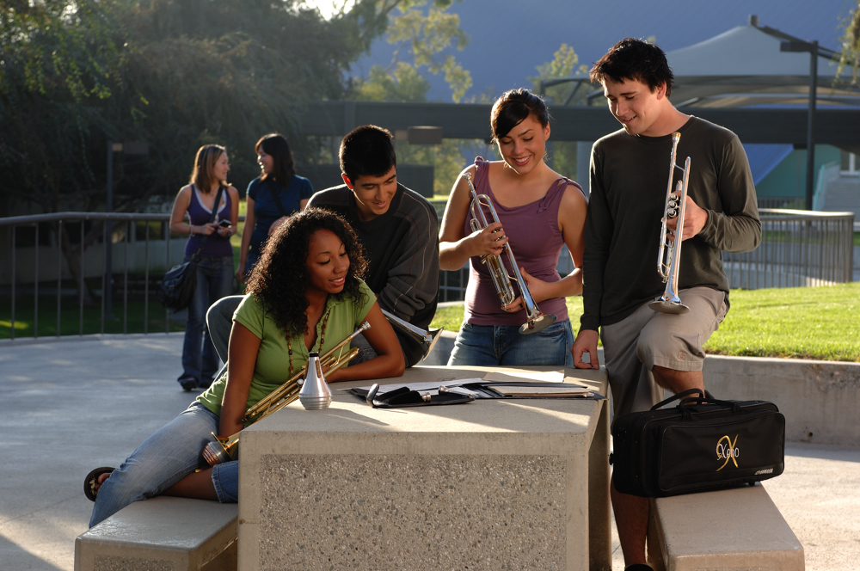
FAMOUS QUOTES. . .
Music has the power of producing a
certain effect on the moral character
of the soul.
. . . Aristotle

Slide 25
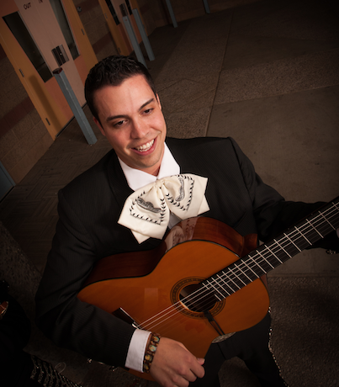
FAMOUS QUOTES. . .
Music furnishes a delightful recreation
for the hours of respite from the cares of the day, and lasts us through life.
. . . Thomas Jefferson

Slide 26
TIPS for Success!
Secrets Revealed From Our Very Best!
Marcia Neel
2016 WMEA
Wendy McKee
Renier Fee
National Association of
School Music Dealers

Slide 27
Consider the Education/Training Needed for These Careers
All of this is YOUR Job! How is it going?
Accountant
Politician
Architect
Psychologist
Author
Public Relations Executive
Career Planner
Quality Assurance Executive
Financial Planner
Sales Executive
Travel Agent
Magician
www.MusicAchievementCouncil.org

Slide 28
1. Focusing on the Classroom

Slide 29
Focusing on the Classroom What does a Music Educator Do?
Teach (Standards-based)
Communicate
Share Love of Music
Communicate
Prepare Quality Lessons
Communicate
Assess Student Progress
Communicate
Notes:
Produced by the Music Achievement Council
29

Slide 30
Effective Communication is a Must!

Slide 31
Focusing on the Classroom Recruitment and Retention
WE WANT YOU!

Slide 32
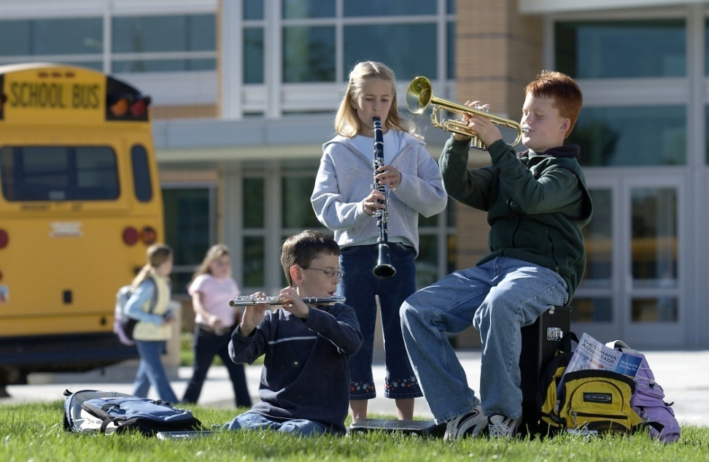
Focusing on the Classroom Recruit: Attract Students Year-Round
Foster student interest through visibility
Inform parents of benefits of music
Build and nurture support among administration & classroom teachers

Slide 33
Focusing on the Classroom Recruit: Attract Students Year-Round
Regular visits with feeder programs/teachers
Mass concerts with feeder programs
including recorder classes
Recruitment meetings with
students and parents—REACH OUT!
Instrument demos/petting zoos—START EARLY!

Slide 34
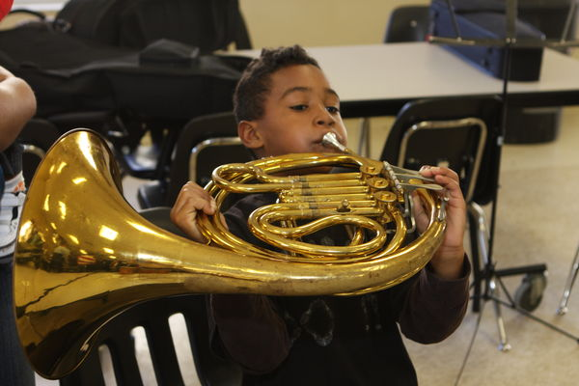
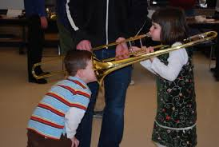
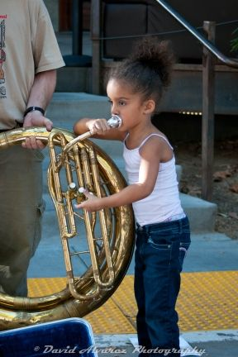
Focusing on the Classroom Recruit: Attract Students Year-Round
Instrument demos/petting zoos

Slide 35
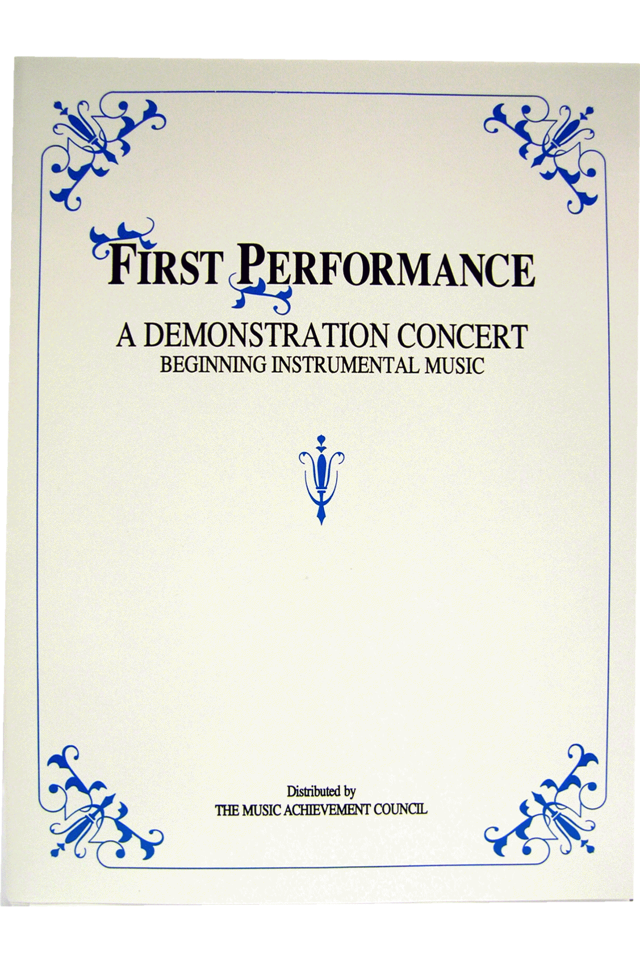
Focusing on the Classroom Build the vision EARLY — Elementary
GET ‘EM FIRED UP!
Give a
First Performance
Concert
With Your Beginners!
Involve Experienced Players!

Slide 36
Focusing on the Classroom First Performance Demo Concert
Build the vision EARLY — Elementary

Slide 37
Focusing on the Classroom Recruitment and Retention
Build the vision EARLY — Elementary

Slide 38
Focusing on the Classroom Recruitment and Retention
Build the vision EARLY—Elementary Parents

Slide 39
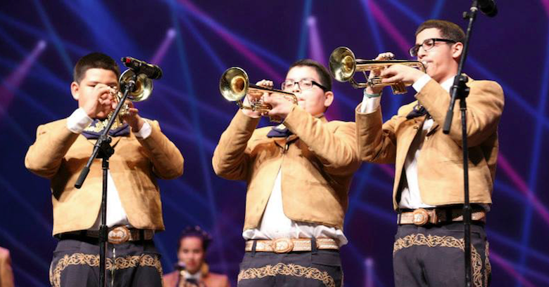
Focusing on the Classroom Recruitment and Retention
Broaden Your Base!
Monaco MS Mariachi

Slide 40
Focusing on the Classroom Recruitment and Retention
Bailey MS Mariachi – Year 2

Slide 41
“13 Reasons They Stay in Band”

Slide 42
2. The Business Side of Teaching

Slide 43
The Business Side of Teaching Working with Administrators/Faculty
Celebrate your faculty!
Include the principal & faculty in concerts to discover the joy of music-making
Keep all informed of activities/events & THANK THEM OUTWARDLY for their support.
Sign up to chaperone a dance, cover a class, attend a game and/or serve on committees
Notes:
Produced by the Music Achievement Council
43

Slide 44
The Business Side of Teaching Choosing a Music Dealer
Dealers Support Our Programs by. . .
Providing advocacy materials & recruiting help
Providing regular service calls
Ensuring competitive prices
Offering lease programs for new instruments
Providing folders, posters, calendars, nametags. . .
Serving as a partner to help develop our programs
All YOU have to do is ask!!!

Slide 45
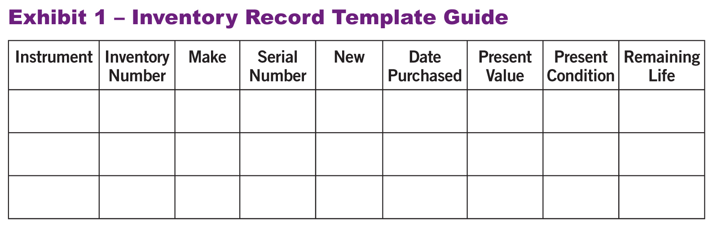
The Business Side of Teaching Instrument Replacement: The 5-Year Plan
1. Evaluate the instruments/equipment. Create an Inventory Record Guide
HINT: Know your school’s Fiscal Policies!

Slide 46
The Business Side of Teaching Instrument Replacement Plan
Prioritize a list that should be replaced within 5 years. Estimate probable growth of program
Write up a complete 5-YEAR PLAN that begins
with a clear explanation. Provide the plan to
your supervising administrator.
Keep Your Rationale STUDENT-CENTERED
Notes:
Produced by the Music Achievement Council
46

Slide 47
The Business Side of Teaching Instrument Replacement Plan
Sample Forms to Use to Develop Your Plan. . .

Slide 48
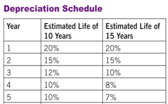
The Business Side of Teaching Instrument Replacement Plan
Maintain a Depreciation Chart.

Slide 49
3. Telling The Story

Slide 50
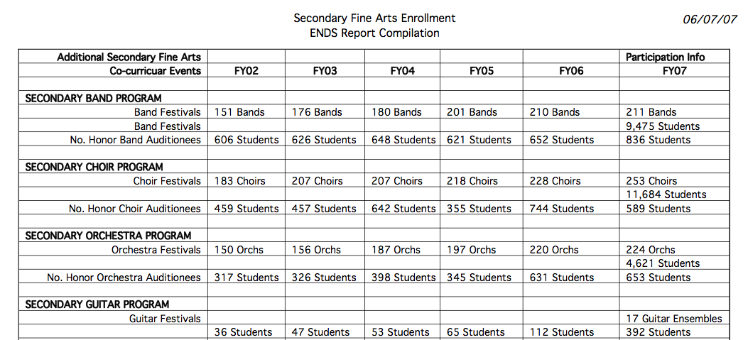
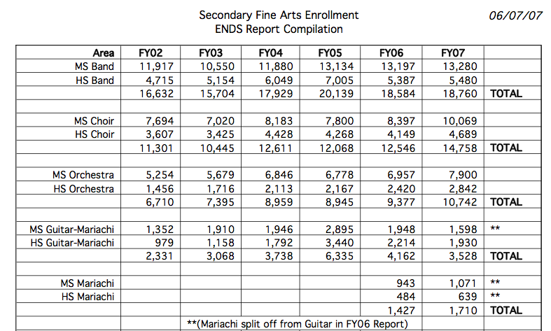
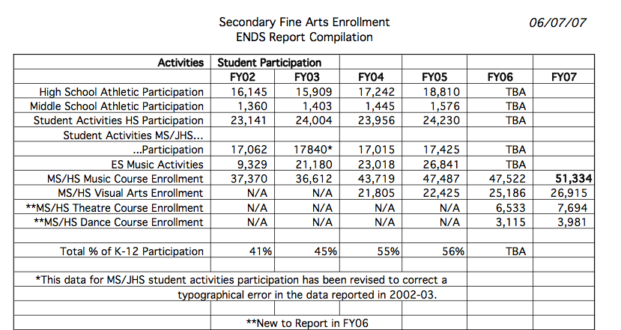
Telling the Story: DATA! DATA! DATA!
Notes:
Produced by the Music Achievement Council
50

Slide 51
Telling the Story Great Ways to Get Out Your Message
Have students tell their
stories. Music Makes
the Difference Because. . .
Profile Your Students:
Student Artist of the
Week/Month.
Create a Snapshot Video.
Notes:
Produced by the Music Achievement Council
51

Slide 52
Telling the Story Snapshot Video: Foothill High School
Notes:
Produced by the Music Achievement Council
52

Slide 53
4. Supporting Music Education
www.MusicAchievementCouncil.org

Slide 54
Supporting Music Education GIVE BACK: Help Others Succeed!
Recruit new, quality music
educators to your school
district and help them get
started
Offer to help with the
interviewing process
Offer to develop a
Mentoring Program or
serve as a mentor

Slide 55
Supporting Music Education GIVE BACK: Help Others Succeed!
Have a Local University?
Offer to have Music Ed students observe
your classes
Allow Music Ed students to teach sectionals
Attend university concerts and encourage
your students to attend
Take student teachers and “be gentle!”
Notes:
Produced by the Music Achievement Council
55

Slide 56
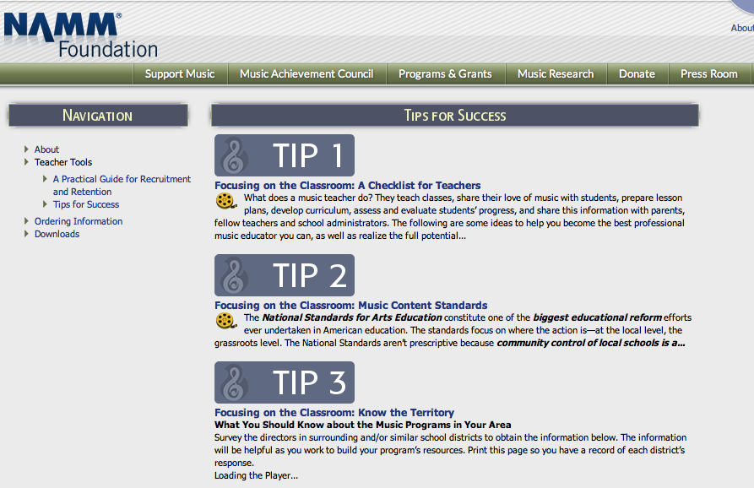
“Tips for Success” Resource Materials
www.MusicAchievementCouncil.org
Notes:
Produced by the Music Achievement Council
56

Slide 57
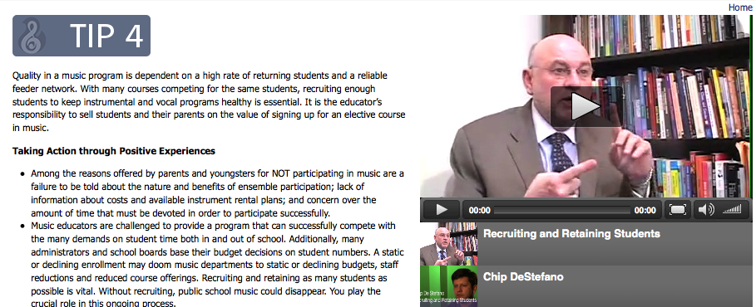
“Tips for Success” Resource Materials Helpful Videos!
www.MusicAchievementCouncil.org
Notes:
Produced by the Music Achievement Council
57

Slide 58
“Tips for Success” Resource Materials Dr. Tim Says It All!
www.MusicAchievementCouncil.org
Notes:
Produced by the Music Achievement Council
58

Slide 59
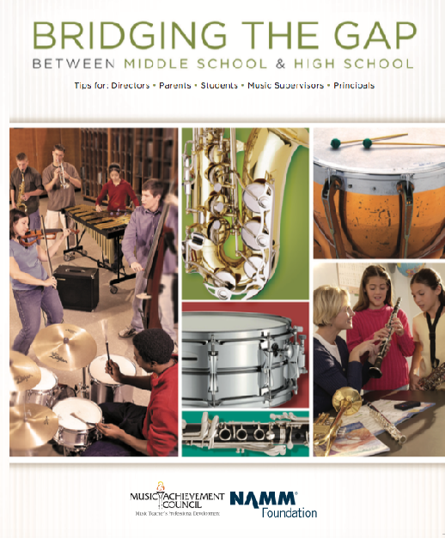
Got SMART Phone?
www.musicedconsultants.net/conference-materials
Notes:
59

Slide 60
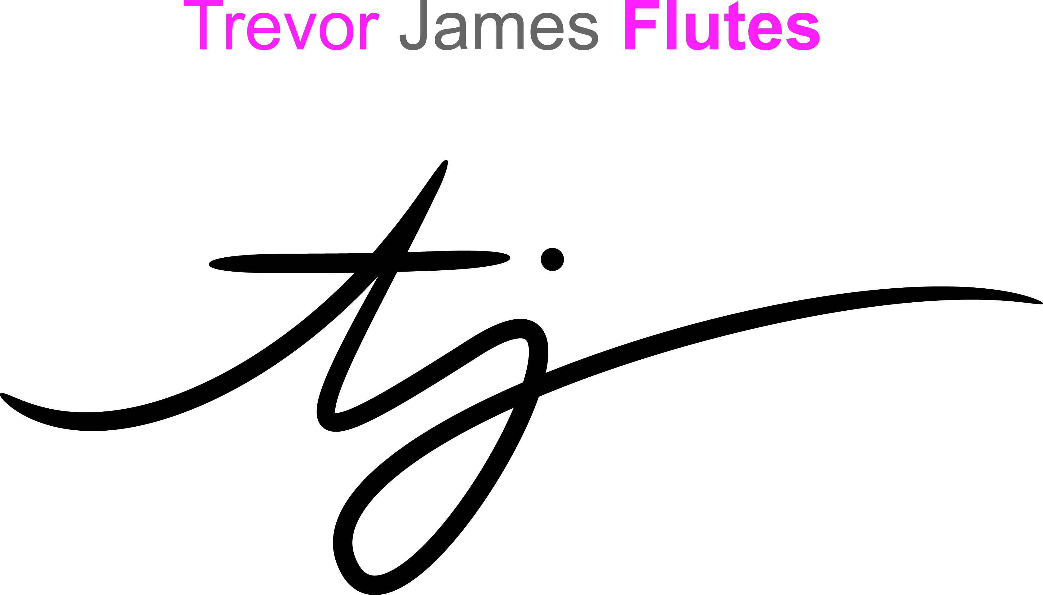
All Materials will be Posted at:
www.musicedconsultants.net/
conference-materials
Notes:
Produced by the Music Achievement Council
60

Slide 61
All Materials will be Posted at:
www.musicedconsultants.net/
conference-materials
Notes:
Produced by the Music Achievement Council
61

Slide 62
All Materials will be Posted at:
www.musicedconsultants.net/
conference-materials
Notes:
Produced by the Music Achievement Council
62

