Slide 1
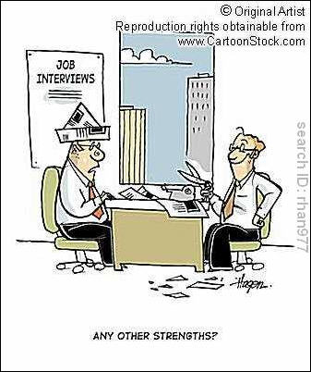
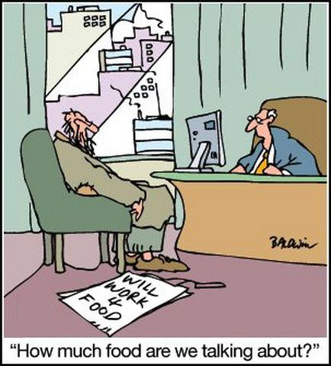
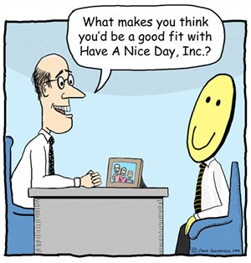
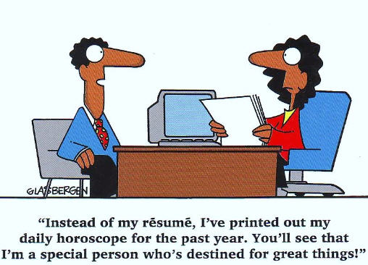
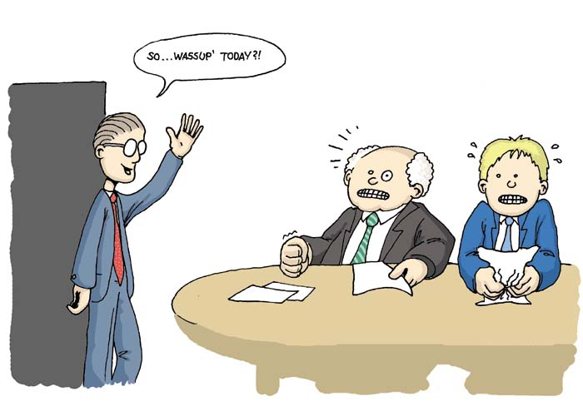
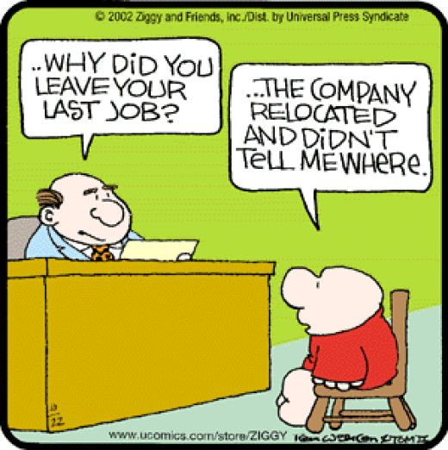
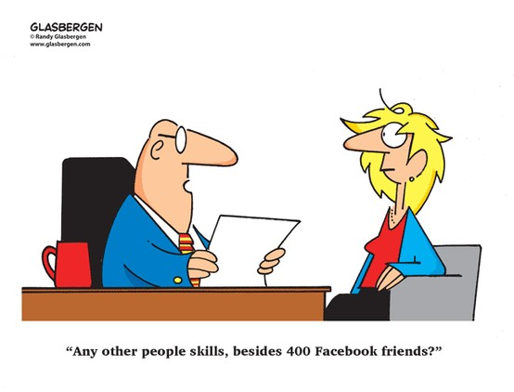
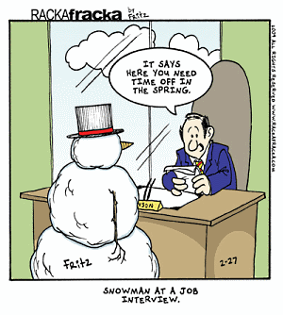
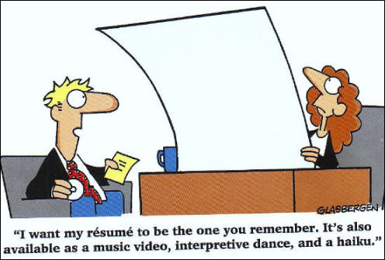
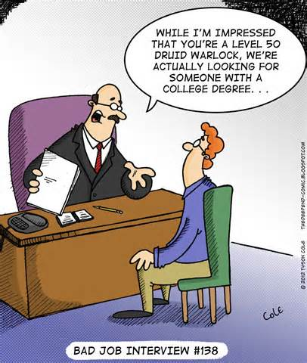
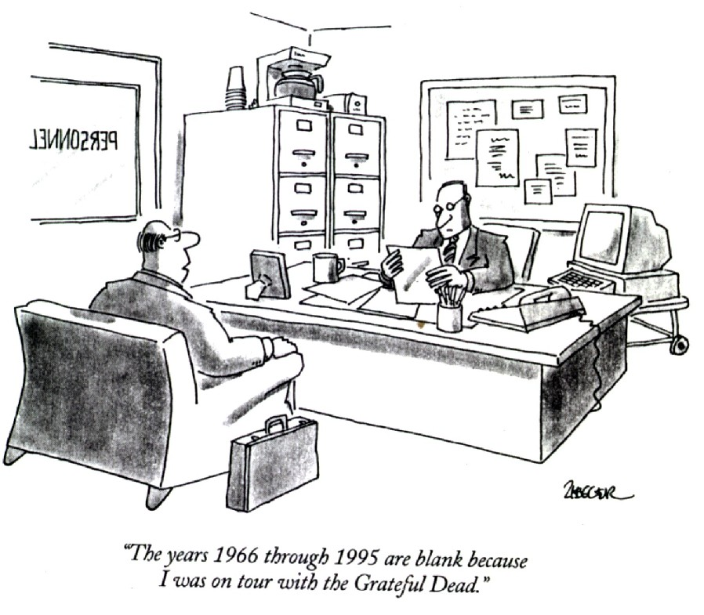
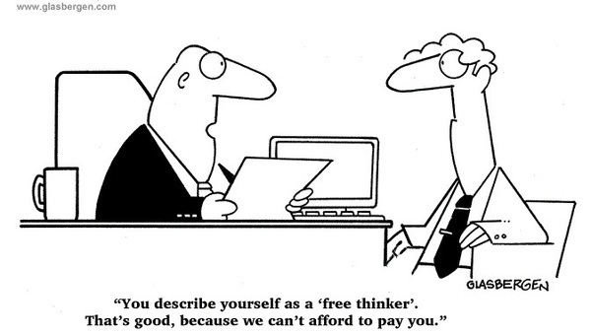
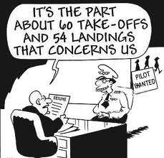
Interviewing Skills:
The Rules of the Road

Slide 2
Interviewing Skills:
The Rules of the Road
Marcia Neel
February 15, 2015
marcia@musicedconsultants.net

Slide 3
Interviewing Skills Much MORE than Knowing
Your Music!
Make a great impression!
Firm handshake and a smile
Good body language
Professional dress--check your gig line!

Slide 4
Interviewing Skills Much MORE than Knowing
Your Music!
2. Put yourself in my place. Would you hire you? Why? Why not?
Exude confidence
Smile!

Slide 5
Interviewing Skills Much MORE than Knowing
Your Music!
3. Be prepared.
Completed (and neat) application
Transcripts to date (copy will do for the interview, but originals are required eventually)
University Placement File
Resume (not required, but extremely helpful--a way to “blow your own horn”)

Slide 6
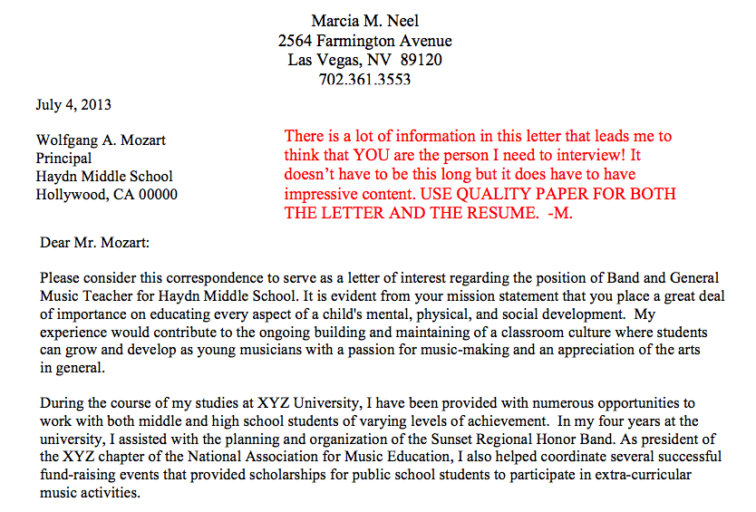
Sample Letter of Introduction

Slide 7
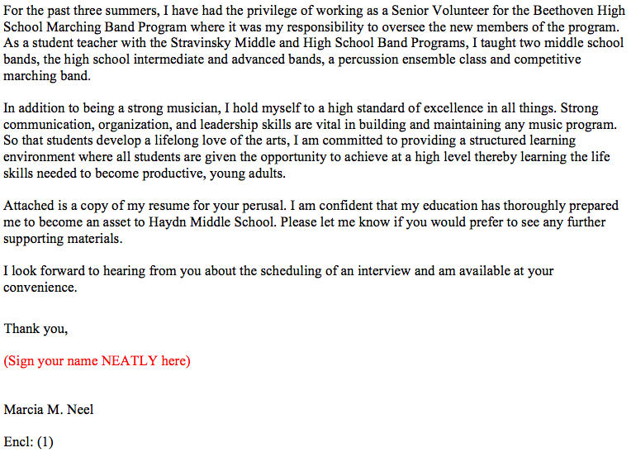
Sample Letter of Introduction p. 2

Slide 8
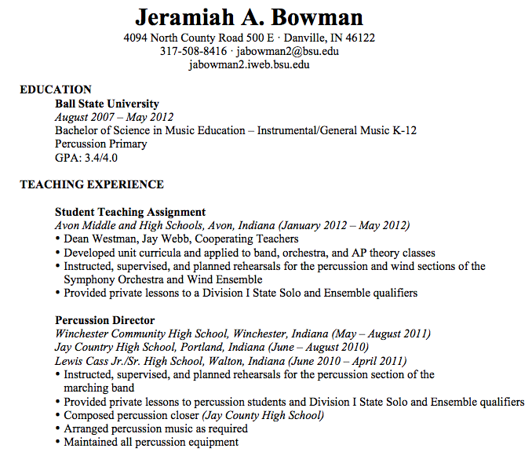
Sample Resume

Slide 9
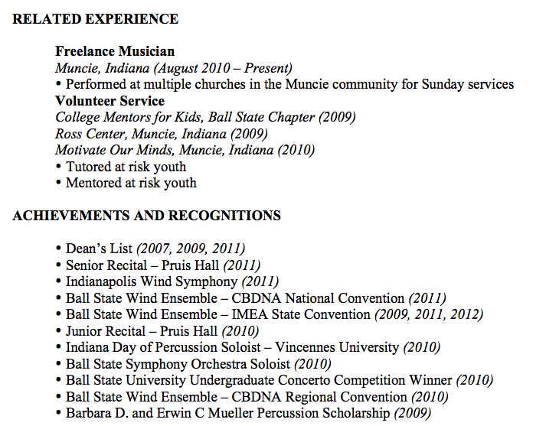
Sample Resume

Slide 10
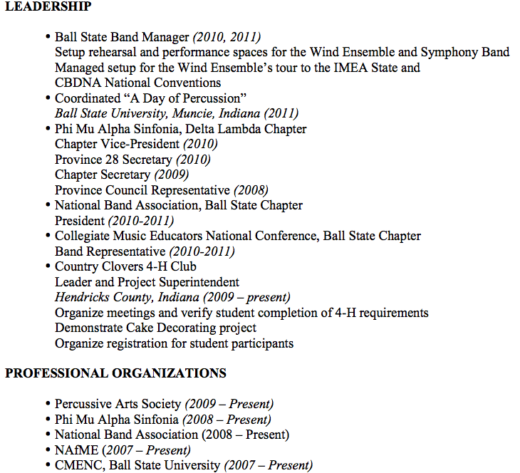
Sample Resume

Slide 11
Interviewing Skills Much MORE than Knowing
Your Music!
4. Do Your Homework
Find out everything you can about the school district and its programs
If you can, visit local programs
Attend concerts from that district

Slide 12
Interviewing Skills Much MORE than Knowing
Your Music!
Do mock interviews with fellow students/friends
Practice makes perfect--sound familiar?
Believe what you say--don’t just give “a right answer”

Slide 13
Interviewing Skills Be Ready to Discuss. . .
Appropriate Literature and Concert Design
Introducing and teaching of SOLID playing/singing skills -- PEDAGOGY!
Instructional Objectives
Content Standards/Expectations
Classroom Management Strategies
Non-musical Responsibilities
Classroom Routine
Motivational Techniques/Strategies

Slide 14
Interviewing Skills: Sample Questions
CURRENT EXPERIENCE/BACKGROUND: EX: BAND
Warm-up: Tell me about yourself.
What is your major instrument?
Describe your proficiency on all other instruments including strings
What do you consider to be typical problems for beginning (wind/brass/percussion students)?

Slide 15
Interviewing Skills: Sample Questions
Describe your high school and college/university background and training. How have these experiences prepared you to be a band director.
5. Describe your ability to develop and chart a Marching Band show.
What are your Jazz Band pedagogical skills and describe how you teach improvisation.
What alternative music classes can you teach?

Slide 16
Interviewing Skills: Sample Questions
8. Discuss your expectations regarding
performance.
9. What are your instructional objectives?
10. Describe your method of lesson planning.
Discuss some of your considerations in
selecting literature for your band.
12. Describe some of the methods you would
use in gaining and maintaining appropriate
classroom management. How will you
handle behavior problems?

Slide 17
Interviewing Skills: Sample Questions
Describe some of the strategies you would use in recruiting and retaining students.
Describe what an observer might see in a typical, daily rehearsal?
Provide an example of a standards-based lesson.
In your opinion, what constitutes a superior,
meaningful performance?

Slide 18
Interviewing Skills: Sample Questions
17. Describe what you consider to be your
obligations in planning and running fundraising activities.
Explain some of the non-musical responsibilities you have to your students.
19. What are your plans for professional
development?
Wrap-up: Is there anything that we haven’t covered in the interview that you would like for me to know?

Slide 19
Saying Thank You!
Show Your Appreciation!
Be Professional
Shake Hands
Look Interviewer in the Eye
Send a NEATLY Handwritten Note:
To thank them for their time
To re-express your interest
To follow-up (Depends on how interview ended)

Slide 20
THANK YOU !!!!
Marcia Neel
marcia@musicedconsultants.net
@MusicEdConsult
Posted: www.musicedconsultants.net/
conference-materials.html

